Slide 1








Slide 2
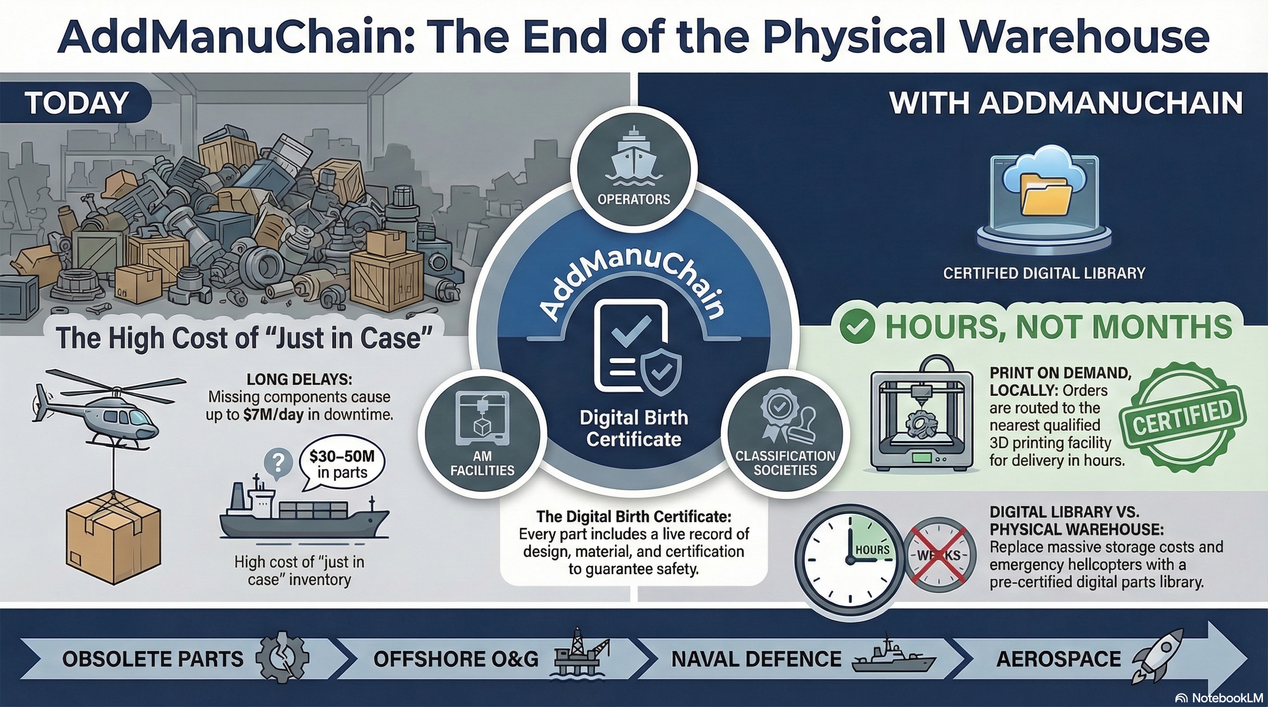

Slide 3
Status | Count | % of Total
Connection | 133 | 32.0%
3rd Request | 90 | 21.7%
1st Request | 62 | 14.9%
Interview Completed | 55 | 13.3%
Dead Lead | 49 | 11.8%
Scheduled | 16 | 3.9%
Company Email | 6 | 1.4%
2nd Request | 4 | 1.0%
Total Outreach | 415 | 100.0%

Slide 4
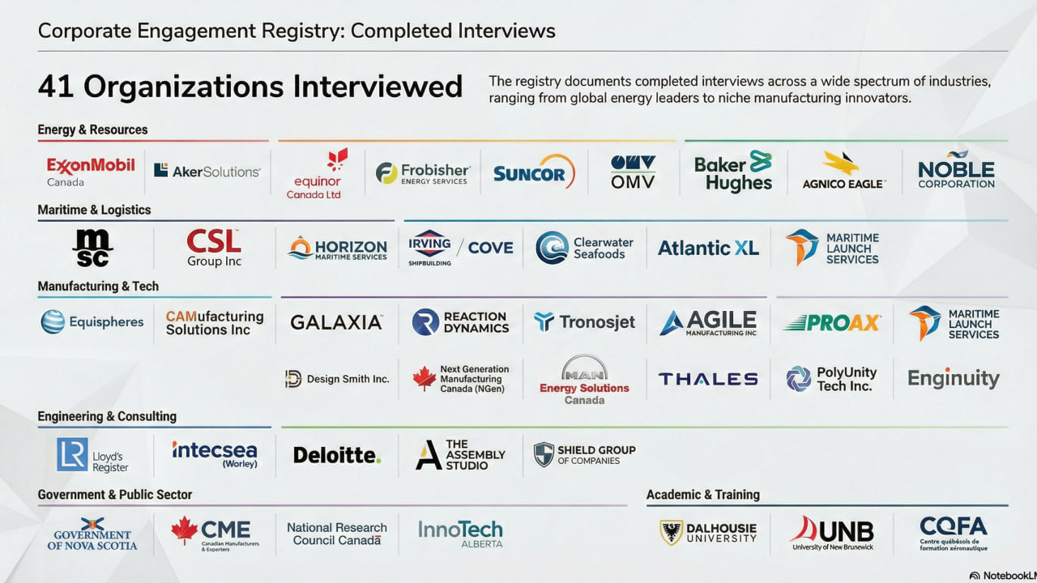





Slide 5
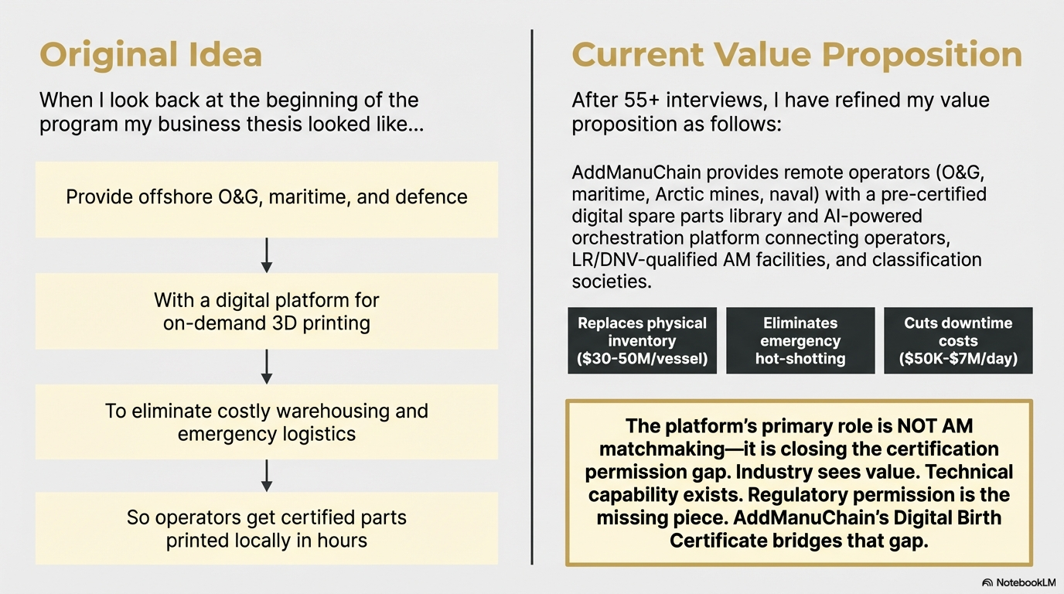

Slide 6
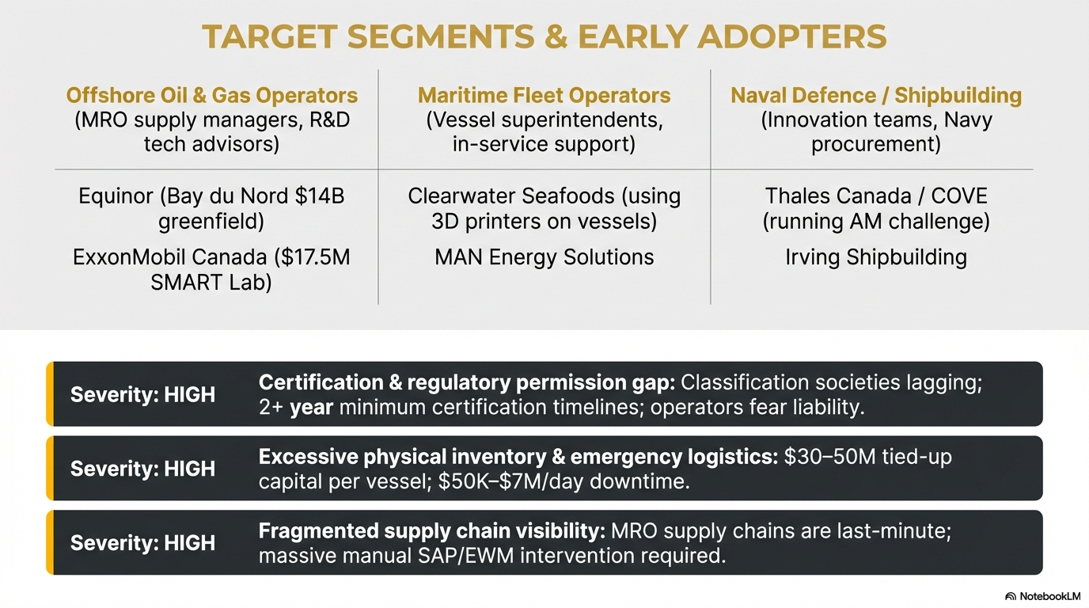

Slide 7
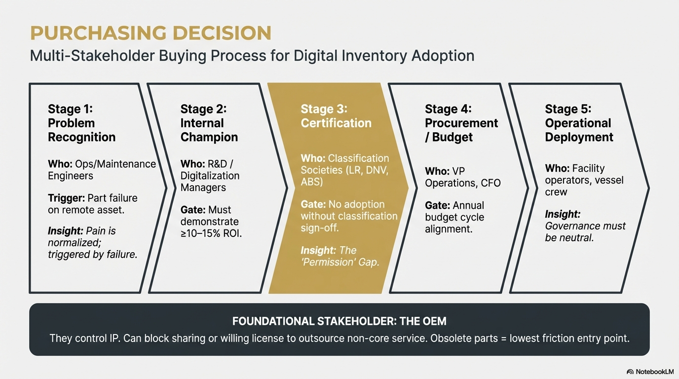

Slide 8
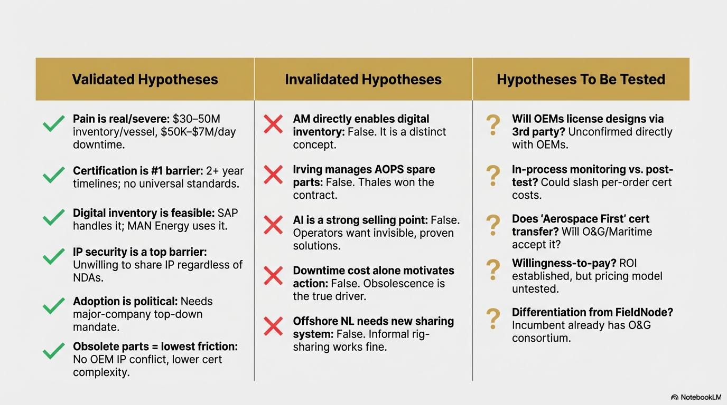

Slide 9
