Slide 1
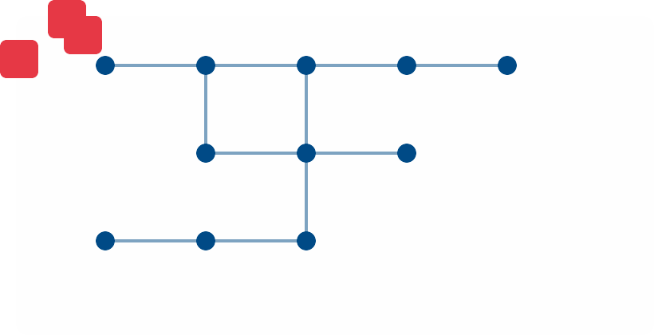


Advanced Intelligent Control of FACTS Devices for Power System Stability Enhancement
A Comprehensive Multi-Agent Coordination Approach
Presenter: [Your Name]
S
SVC
Affiliation: [Your Institution]
U
Date: [Presentation Date]
Made with Genspark

Slide 2

Agenda
1
Introduction & Motivation
2
Research Objectives
3
System Architecture
4
Advanced Control Techniques
5
Multi-Agent Coordination Framework
6
Simulation Methodology
7
Key Results & Analyses
8
Comparative Performance
9
Future Directions
10
Conclusion & Q&A
Made with Genspark
2/10

Slide 3

Introduction & Motivation
Modern power systems face stability challenges due to renewable integration
Intermittency of renewable sources
Reduced system inertia
Voltage fluctuations and power quality issues
FACTS devices play a key role in enhancing power system flexibility, controllability, and stability
Rapid response to voltage/frequency deviations
Power flow regulation and optimization
Enhanced transient stability
Power System Grid
New intelligent control strategies are required to address nonlinearity, uncertainty, and real-time adaptation
Classical controllers have limitations
Need for model-free approaches
Coordination between multiple FACTS devices

Slide 4



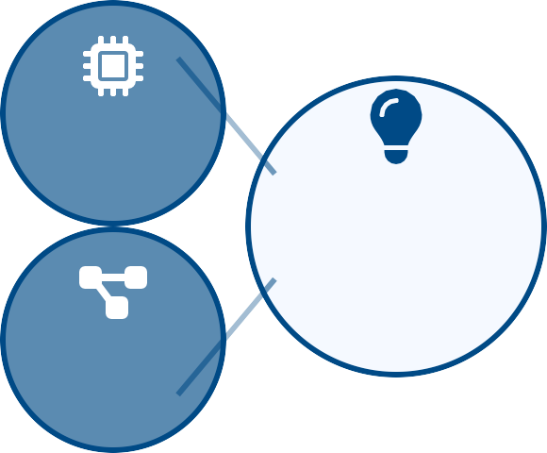
Research Objectives
Develop a hybrid power system model integrating conventional and renewable sources
Thermal, hydro, wind, and solar generation
Accurate dynamic modeling
Scalable architecture
Hybrid System Modeling
Implement multiple FACTS devices (STATCOM, SVC, UPFC) with advanced intelligent control
Detailed device physics and constraints
Integration with existing infrastructure
Advanced control interfaces
FACTS
Implementation
Advanced Intelligent Control of
Design multi-agent coordination and optimization strategies
Hierarchical control architecture
Expert decision systems
Real-time coordination algorithms
Multi-Agent Coordination
FACTS Devices
Evaluate performance under diverse disturbances and high renewable penetration
Response to system faults and load changes
Renewable penetration up to 40%
Rigorous comparative analysis
Performance Evaluation
Made with Genspark
4/10

Slide 5




System Architecture & FACTS Devices
Hybrid Power System Components
System Architecture
Thermal plants: Base load generation, high inertia Hydroelectric: Fast response, frequency regulation Wind farms: Variable output, low inertia
Thermal
Hydro
Solar PV: Intermittent, inverter-based
FACTS Devices
Bus 1
Bus 2
Fast vo_{S}l_{T}t_{A}a_{T}g_{C}e_{O}c_{M}ontrol
STATCOM
Power flow control
Fast voltage regulation, reactive power support, VSC- based, millisecond response time
Bus 3
Bus 5
UPFC
Bus 4
Bulk V_{S}A_{VC}R support
SVC
Steady-state VAR compensation, harmonic-controlled thyristor switching, bulk reactive power
Wind
Solar
Coordinated control strategies integrate multiple FACTS devices to enhance overall system stability
UPFC
Full-range power flow control, simultaneous active & reactive power regulation, series-shunt configuration

Slide 6

Advanced Control Techniques
Fuzzy Logic Controller (FLC)
Handles nonlinearity and imprecision without exact mathematical models
Uses linguistic rules and membership functions
Ideal for uncertain, variable power system environments
Effectively adapts to varying renewable penetration levels
Knowledge-Based Approach
Transforms expert knowledge into control actions
Fuzzy Logic
Suitable for renewable-dominated grids
Response Speed
Safe Reinforcement Learning (Safe RL)
Optimizes FACTS setpoints while respecting system constraints
Learns optimal control policies through interaction
Robust against model errors and topology changes
Balances performance objectives with safety requirements
Robustness
Model-Free Learning Approach
Adaptive control through system interaction
Safe RL
Maintains constraint satisfaction during exploration
Response Speed
Synergetic Nonlinear Control
Direct manipulation of device dynamics via macro-variables
Exploits inherent nonlinear nature of power systems
Fast oscillation damping with minimal settling time
Excels in both local and inter-area oscillation suppression
Robustness
Analytical Nonlinear Approach
Exploits system dynamics via macro-variable control
Synergetic
Superior performance in oscillation damping
Response Speed
Robustness

Slide 7


Multi-Agent Coordination Framework
Coordination through centralized and distributed agent architecture
Central coordinator for global optimization
Local agents for device-specific control
Real-time communication protocols
Power System Grid
Central Coordinator
Expert Decision System (EDS) for dynamic operation
Rule-based mode selection logic
Optimal setpoint allocation
Reactive/active power balancing
Expert Decision System
STATCOM
Agent
SVC
Agent
UPFC
Agent
Intelligent coordination for system resilience
Fast response to disturbances
Energy balance between AC-DC systems
Adaptive priority management

Slide 8

Simulation Methodology
Models implemented in MATLAB/Simulink environment
IEEE test systems (14-bus, 57-bus)
Hybrid generation with 35.5% renewable penetration
Detailed FACTS device models with control interfaces
Hybrid Power System Model
Comprehensive disturbance scenarios
20% step load changes at t=1s
Wind/solar generation fluctuations (±15%)
Three-phase fault (100ms duration) at critical buses
Disturbances
FACTS Models
Control Algorithms
Performance metrics and evaluation framework
Frequency metrics: ITAE, settling time, nadir
Voltage metrics: deviation RMS, recovery time
System stability index and power quality metrics
Simulation Engine
Sample Metrics
Freq. Deviation ±0.1 Hz
Comparative analysis methodology
Classical controllers (PI, PID) as baseline
Individual vs. coordinated FACTS operation
With/without model errors (5-20% parameter mismatch)
Performance AnaVloysltiasge
Profile
0.95-1.05
pu
Settling Time
4.2-5.8s
Stability Index
0.89

Slide 9


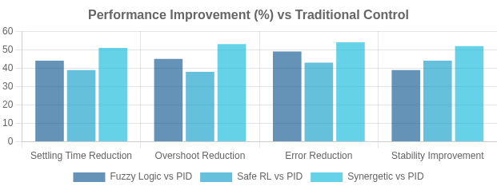
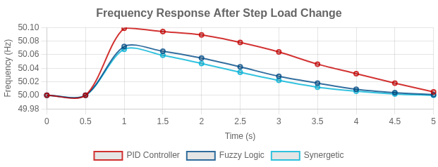
Key Results & Comparative Performance
System maintained frequency deviations within ±0.1 Hz with 35.5% renewable penetration
FACTS coordination minimized voltage dips, secured stability during major events
Advanced controllers outperformed traditional PID/PI: Lower settling time, overshoot, and error indices Enhanced robustness to model uncertainty (RL) Fastest damping with nonlinear synergetic control
Controller Type | Settling Time (s) | Overshoot (%) | ITAE (×10⁻³) | Stability Index
PID Controller | 7.5 - 9.6 | 0.32 - 0.45 | 3.5 - 4.2 | 0.62
Fuzzy Logic | 4.2 - 5.8 | 0.18 - 0.25 | 1.8 - 2.4 | 0.86
Safe RL | 5.1 - 6.3 | 0.22 - 0.28 | 2.0 - 2.6 | 0.89
Synergetic Control | 3.8 - 4.5 | 0.15 - 0.22
1.6 - 2.2
0.9M4ade with Genspark
9/10

Slide 10
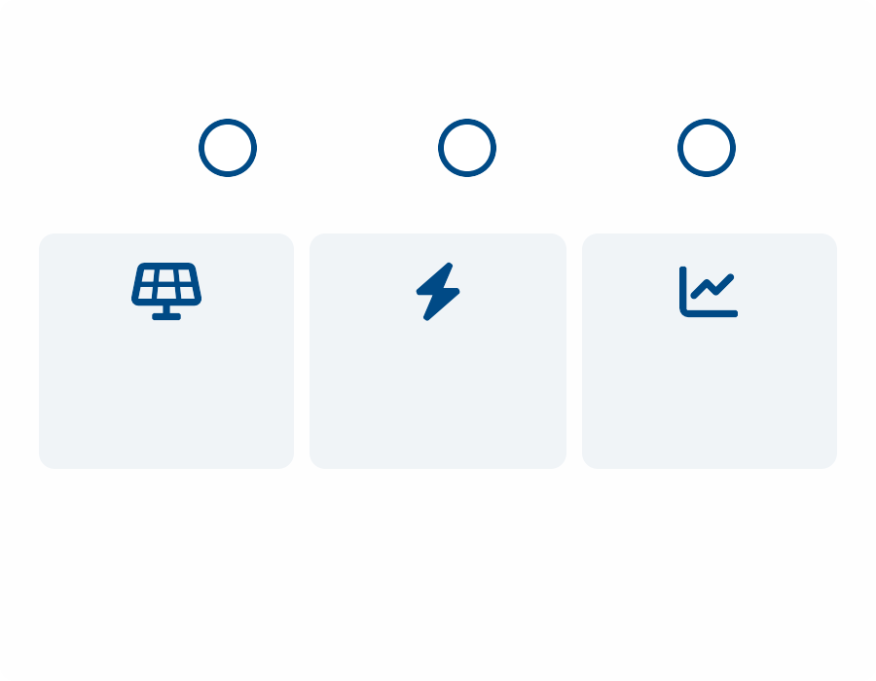

Future Directions & Conclusion
Expanding multi-agent coordination to larger power grids and more FACTS devices
Integration with real-time digital twin and wide-area measurements
Advanced ReseaCrocorhdinRaotioandmapSelf-Adapting
Controllers
1
Framework
2
Systems
3
Future work: Hardware-in-the-loop validation, deeper learning algorithms, and self-adapting intelligence
Key Takeaways
Renewable Integration
Grid Resilience
Optimized Operation
Intelligent, coordinated FACTS control ensures resilient, stable, renewable-rich grids by:
Thank you!
Questions?
Adapting to uncertain operating conditions
Managing system constraints safely
Damping oscillations efficiently
Balancing load and generation dynamically
Made with Genspark
10/10

