Slide 1



Hybrid AGC Framework for Integrated Wind-Solar Energy Systems
Using Ensemble Neural-SVM Architecture with Metaheuristic PID Optimization
Presented by: [Your Name] Affiliation: [Your Institution] Date: [Conference/Event Name]
Overview
Advanced Automatic Generation Control integrating ensemble machine learning, metaheuristic optimization, and virtual inertia for reliable renewable power systems.
Wind Integration
Solar Integration
Machine Learning
PID Optimization
Performance Gains
© 2023 IEEE Conference Presentation
Made with Genspark
Slide 1

Slide 2








Agenda
1
Motivation and Challenges
5
Enhanced ACO Optimization
2
Research Objectives and Contributions
6
Simulation & Performance
3
System Architecture
7
Comparative Analysis
4
Ensemble ML Approach
8
Key Findings
9
Conclusion & Future Work

Slide 3

Motivation & Challenges
!
!
Thermal
Wind
Solar
Load
!
Frequency Instability
Increasing Renewables
Wind/solar penetration challenges frequency stability and power quality in grid operations
Traditional AGC Limitations
Lacks adaptability to fluctuating renewable generation profiles
Intermittency & Low Inertia
Weather-dependent generation patterns and reduced system inertia
Complex Coordination
Difficulty in coordinating multiple generation sources with different characteristics

Slide 4




Research Objectives & Contributions
Objectives
Key Contributions
Hybrid AGC Framework
Develop comprehensive framework for integrated wind-solar power systems
32%
Reduction
45%
Faster
Advanced Prediction & Control
Combine ensemble ML prediction with metaheuristic PID optimization
Frequency Deviation
Settling Times
Multi-Scenario Validation
Virtual Inertia
Implement virtual inertia control for frequency stabilization in low- inertia systems
Additional Achievements
29% lower ITAE
27% lower control effort
Enhanced robustness
Higher renewable penetration

Slide 5



System Architecture & Components
Area 1
Area 2
Area 3
Conventional Generation
Hybrid AGC
Tie-Line
Similar Components
Tie-Line
Similar Components
Wind Farm
Controller
Solar PV
ML Ensemble ACE
Multi-area power system with conventional and renewable generation
Area Control Error (ACE) calculation based on frequency and tie-line power
Tie-line connections with power flow constraints and modeling
Ensemble ML for renewable generation forecasting
Energy storage integration for balancing and stability
Coordinated PID control with virtual inertia implementation
© 2023 IEEE Conference Presentation

Slide 6

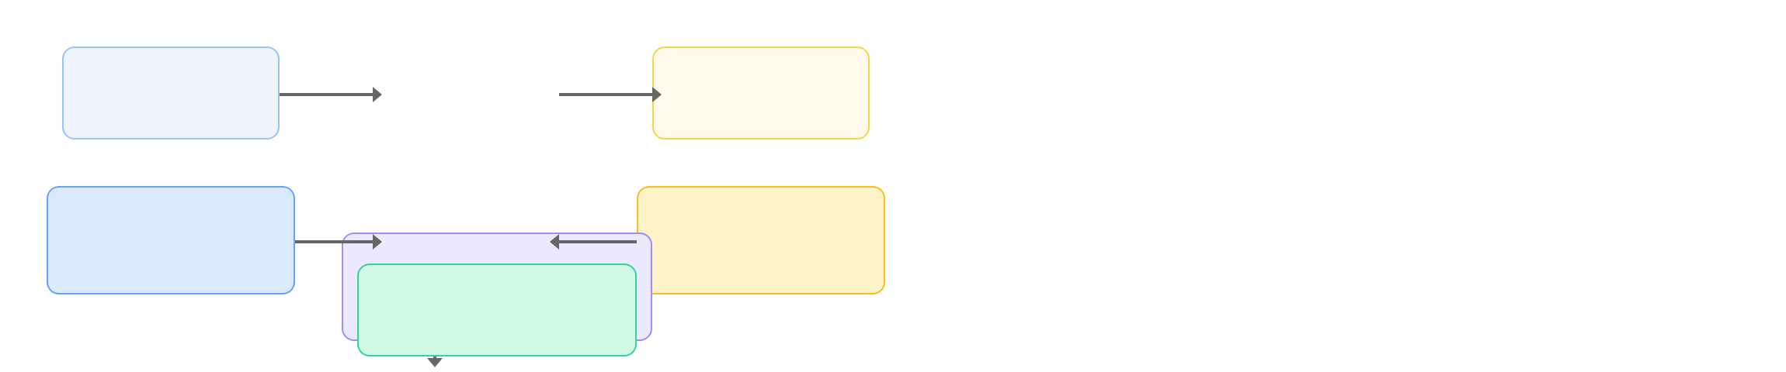

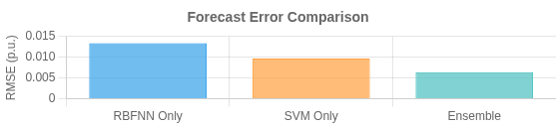
Ensemble Machine Learning Forecasting
Wind Data
Speed, Direction
Solar Data
Irradiance, Temp
RBFNN
Wind Generation Prediction
SVM
Solar Generation Prediction
Adaptive Weighting ^{α(t)}C×o^{P}mRBbFiNnNe⁺d⁽¹F⁻o^{α}r⁽e^{t)}c⁾ a×s^{P}tSVM Enhanced Accuracy
RBF Neural Network
Support Vector Machine
Optimized for wind power variability patterns Hidden layer with Gaussian activation functions RMSE: 0.0134 p.u. (wind prediction)
Well-suited for solar irradiance patterns RBF kernel for nonlinear relationships RMSE: 0.0097 p.u. (solar prediction)
Ensemble Performance
Dynamic weighting based on recent accuracy 37% improvement over single-model forecasting
Enhances AGC response to renewable fluctuations
© 2023 IEEE Conference Presentation
Made with Genspark
Slide 6/10

Slide 7

Enhanced Ant Colony Optimization (ACO) for PID Tuning
Multi-objective PID Optimization
Optimizes five controller parameters simultaneously:
ACO Convergence
KP: Proportional KI: Integral KD: Derivative
KR: Renewable KVI: Virtual Inertia
Enhanced ACO Algorithm
Adaptive pheromone evaporation based on solution diversity Elite ant strategy for faster convergence
Local search refinement of promising solutions Dynamic parameter adjustment during search
Optimization Objectives
Multi-objective function:
J = w₁×ITAE + w₂×OS + w₃×Ts + w₄×Econtrol
Minimize frequency deviation
Reduce ITAE (Integral of Time-weighted Absolute Error)
Minimize settling time (Ts) Optimize control effort
Parameter Evolution
Made with Genspark

Slide 8


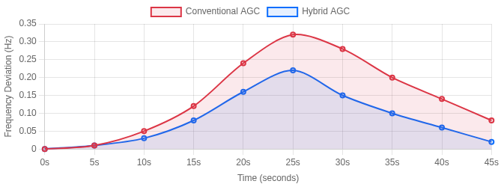
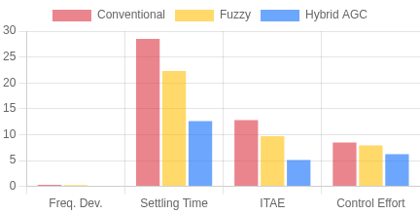
Simulation Results & Performance Metrics
Test Scenarios
Step Load Disturbance
Wind Power Fluctuation
Solar Variability
Combined Disturbances
Frequency Response
Performance Comparison
Key Performance Metrics
Max. Freq. Dev.
Stability Measure
Settling Time
Response Speed
ITAE
Error Measure
Control Effort
Efficiency Metric
Tie-line Dev.
Exchange Stability
Key Achievements
31.8%
Freq. Dev. Reduction
29.1%
Lower ITAE
45%
Faster Settling
© 2023 IEEE Conference Presentation
Made with Genspark
Slide 8/10

Slide 9






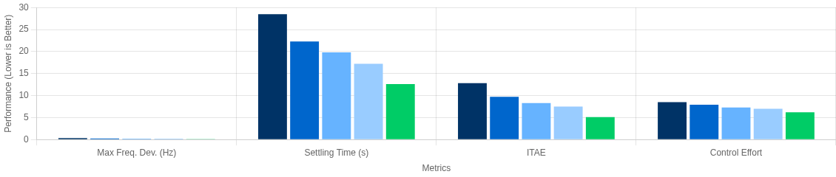


Comparative Analysis & Improvements
Performance Across Control Methods
Conventional
Fuzzy
MPC
ML-only
Hybrid AGC
Outperforms All Baselines
31.8% reduction in frequency deviation vs. conventional 45% faster settling time vs. all alternatives
Consistent performance across all disturbance scenarios
Parameter Robustness
Maintains stability with ±20% parameter variations
57% less frequency deviation under parameter uncertainty Enhanced adaptability to dynamic system changes
Noise Resilience
Robust performance with measurement noise up to 5% SNR Ensemble ML filters noise effects on renewable predictions Superior performance in high-uncertainty environments
Delay Tolerance
Maintains stability with communication delays up to 300ms Predictive components compensate for control delays Graceful performance degradation with increasing latency
© 2023 IEEE Conference Presentation
Made with Genspark
Slide 9/10

Slide 10




Key Findings, Conclusions & Future Work
Key Achievements
Future Work
Frequency Deviation Reduction
Deep Reinforcement Learning
End-to-end control policy development
32%
Settling Time Improvement
45%
Distributed Architecture
Fully decentralized control implementation
Control Effort Reduction
27%
Field Validation
Hardware-in-the-loop & pilot deployments
Ensemble ML + ACO + Virtual Inertia enables secure high-renewable grid operation
Conclusions
Thank You!
Novel hybrid framework effectively coordinates renewable generation with traditional sources
Questions?
Adaptive ensemble ML forecasting improves prediction accuracy by 37%
researcher@ university.edu
Virtual inertia implementation counteracts the low inertia of renewable systems
www.researcher-website.edu
Enhanced ACO optimization reduces parameter tuning complexity
Department of Electrical Engineering

