Slide 1



Load Frequency Control in Two-Area Systems with ABC-Optimized Fuzzy-PID Controllers
Enhanced Stability for Renewable Energy-Integrated Power Grids
ABC-FLC
Presenter: [Your Name]
Affiliation: [Your Institute or Organization] Date: [Presentation Date]

Slide 2
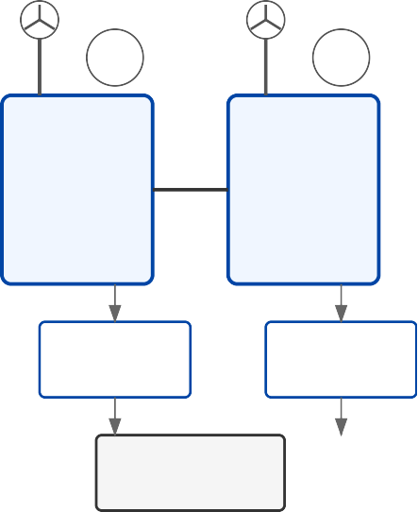
Agenda
1 Introduction
2 Motivation & Challenges
G
G
3 System Model Overview
Tie-line
Area 1
Area 2
4 Fuzzy-PID and ABC Algorithm Concepts
5 Proposed Control Framework
Fuzzy-PID
Fuzzy-PID
6 Simulation Setup
ABC Optimization
7 Key Results & Analysis
SMES
8 Discussion & Implications
Frequency Response
Conclusion
Q&A
Made with Genspark

Slide 3


Introduction: Why Load Frequency Control?
Fundamental for power system stability and reliable operation
Area 1
Tie-line
Area 2
Two-area systems: Multiple generation areas linked by tie- lines for power exchange
Frequency
50 Hz
Renewable integration brings increased variability and reduced system inertia
Load Change
Time
Need for fast, robust frequency regulation to maintain grid standards
With LFC
Without LFC

Slide 4
Motivation & Challenges in Modern Grids
Rapid growth of wind and renewable sources
Conventional vs. Advanced Controllers
40%
Conventional controllers often underperform amid disturbances and uncertainties
30%
Increased Variability
Capacity %
20%
Requirement: Adaptive, optimal strategies for high-RES penetration
10%
Reduced Inertia
0%
Key challenges: Uncertainty, nonlinearity, dynamic coupling, robustness
2010
2015 2020
Time (Years)
2025
Wind Power Solar Power
System Inertia

Slide 5
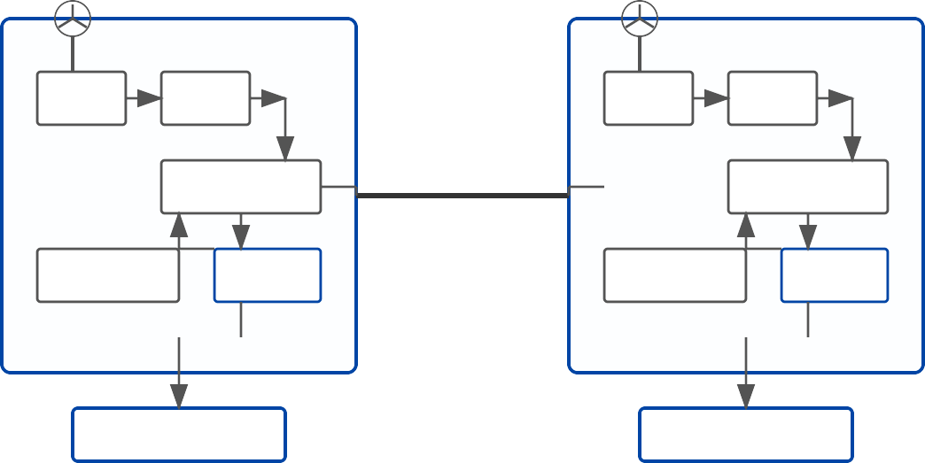
Two-Area System Model with Renewables & SMES
Area 1
Area 2
Each area: Conventional generator + wind farm
Governor
Turbine
Governor
Turbine
1/(1+sTG)
1/(1+sTT)
Tie-line
1/(1+sTG)
1/(1+sTT)
Tie-line enables power exchange
Generator-Load
ΔP_tie
Generator-Load
1/(2Hs+D)
1/(2Hs+D)
Wind Turbine SMES
P=0.5ρAv³Cp(λ,β) _{Δf₂} ΔP_SMES
Mathematical blocks: Governor, turbine, generator-load, wind turbine with pitch control
Wind Turbine SMES
P=0.5ρAv³Cp(λ,β) _{Δf₁} ΔP_SMES
ABC-Fuzzy-PID
ABC-Fuzzy-PID
SMES (Superconducting Magnetic Energy Storage) for improved frequency regulation
Made with Genspark

Slide 6
Fuzzy-PID Controller & Artificial Bee
Colony Optimization
Fuzzy Membership Functions
Fuzzy-PID Controller:
Combines adaptability of fuzzy logic with efficacy of PID control
1.0
0
NB
NS ZO PS PB
ABC Algorithm Optimization Process
Triangular membership functions for error and rate of change
Rule-based decision-making with 7 linguistic variables
Initialize Population
Artificial Bee Colony (ABC) Algorithm:
Swarm-based metaheuristic inspired by honey bee foraging
Employed Bees
Fuzzy-PID
Onlooker Bees
Calculate ITAE
K , K , K
Employed, onlooker, and scout bees collaborate to find optimal solution
p i d
Scout Bees
Optimal Parameters
Tunes controller parameters (K_{p}, K_{i}, K_{d}) to minimize ITAE

Slide 7
Proposed Control Framework & Simulation Setup
Key System Parameters
Parameter | Area 1 | Area 2
Governor Time Constant (T_{G}) | 0.08s | 0.08s
Turbine Time Constant (T_{T}) | 0.3s | 0.3s
Speed Regulation (R) | 2.4 Hz/pu MW | 2.4 Hz/pu MW
Inertia Constant (H) | 5.0s | 5.0s
Damping Coefficient (D) | 0.8 pu MW/Hz | 0.8 pu MW/Hz
Tie-Line Coefficient (T₁₂) | 0.545 pu MW/radian
SMES Time Constant (T_{DC}) | 0.03s | 0.03s
Wind Turbine Gain (K_{WT}) | 1.0 pu | 1.0 pu
Integration of fuzzy-PID controllers (ABC-tuned) in both areas
Wind power modeled with realistic pitch mechanics
Disturbances simulated: Step changes in load for Area 1, Area 2, both
Performance metrics: ITAE, overshoot, settling time, steady-state error
ITAE = ∫0^{T} t·|Δf1|+|Δf2|+|ΔPtie| dt
Peak Overshoot = Maximum deviation of frequency from nominal value
Control Framework
Settling Time = Time to reach and stay within ±2% of final value
Load
Disturbance
Area 1
Tie-line
Load Disturb
Area 2
Fuzzy-PID
Fuzzy-PID
ABC Optimization
Made with Genspark

Slide 8

Key Results: Frequency
and Power Stability
Frequency Response Comparison
ABC-Fuzzy-PID yields 65–80% ITAE improvement vs. classical PID in all scenarios
Frequency Deviation (Hz)
PID
Fuzzy-PID
ABC-Fuzzy-PID
+0.05
0
Significant reduction in frequency nadir, overshoot, and settling time
-0.05
5
10
Time (s¹e⁵conds)
20
25
SMES further enhances performance stability
Tie-Line Power Exchange
PID
Fuzzy-PID
ABC-Fuzzy-PID
+0.03
Power (p.u.)
Performance Comparison
0
Controller | ITAE |  | Settling Time (s)
PID | 1.415 | 15.8
Fuzzy-PID | 0.972 | 9.7
ABC-Fuzzy-PID | 0.485 | 5.2
-0.03
5
10
Time (s¹e⁵conds)
20
25
Made with Genspark

Slide 9
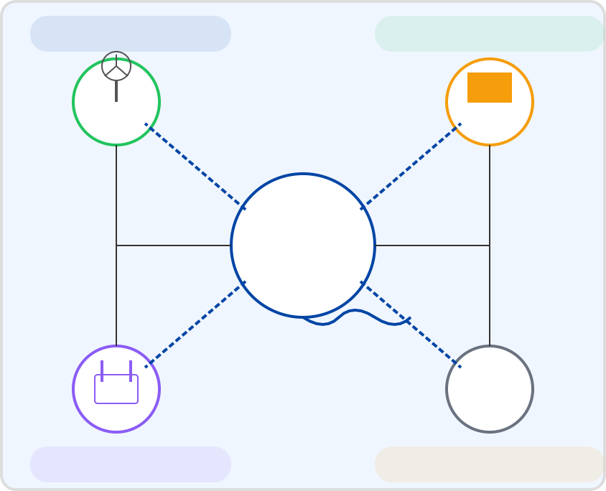
Discussion & Implications
Robust adaptive control essential for future grids
Robust Operation
Renewable Integration
Fuzzy-ABC methods handle nonlinearity and uncertainty better
Wind
Solar
Improved frequency stability = more resilient renewable integration
ABC-Fuzzy-PID
Control Center
Stable Frequency
Practical value for large interconnected networks with high wind/solar share
G
SMES
Conventional
Frequency Stability
Grid Reliability

Slide 10
Conclusion & Q&A
ABC-optimized Fuzzy-PID outperforms other strategies for load frequency control
Performance Improvement vs. Conventional PID
Integrates seamlessly with renewables and storage
100%
73%
Future work: Extension to larger multi-area grids, real hardware-in-the-loop
75%
Performance
46%
50%
23%
25%
0%
Thank you!
Questions?
0%
PID
Fuzzy Fuzzy-PID
Controller Strategy
ABC-Fuzzy-PID

