Slide 1
A Robust Multi-Objective Model Predictive Control Framework for Power Factor Optimization, Voltage Regulation, and THD Reduction in Renewable- Integrated Power Systems
IEEE Conference
Unified Advanced Control for Renewable-Integrated Grids
Presenter: [Your Name]
[Affiliation]
[Presentation Date]
Made with Genspark

Slide 2
Agenda
IEEE Conference
1
Introduction & Motivation
2
Background & Core Principles
3
Proposed RMOMPC Framework
4
Key Results & Findings
5
Discussion & Implications
6
Challenges & Future Work
7
Conclusion & Takeaways
8
Q&A

Slide 3




Introduction & Motivation
IEEE Conference
Growing integration of renewables (solar, wind) introduces new grid challenges with intermittent generation and power electronic interfaces
Power quality concerns: Voltage fluctuations, poor power factor, high THD impact grid stability and equipment lifespan
Need for unified, robust control solutions to ensure grid stability, regulatory compliance, and optimal system performance
Motivation: Simultaneous optimization of power factor, voltage regulation, and harmonic reduction under renewable uncertainty
Key Technical Challenges:
Renewable intermittency & uncertainty
Conflicting optimization objectives
Coordination of multiple control devices
Real-time computational constraints

Slide 4




Background & Core Principles
IEEE Conference
Key components in smart grids:
FACTS Devices
FACTS Devices (STATCOM, UPFC) for voltage and power flow regulation
Static synchronous compensators and unified power flow controllers provide dynamic reactive power compensation and power flow control
Model Predictive Control (MPC) for forecast-driven, constraint- aware control
Multi-objective Optimization (NSGA-II, Hybrid GA-PSO) for balancing trade-offs
Model Predictive Control
Anticipates future system states and optimizes control actions while respecting operational constraints
Importance of real-time forecasting & adaptive systems for proactive power quality management
RMOMPC^{Fo}In^{r}t^{e}eg^{c}rªat^{s}io^{t}n^{in}F^{g}ramework
Module
RMOMPC
Controller
Renewable Sources
Grid Devices

Slide 5
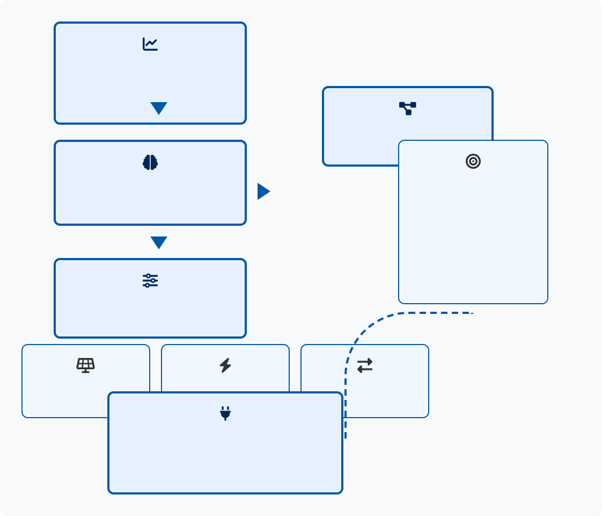


Proposed RMOMPC Framework
IEEE Conference
Unified control architecture integrates:
Hybrid LSTM-Wavelet for solar energy forecasting
Forecasting Module
Hybrid LSTM-Wavelet
Predicted
Generation
Multi-objective MPC to co-optimize power factor, voltage, THD
System Model
State Information
Coordinated actions across multiple devices:
RMOMPC Core
Multi-objective Optimization
Objective Functions
Power Factor
PV inverters with LCL filters
Voltage Regulation
STATCOM for voltage support
THD Reduction
Coordinated Control
UPFC for power flow control
Feedback Measurements
UPFC
Stochastic modeling handles uncertainties in:
PV Inverters
STATCOM
Renewable generation variability
Power System with Renewables
Load fluctuations and harmonic injection
Fig 1: Block Diagram of Proposed RMOMPC Framework

Slide 6


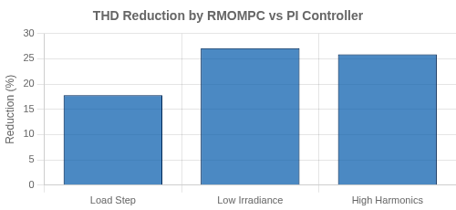
Key Results & Findings
IEEE Conference
RMOMPC outperforms conventional controllers:
THD reduced by 17.8-27.1% Power factor consistently >0.95 Voltage deviation maintained <3%
Forecasting module performance:
Wavelet-LSTM: NRMSE 4.1%
Coefficient of Determination (R²): 0.94 48% RMSE reduction vs ARIMA
Key Achievement:
Simultaneous optimization of multiple power quality objectives while maintaining robust performance under uncertainty
Controller | Max THD (%) | Avg Power Factor | Max Voltage Dev (%)
PI | 5.00 | 0.990 | 6.2
LQR | 4.81 | 0.954 | 10.7
Fuzzy | 5.00 | 0.978 | 7.5
RMOMPC | 3.71 | 0.958 | 2.9

Slide 7

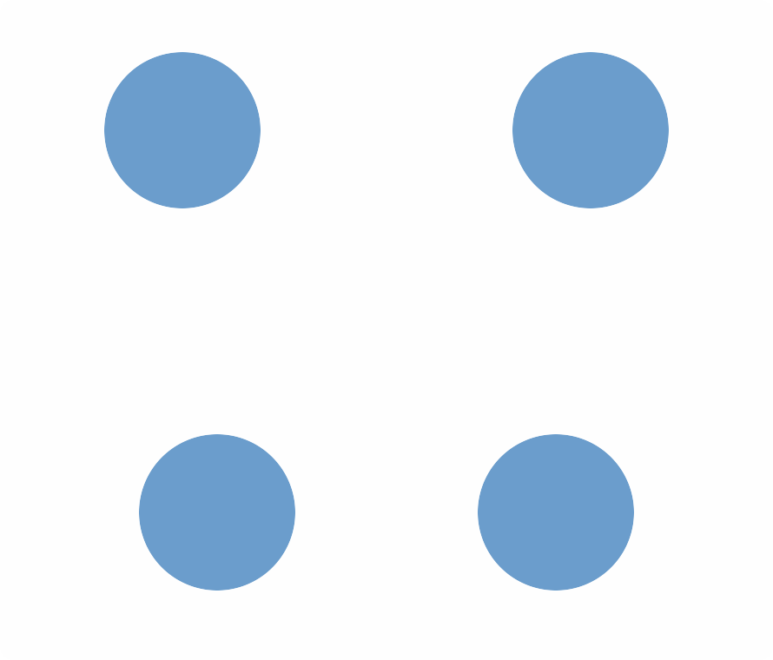


Discussion & Implications
IEEE Conference
Coordinated, proactive RMOMPC enhances grid stability and power quality across fluctuating renewable conditions
Resilience
Grid Stability
Unified approach enables:
Predictive, fast response to disturbances through advanced forecasting
Dynamic balancing of conflicting objectives (THD, voltage, power factor)
RMOMPC
Framework
Supports future grid paradigms through coordinated control architecture
Renewable Integration
Power Quality
Smart, decentralized, and resilient operation
Practical Impact:
RMOMPC reduces operational costs while extending equipment lifespan through optimized control actions and reduced stress on system components

Slide 8







Challenges & Future Work
IEEE Conference
Computational complexity and real-time optimization speed (hybrid GA-PSO takes ~12.5ms, complete control path ~26.5ms)
Communication and synchronization in large-scale deployments (216 kbps bandwidth, 50ms max tolerable delay)
HIL Validation
Grid Resilience
Hardware-in-loop testing with DSP/FPGA
Cyberattack mitigation strategies
Hardware-in-the-loop validation, decentralized peer-to-peer control architecture implementation
Optimization Speed Decentralized Control
Deep learning acceleration for real-time control
Peer-to-peer energy management
Enhancing resilience to cyberattacks and extreme disturbances with fail-safe mechanisms
Development Timeline:
Phase 1: FPGA-based controller prototype (6 months)
Phase 2: Distributed multi-agent implementation (12 months)
Phase 3: Resilient control with security features (18 months)

Slide 9



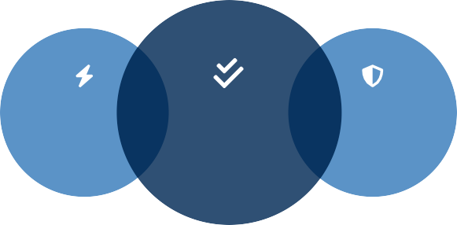

Conclusion & Key Takeaways
IEEE Conference
RMOMPC delivers comprehensive power quality improvements:
Improved power quality (THD reduced by 17.8-27.1%)
Proactive operation through forecasting integration
Robust performance under renewable uncertainty
Key Achievements
THD reduction: 17.8-27.1%
Power factor: >0.95
Voltage deviation: <3%
Forecast accuracy: 94% (R²)
Real-world validation demonstrates practical viability:
Scalable for multi-bus systems with high renewables
Practical computation time (~26.5ms) suitable for controllers
Hierarchical implementation with 50Hz RMOMPC loop
Advanced forecasting delivers power quality improvements:
Hybrid LSTM-Wavelet provides 48% lower RMSE vs ARIMA
Coordinated control of multiple grid elements
Explicit uncertainty handling through stochastic MPC
Power Quality
RMOMPC
Framework
Grid Stability
Next Steps
Hardware-in-the-loop validation
Smart grid integration testing
Decentralized control implementation
Resilience to extreme events & cyber threats
Made with Gens₉pa/rk₁₀

Slide 10




Thank You for Your Attention!
Thank You & Q&A
IEEE Conference
Questions & Discussion
youremail@ institution.edu www.researchgroup.institution.edu
+1 (555) 123-4567
This research was supported by [Funding Agency/Grant Number].
Special thanks to collaborators at [Partner Institution].
Made with Gen₁s₀pa/rk₁₀

