Slide 1

Adaptive Multi-Layer RL & Neuro-Fuzzy Coordination for Load Frequency Control
Advanced Control Solutions for Renewable-Rich Power Systems
Presenters: [Your Name(s)] Affiliation: [Institute or Organization] Date: [Presentation Date]
Made with Genspark

Slide 2


Adaptive Multi-Layer RL & Neuro-Fuzzy Coordination for LFC
2 / 10
1
Introduction & Motivation
2
Background & Core Principles
3
Proposed Method & System Design
Agenda
4
Results & Key Findings
Overview of our presentation
5
Discussion & Implications
6
Challenges & Future Work
7
Conclusion & Key Takeaways
8
Q&A
Made with Genspark

Slide 3






Adaptive Multi-Layer RL & Neuro-Fuzzy Coordination for LFC
3 / 10
Introduction & Motivation
The rise of renewables in power systems introduces new challenges for frequency stability.
Load Frequency Control (LFC) is more complex due to uncertainty, reduced inertia, and variability.
Traditional controllers show limitations under high renewable penetration.
Research Objective
Develop an intelligent, robust, and adaptive LFC solution for renewable-rich grids.
Intelligent Control Solution

Slide 4






Adaptive Multi-Layer RL & Neuro-Fuzzy Coordination for LFC
4 / 10
Background & Core Principles
Load Frequency Control (LFC)
Major Challenges in Modern Power Systems
Ensures power system frequency and tie-line power exchanges remain within operational limits, maintaining generation-load balance.
Renewable Intermittency
Fluctuating wind and solar generation create unpredictable power variations
Uncertain Generation/Load
Stochastic behavior complicates prediction and control
Core Concepts
Frequency deviation & Area Control Error (ACE)
Tie-line power flows between areas System inertia & damping coefficient
Predictive & adaptive control strategies
Reduced System Inertia
Inverter-based resources provide limited natural inertia
Faster Dynamics
Quicker frequency deviations requiring faster response times

Slide 5







Adaptive Multi-Layer RL & Neuro-Fuzzy Coordination for LFC
5 / 10
Proposed Method & System Design
System Architecture
Multi-layer architecture combining complementary intelligent control techniques
Layer 1: CNN-LSTM Forecaster
Predicts future load and renewable generation patterns
Hierarchical coordination for robust response to disturbances
Layer 2: DDPG Reinforcement Learning
Optimizes control policies based on system performance
DDPG for online policy optimization and adaptive learning
IT2FLC for real-time uncertainty handling and control
CNN-LSTM for predictive load/renewable forecasting
Layer 3: Type-2 Fuzzy Logic Controller
Handles real-time control with uncertainty management
Real-time adaptation to changing system conditions and disturbances
Multi-Area Power System with Renewables

Slide 6
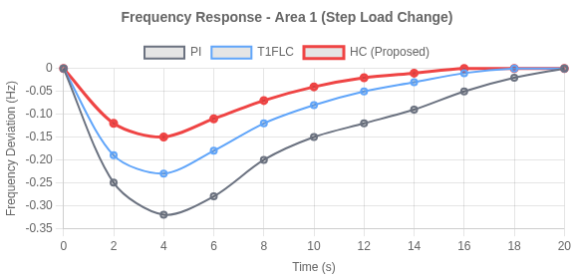

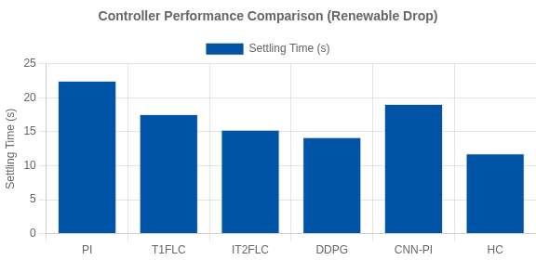

Adaptive Multi-Layer RL & Neuro-Fuzzy Coordination for LFC
6 / 10
Results & Key Findings
3-Area System
30-35% Renewable
Test Scenarios:
Step Load
Wind Drop
Random Fluctuation
Performance Metrics: Frequency nadir, settling time, ITAE, control effort
PI T1FLC IT2FLC DDPG CNN-PI HC (Proposed)
Up to 54% reduction in frequency nadir compared to PI controller 47% faster settling time under renewable disturbances
Superior adaptation to renewable variability & disturbance rejection

Slide 7









Adaptive Multi-Layer RL & Neuro-Fuzzy Coordination for LFC
7 / 10
Discussion & Implications
Synergy: Combines adaptability (DDPG), robustness (IT2FLC), and anticipation (CNN-LSTM) for comprehensive control.
Synergistic Integration of Technologies
Application: Real-time grid frequency control that supports higher renewable integration without compromising stability.
DDPG
Adaptability
Hybrid LFC
CNN-LSTM
Anticipation
Real-time validation: Average execution time of 4.52ms (within 10ms control period) with 186MB memory usage.
IT2FLC
Superior
Robustness
Performance
Potential impact: Enables smarter, more resilient grids with improved operational
reliability under uncertainty.
Practical Applications
Microgrids with high renewable penetration
Key Insights
Island grids with limited interconnection
54% reduction in frequency nadir compared to PI controllers
Large interconnected systems with diverse generation
47% improvement in settling time across disturbance scenarios
Grids transitioning from traditional to renewable sources
53%+ better performance with ITAE metrics during fluctuations

Slide 8







Adaptive Multi-Layer RL & Neuro-Fuzzy Coordination for LFC
8 / 10
Challenges & Future Work
Today's Challenges
Current Limitations:
Higher computational demands compared to conventional controllers
Need for efficient parameter tuning and offline RL training
High computational complexity
Scalability concerns for larger grids and market mechanisms
Future Research Directions
Parameter optimization & training
Distributed & scalable control architectures
Transfer learning for new grid scenarios
Security & scalability issues
Cybersecurity and integration with grid markets
Future Solutions

Slide 9








Adaptive Multi-Layer RL & Neuro-Fuzzy Coordination for LFC
9 / 10
Conclusion & Key Takeaways
Developed a robust hybrid LFC controller leveraging RL, fuzzy logic, and deep
learning for adaptive control in renewable-rich power systems.
Key Achievements
Achieved superior frequency control with up to 54% reduction in frequency nadir and 47% faster settling time compared to conventional methods.
Our hybrid approach successfully addressed the major challenges in modern power system control:
Validated via comprehensive simulation and hardware-in-the-loop tests, confirming real-time applicability with 4.52ms execution time.
Reduced Inertia
Uncertainty Handling
Real-time Control
Next steps include real-world deployment, larger grid scaling, and integration with energy market mechanisms.
Future Roadmap
Deploy in real-world grids and enhance scalability

Slide 10




Adaptive Multi-Layer RL & Neuro-Fuzzy Coordination for LFC
10 / 10
Thank You!
Questions?
[Your Name(s)]
[Institute or Organization] [Your Email] [Website/Research Group]
Made with Genspark

