Slide 1
IEEE Logo
Advanced Modeling and Stability Analysis of Grid Frequency Control in Smart Power Systems with High Penetration of Bidirectional Electric Vehicle Integration
Authors: [Name] [Institution]
[IEEE Venue] June 15, 2025
Made with Genspark

Slide 2
Grid Frequency Control with EV Integration
IEEE Logo
Outline
1
Background & Motivation
2
Problem Statement
3 System Model
4 EV Aggregator Modeling
5
Control Strategies (MPC, RL, Adaptive)
6
Simulation Scenarios
7 Results: Frequency Response
8 Results: EV Fleet & Sensitivity
9
Key Findings & Discussion
10
Conclusions & Future Work

Slide 3




Background & Motivation
IEEE Logo
Transforming Power Systems
The shift to renewable energy and electrification of transportation is fundamentally changing power system dynamics
Traditional Power System
Frequency stability becomes more challenging due to reduced system inertia and increased variability from renewables
Frequency Stability Challenges
Renewable Integration
Advanced Control Strategies
Bidirectional Electric Vehicles (V2G) offer unprecedented opportunities as flexible distributed energy resources for grid support
Need for advanced modeling and control strategies to effectively leverage EV fleets for grid services while respecting user preferences
Bidirectional EV Integration
By 2030, global EV stock projected to reach 245 million,
representing 30% of all road vehicles

Slide 4







Problem Statement
IEEE Logo
Research Challenges
Conventional frequency control is insufficient with high penetration of EVs and intermittent renewable generation
VS
Conventional Frequency Control
Advanced EV-Based Control
How to efficiently model and control power systems with thousands of distributed EVs while ensuring grid stability?
Key Research Questions
Need for balancing grid requirements with EV user preferences (charging completion, battery health)
How effective are MPC, RL, and Adaptive Control for large-scale EV integration?
What are the impacts on frequency nadir, settling time, and stability margins?
Managing stochastic nature of EV availability, connection patterns, and state-of-charge levels
How can we balance grid services with EV user charging preferences?
Determining appropriate control architectures and performance metrics for V2G frequency support
What is the minimum EV fleet size needed for meaningful frequency support?

Slide 5

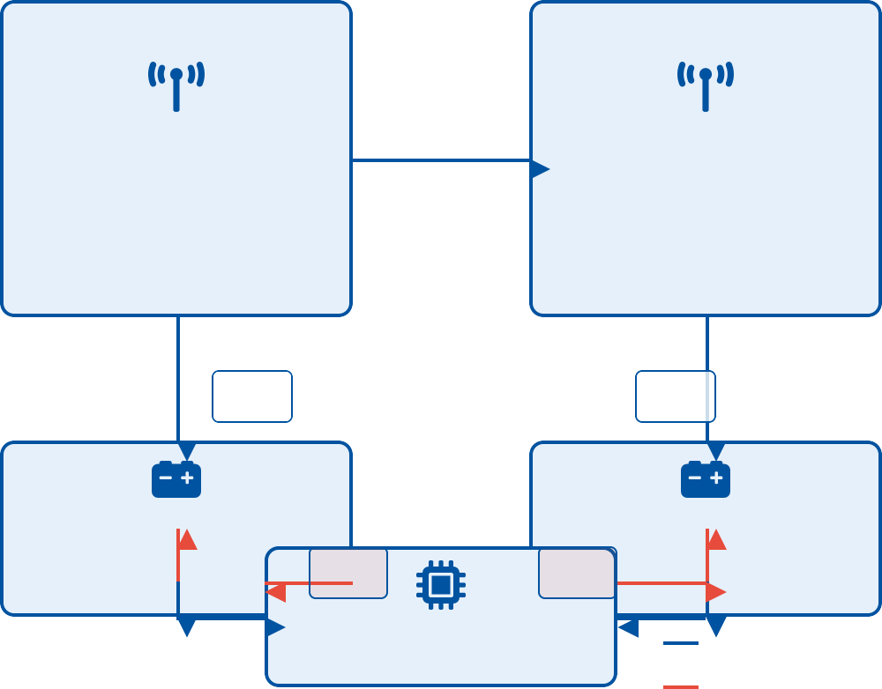


System Model: Two-Area Power System with EV Integration
IEEE Logo
Two-Area Power System
Δf₁
Δf₂
Modified IEEE two-area system with bidirectional power flow capability, enhanced for distributed energy resources
Each area includes conventional generation, renewable sources, and EV aggregators with different dynamic characteristics
Power System Area 1
Tie-Line
Power System Area 2
Conventional + Renewable H₁ = 5s, D = 1 p.u./Hz
Conventional + Renewable H₂ = 4s, D = 1 p.u./Hz
Developed linearized state-space models for each subsystem, capturing the essential dynamics while maintaining computational tractability
PEV₁
PEV₂
EV Aggregator 1
10,000+ EVs
EV Aggregator 2
System parameters: Area 1 inertia (H₁) = 5s, Area 2 inertia (H₂) = 4s, Damping (D) = 1 p.u./Hz
u₁(k)
u₂(k)
10,000+ EVs
Advanced Controller
Power/Frequency Flow
Control Signals
Tie-line connects the areas with bidirectional power flow, modeled with synchronizing coefficient T₁₂
Swing equation: dΔf/dt = (1/2H)·(ΔP − ΔP − D·Δf − ΔP )_{m L tie}

Slide 6
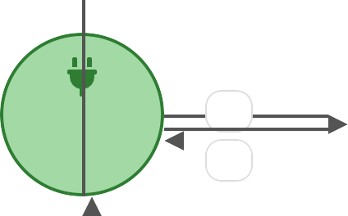


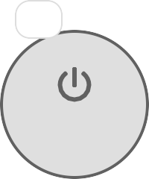


EV Aggregator Modeling
IEEE Logo
State-Space Representation
Reduced-order state-space model efficiently captures the collective behavior of thousands of individual EVs
State vector represents SOC distribution and connection status of the EV fleet
Transitions between states follow Markov chain dynamics capturing stochastic nature of EV behavior
Progressive state recovery mechanism ensures that EV user preferences are respected during grid services
State equation: x(k+1) = Ax(k) + Bu(k) + Cv(k) + Δx(k) Output equation: y(k) = Dx(k) = [P_{c} I_{Ns} O_{Ns} -P_{d} I_{Ns}]x(k)
Recovery: u(k) = u_{reg}(k) + α(x_{pref} - x(k))
Connected Charging
^{p}ci
Connected
^{p}ic
Idle
^{p}dc
^{p}id ^{p}di
^{p}id
Disconnected
Connected Discharging
Fig. 1: Markov chain model of EV states with transition probabilities influenced by control inputs and user behavior

Slide 7



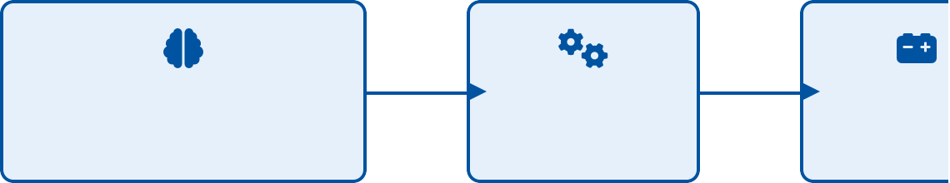


Control Strategies for EV Integration
IEEE Logo
Advanced Control Strategies
Performance Comparison
Model Predictive Control (MPC)
Optimizes control actions over a finite prediction horizon while respecting system and operational constraints
Model Predictive Control
Optimization-based with constraints & prediction horizon
RL: 48% ↓ freq. nadir, 35% ↓ settling time
MPC: 45% ↓ freq. nadir, 33% ↓ settling tim
Adaptive: 41% ↓ freq. nadir, 30% ↓ settling t
Reinforcement Learning (RL)
Model-free approach that learns control policies through interaction with the environment using Deep Q-Networks (DQN)
Reinforcement Learning
Learning through interaction using DQN algorithm
Control Signal
u(k) = f(x, Δf)
EV Aggre
10,000+ EV
each
Adaptive Control
Online parameter adaptation with Lyapunov stability guarantees to handle system uncertainties and changes
Progressive State Recovery
u(k) = u_{reg}(k) + u_{rec}(k), where u_{rec}(k) = α(x
x(k))
Progressive State Recovery
Ensures gradual return to user-preferred EV states (e.g., SOC levels) after grid service provision while minimizing impact on system stability
Adaptive Control
Online parameter updates with stability guarantees
Key Result: MPC and RL achieve up to 48% reduction in frequency nadir and 35% improvement in settling time compared to conventional AGC

Slide 8






Simulation Scenarios & Experimental Setup
IEEE Logo
Test Scenarios & Metrics
Disturbance Scenarios
Scenario S1: Load Step Change
Sudden 10% load increase at t=30s in Area 1, normal operating conditions in Area 2
Scenario S2: Generation Loss
Sudden 5% generation loss at t=30s in Area 2, normal operating conditions in Area 1
Scenario S3: Renewable Fluctuation
Random variation in renewable generation (σ=3%) starting at t=30s in both areas
Test Cases: Load step changes (±10%), sudden generation loss (5%), stochastic renewable fluctuations (σ=3%)
EV Configuration: 10,000 EVs with 7kW bidirectional charging/discharging capability, 20 SOC intervals (5% increments)
Performance Metrics: Frequency nadir (Hz), settling time (s), ROCOF (Hz/s), IAE, ISE, ITAE, control effort
Implementation: MATLAB/Simulink for continuous-time simulation, Python for advanced control algorithms and batched analysis
Simulation Parameters: 5ms time step, 120s simulation window, 30s pre-disturbance initialization
System Parameters
Parameter Value Description
H , H 5s, 4s Inertia constants₁ ₂

Slide 9
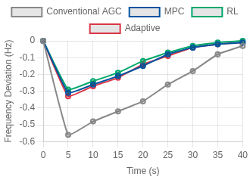
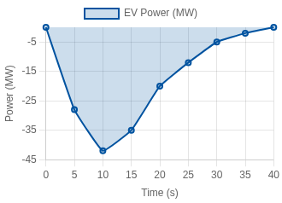


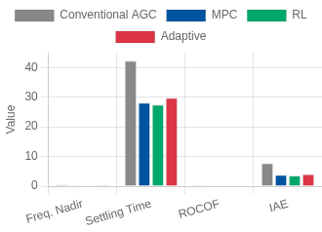
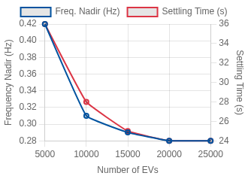

Results & Analysis: Frequency Control Performance
IEEE Logo
Key Performance Results
Frequency Response Comparison
EV Power Contribution
Advanced control strategies achieved up to 48% reduction in frequency nadir and 35% reduction in settling time vs. conventional AGC
RL and MPC showed best overall performance, with adaptive control following closely
Sensitivity analysis reveals optimal fleet size of ~15,000 EVs with diminishing returns beyond this point
Longer MPC prediction horizons (15-20 steps) produce better control performance
Performance Metrics Comparison
Sensitivity Analysis
Progressive state recovery successfully maintained EV user satisfaction while providing grid services
Communication delays up to 300ms had minimal impact on advanced controllers

Slide 10



Conclusions & Future Directions
IEEE Logo
Key Conclusions
Future Research Directions
Advanced EV control strategies significantly enhance frequency stability, with up to 48% improvement in frequency nadir and 35% in settling time
Voltage Stability Analysis
Integration benefits saturate beyond ~15,000 EVs in the
test system, suggesting optimal fleet sizing for frequency regulation
Real Grid Pilot Projects
Hybrid Control Strategies
Progressive state recovery successfully balances grid services with user preferences, maintaining EV owner satisfaction
Market Mechanisms & Incentives
Communication Optimization
Implementation challenges include communication infrastructure, latency management, and creating effective financial incentives for EV owners
Large-Scale Integration
The proposed framework provides a comprehensive
foundation for integrating large-scale bidirectional EVs into

