Slide 1






Advanced FACTS Control with Reinforcement Learning
Enhancing Power System Stability and Performance through Intelligent Control Strategies
Presented by: [Your Name/Team]
Affiliation: [Your Institution] Date: [Presentation Date]
Made with Genspark

Slide 2

Advanced FACTS Control with Reinforcement Learning
Agenda
Introduction & Motivation
Background: FACTS and Modern Power Systems Challenges in Conventional Control
Proposed RL-based Coordinated Control Framework System Model & Simulation Setup
Key Results: Performance & Optimization
Discussion: Impact and Applications Challenges & Future Directions
Conclusions
Q&A
Advanced FACTS Control with Reinforcement Learning

Slide 3




Advanced FACTS Control with Reinforcement Learning
Introduction & Motivation
RL-based Controller
FACTS devices are essential for modern power systems - enabling dynamic control of voltage, impedance, and phase angle.
SSSSSSCC
Growing need for smarter, adaptive, and robust control strategies beyond conventional PI controllers.
UUPPFFCC
SSVVCC
Increasing complexity due to high penetration of renewables, dynamic loads, and system uncertainties.
STAT
STAT
Motivation: Achieve multi-objective optimization using reinforcement learning for coordinated FACTS control.
Advanced FACTS Control with Reinforcement Learning

Slide 4




Advanced FACTS Control with Reinforcement Learning
Background: FACTS and Their Roles
Device | Primary Function | Industrial Examples
SVC | Voltage regulation, VAR compensation | Allegheny Power (USA), NGC (UK)
STATCOM | Dynamic voltage support, PF correction | Inelfe (France-Spain), SDG&E (USA)
SSSC | Power flow control, oscillation damping | AEP (USA), KEPCO (South Korea)
UPFC | Comprehensive power flow control | Inez (Kentucky, USA), Kanpur (India)
SVC (Static VAR Compensator): Shunt-connected for voltage regulation and reactive power compensation.
STATCOM (Static Synchronous Compensator): Faster response than SVC, voltage support, and active power exchange capability.
SSSC (Static Synchronous Series Compensator): Series-connected for line impedance control and power flow management.
Voltage Support
UPFC (Unified Power Flow Controller): Most versatile, combines series and shunt controllers, complete power flow control.
STATCOM
Series Control
Combined Control
Limitations of PI control: Model dependency, slow response to transients, limited coordination abilities, and requires manual tuning.
G
SSSC
UPFC
Generator
SVC
Reactive Power
Load
4 / 10
Made with Genspark
Advanced FACTS Control with Reinforcement Learning

Slide 5
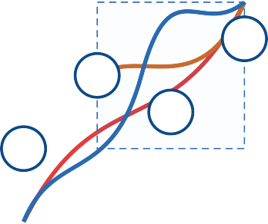


Advanced FACTS Control with Reinforcement Learning
Challenges in Conventional FACTS Control
PI Control Limitations
Data-Driven
RL
Model Uncertainty
UPFC
Coordination Issues
STAT
SSSC
Objective Conflicts
SVC
Nonlinearity
Multi-objective conflict between power loss minimization, voltage profile improvement, cost reduction, and stability enhancement.
Performance
Difficulty in coordination between multiple FACTS devices due to cross-coupling effects and varying response times.
Nonlinearity and model uncertainties in large-scale systems make accurate modeling and control increasingly complex.
Control Complexity
Need for data-driven, adaptive solutions that can operate effectively with partial or imperfect system knowledge.
Advanced FACTS Control with Reinforcement Learning

Slide 6



Advanced FACTS Control with Reinforcement Learning
Proposed RL-Based Coordinated FACTS Control
Actions
RL Agent(s)
(Policy/Value Networks)
Power System
(FACTS Devices & Grid)
State/Reward
RL framework: Agent-environment interaction paradigm for adaptive control
Key Algorithms:
Multi-agent system coordinating SVC, STATCOM, SSSC, and UPFC devices
Soft Actor-Critic (SAC)
Entropy-regularized RL algorithm balancing exploration & exploitation
LAMBDA
Model-based RL with Lagrangian methods for constraint satisfaction
Multi-objective optimization: Losses, voltage profile, stability, cost
Multi-Objective Pareto Optimization
Balancing multiple competing objectives without predetermined weights
Robust adaptation to system disturbances and operational changes
FACTS Control Flow:
System
State Detection
RL Control Action
Disturbance

Slide 7
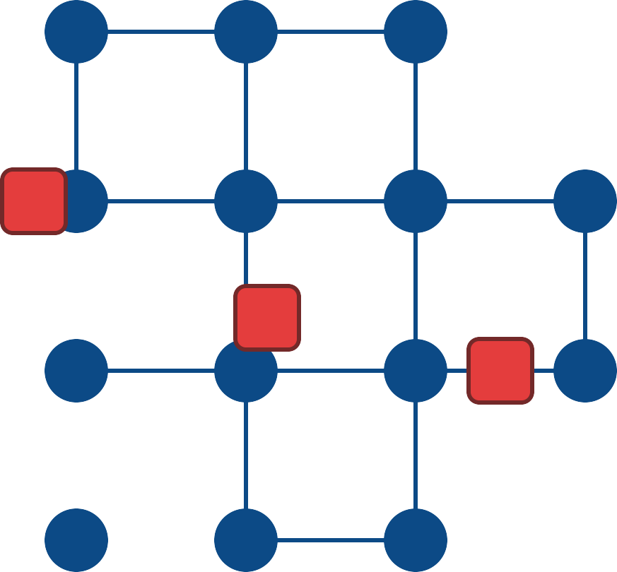




Advanced FACTS Control with Reinforcement Learning
System Model & Simulation Setup
IEEE 14-bus test system - standard benchmark with generators, loads, and transmission lines.
1
2
3
Strategic placement of FACTS devices at buses 4 (SVC), 7 (STATCOM), 9 (UPFC), and line 6-11
(SSSC).
SVC 4
5
6
7
STAT
Reward Structure
R = w₁(voltage deviation) + w₂(power losses) + w₃(stability margin) + w₄(control effort)
SSSC
11
10
9
UPFC
8
Disturbance Scenarios
20% load increase at buses 9, 10, 14
Line outage between buses 2-4
Generator output fluctuation at bus 2
14
12
13
Training Parameters
Episodes: 200
Exploration rate: 0.9 → 0.1
Batch size: 64
Bus
FACTS Device
Transmis
sio
n Line
Simulat
7 / 10
Made with Genspark
Advanced FACTS Control with Reinforcement Learning

Slide 8
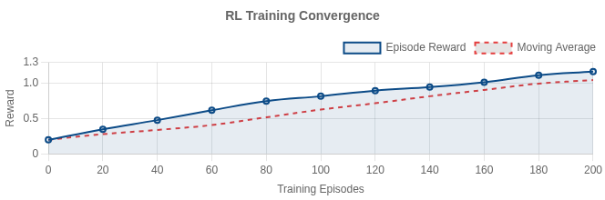
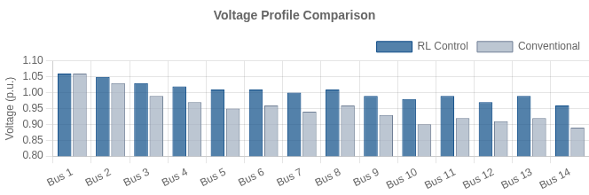
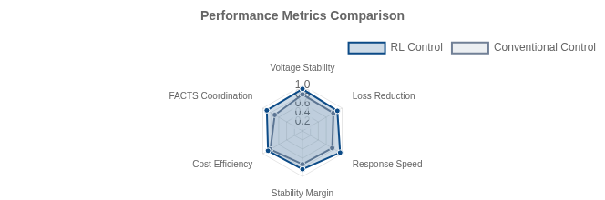
Advanced FACTS Control with Reinforcement Learning
Key Results: Performance & Optimization
RL controller vs Conventional control (PI)
Training converged after ~150 episodes 12.5% improvement in voltage profile stability 8.7% reduction in power flow congestion
15.3% increase in stability margin during faults
7.2% operational cost savings
FACTS Utilization Response Speed Coordination Efficiency
Metric | RL Control | Conventional | Improvement
System Losses | 0.0455 p.u. | 0.0512 p.u. | 11.1%
Voltage Dev. | 0.0308 p.u. | 0.0352 p.u. | 12.5%
Stability Margin | 0.84 | 0.73 | 15.3%
Cost ($) | 37.28 | 40.15 | 7.2%
8 / 10
Made with Genspark
Advanced FACTS Control with Reinforcement Learning

Slide 9
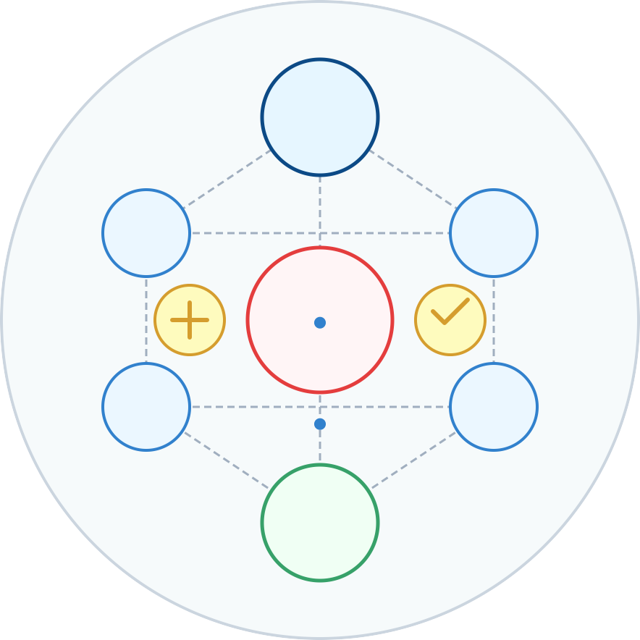









Advanced FACTS Control with Reinforcement Learning
Discussion: Impact, Applications & Future Research
Impact:
Advanced RL
Smarter, adaptive grid control
Controller
Increased system reliability and resilience
SVC
STATCOM
Potential for large-scale, multi-device coordination
Enhanced Power System Stability
Applications:
Smart grids & microgrids
SSSC
UPFC
Renewable energy integration
Smart Grid Applications
Future Directions:
Advanced RL (multi-agent, safe RL) Field trials & industrial validation
Market & TSO/DSO operations integration
9 / 10
Made with Genspark
Advanced FACTS Control with Reinforcement Learning

Slide 10

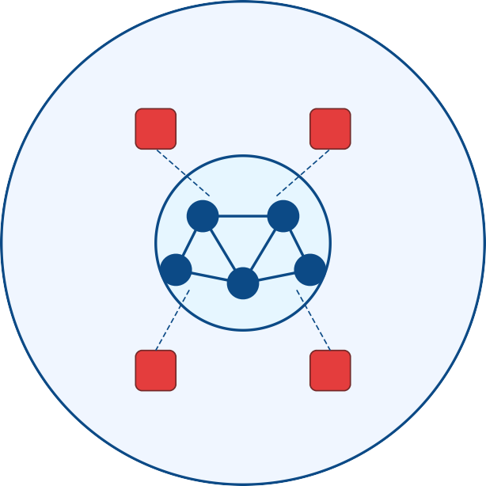


Conclusion & Next Steps
Advanced FACTS Control with Reinforcement Learning
RL-based coordinated FACTS control achieves strong multi- objective performance across power loss reduction, voltage profile improvement, and cost optimization.
?
Our approach enables robust, adaptive operation under
SVC
STAT
system uncertainties and model errors without requiring perfect system models.
?
?
Next steps: Scaling to larger systems, multi-agent
coordination frameworks, industrial validation with hardware- in-the-loop testing.
SSSC
UPFC
?
Thank you!
Questions?
10 / 10
Made with Genspark
Advanced FACTS Control with Reinforcement Learning

