Slide 1
Primitives
Lesson №3

Slide 2
Numbers
Integer | Float

Slide 3
Integer
1
234234
-6543 puts 10 + 10 #=> 20 puts 17 - 7 #=> 10 puts 12 / 3 #=> 4 puts 5 * 5 #=> 25

Slide 4
Float
1.012
234234.3
-6543.8765432 puts 10.45 + 10.43 #=> 20.88 puts 17.76543 - 7.2 #=> 10.56543 puts 12.0 / 34.0 #=> 0.35294117647058826 puts 5.5 * 5.5 #=> 30.25

Slide 5
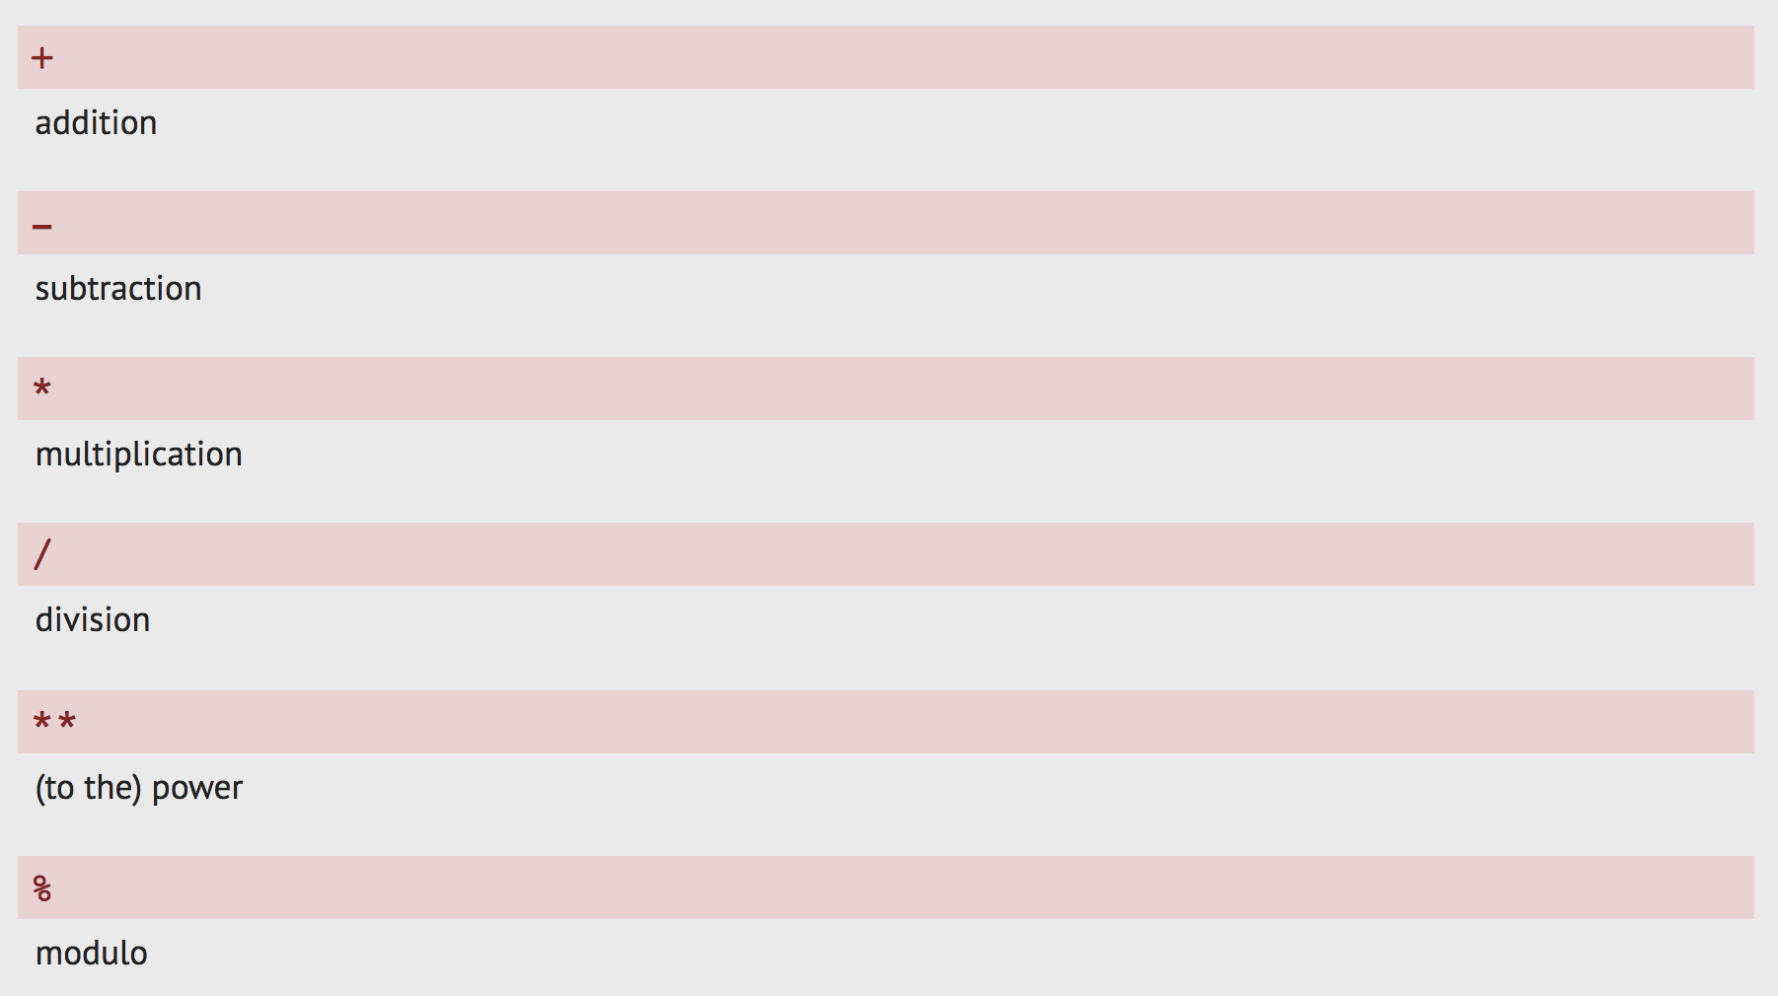
Numbers: Operators

Slide 6
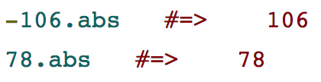
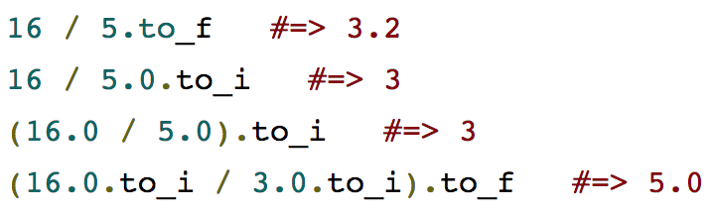
Numbers: Base methods
16.22592737.round(2) #=> 16.23

Slide 7
Examples
12 - 1 * 4 #=> 8 -40 * -20 #=> 800 4.2.to_i * 5 #=> 20 10 + 1.to_f #=> 11.0 14 % 4 #=> 2 6 % 3 #=> 0 3 ** 8 / 4.to_f #=> 1640.25 3 ** 8 / 4.to_i #=> 1640 (3 ** 8 / 4.to_i).to_f #=> 1640.0 20.9.to_i / 15 % 3 #=> 1

Slide 8
String

Slide 9
Strings are a sequence of characters denoted by single or double quotes.
"a"
"puts"
"John's book"
"12+100"
'To be or not to be, that is the question...'

Slide 10
Important!
String opened with single quote can be closed only with a single quote and vice versa.
Always close the string you’ve opened!
puts 'Quick brown fox' => 👍
puts "Quick brown fox" => 👍
puts Quick brown fox => 👎 + Error.
puts "Quick brown fox puts 10 + 10 => 👎 + Unavailability to finish the expression until nnnnnnnnnnnnnnnnnnnnnnnnclosed with a "

Slide 11
String operations and methods
puts "abc" + "def" #=> "abcdef" puts "the quick brown fox jumps over the lazy dog".capitalize #=> "The quick brown fox jumps over the lazy dog" "abc".upcase #=> "ABC" "DEF".downcase #=> "def" "abcdef".reverse #=> "fedcba" "ABCdef".capitalize #=> "Abcdef" "dog park".length #=> 8

Slide 12
puts "The cat and the hat".sub("hat", "rat") #=> The cat and the rat puts "Another brick in the wall".sub("brick in the", "") #=> "Another wall" puts "I own an iPad, iPhone and an iPod".gsub('i', 'my') #=> I own an myPad, myPhone and an myPod puts "the quick brown fox jumps over the lazy dog".split(" ") #=> ["the", "quick", "brown", "fox", "jumps", "over", "the", "lazy", "dog"] puts "I own an iPad"[3] #=> "w" puts "I own an iPad"[0..4] #=> "I own"

Slide 13
Mixing datatypes
puts 2 + 2 #=> 4 puts "2" + "2" #=> "22" puts "2" + "abc" #=> "2abc"

Slide 14
Conversion methods
puts "42".to_i + 42 #=> 84 puts "42" + 42.to_s #=> "4242"

Slide 15
Combining strings with interpolation
puts "The result of 7 + 7 is " + (7 + 7).to_s #=> The result of 7 + 7 is 14
puts "The result of 7 + 7 is #{7+7}" #=> The result of 7 + 7 is 14 puts "#{10 * 10} is greater than #{9 * 11}" #=> 100 is greater than 99

Slide 16
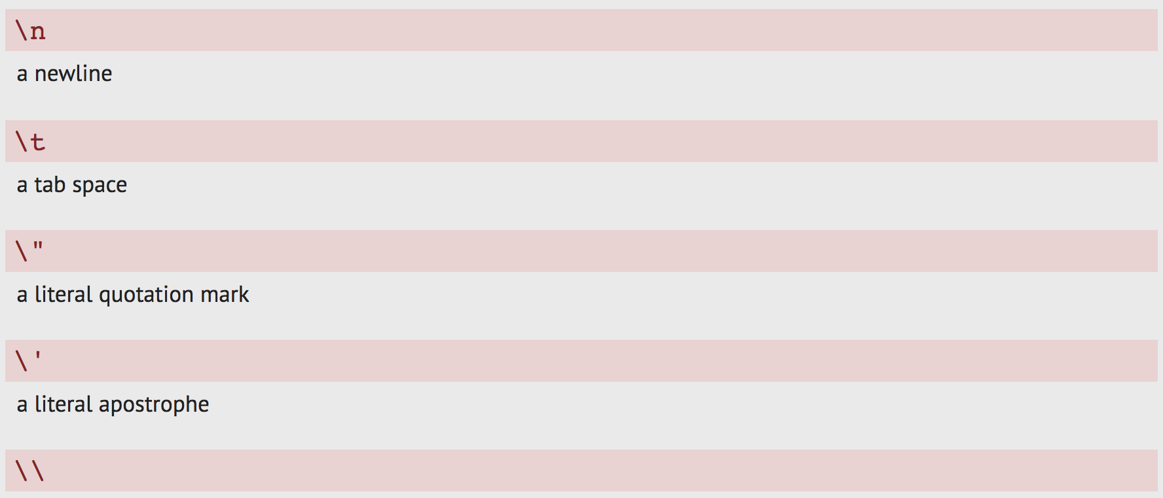
"Escape" with backslash
In the context of a String, the backslash character \ tells Ruby that the character immediately following it is special.

Slide 17
The newline character
puts "Doe, a deer, a female deer.\nRay, a piece of the\nsun." #=> Doe, a deer, a female deer. #=> Ray, a piece of the #=> sun.

Slide 18
Symbol

Slide 19
A symbol is created by adding a colon in front of a word.
Symbols are unique identifiers that are considered code, not data.
Symbols are a special, limited variation of Strings.
Symbol looks like => :some_name You can transform single word string to symbol with: puts "banana".to_sym #=> :banana That’s all about symbol.

Slide 20
False, True, nil

Slide 21
True is when something is true.
"Join the Banana-bob".include?("Banana") #=> true "Join the Banana-bob".is_a?(String) #=> true
False is when something is false.
"Join the Banana-bob".include?("banana") #=> false "Join the Banana-bob".start_with?("Mark") #=> false
Nil is when there is nothing out there. "People"[6] #=> nil

