Slide 1
Gabriel Desrosiers-Gregoire
Supervisor: Dr. Mallar Chakravarty, CoBrA lab
https://github.com/mtl-brainhack-school-2018/Gabriel_D-G

Slide 2
Brainhack network
Elizabeth DuPre: fmriprep/nipype and multiecho fMRI acquisition
Aman Badhwar: neurovascular coupling
Pierre Bellec: NIAK
Jacob Vogel: Nilearn

Slide 3
Tools I learned to use at brainhack
Github
Compute canada
Building/running Docker/Singularity container
Setting personalized anaconda environments
Setting and running fmriprep
Nilearn: visualization and ICA
Also a bit of NIAK and Nipype

Slide 4
What I got done
Dataset on openneuro: A high resolution 7-Tesla resting-state fMRI test-retest dataset with cognitive and physiological measures
2 subjects from the dataset
2 session of fMRI resting-state data per subject, 2 15 min run per session
Preprocessing: fmriprep
Analysis: conduct ICA with 20 components on each individual using CanICA from nilearn

Slide 5
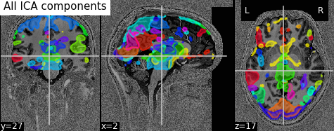
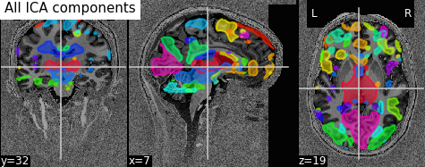
Atlas of 20 ICA components
Subject1
Subject2

Slide 6
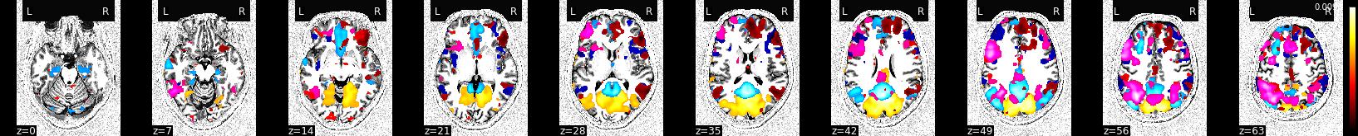
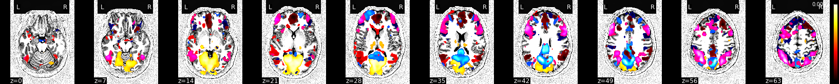
Congruent networks between subjects
Subject1
Subject2

Slide 7
Thank you!

