Slide 1
Background
Gabriel Desrosiers-Gregoire
Native from Drummondville, QC
Undergrads: Neuroscience, McGill
Master: starting MSc neuroscience at the Douglas Institute
Supervisor: Dr. Mallar Chakravarty, CoBrA lab
Research project: Investigating how exposure of mouse offsprings to maternal immune response during gestation impact functional connectivity later in life
Notes:
Background
Research

Slide 2
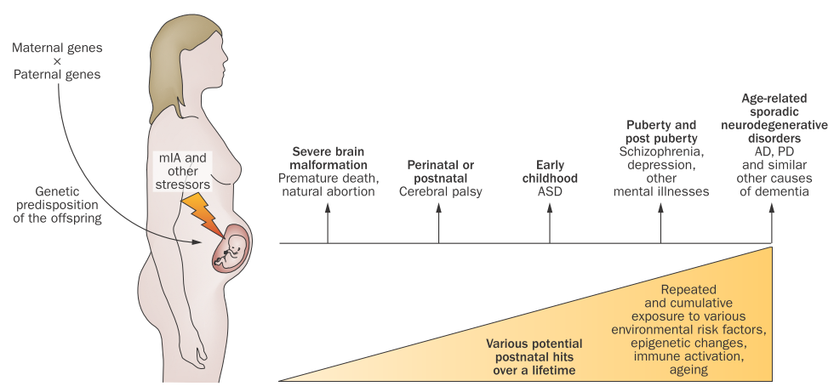
Maternal immune activation (MIA) and mental disorders
Knuesel et al., Nature reviews Neurology, 2014.
Notes:
Mental health disorders are the product of a complex interaction between genetic and environmental factors. The influence of maternal immune activation in particular has gain a lot of research interest in the past years, since a strong immune response by the mother during pregnancy has been linked to an increased occurrence of various mental health disorders. It is believed that MIA can disrupt neurodevelopmental processes and render the individual more vulnerable to future environmental factors and the development of mental disorders.

Slide 3
MIA animal model
Procedure: Trigger immune response in pregnant dams at mid gestation and follow the offsprings throughout development
Behavior: behavioral abnormalities characteristic of schizophrenia and autism (defective sensorimotor gating, deficits in executive functions, …)
Structural imaging: different developmental trajectories of PFC, hippocampus, ventricles…
Functional imaging: hasn’t been investigated

Slide 4
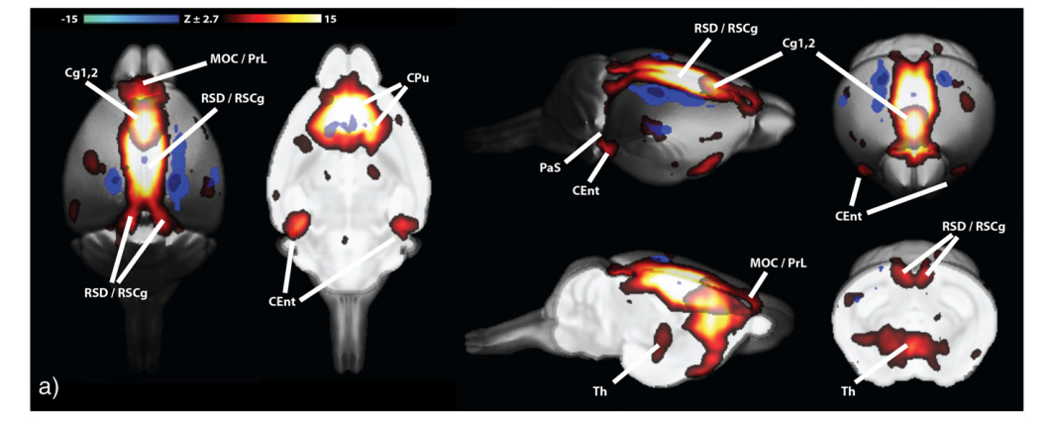
Functional connectivity in mouse from ICA analysis
Zerbi et al., Nature reviews Neurology, 2014.
Notes:
Resting-state fMRI in mice: new field
Group ICA analysis had components which corresponded to DMN in mouse
Cg:cingulate cortex
Cent: entorhinal cortex
PrL:prelimbic cortex
MOC: orbitofrontal cortex

Slide 5
Brainhack school
General goal: practice and develop my understanding of the preprocessing of rs-fMRI data and subsequently conduct functional connectivity analysis
Learning to implement preprocessing with NIAK, understand its documentation, and maybe another preprocessing pipeline (FSL, fmriprep) on a open source BIDS dataset of rs-fmri
Learn the good practice of QC procedures
Learn to conduct independent component analysis (ICA) and seed-based correlation analysis to map the default mode network
Practice my coding skills for data visualization, manipulation, and also learn to use Docker for containerized applications
If I have the time, try to conduct a similar analysis on an online dataset of fMRI data from a mouse study

