Slide 1
BrainHack School 2018
Guido Guberman

Slide 2
What tools I learned about (applicable to my projects)
Nilearn and SciKitLearn (Jake)
NiPype (Elizabeth)
MAGeT (Gabriel and Ray)
Pandas (Angela)
Argparse (Greg)
iPython, PyCharm, Jupyter
READ THE DOCUMENTATION (everyone)

Slide 3
Who I met
A lot of incredibly nice and smart people
Inspiring people:
Advocates for open science and good science
Open code
Preprints
Met people with similar interests and talked about possible collaborations
Even made a friend who helped me move out of my apartment

Slide 4
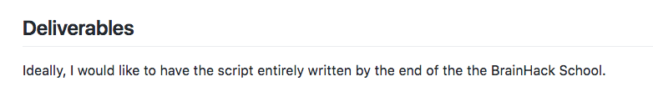
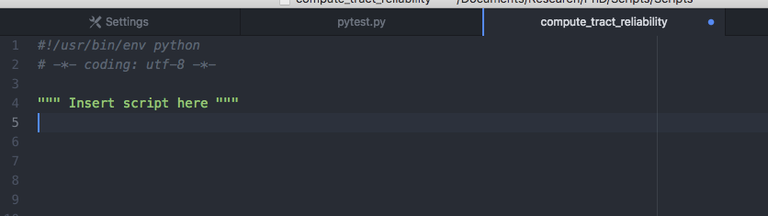
Progress on my project

Slide 5
Progress on my project
BUT:
I can now go through a python script and be only 80% lost
I am slowly learning how to use argparse to write a python script

Slide 6
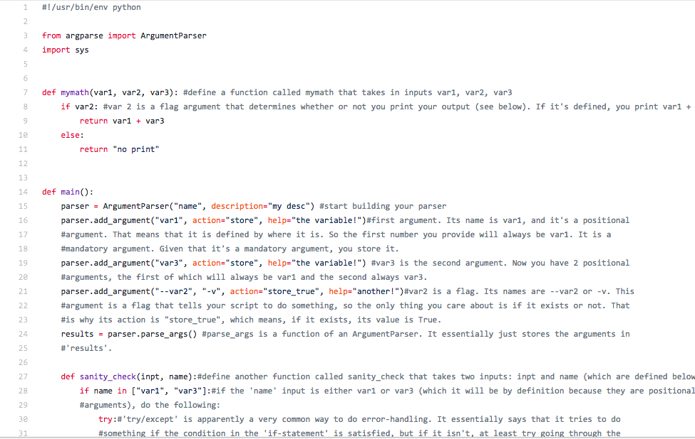

Slide 7
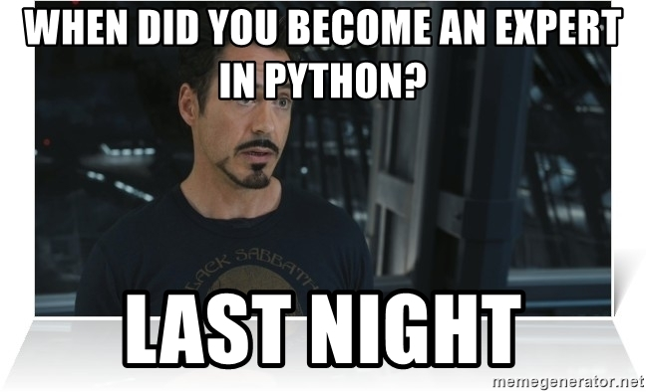
Progress on my project
SEMILITERATE
I am convinced I will continue using python
All thanks to BrainHack
DURING THE BRAINHACK SCHOOL

Slide 8
THANK YOU!!!
PIERRE AND ALL THE ORGANIZERS

