Slide 1

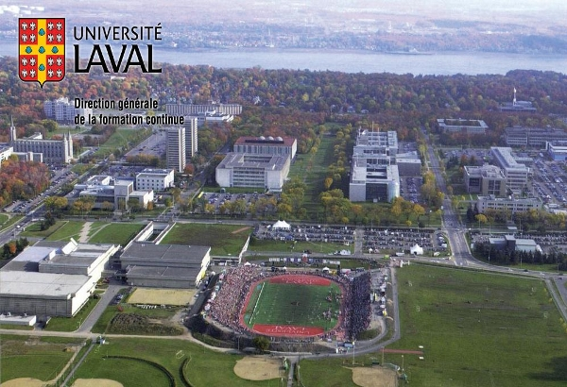
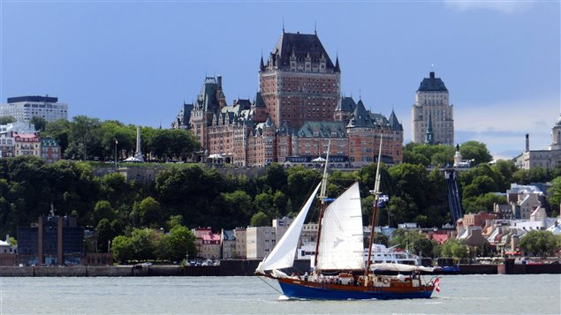

What is my background?
Laval University – Quebec City, Canada
  Undergraduate degree: physics
  Master degree: neurobiology/electrophysiology
  PhD degree: medical research
    Parkinson’s disease
    Cognition, Language and Depression
    Brain stimulation: DBS and TMS

Slide 2
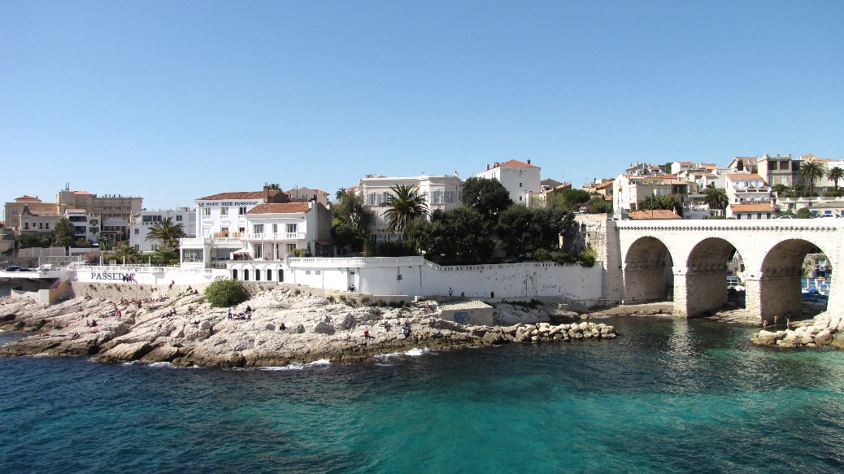
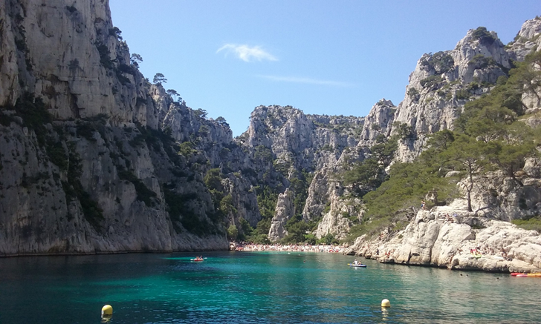

What is my background?
  Aix-Marseille University – Marseille, France
  Postgraduate associate: cognitive neuroscience
    Decision making/Inhibition, TMS, EMG
    Python, MRI software: BrainVisa
    Basic trainings: fMRI - connectivity - DTI
2

Slide 3
Where I'm from?
  McGill University, MNI
  Department of neurology and neurosurgery
What I do?
  Postgraduate associate: Alain Dagher lab
  PD – Cognition – Depression – MRI
  Parkinson's Progression Markers Initiative (PPMI)
    350 PD, 150 HC
    Longitudinal Database (from baseline to 5 years)
    Multiple cohorts: 33 different sites
    Structural MRI (T1/T2), resting state fMRI, DTI
    Neuropsychological data (depression, cognition)
    Motor evaluation, etc.
3

Slide 4
4
What we have? Data at Baseline, 1Y, 2Y, 3Y & 4Y
  MRI: BIDS format
  Preprocessed structural MRI for PD and HC subjects
  For each subject: DBM map (atrophy)
  What I am interested in?
      Quality control (measures/tools) ☑
      Neuroimaging analysis (groups comparison) ◻
        Statistical analysis with MRI data (tools?)

Slide 5
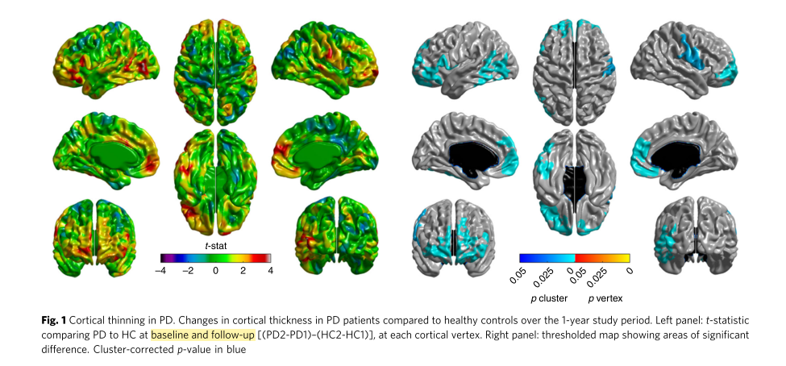
What project I would like to do?
  Subgroups comparison: HC vs PD-Depressed vs PD
    Learn how to do MRI analysis: Cortical thickness changes (baseline vs 4Y)
    comparison between 3 subgroups (10 subjects/group)
5
Yau, Y., et al. "Network connectivity determines cortical thinning in early Parkinson’s disease progression." Nature communications 9.1 (2018): 12.

