Slide 1
Brainhack School 2018
Liza Levitis
MSc Candidate, McGill University

Slide 2
Academic & Research Background
MSc student in the Integrated Program in Neuroscience since January
BA&Sc at McGill in Cognitive Science
Relevant research experience:
Neuropsychology lab: project relating personality and creativity measures to spatial and stimulus-response navigation.
Breast cancer informatics lab: I worked on a machine learning project to subtype breast cancer patients in a generalizable way based on microarray data.
LORIS software developer

Slide 3
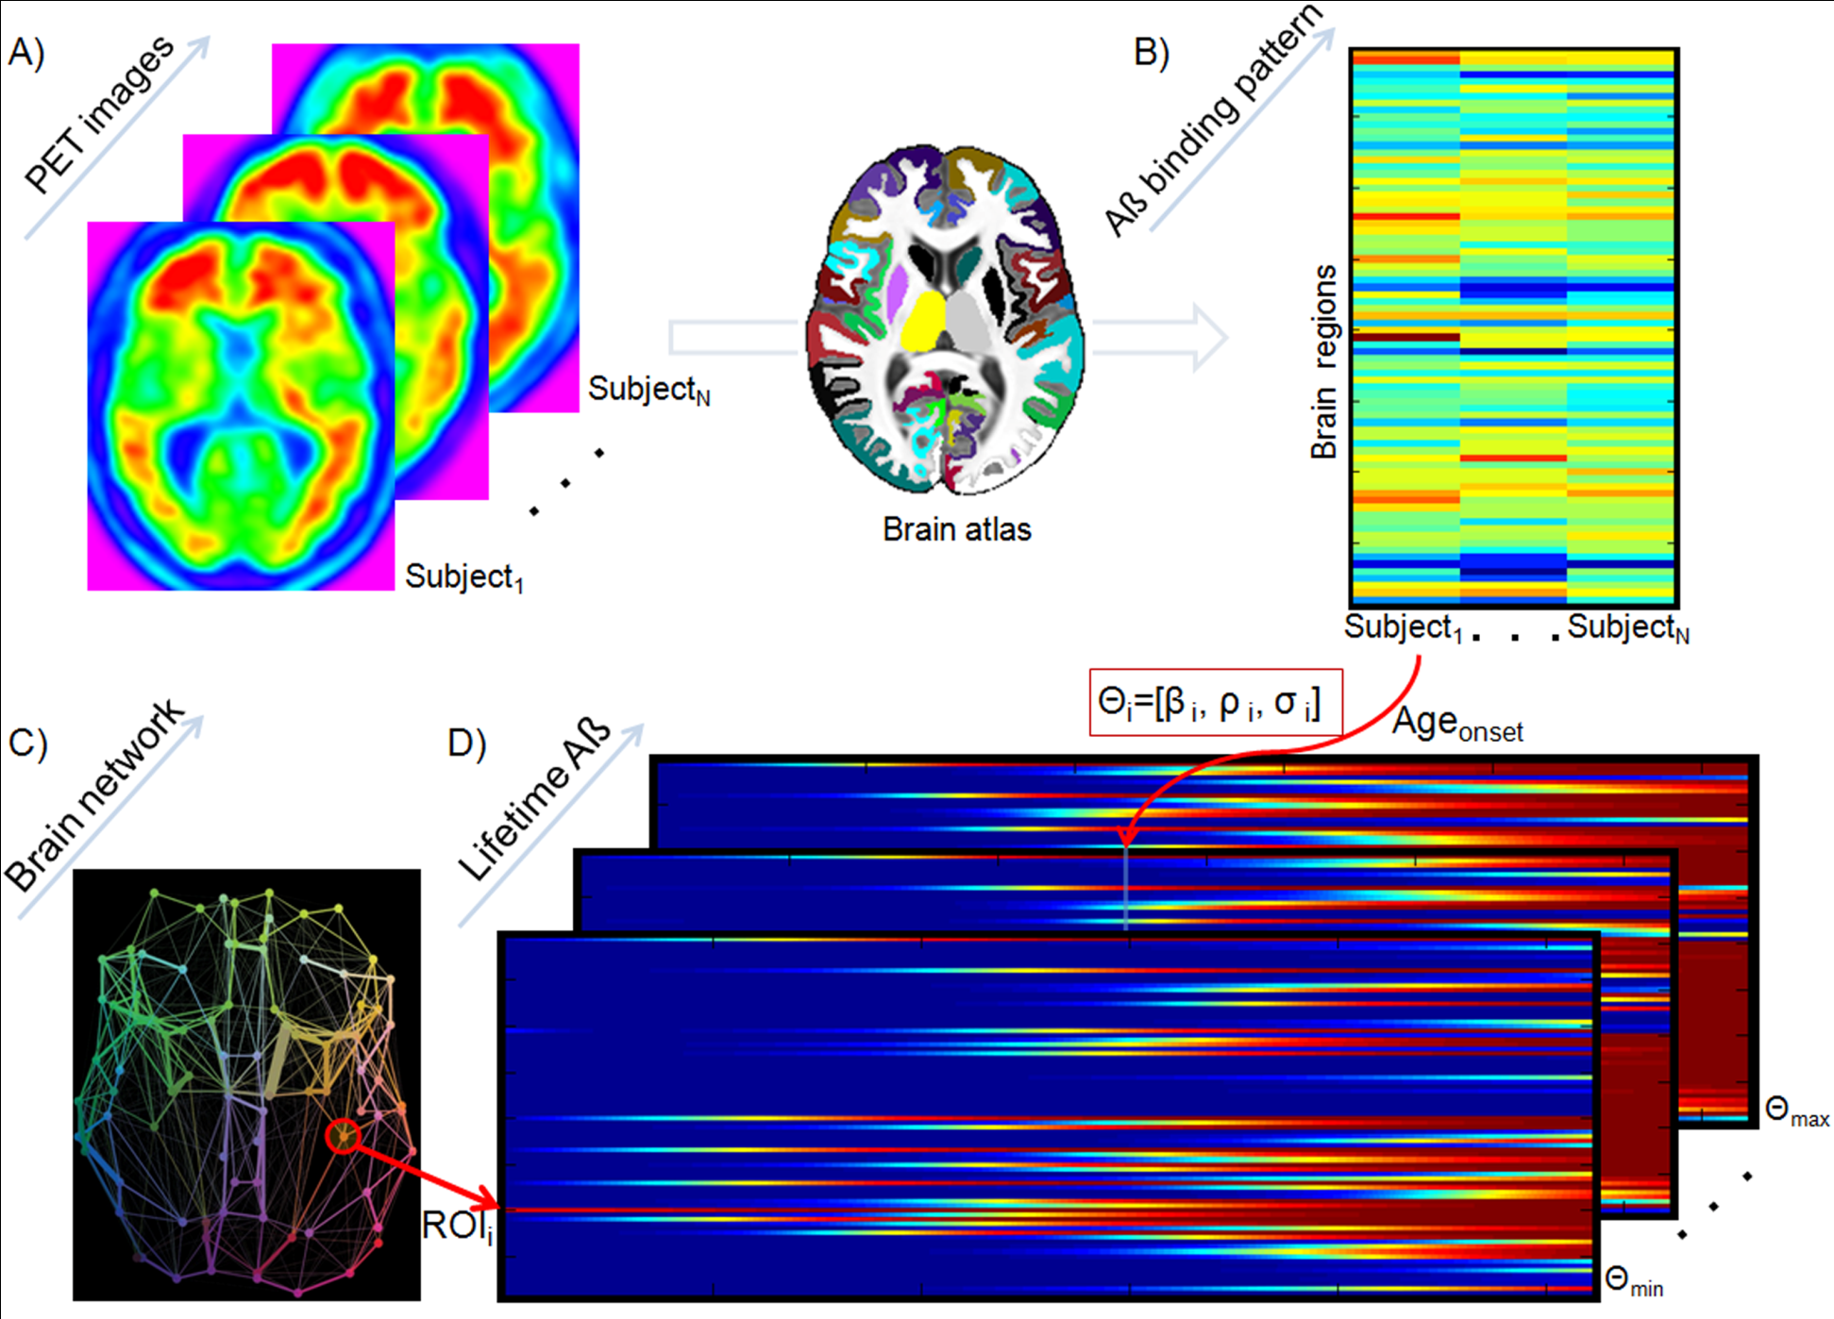
Epidemic Spreading Model
(Iturria-Medina Y, et al, 2014; PloS Comp. Biology)

Slide 4
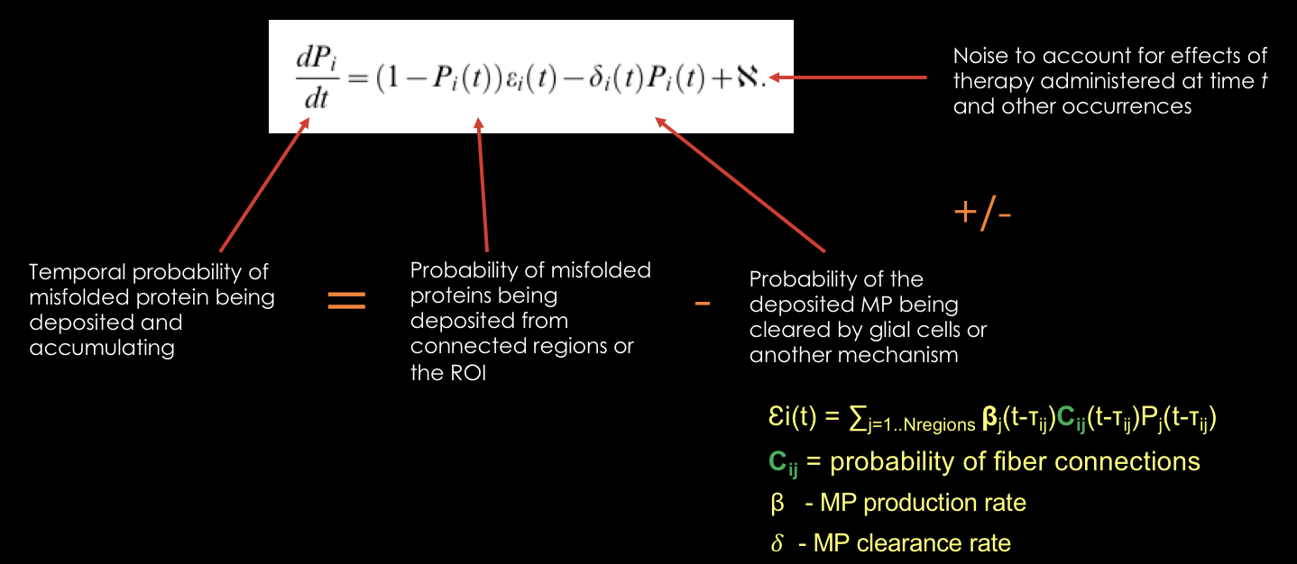
Epidemic Spreading Model

Slide 5
Current Project
The main inspiration for my MSc project is Itturia-Medina's Epidemic Spreading Model (ESM). In a nutshell, the ESM is a mechanistic model that predicts amyloid beta deposition based on a clearance rate, production rate, and a noise factor. At the moment, I have several goals for my project:
apply the ESM to ADNI grey matter cortical volume and thickness data
develop a comparable deep learning model and apply to GM to predict Alzheimer's disease progression based on single ROI cortical volume
apply the ESM to the DIAN (Dominantly Inherited Alzheimer's Network) data and further optimize it

Slide 6
Brainhack goals
Learn more about relevant deep learning approaches + tools (Keras/Pytorch)
I'm new to neuroimaging, so I'd like to learn more about Nipype and Nilearn for pre-processing and statistical learning.
If time permits, I'd love to also learn more about ndmg for connectome estimation.

Slide 7
DeepQC
In addition to my MSc project, I have been working with @crocodoyle on a separate project to create a REST-API for a deep learning model to predict QC probabilities and to make it interoperable with LORIS. I'm interested in potentially turning the Flask app into a Docker container during the Brainhack school.

