Slide 1
Microtask Liberation Front

Slide 2
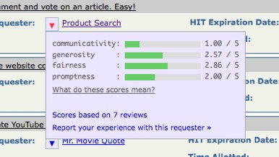
Power imbalance
Requesters control reputation/payment
Workers only have TurkOpticon
“Market for lemons”

Slide 3
Goals
Workers need tools to optimize their experience and choices
TurkOpticon++
Need
Wage tracking (hourly, overall)
Task preference
Continuous recommendations of new tasks
Actionable recommendations

Slide 4
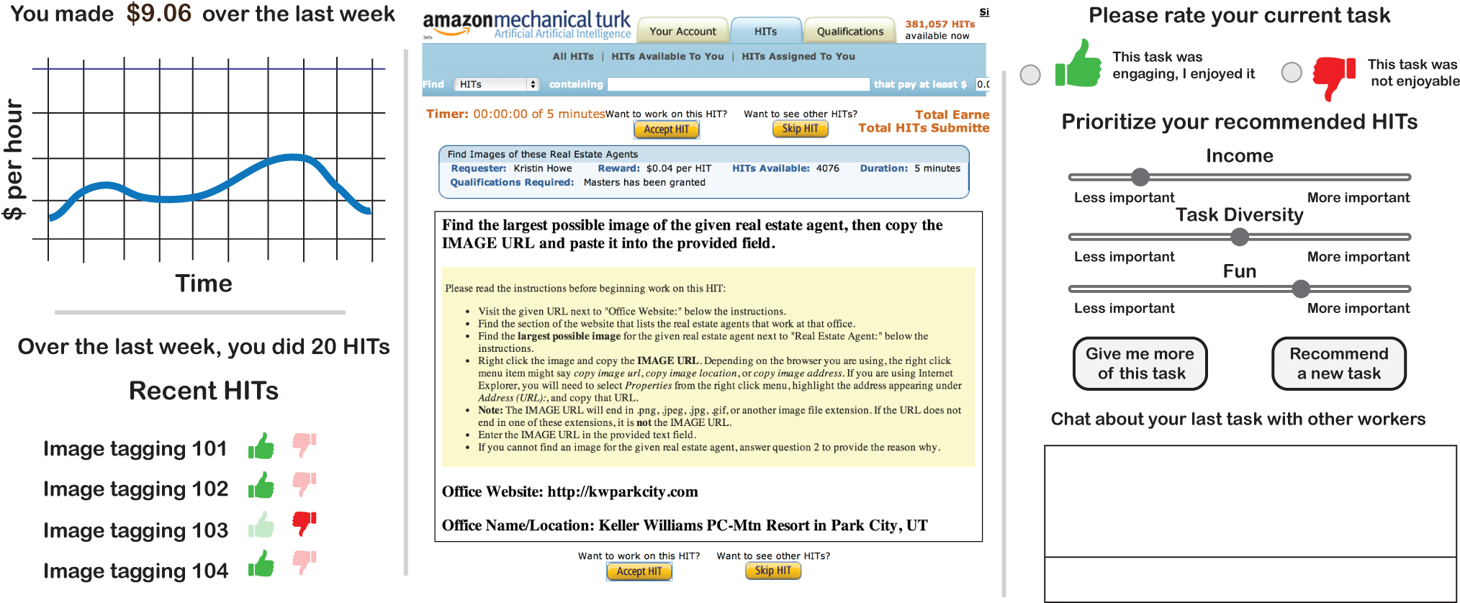

Slide 5
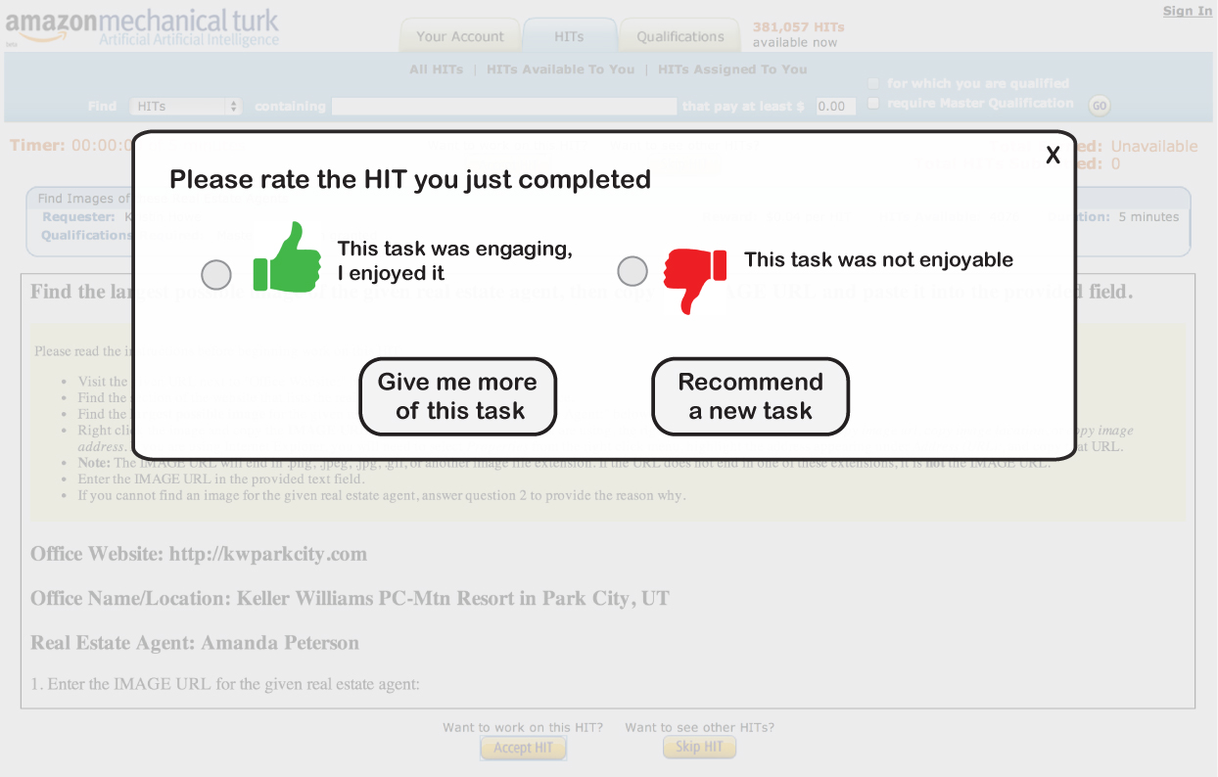
Plus/Minus

Slide 6
Implementation plan
Scrape datasources: TurkOpticon, Mturk
Database + Recommendation engine
Browser plugin

Slide 7
Evaluation
Qualitative: Turker feedback
Quantitative: Do recommendations optimize for worker preferences?
Wages
Task type
Diversity
Metrics
Time on task
Money earned
Number of recommendations liked

