Slide 1

Photo-Sketching:
Inferring Contour Drawings from Images^{[1]}
Xingchen Ming xingchen_ming@brown.edu
Ming Xu ming_xu1@brown.edu
Geng Yang geng_yang@brown.edu
[1] M. Li, Z. Lin, R. Měch, E. Yumer, D. Ramanan. Photo-Sketching: Inferring Contour Drawings from Images.
In arXiv:1901.00542
Notes:
The paper we selected is about inferring contour drawings from images.
And this paper was posted on Arxiv 3 months ago by Mengtian Li et. al.

Slide 2
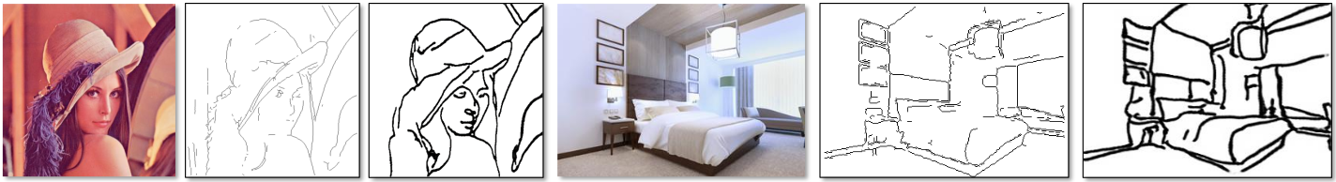
Introduction
Goals
Generate contour drawings
Adopt artistic style
Ideas
Adopt conditional GAN^{[2]}
Map 1 image to 5 ground truths
Input
Edge Detection
Contour Drawing
[2] M. Mirza and S.Osindero. Conditional Generative Adversarial Nets. In arXiv:1411.1784
Notes:
Contour drawings can be considered as an expression of human vision.
E.g. when we see something or recall something, we can draw some sketches for it. That may not be as accurate as edge or boundary detections, but can be vivid and artistic.
So, the goal of this paper is to generate contour drawings given an input image, and to make it look like created by human beings, rather than detected by machines.
This sounds interesting, but how to achieve such kind of effect?
In the NIPS of 2014, Ian Goodfellow introduced Generative Adversarial networks, which made computer creating art like human beings happen.
This paper adopted conditional GAN, which is a derivative of GAN, to do the contour generation.
In addition, the authors also created a new dataset, in which every image corresponds to 5 ground truths of sketch. Intuitively, that will push the model to resolve the diversity in imperfect alignment of annotations.

Slide 3
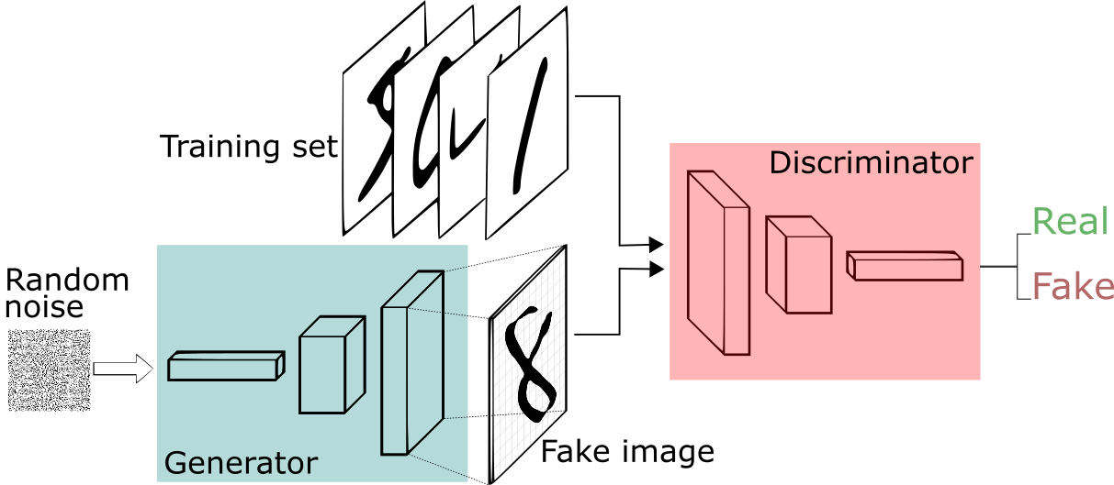
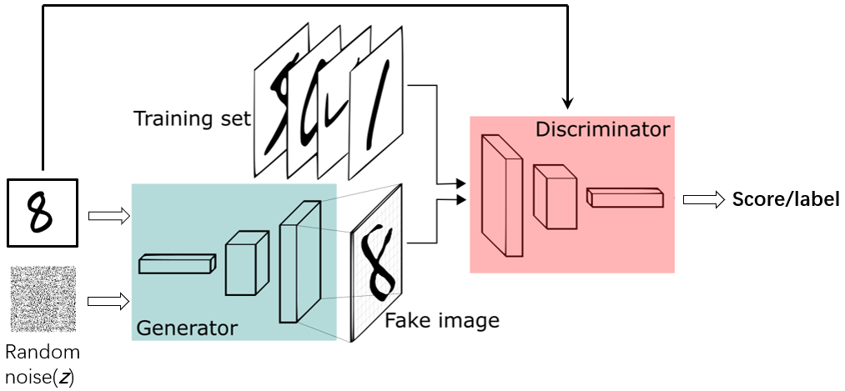
Generative Adversarial Network
GAN
Conditional GAN
c
Discriminator
Binary classifier
Distinguish real images and fake ones generated by G
Generator
Take random noise as input
Generate plausible image to fool D
Conditioned on input image c
Application
Text to Image
Image to Image
Speech Enhancement
Notes:
Now, Let’s see how the GANs work.
GAN consists of a generator and a discriminator. The discriminator is actually a binary classifier that tells whether the input image is real or fake. Generator takes some random noise to generate an image. We wanna them compete with each other. That is, The discriminator tries to distinguish the images generated by the generator, while the generator tries to generate real images to fool discriminator.
The conditional GAN is also intuitive. We wanna generate a sketch for a given input image, so, both generator and discriminator will be conditioned on this input image.

Slide 4
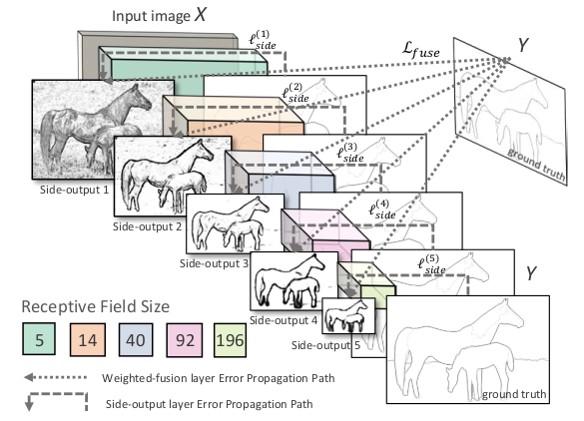
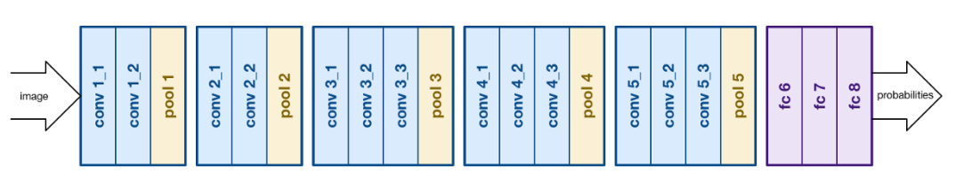
Related Approach
HED^{[3]} (Boundary detection)
Adopt VGG-Net^{[4]}
Connect side output layer to the last convolutional layer in each stage
Cut the last stage (5th pooling layer and fully connected layers) of VGG-Net
Cannot work with diverse ground truths
VGG-Net
[3] S. Xie and Z. Tu. Holistically-nested edge detection. In ICCV, 2015. 1, 6, 7
[4] K. Simonyan, A. Zisserman.Very deep convolutional networks for large-scale image recognition. In ICLR, 2015
Notes:
Naturally, the problem of generating contour drawings can be cast into an image translation problem or a classical boundary detection problem. So, we investigated 2 state of the art papers related to them respectively.
The first one is Holistically-nested edge detection proposed by Saining Xie et. al in the ICCV of 2015. This paper adopted VGG-Net and modified it by connecting side output layer to the last convolutional layer in each stage. Besides, they also cut the fully-connected layers of VGG. Since the output of the deep layers are too fuzzy to utilize and the fully-connected layers are computationally intensive. Such kind of boundary detection models doesn’t work well on diverse ground truths, since they will learn to average multiple ground truths, making the output image blurry.

Slide 5
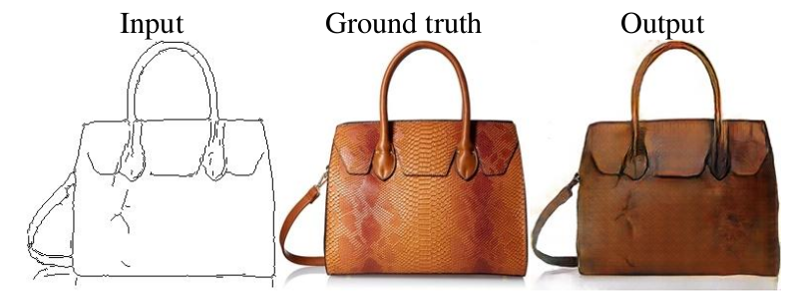
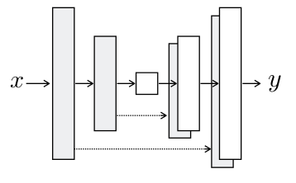
Related Approach
Pix2Pix^{[5]} (Conditional GAN)
A general-purpose image-to-image translation model
Generator: U-Net (autoencoder with skip connections)
Discriminator: patchGAN
Input
Input
Output
D
Ground truth
U-Net
PatchGAN
Output
[5] P. Isola, J.-Y. Zhu, T. Zhou, and A. A. Efros. Image-to-image translation with conditional adversarial networks.
In CVPR, 2017. 3, 4
Notes:
The second competing method is pix2pix, proposed by Philip Isola et. al in the CVPR of 2017. This method is also based on conditional GAN, which uses a U-net as generator, and patchGAN as discriminator. U-net is actually an autoencoder with skip connections that help reserve low-level features. In a regular GAN, the discriminator maps an input image to a single scalar that indicates fake or real. PatchGAN is a little different, which maps an image to a 2d array, in which every entry corresponds to a small patch in input image, and finally they vote to decide whether the image is fake or real.

Slide 6
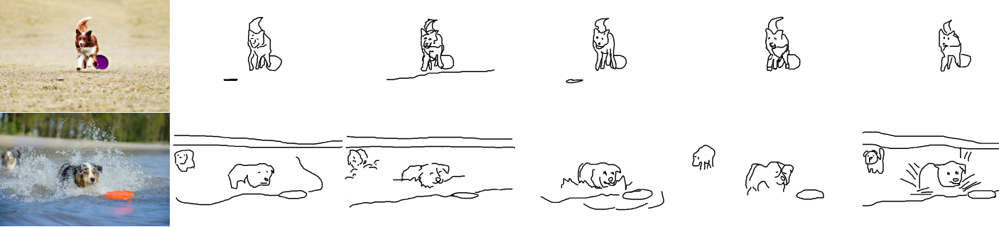
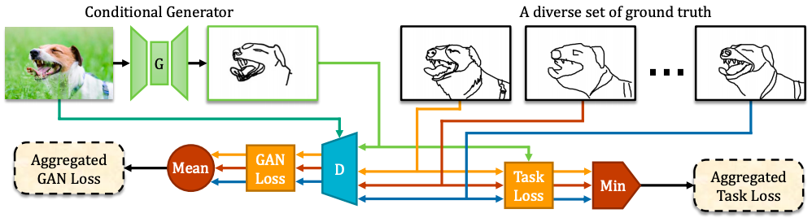
Novel Approach
Training data: 5 ground truths of sketch for 1 input image
Conditional GAN with a novel Mean-Min-Loss
Min-aggregate(Regression)
Mean-aggregate(GAN)
Notes:
In this paper, more than one target for each source image are used in the training data for accuracy. However, those ground truths shouldn`t be simply averaged, because that will lead to a very blurring boundary.
Because the training data contains multiple ground truth results, the conditional GAN should be optimized. In this paper, the cGAN is combined with a novel Min-Mean-Loss function. To rectify the conflicting gradients obtained by different ground truths, the GAN loss outputted by Discriminator and the regression task loss are aggregated carefully.
The mean aggregate function can make the discriminator to learn from all modalities with equal importance.
The min aggregate function allows the generator to adaptively pick the most suitable modality to generate on-the-fly.

Slide 7
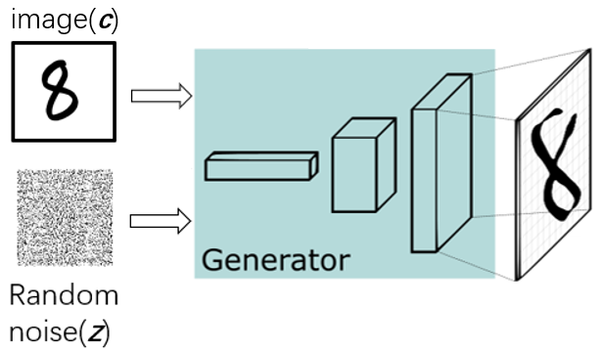
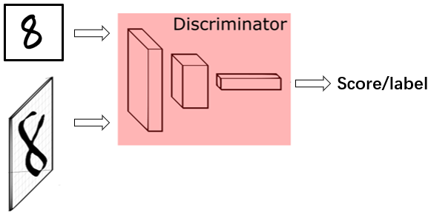
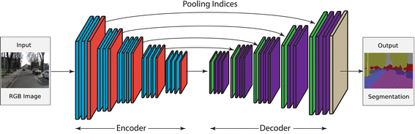
Architecture
Generator:
A standard encoder-decoder
Discriminator:
A regular GAN
[6] M. Li, Z. Lin, R. Měch, E. Yumer, D. Ramanan. LF-SegNet: A Fully Convolutional Encoder–Decoder Network for Segmenting
Lung Fields from Chest Radiographs. Wireless Personal Communications, July 2018, Volume 101, Issue 1, pp 511–529
Notes:
In this paper, the generator in the cGAN has a standard encoder-decoder architecture. The encoder takes in a image and output a vector to describe the feature of the image. The decoder takes in the generated vector and try to output the same image. Usually, there are some skip connections between the hidden layers.
In this paper, the authors found that removing the skip connections between encoder and decoder yields good performance.
This may because that the target in this paper is mainly about the object boundaries instead of the texture edges, removing the skip connections suppresses the low-level information.
We will examine if it`s the fact in the future.
The discriminator is a regular global GAN discriminator, takes in a whole image and output labels or a score.

Slide 8

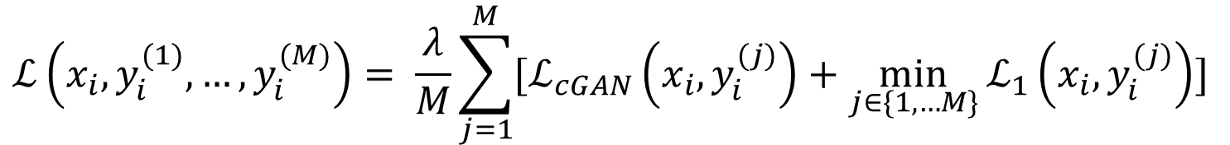
Basic Algorithm
Design the model(neural network/function set)
Loss function
In this paper, multiple targets for one image are used, the training data is
Find best parameter set
Backpropagate the gradients
$$ℒ_{cGAN}\left(x,y,z\right)=\min_{G}{\max_{D}{E_{x,y}\left[logD\left(x,y\right)\right]+E_{x,z}[log⁡(1−D(x,G(x,z)))]}}$$
$${ℒ_{c}\left(x,y\right)=λ∗ℒ}_{cGAN}\left(x,y\right)+ℒ_{1}(x,y)$$
Combined loss function
cGAN loss function
regression loss function
$$\left(x_{i},y_{i}^{(1)},…,y_{i}^{(M)}\right)$$
$$ℒ\left(x_{i},y_{i}^{(1)},…,y_{i}^{(M)}\right)= \frac{λ}{M}\sum_{j=1}^{M}{[ℒ_{cGAN}\left(x_{i},y_{i}^{(j)}\right)+\min_{j∈\{1,…M\}}{ℒ_{1}\left(x_{i},y_{i}^{(j)}\right)}] }$$
Notes:
Basically, there are three steps to develop a machine learning solution. Design the model, find the loss function and find the best set of parameters iteratively to minimize the loss function.
In this paper, the model is conditional GAN which is introduced previously. The total loss function is a combination of cGAN loss and regression loss. And since the input image comes with multiple ground truths, the total loss function is modified.
This is how this paper solve the conflicting gradients caused by multiple targets.
The last step is to find the best parameter set, that`s training the neural network. Backpropagate method is used.

Slide 9
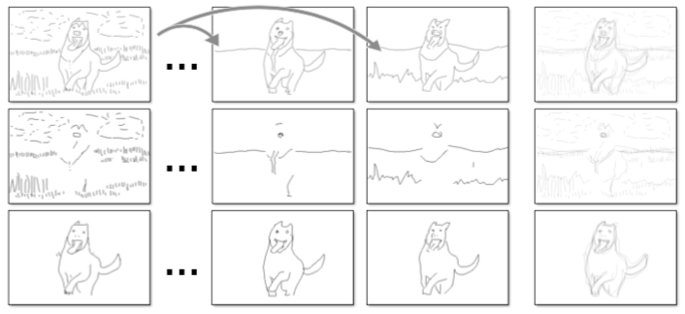
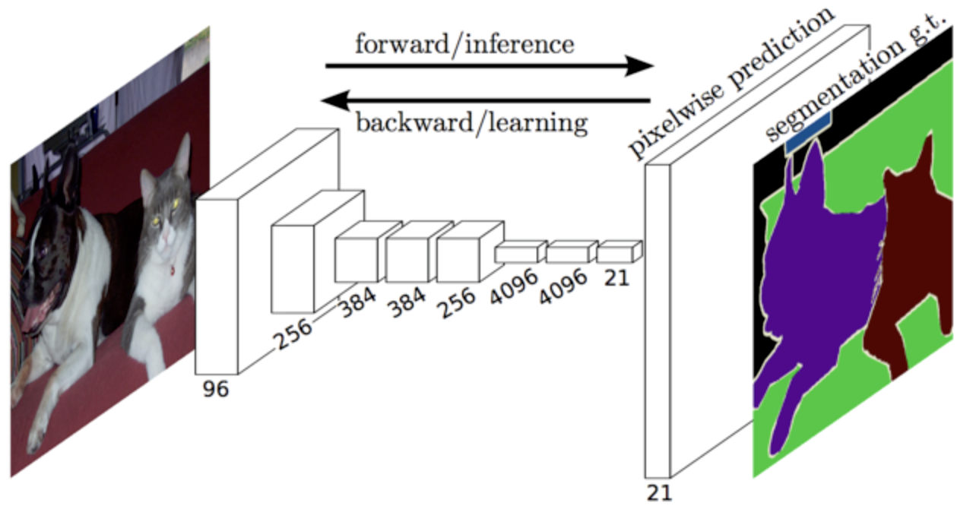
Evaluation Metric
Quantitative Evaluation
X. Hou’s evaluation for boundary detection^{[7]}
Semantic segmentation with FCN-8s
[7] X. Hou, A. L. Yuille, and C. Koch. Boundary detection benchmarking: Beyond f-measures. CVPR, pages 2123– 2130, 2013. 4, 5, 7
Notes:
Hou’s evaluation method has some prerequisites: since we have 5 ground truths corresponding to the same image, we thus need to refine the ground truth by removing strokes that could not be matched. In addition, contour drawings may not exactly aligned with image boundaries, makes it hard to match different annotations. So in practice we double standard offset tolerance and treat each ground truth pixel as an ‘object’ in precision-recall framework
2. Another metric mentioned in pix2pix is that we can use pre-trained semantic classifier such as FCN-8 for generated image. The intuition is that if the generated image is realistic, classifiers trained on real images would classify the generated one as well. We can then score the generated image by classification accuracy against the label of original image.

Slide 10
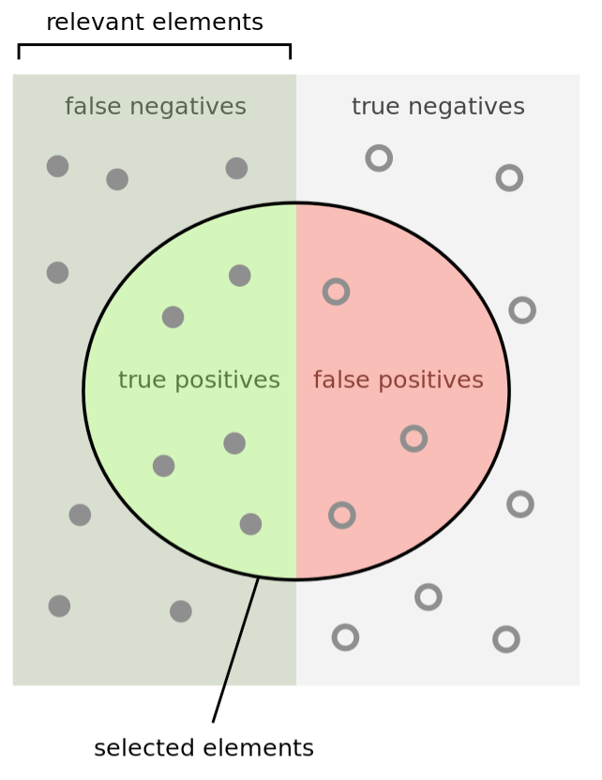
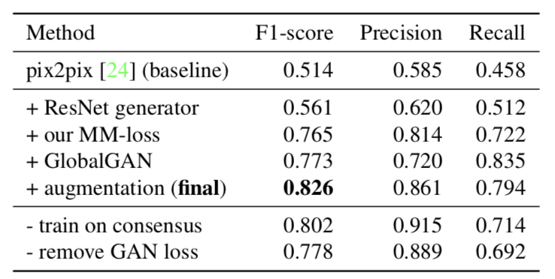
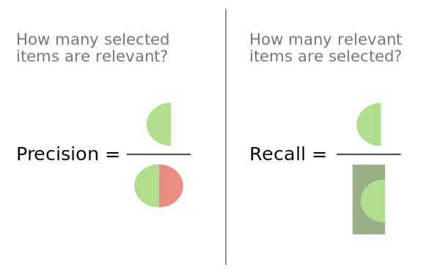
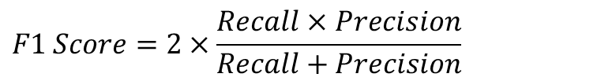
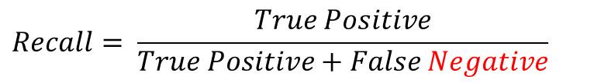
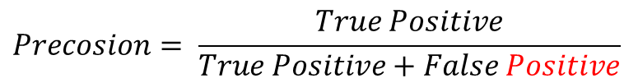
Precision vs Recall vs F1 Score
Evaluation Metric
$$Precosion= \frac{True Positive}{True Positive+False Positive}$$
$$Recall= \frac{True Positive}{True Positive+False Negative}$$
$$F1 Score=2×\frac{Recall×Precision}{Recall+Precision}$$
Training on the complete set of sketches with MM-loss outperforms training on consensus
(baseline)
Notes:
Precision, Recall, and F1 Score are three metrics used for evaluation in this paper, which are combinations of 2×2 contingency table’s elements: true positive, true negative, false positive and false negative. The first word represent whether the prediction is true or false, while the second word represents what the prediction is. For example, if the we have a boundary that is classified as a boundary, we define it as true positive. But if the we have a boundary that is actually not a boundary, then we define it as a false positive.
Literally, Precision shows whether the generated sketches look similar to the ground truth, and recall is a term that high recall means the generator can generate any sample found in training dataset, and F1 score is the harmonic combination of precision and recall.
Our final model is built from pix2pix model but uses Res-net generator, (which differs from u-net because it has no skip connections), a global discriminator and our Min-mean loss. The Table shows that our model performs a little bit better than model just trained on consensus strokes. So we conjecture that our MM-loss can help resolve conflict strokes and Res-Net can keep more low-level information than U-Net, which is more suitable for boundary generation.

Slide 11
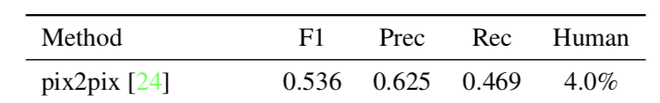
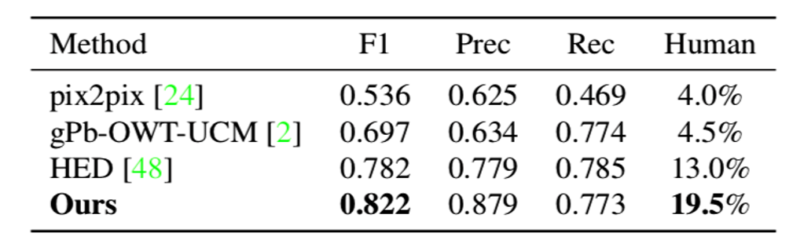
Evaluation Metric
Perceptual Study
Evaluated results with AMT Turkers
Notes:
Another metric of evaluation is to use Amazon Mechanical Turk to evaluate each algorithm. Turkers were asked to select a more artistic stroke from a human drawing and a generated one. The result is shown in last column of the table, and our algorithm outperforms the baseline algorithm and HED

Slide 12
Goals and Objectives
04/01
Data Augmentation
Flip, rotation, translation, downsampling
Test on other datasets
BSDS500, ImageNet
Explore different schemes in
Gradient descent algorithms
Momentum, Adagram, RMSprop, etc
Architectures of generator
U-Net, ResNet, etc.
Architectures of discriminator
PatchGAN, GlobalGAN, etc.
Read paper and references
04/08
First Presentation
Get preliminary results
04/22
Mid Presentation
Improve model
05/06
Final Presentation
Notes:
We will testing the testing the algorithm on different datasets such as BSDS500 and try to find failure modes of the algorithm.
We will explore different schemes in gradient descent algorithms and architectures of generator and discriminator to improve our model

Slide 13
Thank you!

