Slide 1
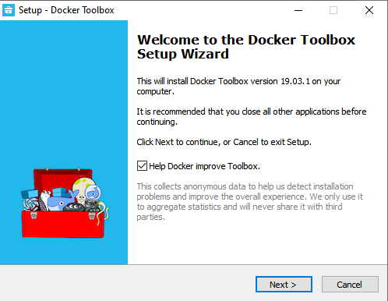
Installation - Docker on Windows 10 Home
For Docker to work in Windows 10 Home, you must make use of Docker Tollbox because you use VirtualBox for virtualization, unlike Docker Desktop for Windows that makes use of Hyper-V.
Reference link: https://docs.docker.com/toolbox/toolbox_install_windows/
Requirements:
Windows 7 or higher 64-bit architecture Enable virtualization in Bios
Installation:
Download link: https://github.com/docker/toolbox/releases
Download DockerToolbox-<version>.exe
Tested version: 19.03.1 Components included:
docker 19.03.1 docker-machine 0.16.1 1.24.1 docker-compose Kitematic 0.17.7 Boot2Docker ISO 19.03.1 VirtualBox 5.2.20 (Can upgrade to 6)
DockerToolBox installation:
Clicar em avançar

Slide 2
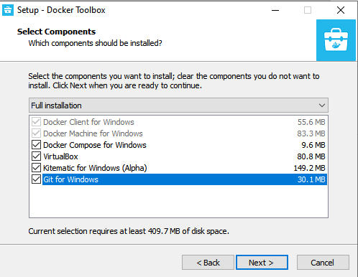
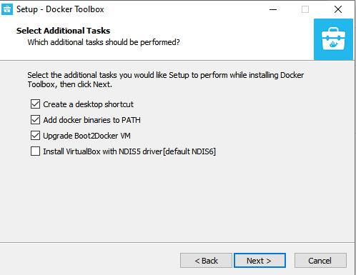
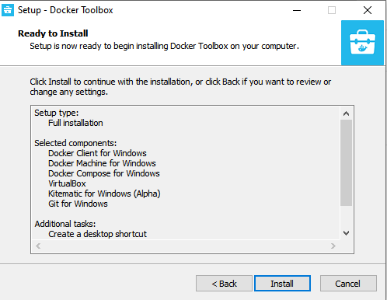
Enable all options, if you already have VirtualBox, clear
Enable only the options below
Finish installation

Slide 3
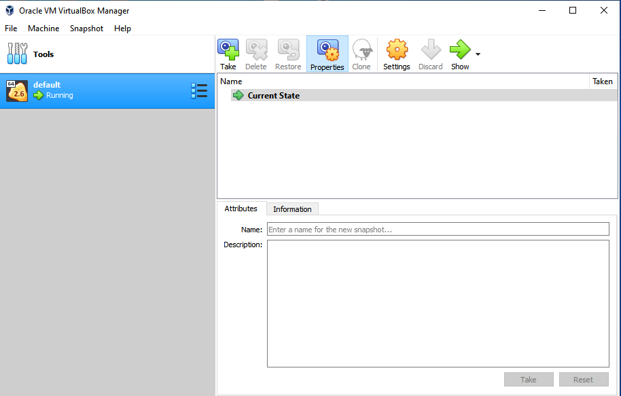
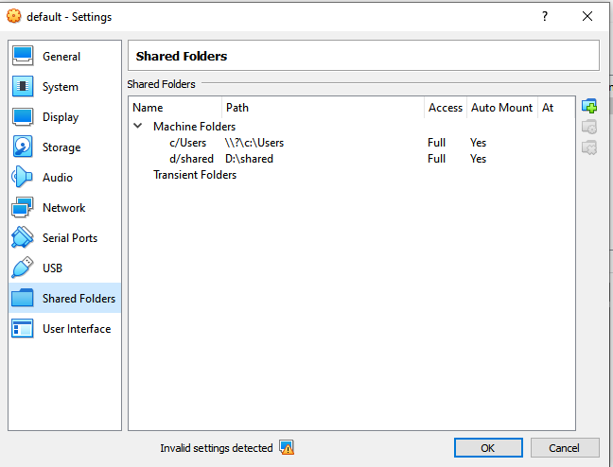
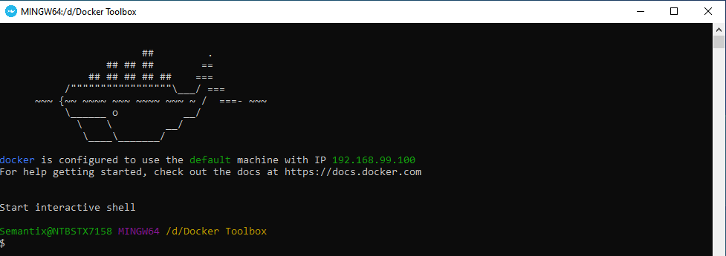
Open Oracle VM VirtualBoxManager (As Administrator):
ToolBox Docker creates a default image to be the docker driver
Right-click on the image and go to Shared Settings/Locations to view the locations that Docker will have access to, the default is to have access only to the C:/Users folder
Open Docker Quickstart Terminal (As an Administrator):
View machine IP 192.168.99.100 to access exposed Docker ports through the browser and enter Docker commands
\o/

Slide 4
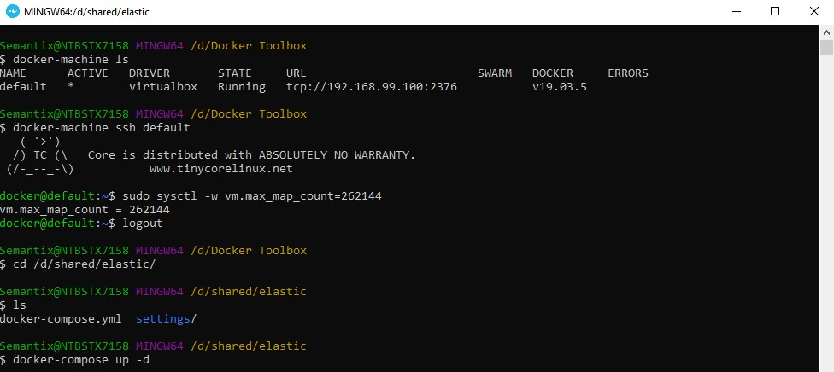
Example - ELastic Training For elasticsearch to work, you need to set vm.max_map_count in the Dropbox image
Access the default Dropbox machine (ToolBox Docker automatically creates it)
$ docker-machine ls
$ docker-machine ssh default
Change the vm.max_map_count towards 262144 on the machine of the Docker
$ sudo sysctl -w vm.max_map_count=262144
Exit the docker machine
$ logout
Sign in to the folder with the configuration files and start the elastic cluster
$ docker-compose up -d
Criado por: Rodrigo Augusto Rebouças
E-mail: rodrigo.augusto@semantix.com.br

