Slide 1
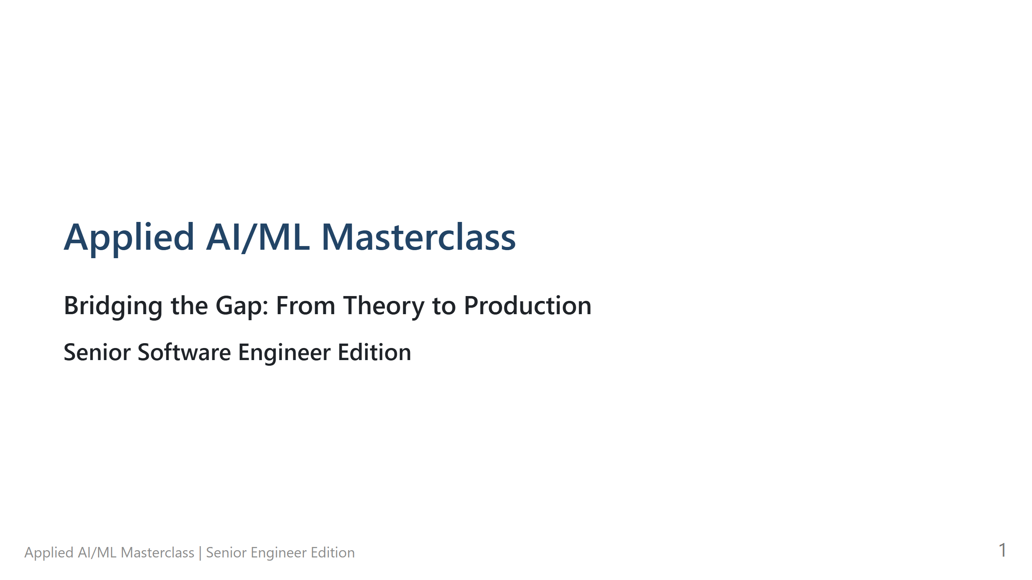
Notes:
Applied AI/ML Masterclass - **The Hook:** "Welcome everyone. Today, we're not here to talk about the hype. We're here to talk about the 'how'. We're moving beyond the math-heavy academic approach and focusing on what you, as senior engineers, need to build and deploy real systems." - **Technical Deep Dive:** N/A (Intro) - **Pro-tips:** Briefly mention the 'Applied' focus to set expectations. - **Lab Transition:** N/A

Slide 2
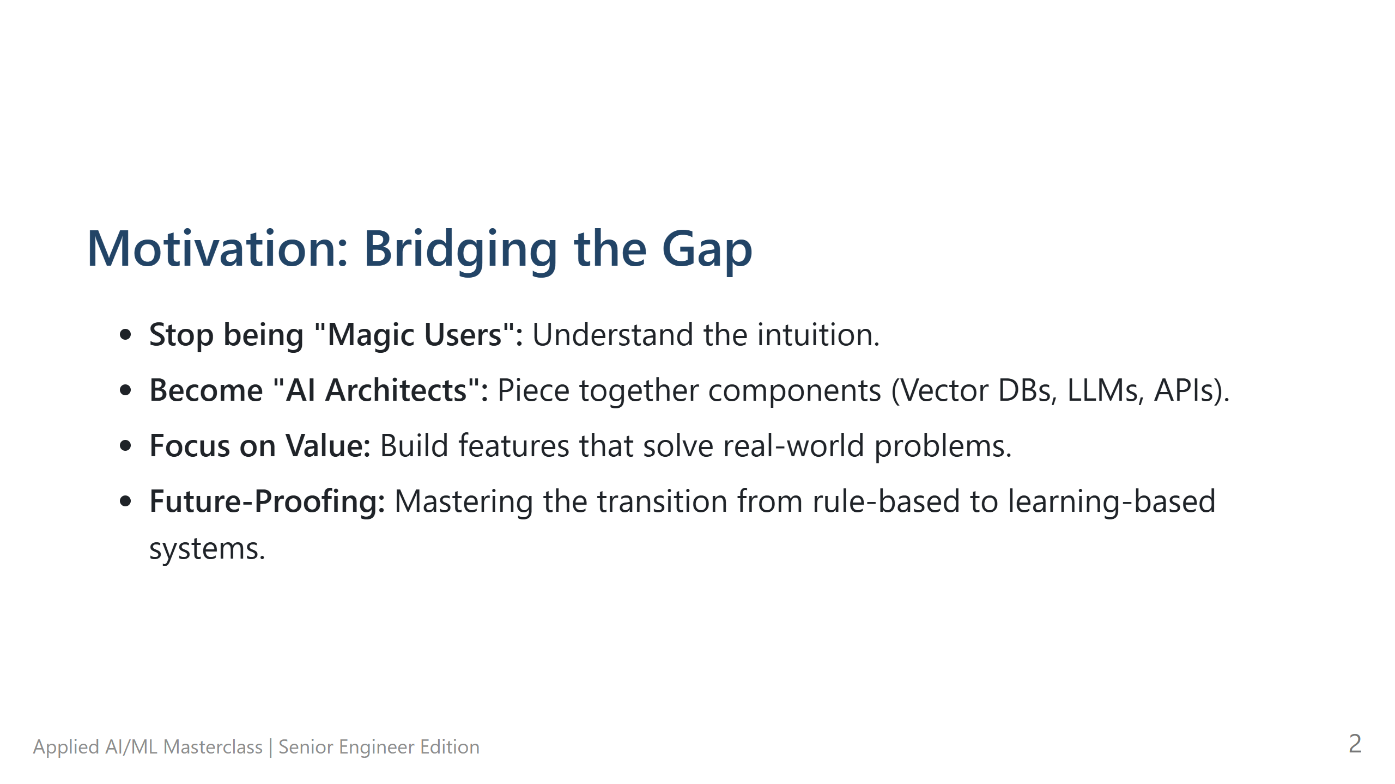
Notes:
Motivation: Bridging the Gap - **The Hook:** "Why are we here? Because there's a gap between being a 'Magic User' who just calls APIs and an 'AI Architect' who builds reliable systems." - **Technical Deep Dive:** Explain the shift from deterministic rule-based programming (`if/else`) to probabilistic learning-based systems. - **Pro-tips:** Acknowledge that AI is 'fuzzier' than traditional software, which can be frustrating for engineers. - **Lab Transition:** N/A

Slide 3
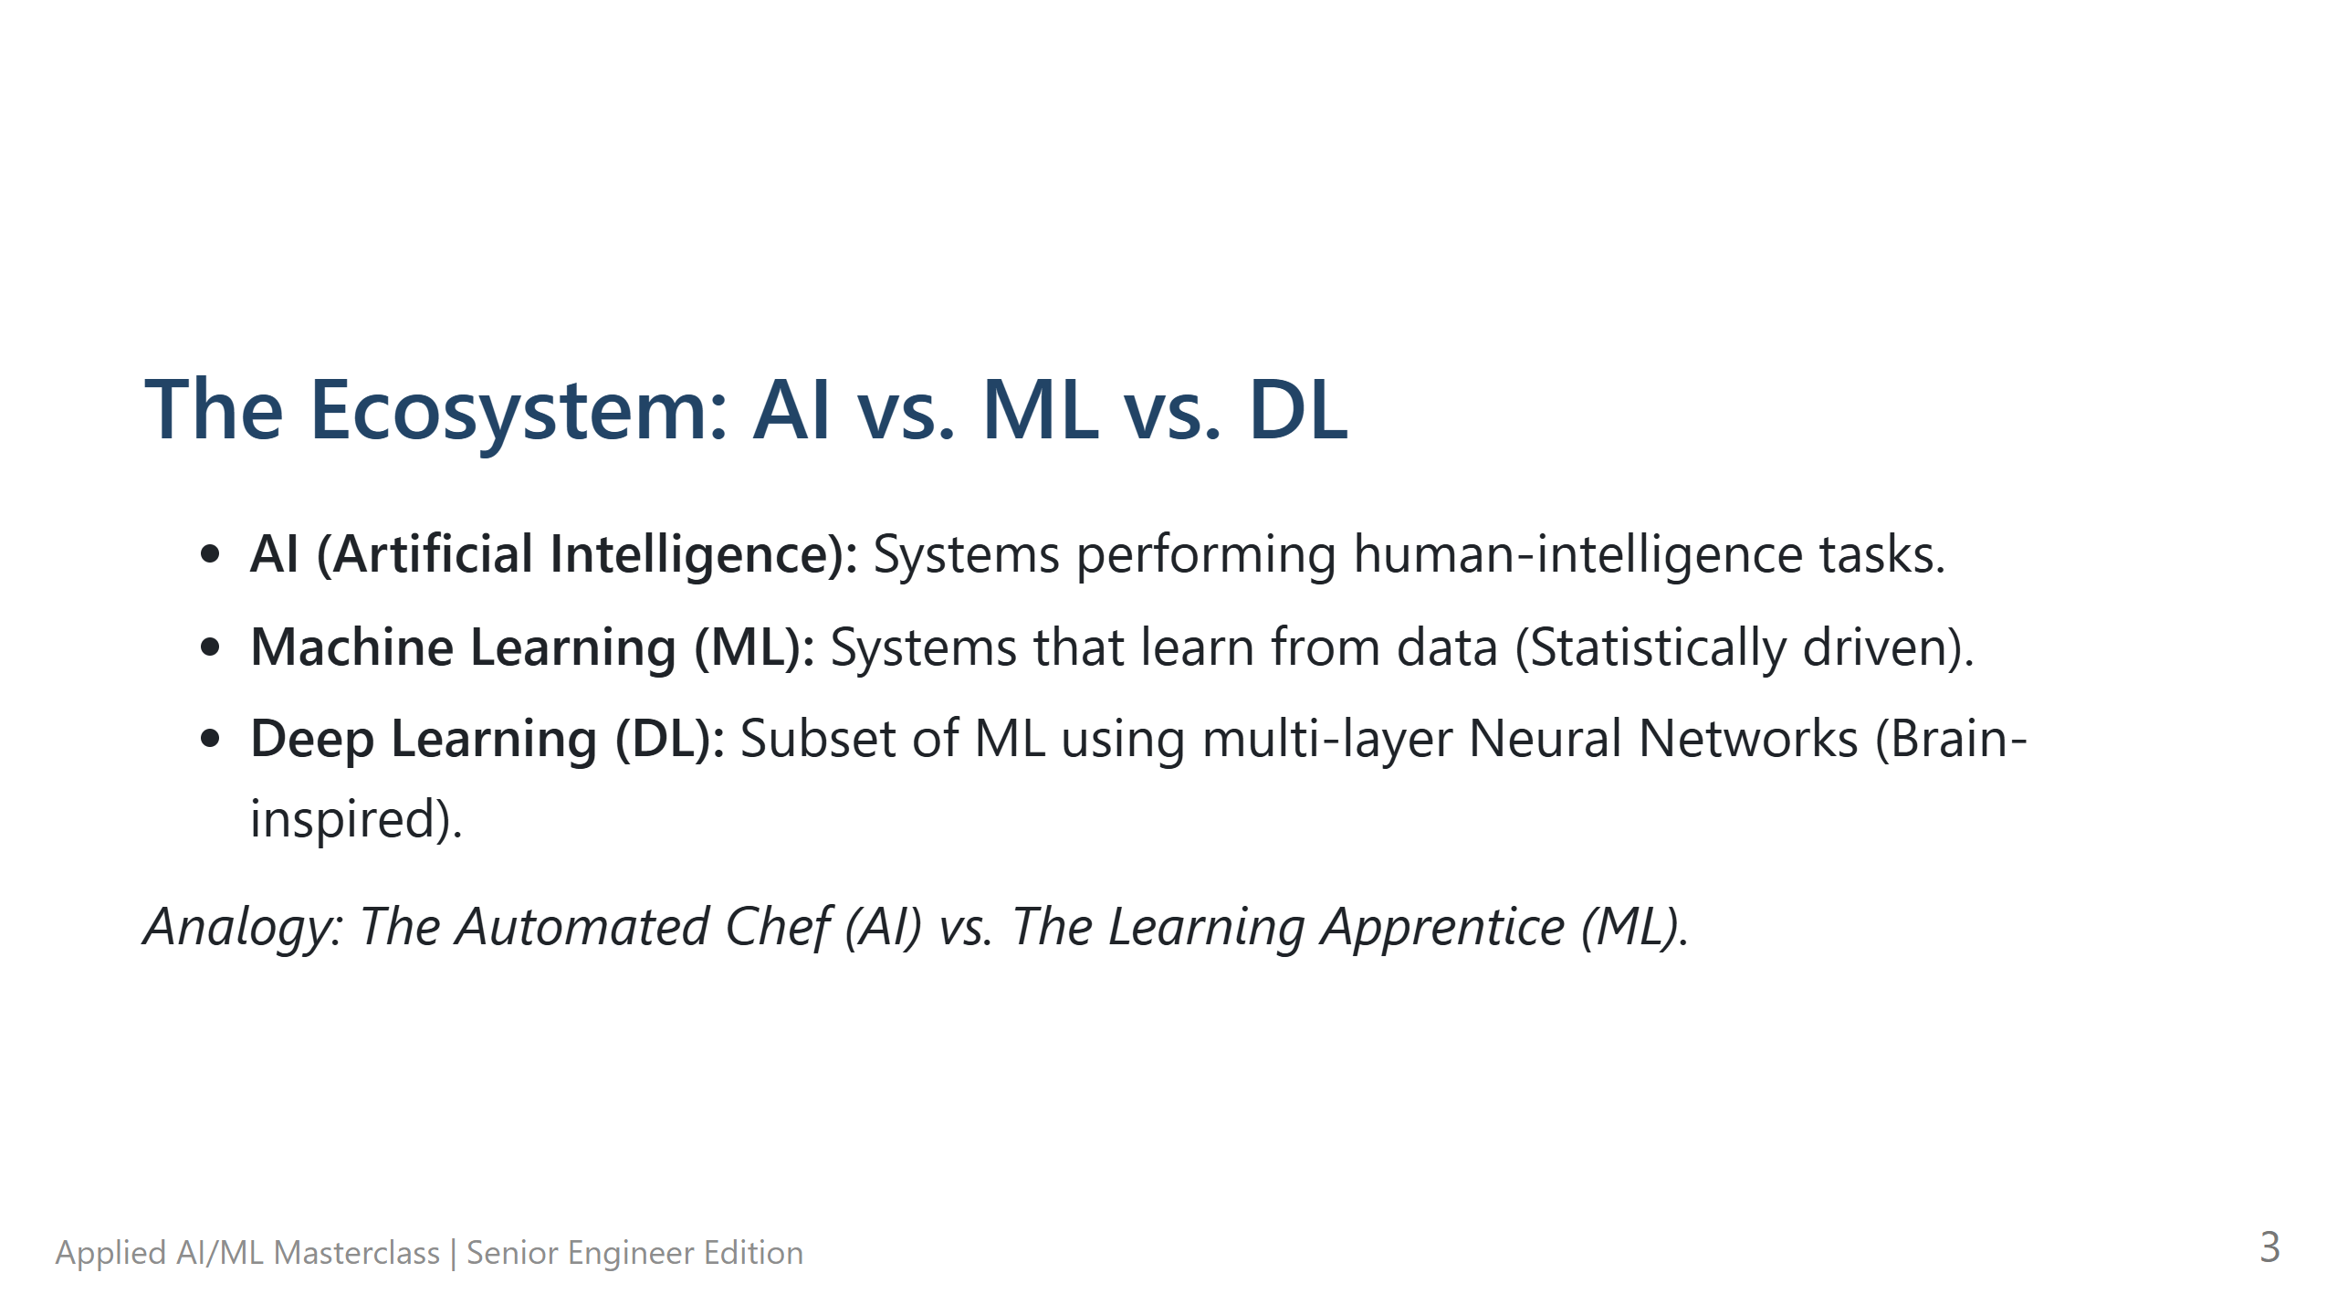
Notes:
The Ecosystem: AI vs. ML vs. DL - **The Hook:** "Let's clear up the jargon. These terms are often used interchangeably, but they shouldn't be." - **Technical Deep Dive:** - AI is the broad goal. - ML is the statistical engine (learning from patterns in data). - DL is the modern implementation using multi-layered networks (the 'Deep' in deep learning). - **Pro-tips:** Use the 'Automated Chef' analogy: Rule-based (Recipe) vs. ML (Watching 1,000 chefs and learning the pattern). - **Lab Transition:** N/A

Slide 4
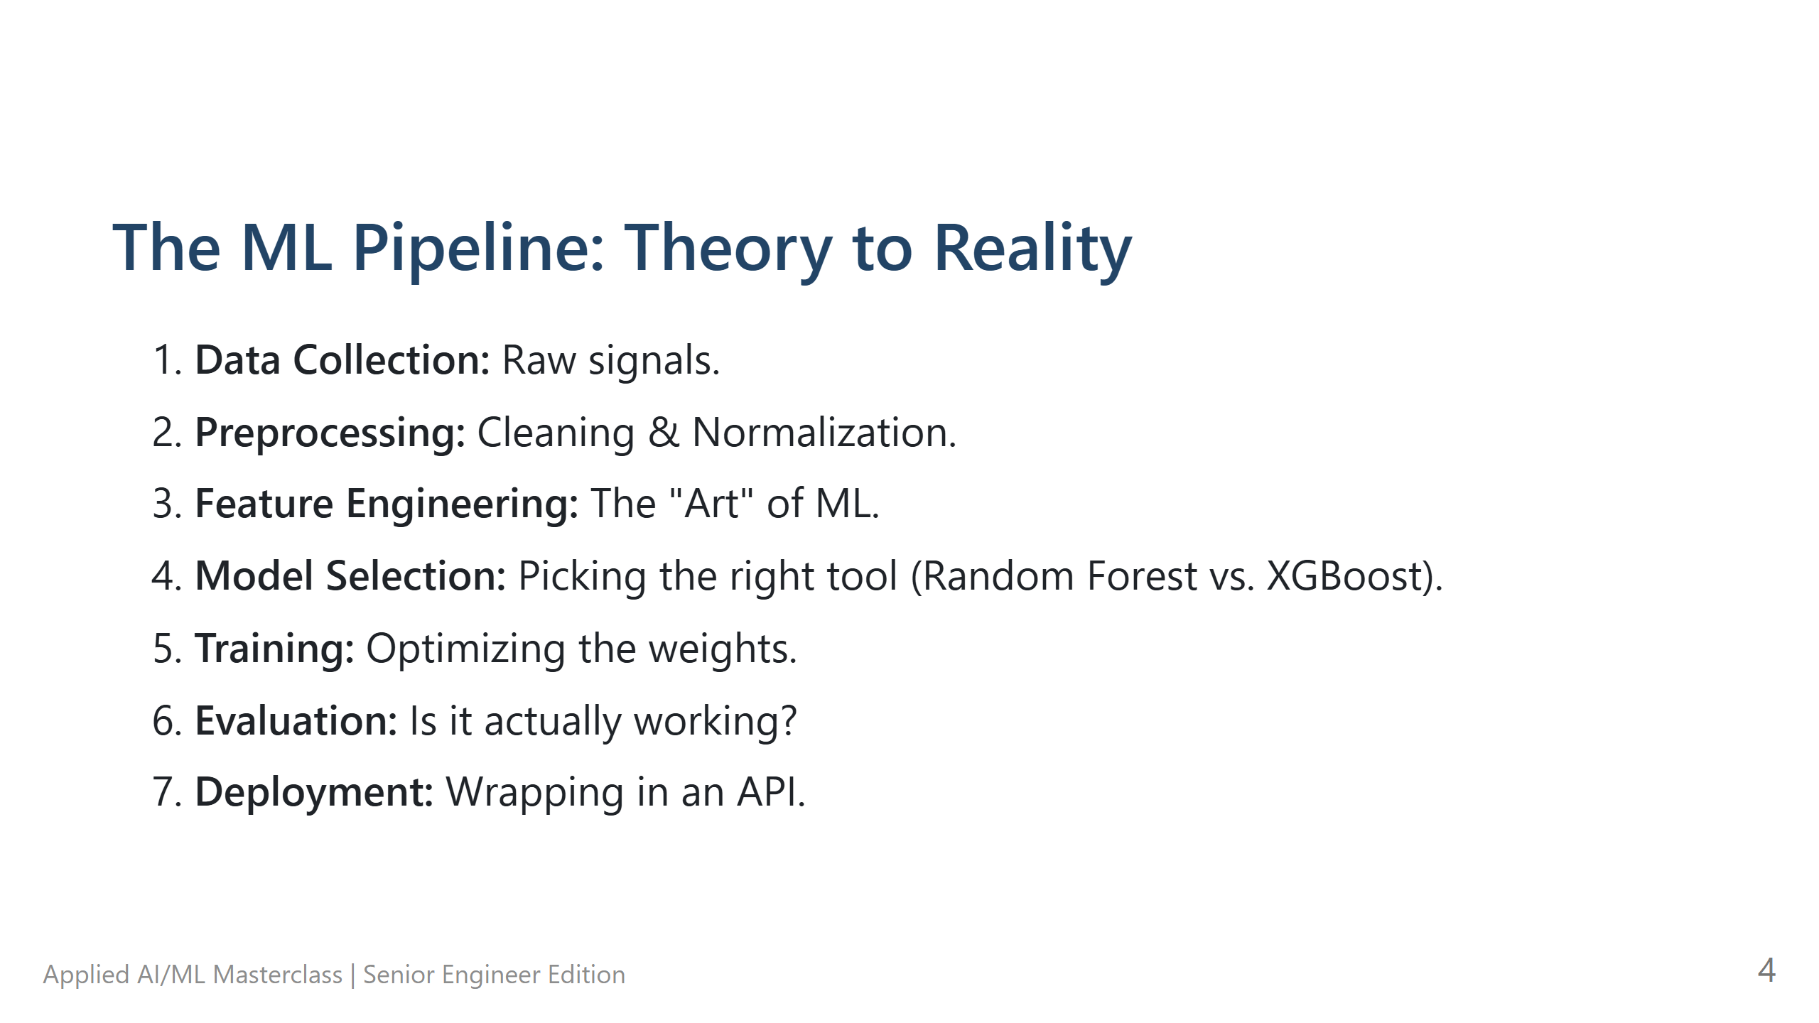
Notes:
The ML Pipeline: Theory to Reality - **The Hook:** "ML isn't just about the model. It's about the pipeline. 80% of your work is actually 'Data Engineering'." - **Technical Deep Dive:** Walk through each step. Highlight that 'Feature Engineering' is where domain knowledge (your engineering skills) matters most. - **Pro-tips:** Remind them that 'Garbage In, Garbage Out' is the golden rule of ML. - **Lab Transition:** "We'll dive into this pipeline in our first Jupyter notebook soon."

Slide 5
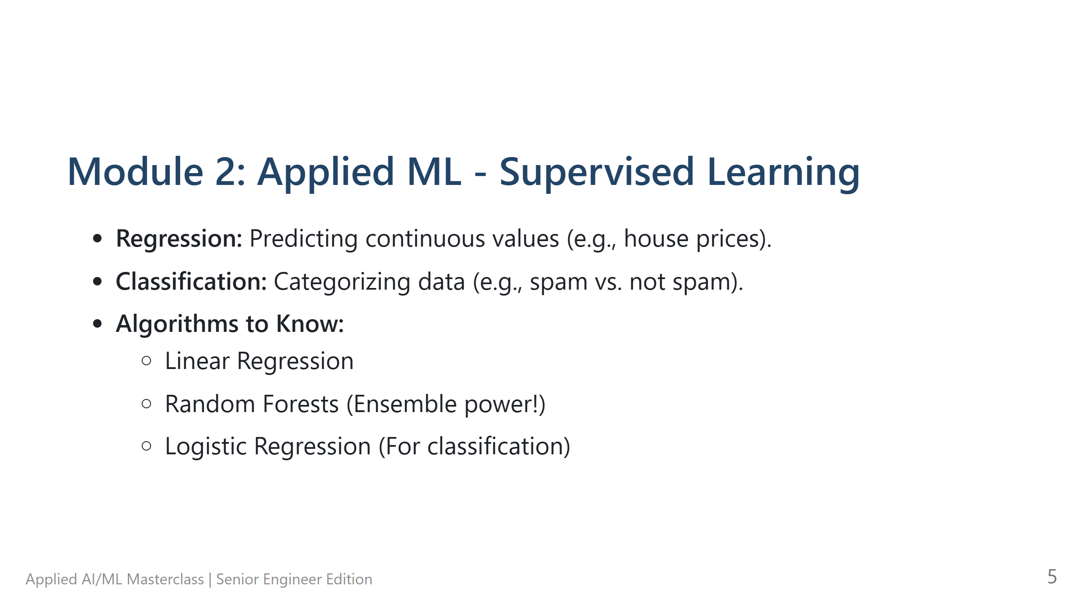
Notes:
Module 2: Applied ML - Supervised Learning - **The Hook:** "Supervised learning is like teaching a child with flashcards. You give it the input and the answer (label)." - **Technical Deep Dive:** - **Regression:** Predicting a scalar (House Price). - **Classification:** Predicting a category (Spam/Not Spam). - Mention **Random Forests** as a robust, 'go-to' algorithm for tabular data because they handle non-linearity well. - **Pro-tips:** If you have structured/tabular data (SQL, CSV), start with Random Forests or XGBoost before reaching for a Neural Network. - **Lab Transition:** Transition to **Lab 01: Scikit-Learn Foundations**.

Slide 6
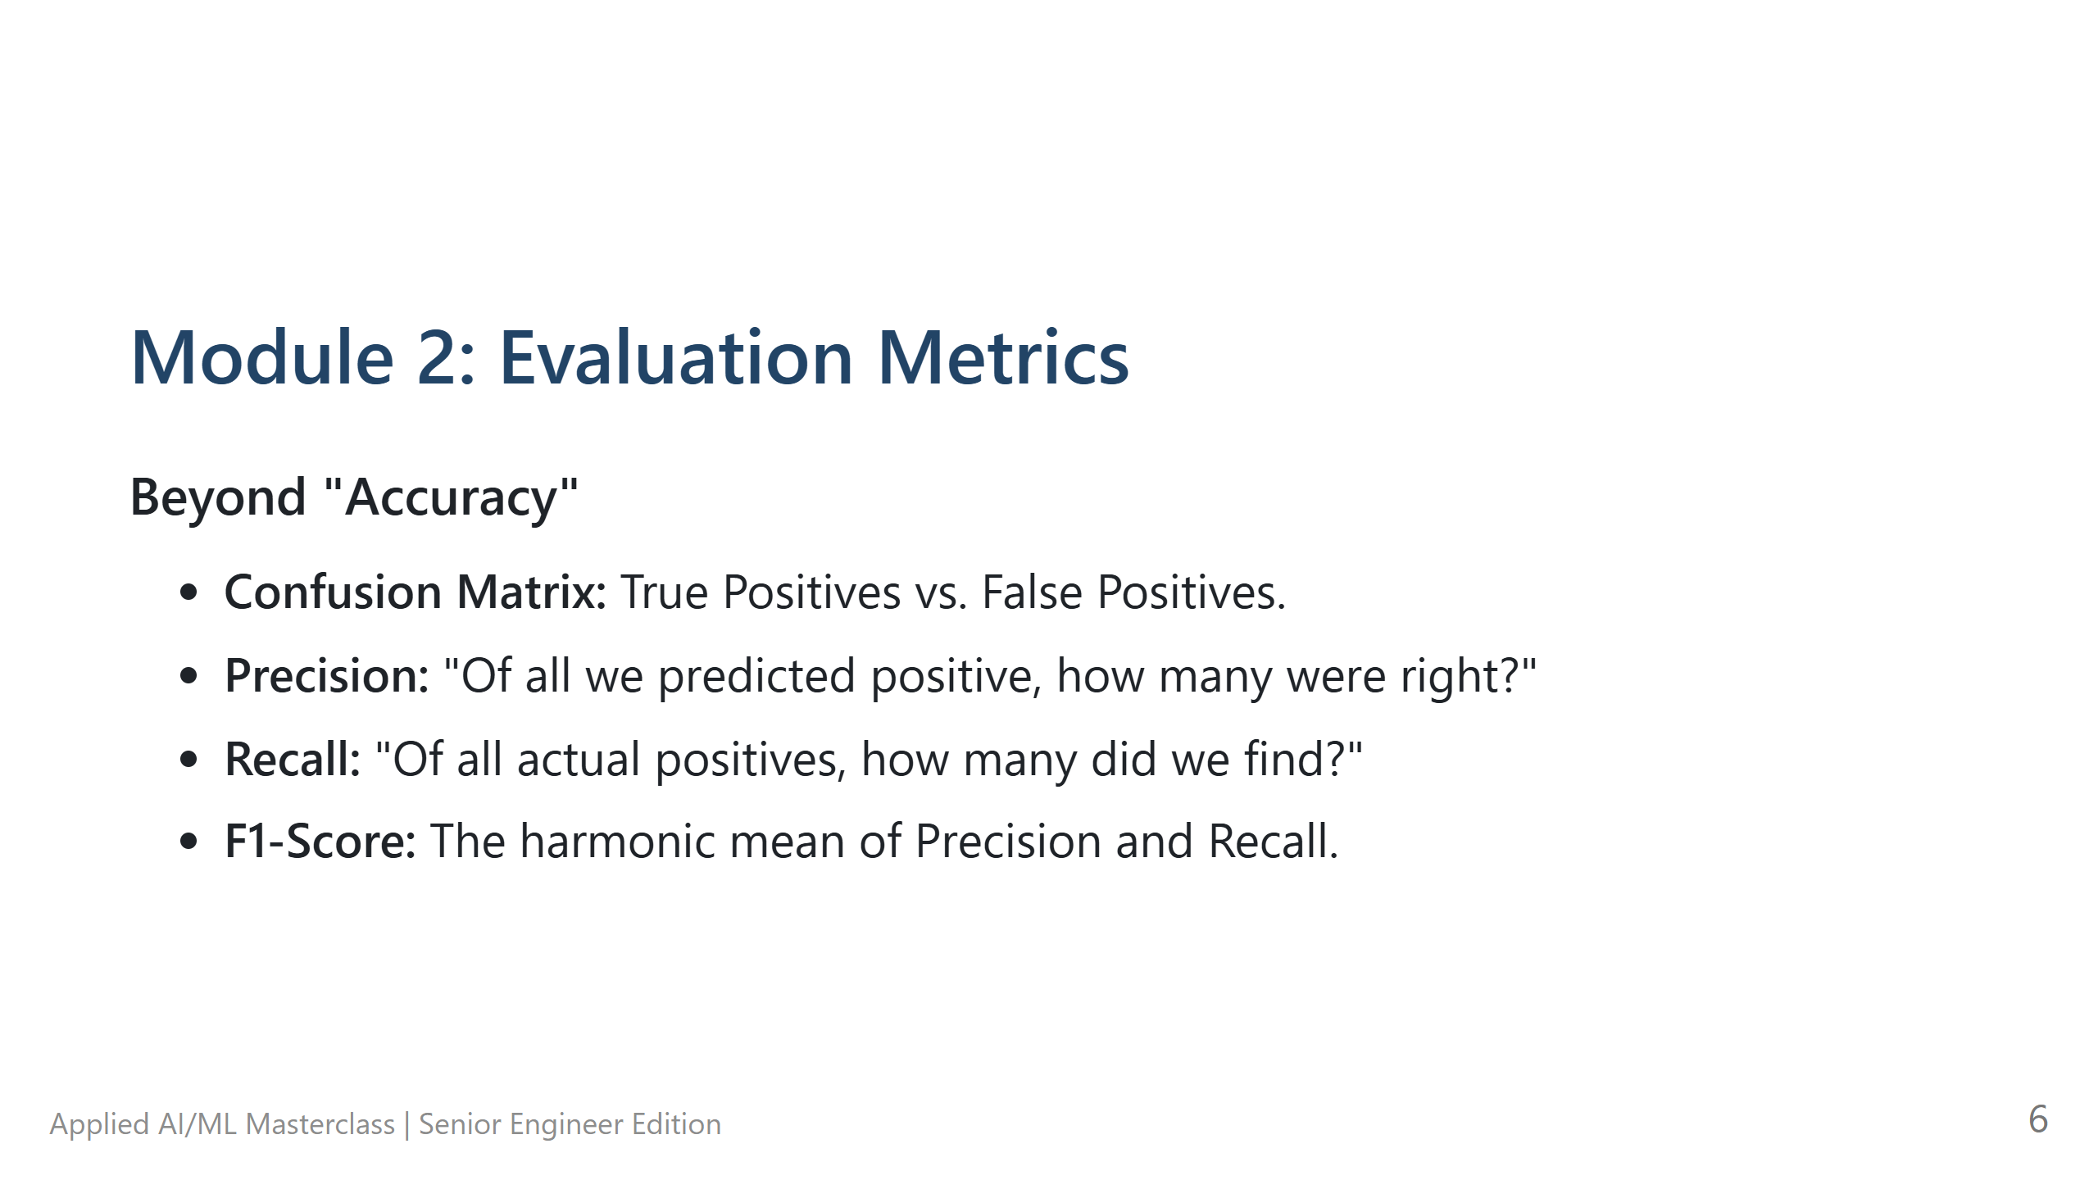
Notes:
Module 2: Evaluation Metrics - **The Hook:** "How do you know your model is good? If 99% of your emails are NOT spam, a model that says 'NOT SPAM' every time is 99% accurate... but it's totally useless." - **Technical Deep Dive:** - Explain the **Confusion Matrix**. - **Precision:** Focus on minimizing False Positives (e.g., don't mark real emails as spam). - **Recall:** Focus on minimizing False Negatives (e.g., don't miss a cancer diagnosis). - **Pro-tips:** Students often confuse Precision and Recall. Use the 'Police/Criminal' analogy: Precision = Don't arrest innocent people. Recall = Don't let criminals escape. - **Lab Transition:** N/A

Slide 7
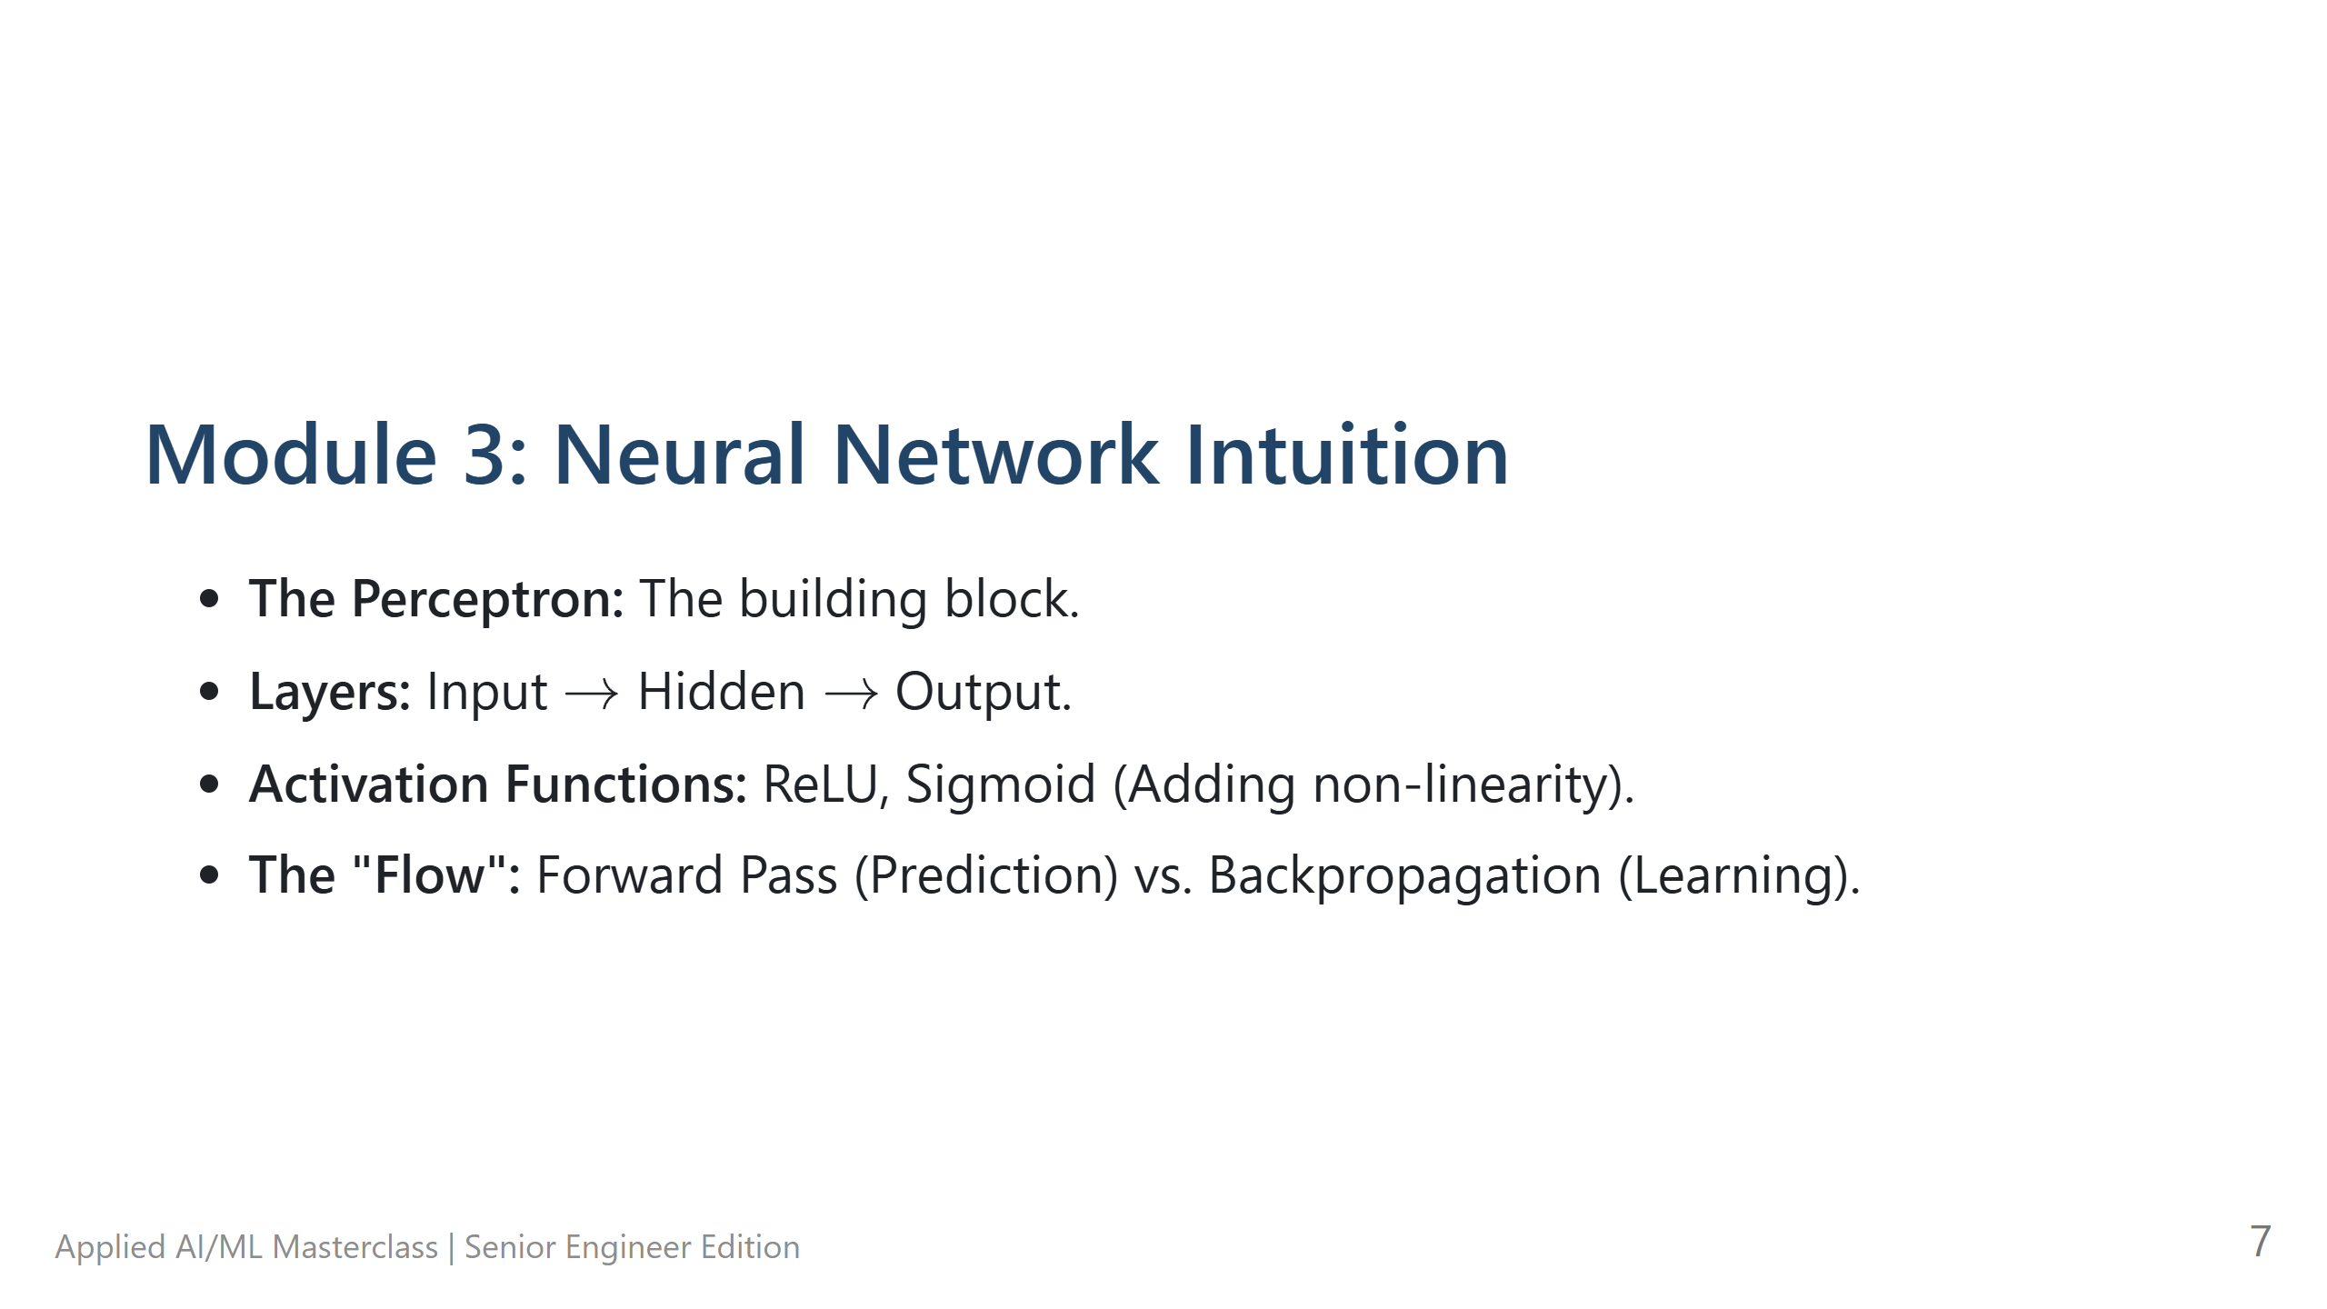
Notes:
Module 3: Neural Network Intuition - **The Hook:** "Neural networks are just layers of math that approximate any function. Think of them as a giant set of knobs we can tune." - **Technical Deep Dive:** - The **Perceptron** is a linear separator. - **Hidden Layers** allow us to learn complex, non-linear patterns. - **Activation Functions (ReLU)** are the 'switches' that decide if a neuron fires. - **Pro-tips:** Don't get bogged down in biological brain comparisons—they are misleading. Focus on the mathematical function approximation. - **Lab Transition:** N/A

Slide 8
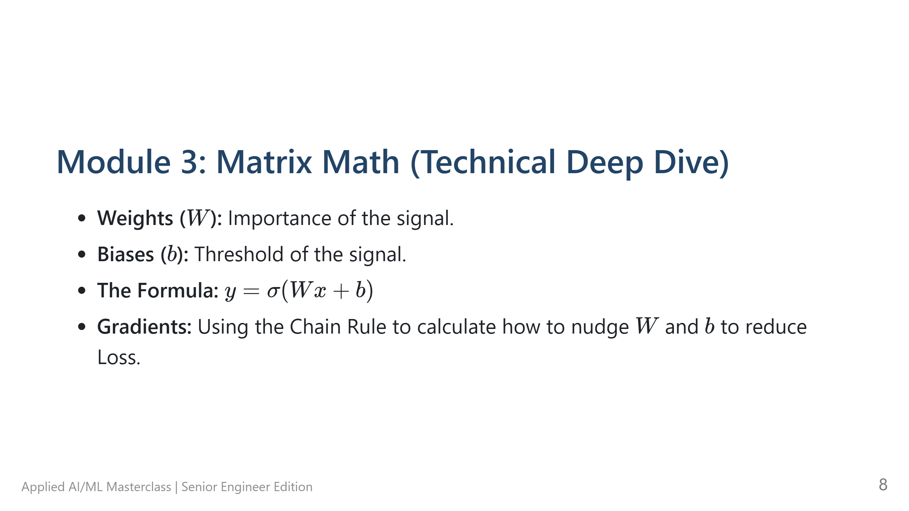
Notes:
Module 3: Matrix Math (Technical Deep Dive) - **The Hook:** "Let's look under the hood. It's all just matrix multiplication and the Chain Rule." - **Technical Deep Dive:** - $y = \sigma(Wx + b)$. - **$W$ (Weights):** Matrix of parameters. - **$b$ (Bias):** Vector to shift the output. - **Backpropagation:** We calculate the error at the output and 'propagate' it back using the derivative (Gradient) to update $W$ and $b$. - **Pro-tips:** Emphasize that **Gradients** tell us the *direction* to turn the knobs to make the error smaller. - **Lab Transition:** Transition to **Lab 02: Building a Perceptron from Scratch**.

Slide 9
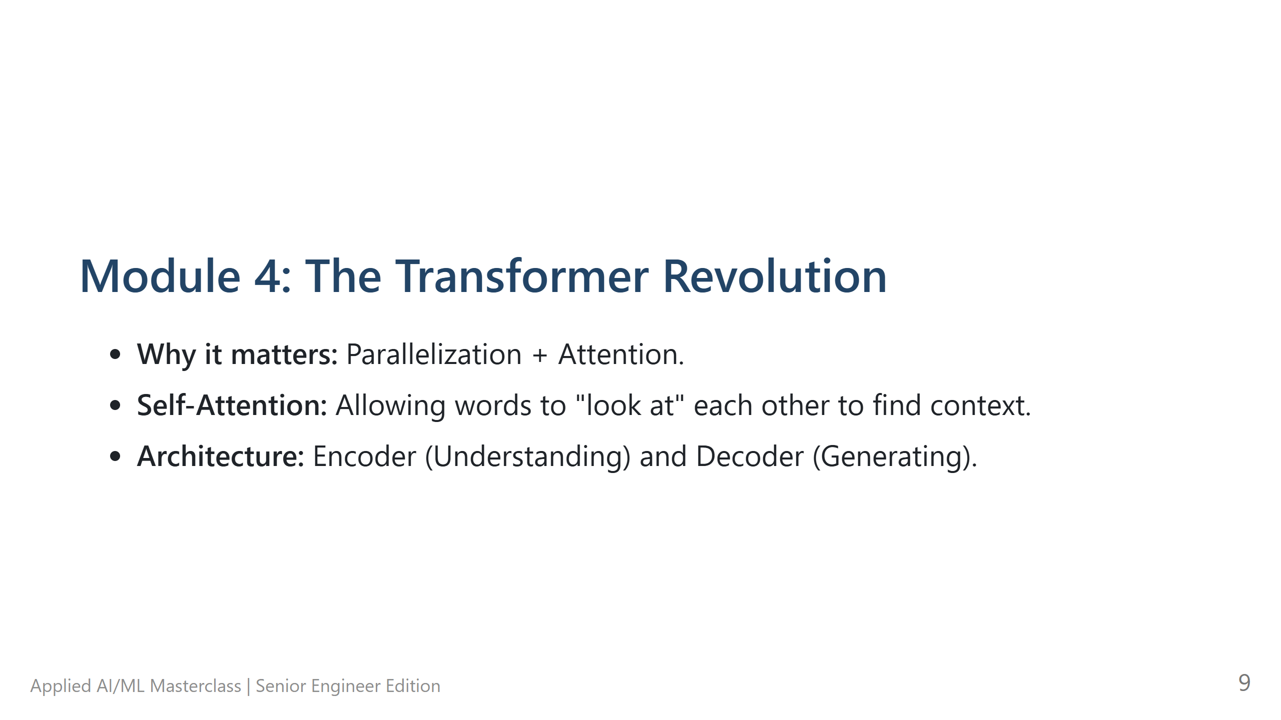
Notes:
Module 4: The Transformer Revolution - **The Hook:** "In 2017, the paper 'Attention Is All You Need' changed everything. Why? Because Transformers can process data in parallel, unlike older models (RNNs)." - **Technical Deep Dive:** Explain the **Attention Mechanism**. It allows the model to look at the entire sentence at once and weigh which words are most important to the current word. - **Pro-tips:** Mention that this is why LLMs are so much faster to train and more capable of handling long-range context. - **Lab Transition:** N/A

Slide 10
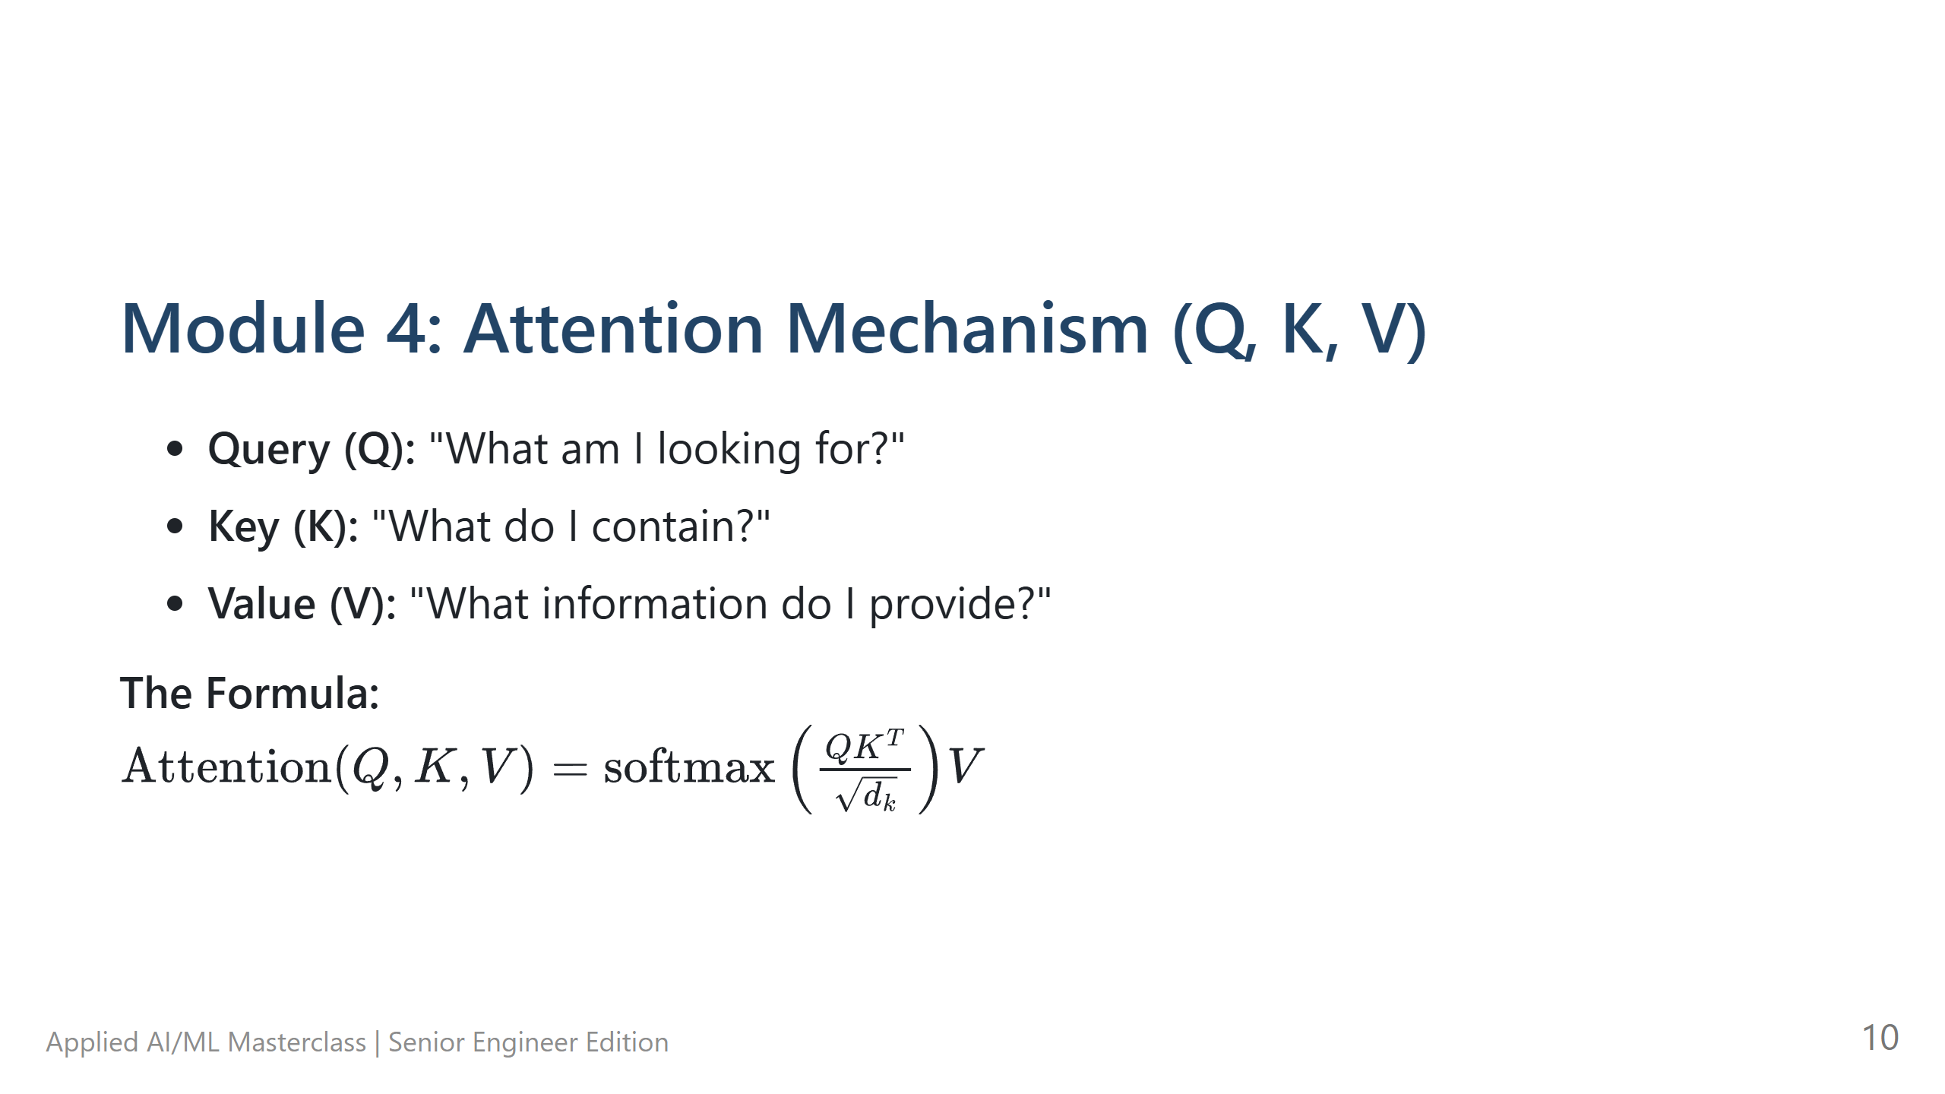
Notes:
Module 4: Attention Mechanism (Q, K, V) - **The Hook:** "Q, K, and V are the 'Secret Sauce'. Think of it as a retrieval system." - **Technical Deep Dive:** - **Query (Q):** What I'm asking. - **Key (K):** What the database has indexed. - **Value (V):** The information I get back. - We multiply $Q$ and $K$ to get a 'score' (how much to pay attention), then multiply by $V$ to get the weighted result. - **Pro-tips:** Use the 'Library' analogy. Q is your search term, K is the book spine/index, V is the content of the book. - **Lab Transition:** N/A

Slide 11
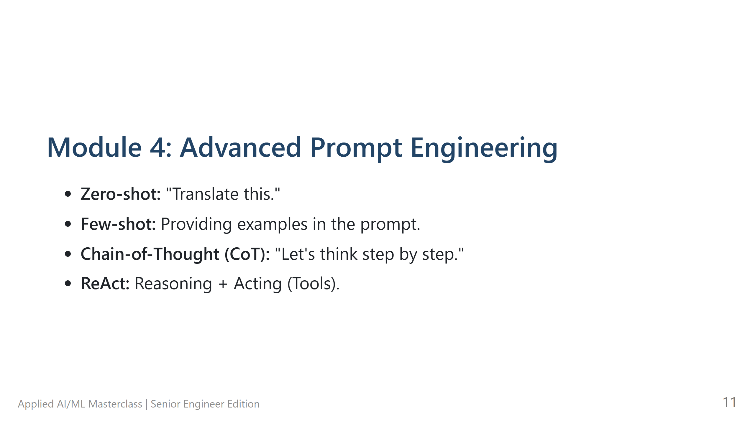
Notes:
Module 4: Advanced Prompt Engineering - **The Hook:** "Prompting isn't just 'asking nicely'. It's programming in natural language." - **Technical Deep Dive:** - **Few-shot:** Showing is better than telling. - **Chain-of-Thought:** Asking the model to think step-by-step reduces errors in logic. - **ReAct:** The foundation for agents—the model thinks, then acts (calls a tool). - **Pro-tips:** "System Prompts" are the most powerful way to set boundaries. - **Lab Transition:** Transition to **Lab 03: Prompt Engineering Lab**.

Slide 12
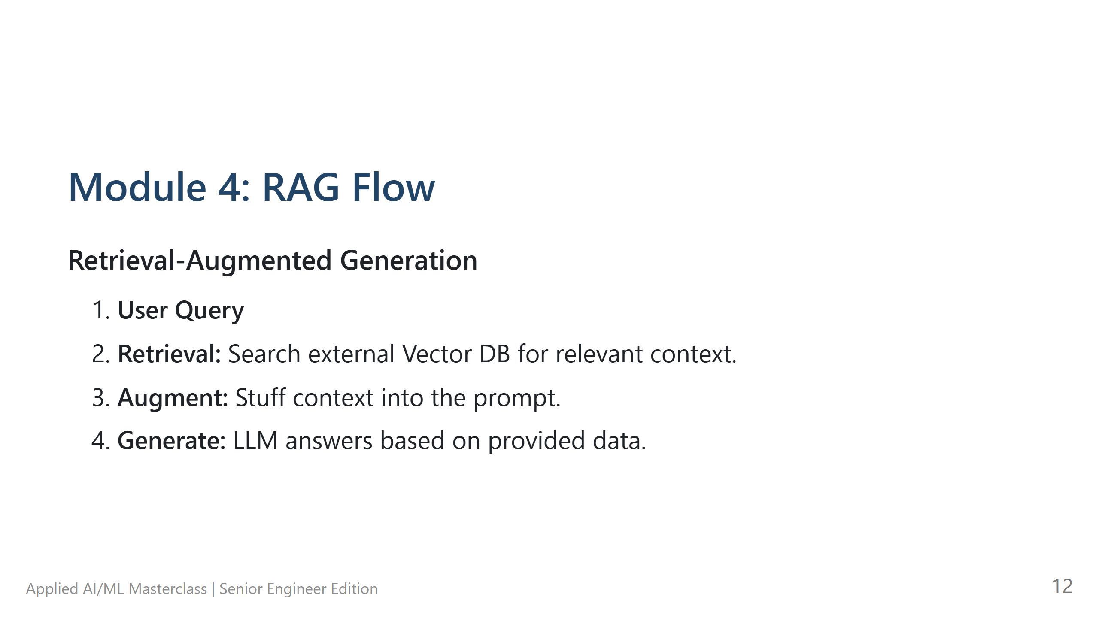
Notes:
Module 4: RAG Flow - **The Hook:** "LLMs are like smart students who graduated in 2023. They don't know your private company data. RAG is giving them an 'Open Book' to look at." - **Technical Deep Dive:** Walk through the 4 steps: Query -> Retrieval -> Augment -> Generate. - **Pro-tips:** RAG is the most important pattern in AI today because it solves the 'Hallucination' problem by providing grounded facts. - **Lab Transition:** N/A

Slide 13
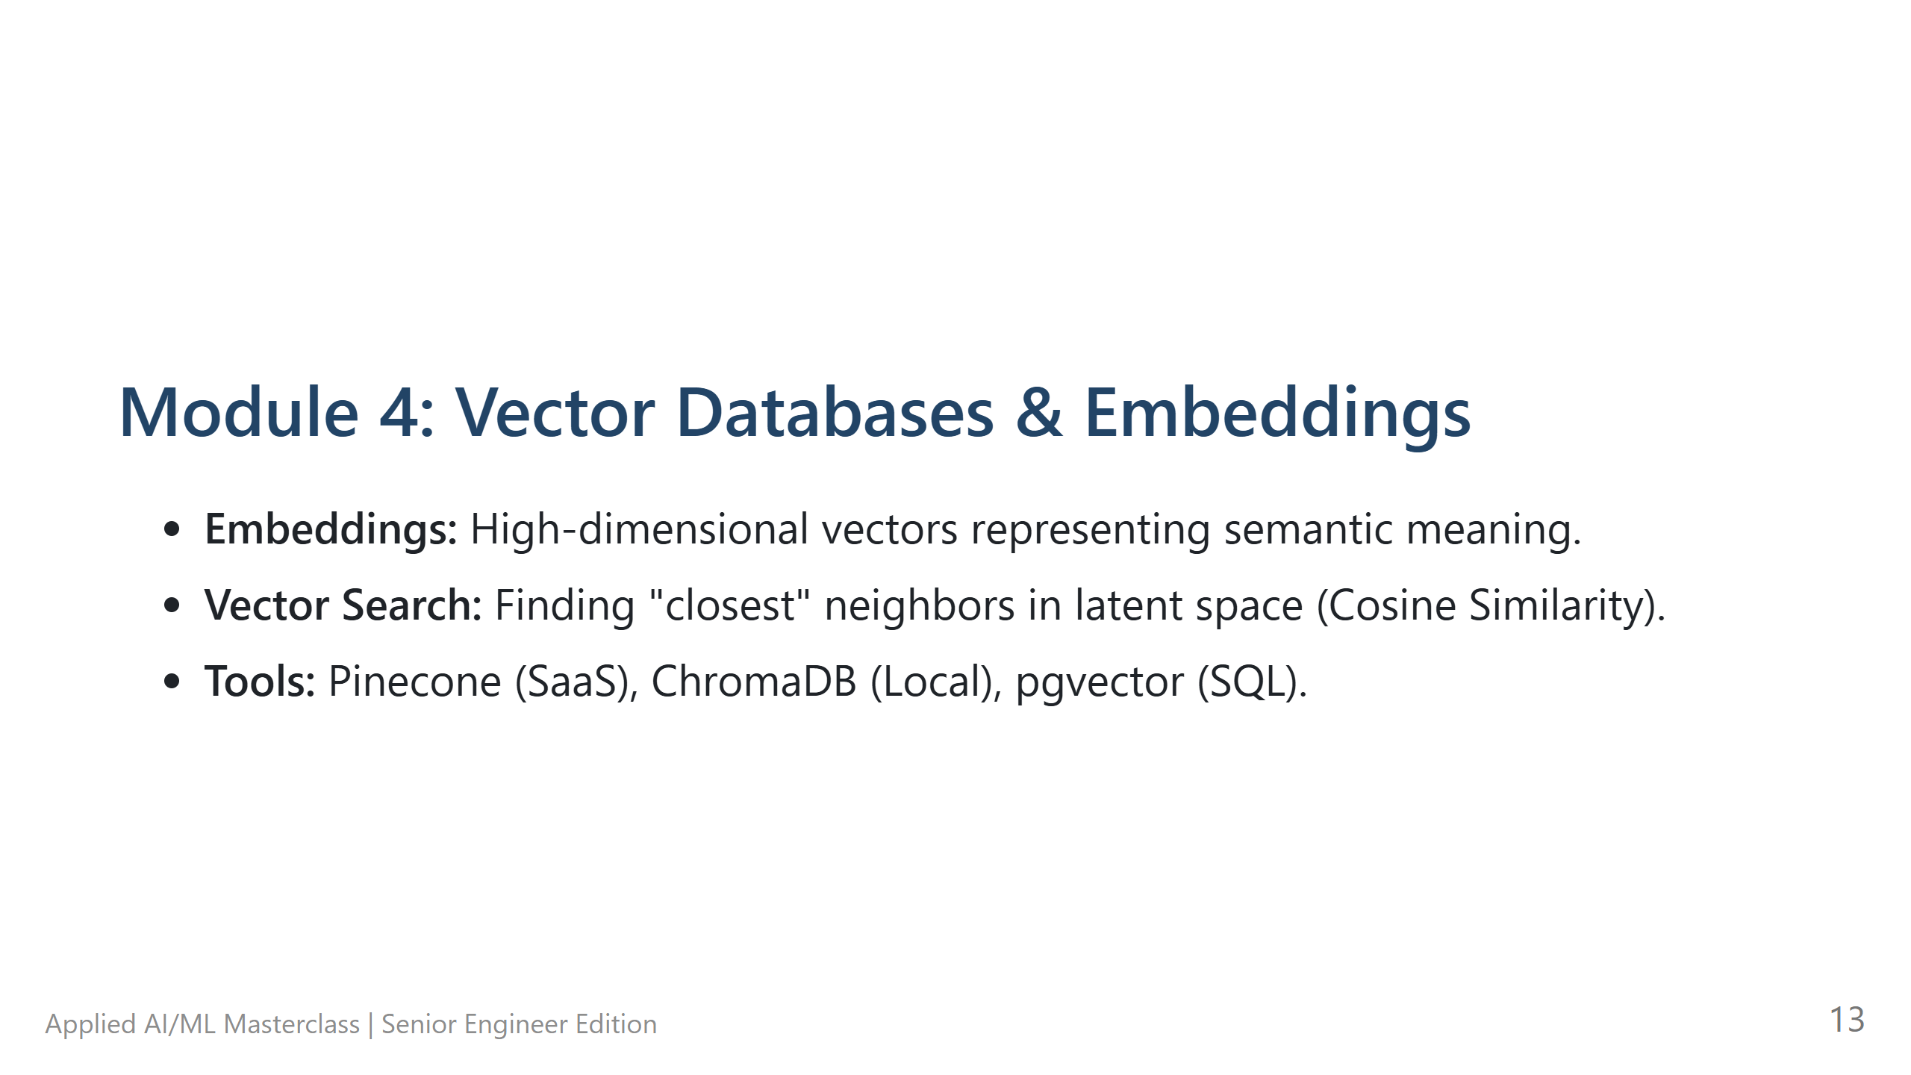
Notes:
Module 4: Vector Databases & Embeddings - **The Hook:** "How do we search by 'meaning' instead of 'keywords'? We use Embeddings." - **Technical Deep Dive:** - **Embeddings:** Numbers that represent a point in space. - Words with similar meanings are 'closer' in that space. - **Vector Search:** Calculating the distance (Cosine Similarity) between two vectors. - **Pro-tips:** Keyword search finds 'Apple' (the fruit). Vector search finds 'Apple' and 'iPhone' (the brand) because they are semantically related. - **Lab Transition:** N/A

Slide 14
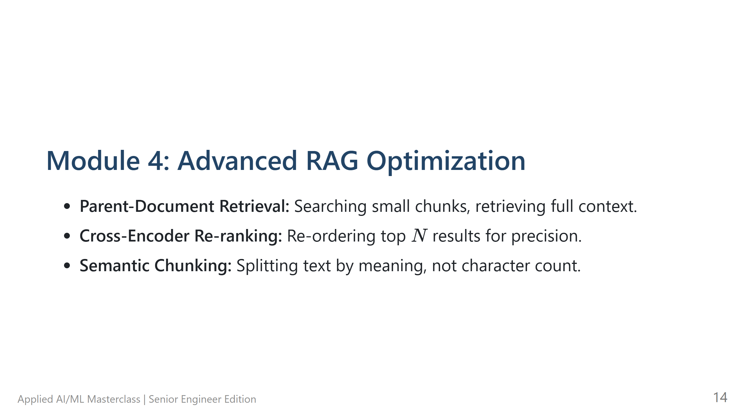
Notes:
Module 4: Advanced RAG Optimization - **The Hook:** "Basic RAG is easy. Production RAG is hard. Here is how you make it reliable." - **Technical Deep Dive:** - **Parent-Document Retrieval:** Use small chunks for searching (more precise) but give the LLM the full context (more accurate). - **Re-ranking:** Use a slow, smart model to check the top 10 results from a fast, dumb search. - **Pro-tips:** Most RAG failures are 'Retrieval failures'. If the context is bad, the answer will be bad. - **Lab Transition:** N/A

Slide 15
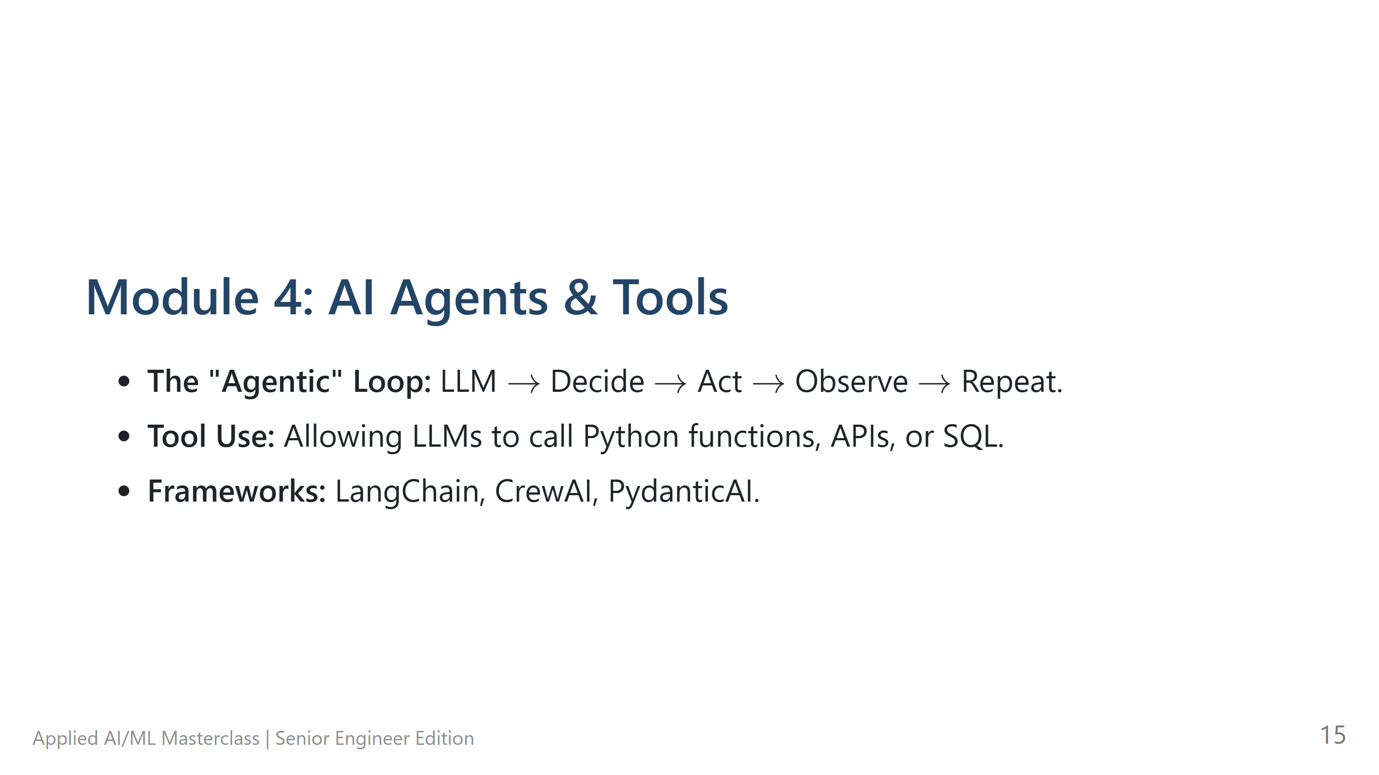
Notes:
Module 4: AI Agents & Tools - **The Hook:** "Agents are LLMs with 'hands'. They can actually DO things." - **Technical Deep Dive:** - The **Agentic Loop**: LLM generates a JSON command -> your code executes it (SQL, API, Python) -> result is fed back to the LLM. - **Pro-tips:** Be careful with autonomous loops! They can run forever and burn your API budget. - **Lab Transition:** Transition to **Lab 04: Building a ReAct Agent**.

Slide 16
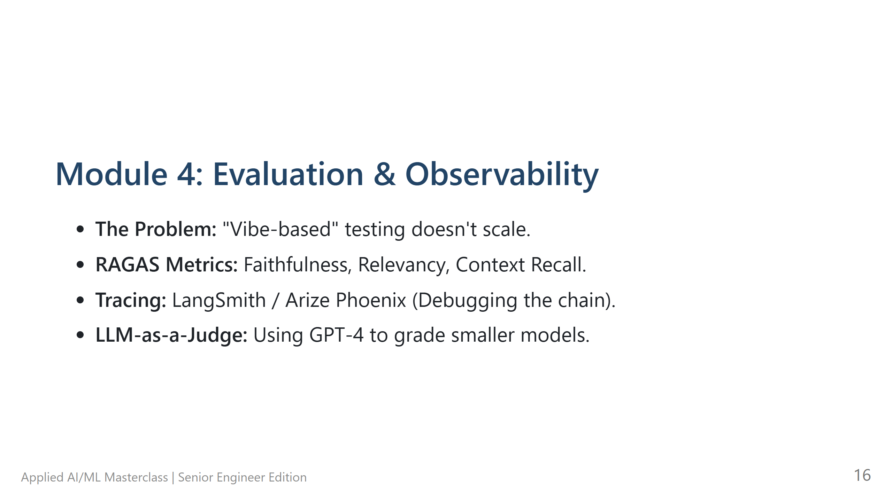
Notes:
Module 4: Evaluation & Observability - **The Hook:** "You can't manage what you can't measure. 'Vibe-checking' a few outputs is NOT engineering." - **Technical Deep Dive:** - **RAGAS:** Automated scoring for Faithfulness (is it true to the context?) and Relevancy. - **LLM-as-a-Judge:** Using GPT-4 to review the work of a cheaper model (Llama-3). - **Pro-tips:** Set up tracing (LangSmith) early. It's the 'Debugger' for your AI chains. - **Lab Transition:** N/A

Slide 17
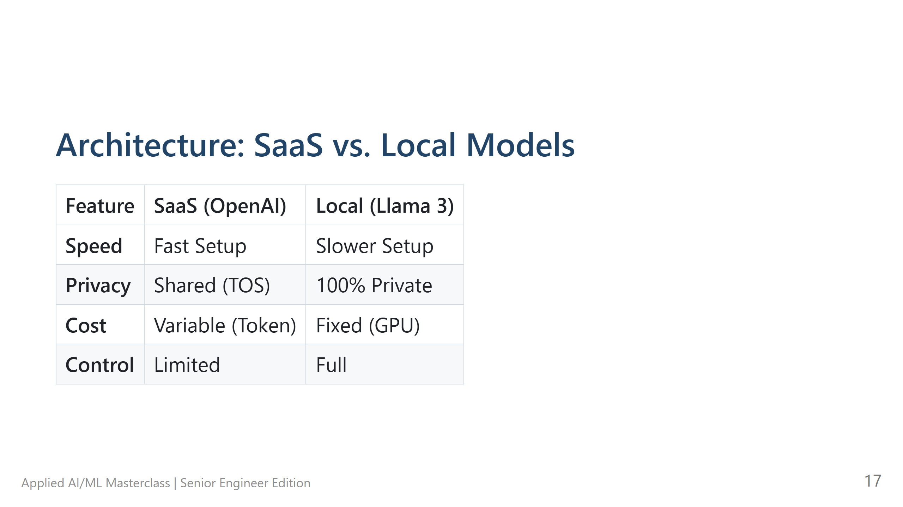
Notes:
Architecture: SaaS vs. Local Models - **The Hook:** "Do you use OpenAI or run your own? It depends on your constraints." - **Technical Deep Dive:** - **SaaS:** Best for speed and 'intelligence' ceiling (GPT-4). - **Local:** Best for privacy (HIPAA/GDPR) and fixed costs. - **Pro-tips:** Start with SaaS to prove the value, then optimize for cost/privacy later by moving to Local models. - **Lab Transition:** N/A

Slide 18
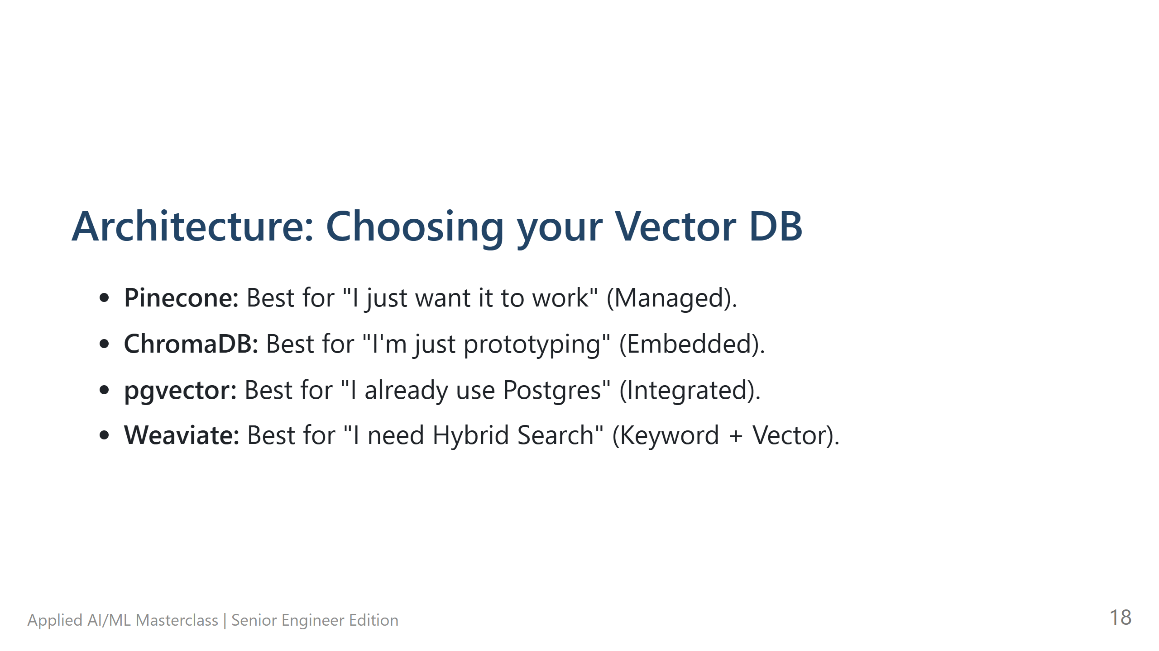
Notes:
Architecture: Choosing your Vector DB - **The Hook:** "Where do you store these millions of vectors?" - **Technical Deep Dive:** - Pinecone for low ops. - pgvector if you already have Postgres (don't add infra if you don't have to!). - **Pro-tips:** Most people over-complicate this. Start with ChromaDB (embedded) or pgvector. - **Lab Transition:** N/A

Slide 19
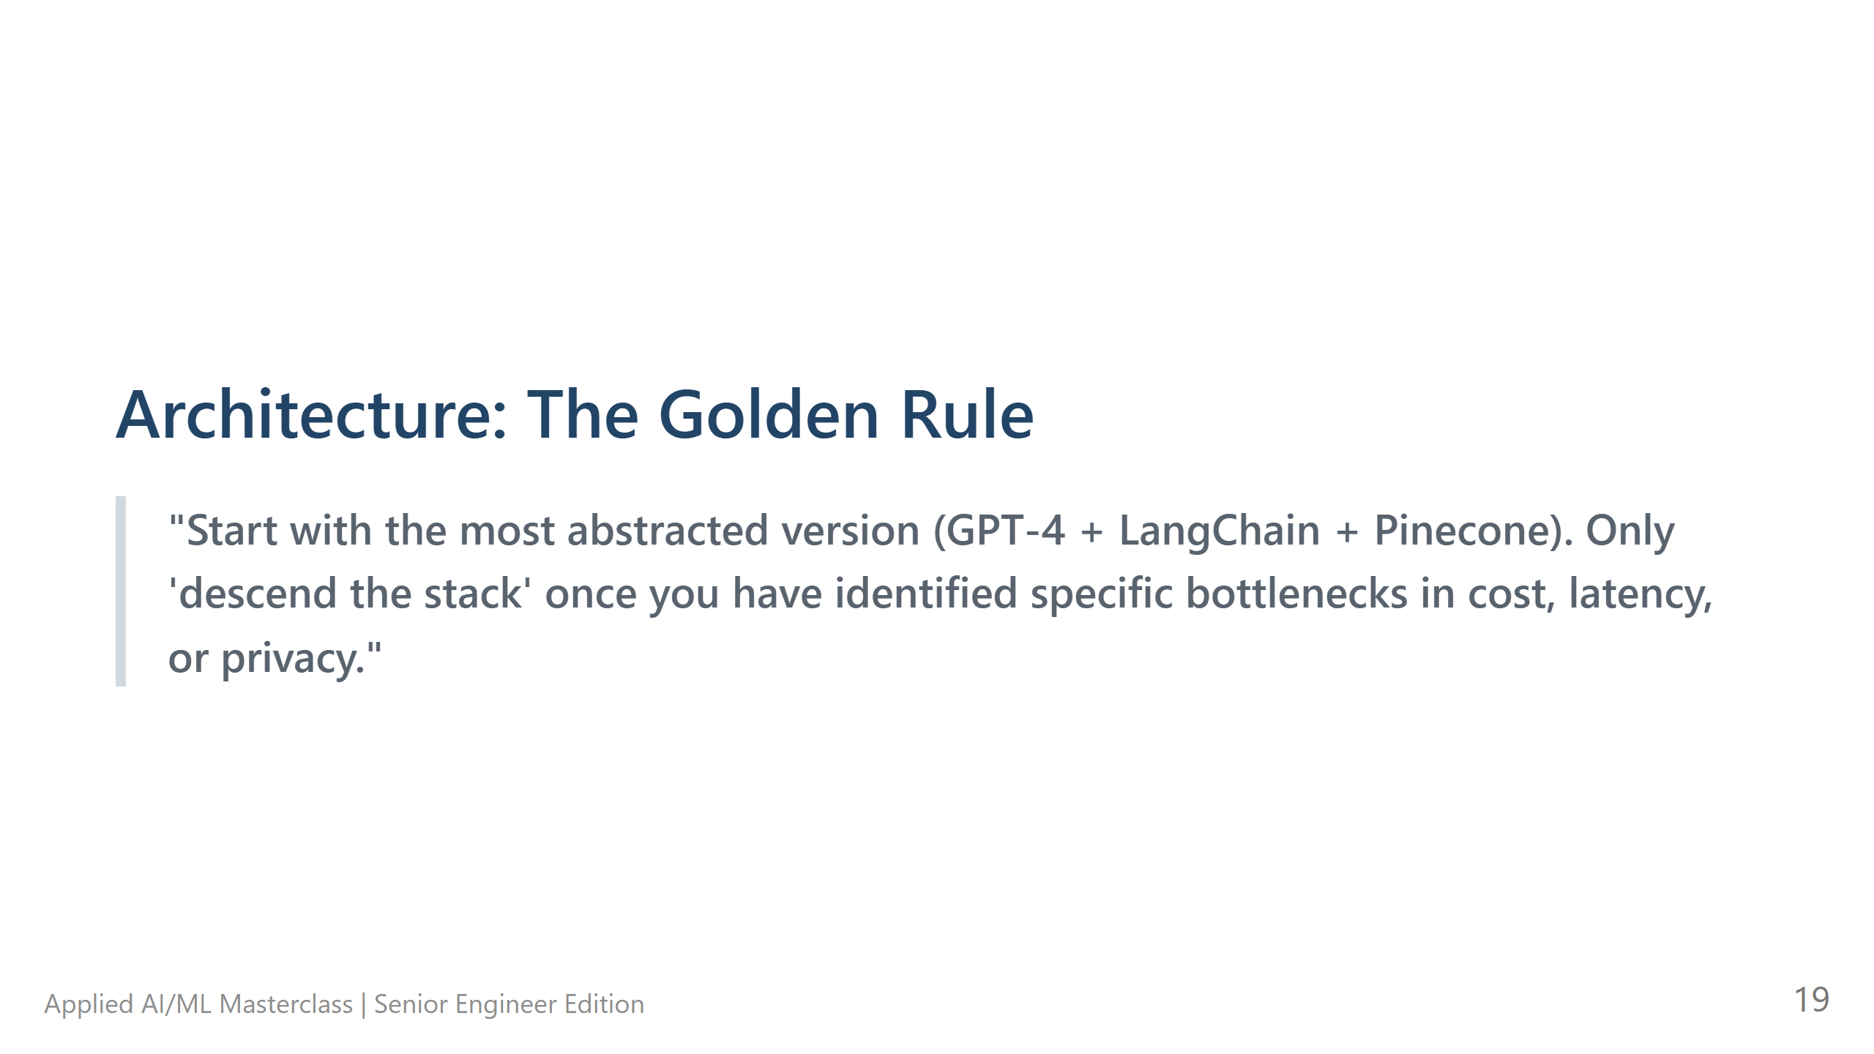
Notes:
Architecture: The Golden Rule - **The Hook:** "If you remember one thing today, remember this rule." - **Technical Deep Dive:** "Start high-level (abstracted). Only descend the stack when you hit a specific bottleneck (Cost, Latency, Privacy)." - **Pro-tips:** Don't build your own vector search engine or train your own base model. It's almost never worth it. - **Lab Transition:** N/A

Slide 20
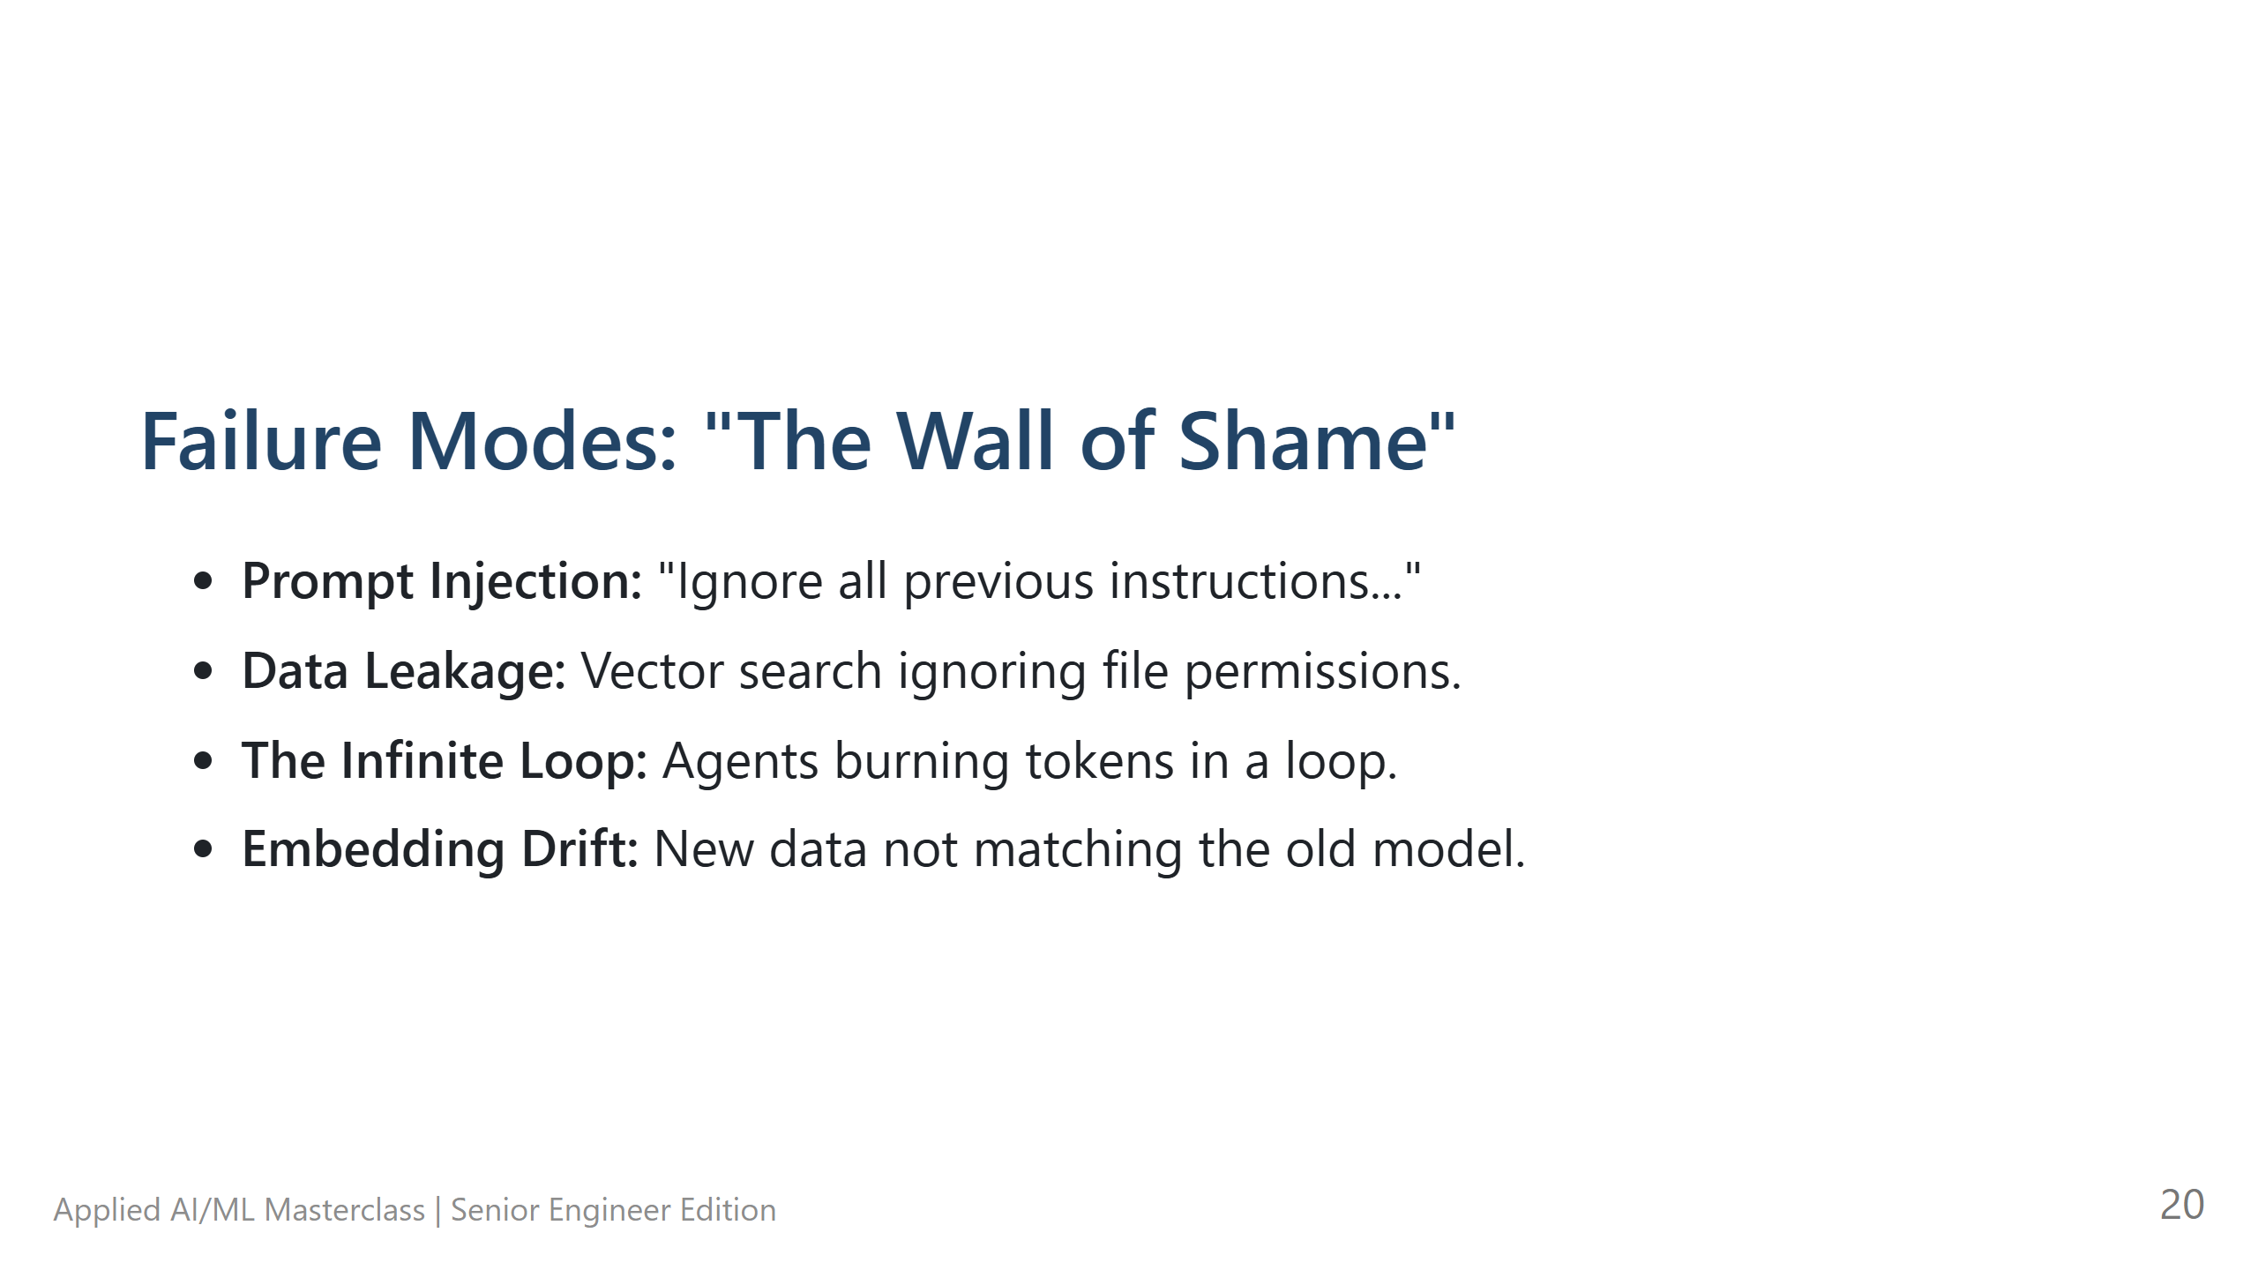
Notes:
Failure Modes: "The Wall of Shame" - **The Hook:** "Let's look at how things break in the real world." - **Technical Deep Dive:** - **Prompt Injection:** Treat LLM input like untrusted SQL input. - **Data Leakage:** If your Vector DB doesn't know who is asking, it will show anyone's data to everyone. - **Pro-tips:** Metadata filtering is the solution to 90% of RAG security issues. - **Lab Transition:** N/A

Slide 21
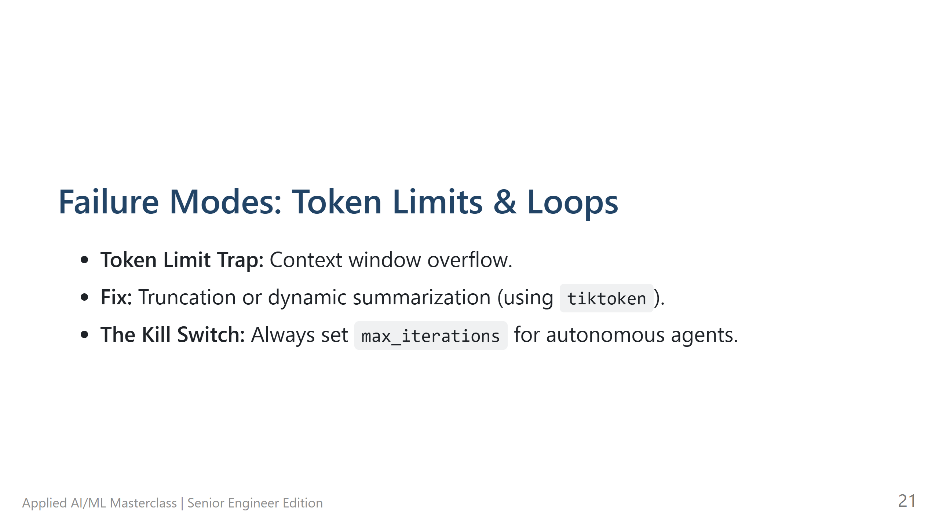
Notes:
Failure Modes: Token Limits & Loops - **The Hook:** "Technical limits will crash your app if you aren't careful." - **Technical Deep Dive:** - **Token Limits:** Use `tiktoken` to count tokens BEFORE you call the API. Truncate if needed. - **The Kill Switch:** Every agent loop must have a `max_iterations=5` safety valve. - **Pro-tips:** Document `08` in your resources has a full list of these 'Gotchas'. - **Lab Transition:** N/A

Slide 22
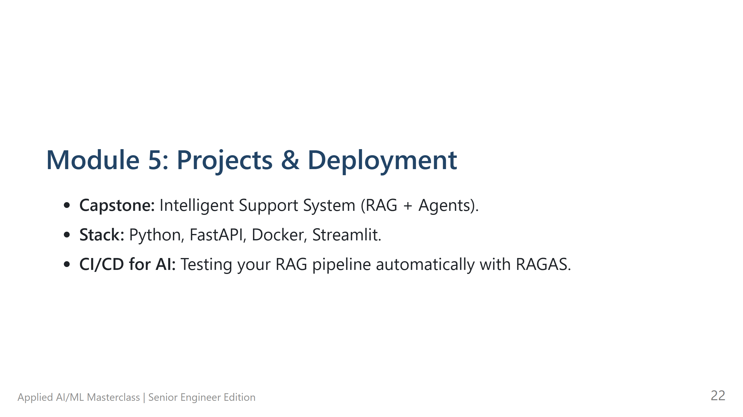
Notes:
Module 5: Projects & Deployment - **The Hook:** "Now, let's put it all together. From a notebook to a production container." - **Technical Deep Dive:** - Use **FastAPI** for low-latency endpoints. - **Docker** ensures your specific versions of PyTorch/LangChain work everywhere. - **Pro-tips:** AI models are heavy. Use multi-stage builds in Docker to keep images small. - **Lab Transition:** Transition to **Final Capstone Project**.

Slide 23
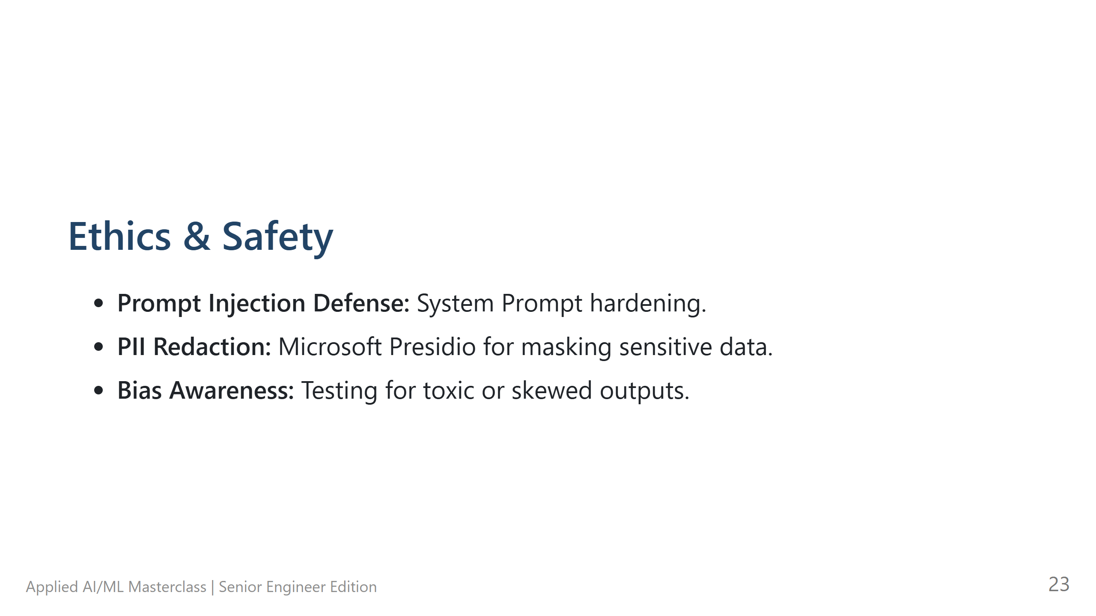
Notes:
Ethics & Safety - **The Hook:** "With great power... well, you know. But seriously, ethics in AI is a technical requirement, not just a policy." - **Technical Deep Dive:** - **PII Redaction:** Use tools like Microsoft Presidio to scrub emails/SSNs before they even hit the LLM. - **Guardrails:** Add a 'Safety Layer' that checks the LLM's output for toxicity. - **Pro-tips:** If you are in a regulated industry, PII redaction is non-negotiable. - **Lab Transition:** N/A

Slide 24
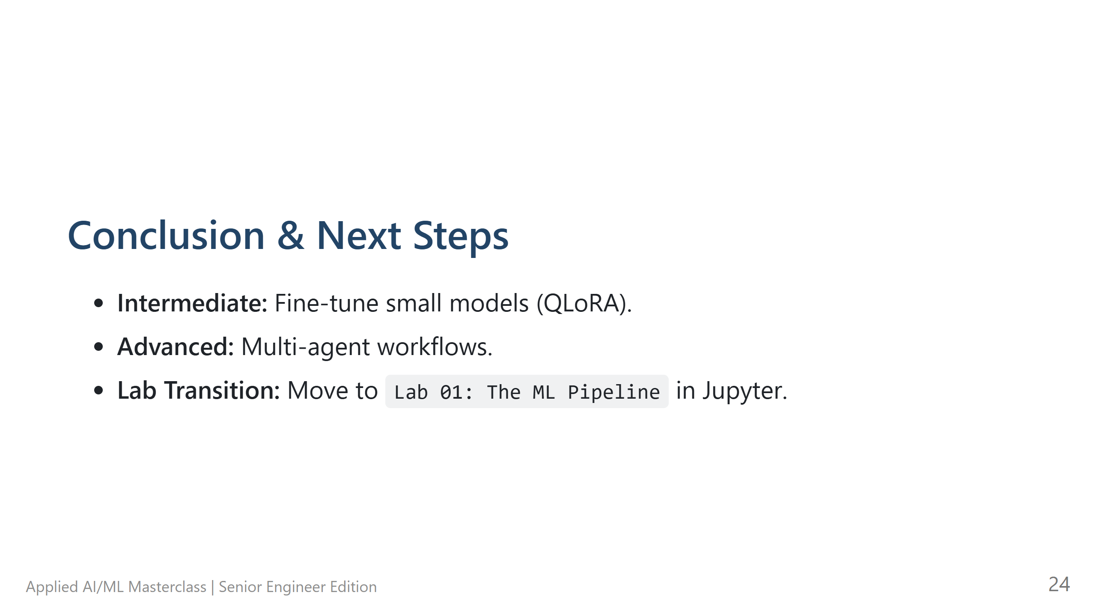
Notes:
Conclusion & Next Steps - **The Hook:** "You're now equipped to move from an AI hobbyist to a professional AI engineer." - **Technical Deep Dive:** Mention QLoRA for fine-tuning as the 'next level' for those who want more. - **Pro-tips:** Stay curious. This field moves fast. Follow the resources in document `09`. - **Lab Transition:** "Open your laptops. Let's start Lab 01."

Slide 25
