Slide 1
How to warm up VM
Mateusz Wielgosz

Slide 2

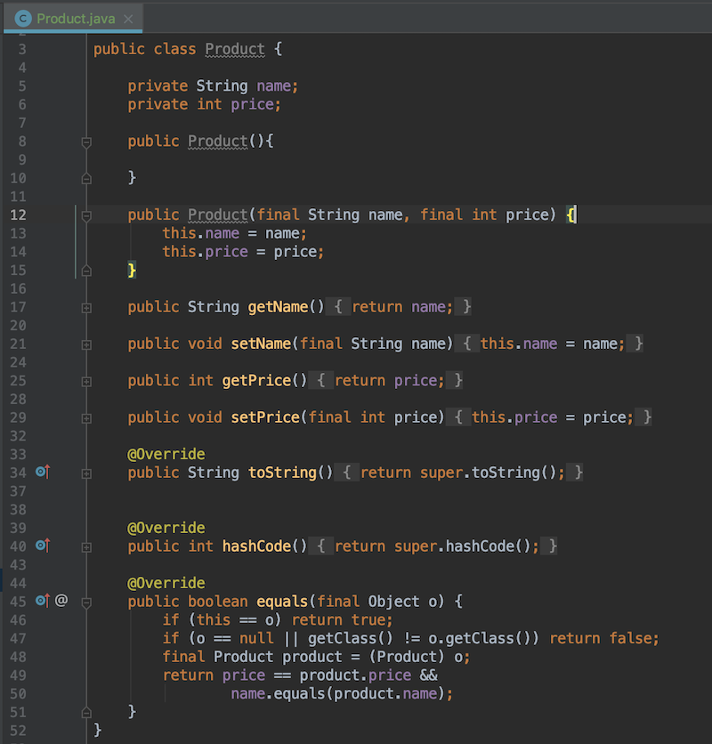

Java Virtual Machine
VM? JVM? -> Java Virtual Machine
It’s just normal C++ program!
Java - Write Once, Run Anywhere
Compile
Source code
Magic

Slide 3
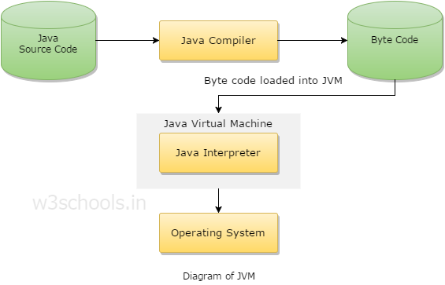
JVM - How it actually works
Source: https://www.w3schools.in/java-tutorial/java-virtual-machine/

Slide 4

Java Performance
„Warm up”
Just in Time Optimalization
Garbage Collector

Slide 5
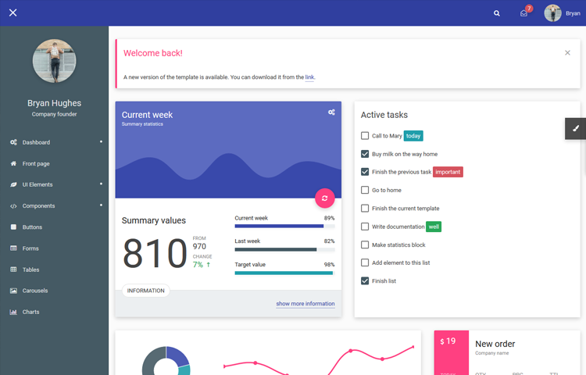
What cause the performance problem?
Query on Database takes too long
List with DTOs overflows JVM and Garbage Collector gets crazy
Elements in dropdown list on JSF View are being rendered forever
Bean
DB
JPA
JSF
~100 000
complex entries
List of ~100 000 DTOs
Dropdown with
~100 000 elements

Slide 6
Handsome tools and links
VisualVM
> https://visualvm.github.io/
VisualVM Launcher for IntelliJ
> https://plugins.jetbrains.com/plugin/7115-visualvm-launcher
JMH (Java Microbenchmark Harness)
> https://openjdk.java.net/projects/code-tools/jmh/
Sample code
> https://github.com/mtmwielgosz/JavaPerformance

Slide 7
Sources
Co każdy programista Java powinien wiedzieć o JVM
> https://bottega.com.pl/pdf/materialy/jvm/jvm1.pdf
Optimizing Java (Book)
> http://shop.oreilly.com/product/0636920121718.do
Icons
> https://www.shutterstock.com/

