Slide 1



Doodle Alive
Draw it. Snap it. Watch it move.
An AI workshop project: turning paper drawings into animations with free, open AI models
Notes:
Doodle Alive: someone draws on paper, takes a photo with their phone, and a few seconds later the drawing moves. Everything runs on free or open models.

Slide 2
The idea
Anyone draws on paper, takes a photo with their phone, and gets the drawing back as an animation. No app install and no typing needed.
Draw
Snap
Watch it move
Pen and paper. Kids, adults, anyone.
Phone browser opens the camera directly.
AI returns a GIF or short video to save and share.

Slide 3



What the user sees
1
2
3
4
Open the link
Take a photo
Pick a mode
Watch & save
Scan a QR code or open the laptop URL. It's a web page, so there's nothing to install.
The page opens the phone's rear camera. Snap the drawing.
"Let AI decide", "A person / figure" or "Anything else". Optionally type how it should move.
Progress steps show while it works, then the GIF or MP4 plays. Tap Save.
Notes:
The phone side is a plain web page. The file input with capture="environment" opens the camera directly, which also works over plain HTTP on the local Wi-Fi.

Slide 4




How it works
Phone
1 · Clean
2 · Understand
3 · Animate
Result
Uploads photo, polls status every 1.5 s
Fix rotation, resize, boost contrast
Claude: what is it, figure or scene, motion prompt
Route to the right model
GIF / MP4 back to phone
Runs in the background.
The API replies at once with a job id, and the phone shows each step as it happens.
Character mode
Scene mode
Safety net
Meta Animated Drawings rigs the figure and makes it dance
Wan 2.2 / LTX-Video turns image + prompt into video
Offline mock GIF if a model fails
Each step is its own Python module, so a model can be swapped without touching the UI.

Slide 5


Two AI paths, picked per drawing
CHARACTER MODE
SCENE MODE
Meta Animated Drawings
Wan 2.2 / LTX-Video
For human-like figures (head, body, arms, legs)
How detect, cut out, fit a skeleton, then play a motion (dance, wave, jump)
Output GIF that keeps the exact hand-drawn lines
Speed about 10–30 seconds
Licence MIT, open source
For anything else: rockets, cats, houses…
How image + text prompt into a video diffusion model
Output short MP4 with AI-generated motion
Speed 1–10 minutes, depending on GPU and queue
Licence Apache 2.0 (Wan) / open weights (LTX)
Notes:
Character mode is reliable and fast, so it is the safe live demo. Scene mode is the "wow" but depends on free GPU queues on Hugging Face Spaces or Colab.

Slide 6
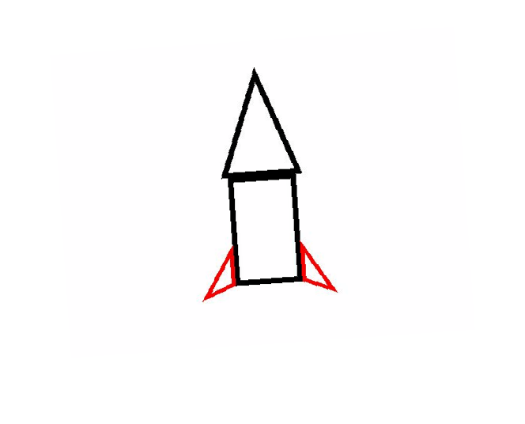
The smart step: Claude looks at the drawing
{
"subject": "a red-finned rocket",
"kind": "scene",
"motion_prompt":
"The rocket blasts off with
puffs of smoke, crayon
style, static camera."
}
Photo of the drawing
Example output (illustrative)
Picks the model
"kind" routes to character or scene mode
Writes the prompt
users never have to type
Never blocks
with no key, a default prompt is used
Notes:
Model: claude-opus-5 via the Anthropic Python SDK, with low effort for speed and server-side refusal fallback. Output is strict JSON with subject, kind and motion_prompt.

Slide 7


Technology applied
Frontend
Backend
Image processing
Plain HTML, CSS and JS with no build step. A camera file input, and polling for job status.
Python 3.14, FastAPI and Uvicorn. Background tasks and an in-memory job store.
Pillow: EXIF rotation, resize, auto-contrast. OpenCV paper detection is next.
Understanding
Animation models
Free GPU hosting
Claude (Anthropic SDK) reads the image and returns JSON: subject, kind, prompt.
Meta Animated Drawings, Wan 2.2, LTX-Video, plus an offline mock animator.
Hugging Face Spaces (ZeroGPU) through gradio_client, with Google Colab as plan B.

Slide 8



Built so the demo never breaks
3
1
6
0
pluggable animators
command to start
automated tests
apps to install
Pluggable providers
Auto fallback
Fixed API contract
A new model is one Python file plus one registry line. Chosen in .env.
If a real model fails, the mock animation is shown with a warning, never an error screen.
Frontend and backend teams work in parallel. Fields are only ever added, never changed.

Slide 9
API: two endpoints
Submit a drawing
Poll until done
POST /api/jobs (multipart)
image file, required
mode auto | character | scene
prompt text, optional
→ 202 Accepted + Job
GET /api/jobs/{id}
{ "status": "running",
"step": "Animating (hf_space)",
"subject": "a rocket",
"kind": "scene",
"animator": "hf_space",
"output_url": "/media/…/animation.mp4",
"warning": null, "error": null }
status goes queued → running → done / failed. Errors: 400 bad input · 413 file too large · 404 unknown job. GET /api/health shows the active configuration.

Slide 10


Where we are
M0
M1
M2
M3
M4
Skeleton
Real model
Smart prompt
Polish
Demo ready
Phone → photo → GIF works end-to-end on the mock animator
Wan 2.2 / LTX via Hugging Face; Meta Animated Drawings
Claude picks the mode and writes the motion prompt
Paper detection, motion picker, gallery wall, UI
Backup recordings, rehearse twice
Full task board: docs/PLAN.md · setup guides and blockers: docs/HANDOFF.md

Slide 11



Risks and how we handle them
Free GPU queue slow or out of quota
Office network blocks Hugging Face
Rotate tokens, switch Space, use Colab, and the mock fallback covers the rest
Use a phone hotspot or the workshop Wi-Fi, or run on another laptop
Animated Drawings needs Docker
Wi-Fi blocks phone → laptop
Scene mode for everything, plus recordings from Meta's web demo
Tunnel with ngrok or cloudflared and share an HTTPS QR code

Slide 12

Let's make it move
Live: a stick person
Live: anything else
The wall
A volunteer draws it and it dances
A rocket, cat or fish becomes a video
Planned: everyone's animations on the big screen
Try it: http://<laptop-ip>:8000

