Slide 1
FOCUS
Data Platform for Clinical Studies
Yavuz Kağan Akyol
Aslıhan Özçelik
Metin Demir

Slide 2
Overview
Problem Statement
Related Works
Technologies
About Project
Future Works

Slide 3
Problem Statement
In Hospital database system there are a lot of information recorded.
This information is kept in different databases.
We have decided to combine all data in a single database for ease of use.
There are different types of data and multiple entry forms are needed to enter information required for each of them.
As one can not predict all the fields of those forms at the beginning, we have developed an application that allow dynamic form creation as they needed in time.

Slide 4
Problem Statement
With this application, any user can create his own form according to his/her needs anytime.
Then we have merged existing data in a platform to use them as a machine learning model and to prevent information to be garbage.
This model provides a useful resource to clinicians as it can help them to better define dieases easily.

Slide 5

Related Works
Research Electronic Data Capture (REDCap) is a web-based application developed by Vanderbilt University to capture data for clinical research and create databases and projects.
REDCap is a secure web application for building and managing online surveys and databases.

Slide 6

Technologies
Python
Django: Django is a Python-based free and open-source web framework, which follows the model-template-view architectural pattern.
ReportLab: An Open Source Python library for generating PDFs and graphics.

Slide 7

Technologies
SQLite: SQLite is a relational database management system contained in a C library. In contrast to many other database management systems, SQLite is not a client–server database engine.

Slide 8

Technologies
Bootstrap: Bootstrap is a free and open-source CSS framework directed at responsive, mobile-first front-end web development. It contains CSS- and JavaScript-based design templates for typography, forms, buttons, navigation and other interface components.

Slide 9
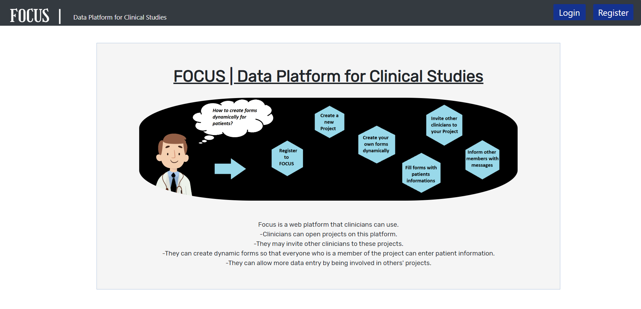
About Project
At the beginning an introductory page was designed to give some information about this web application.
There are buttons for login and register.

Slide 10
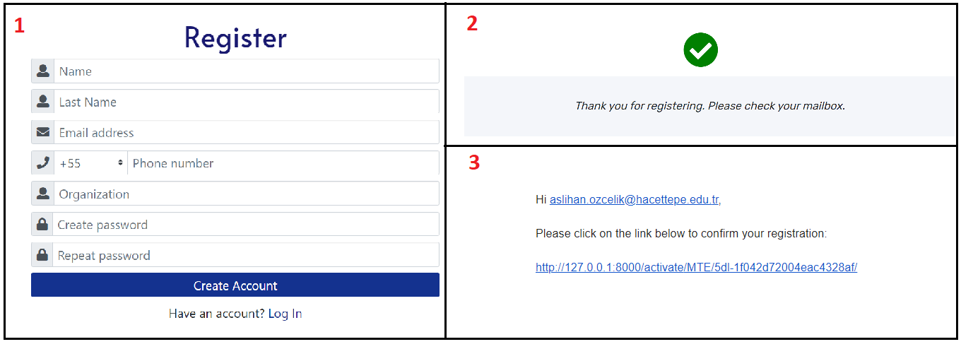
About Project
A user starts with filling the registration form with personal information including his email address. Then confirms his email address with the activation link sent by the system.After that waits for admin approval for login.

Slide 11
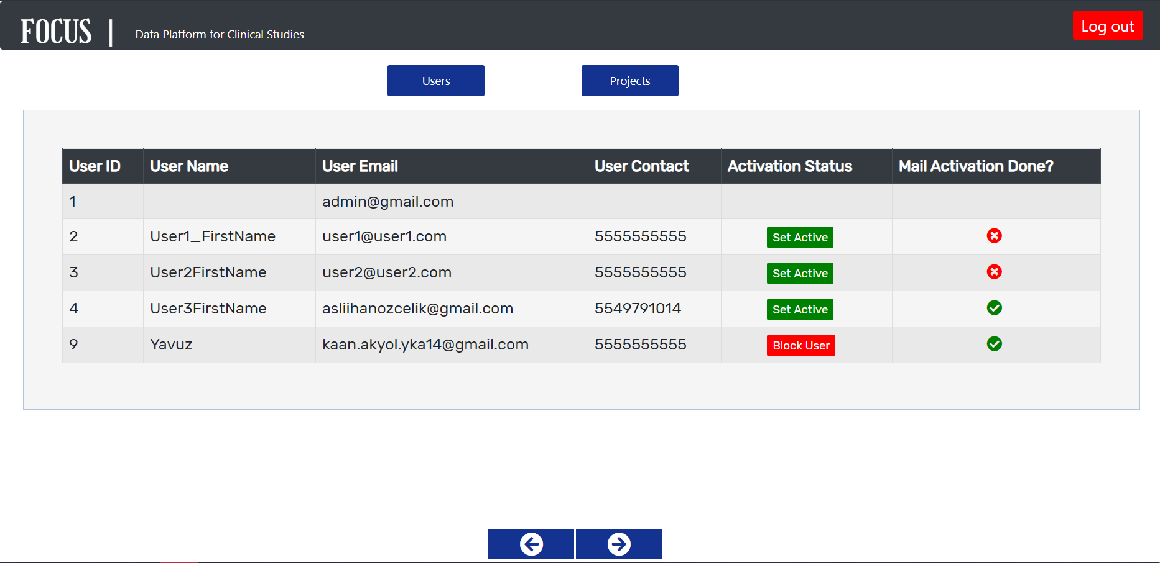
About Project
We have created an admin panel in the application.
In this panel, admin can activate or block a registered user's account.
Admin can also view all projects in the system and can block inappropriate users and/or projects.

Slide 12
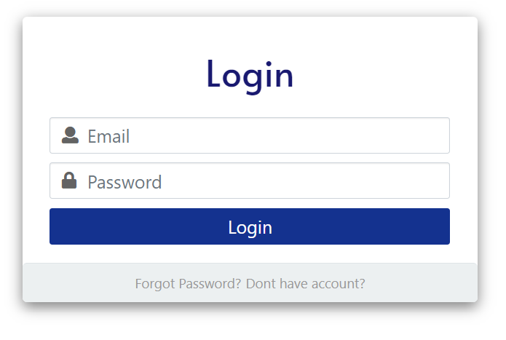
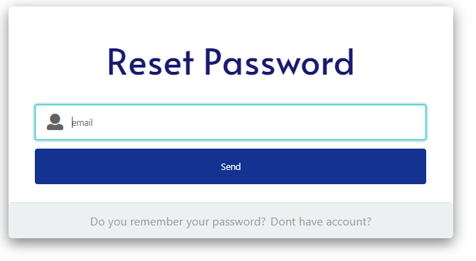
About Project
Users who have received the admin approval can login from this page.
A forgot password button is included also.

Slide 13
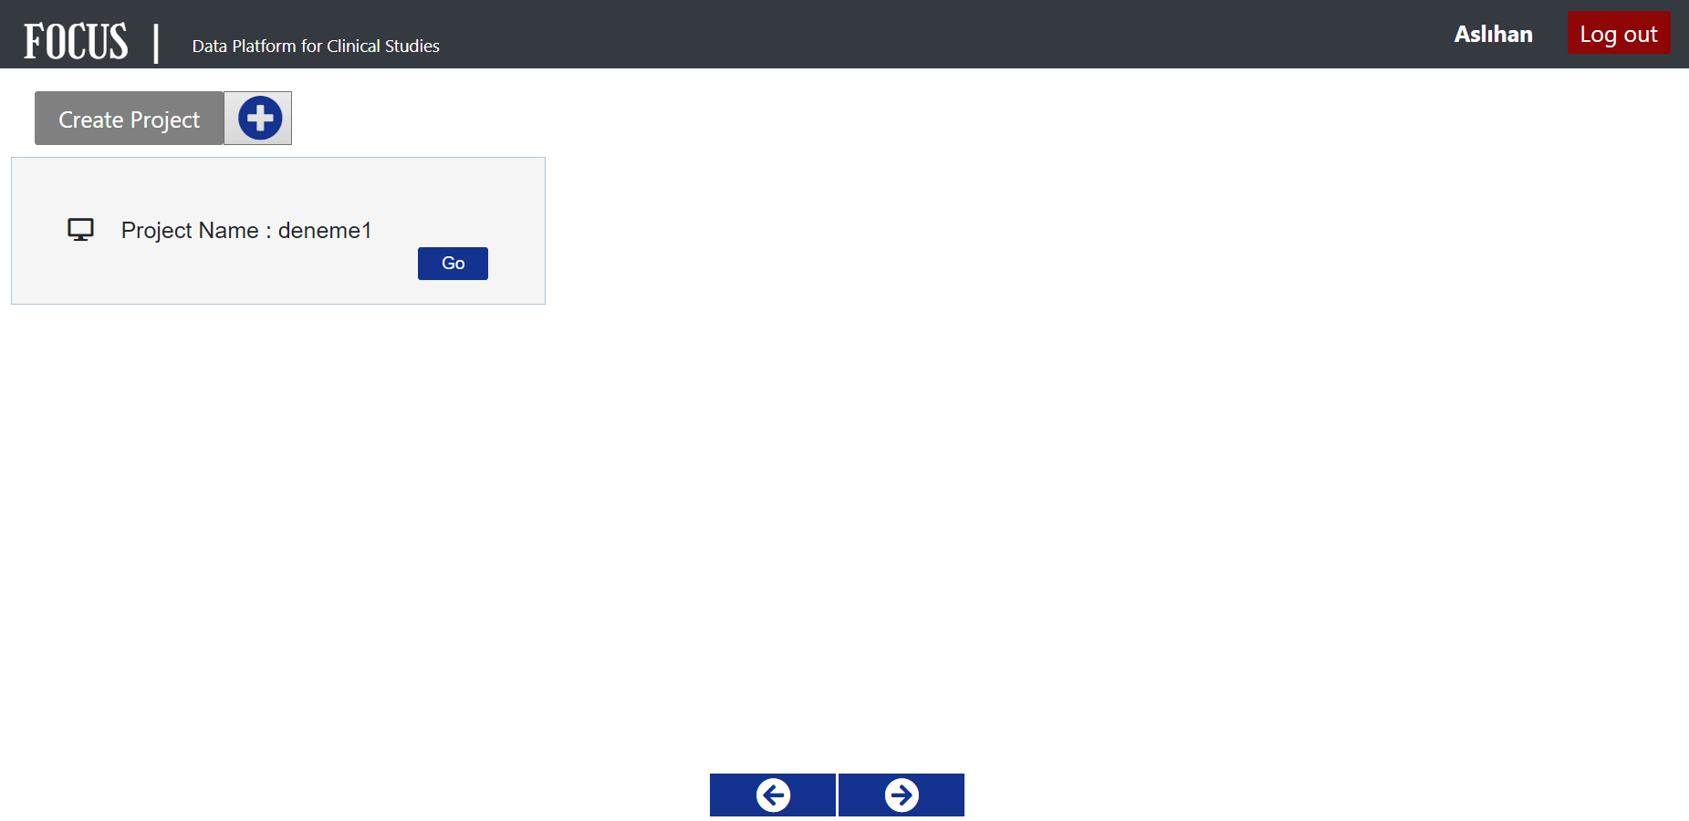
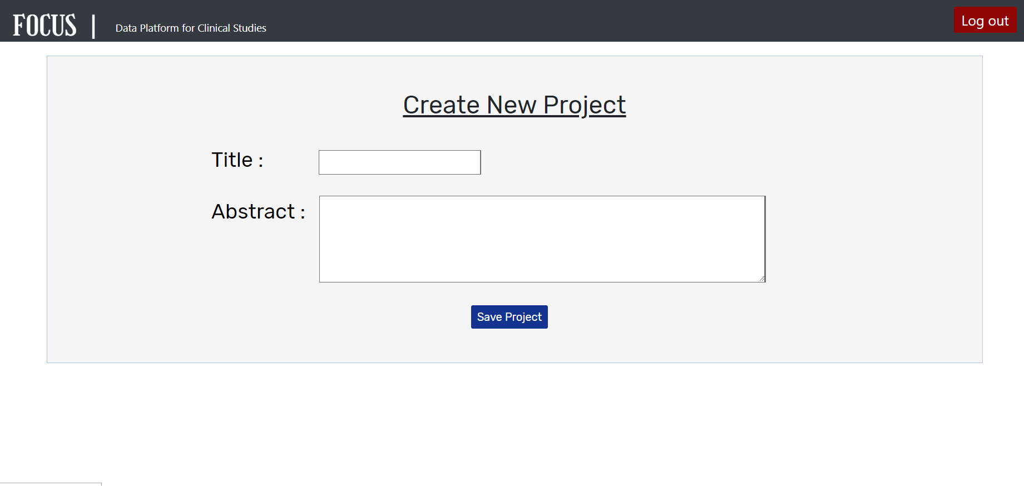
About Project
This page is the user's homepage.
A user can create a new project or switch to an existing project on this page.

Slide 14
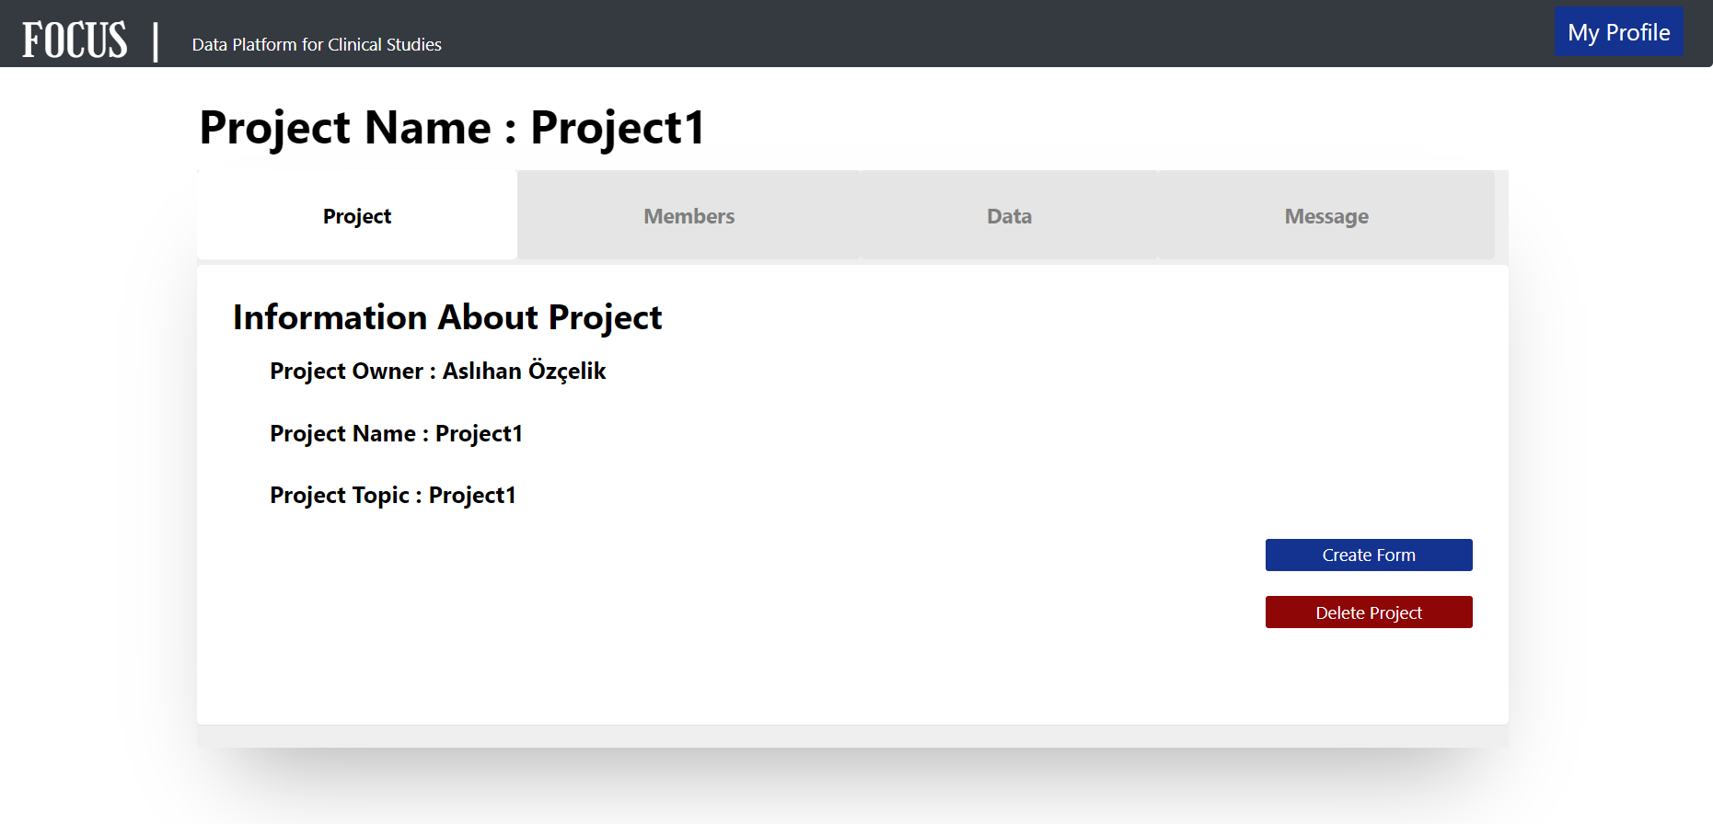
About Project
This tab contains general information about the project.
Users can also create form or delete project here. A form can be edited later if no data has been entered yet.

Slide 15
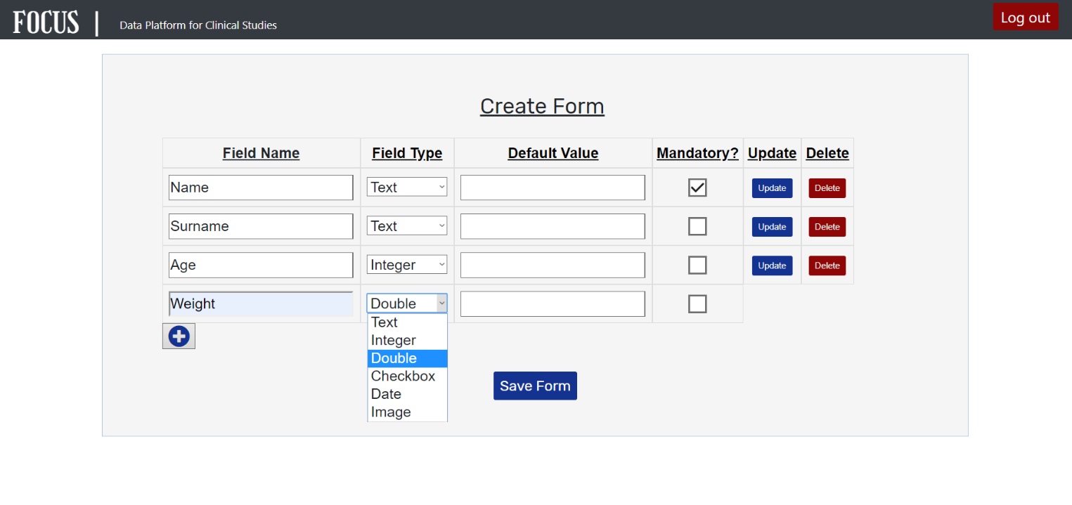
About Project
On this page, the project owner dynamically creates a form for other users to fill out.
Users can specify field names and types as desired.
Users can also update and delete fields, define default values for the fields or determine whether the field is mandatory or not.

Slide 16
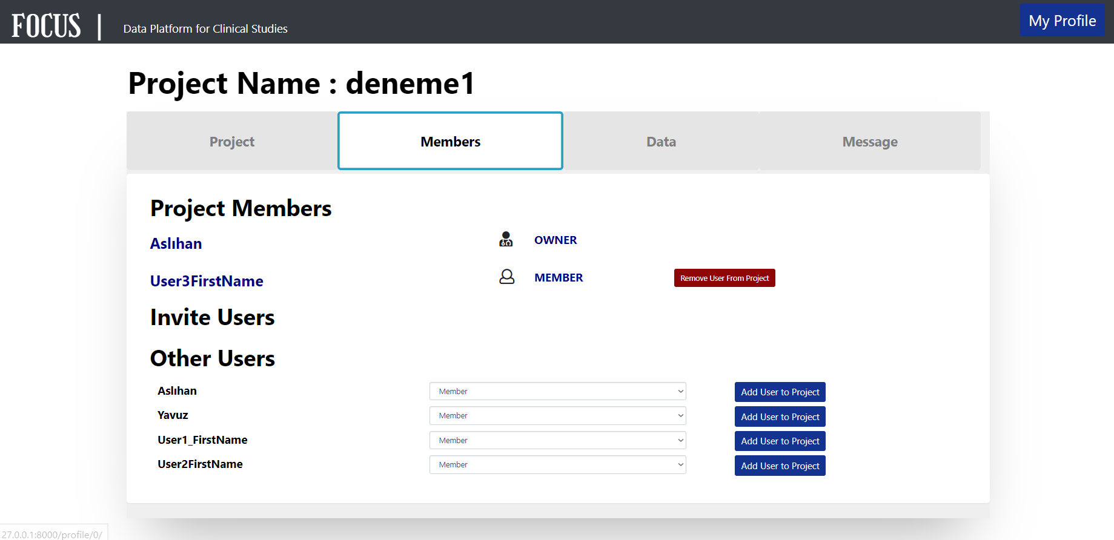
About Project
There is a list of members of the project in this tab.
Owner of the project can invite other registered users as "member" or as "manager" to his project.
He may also remove them as required.

Slide 17
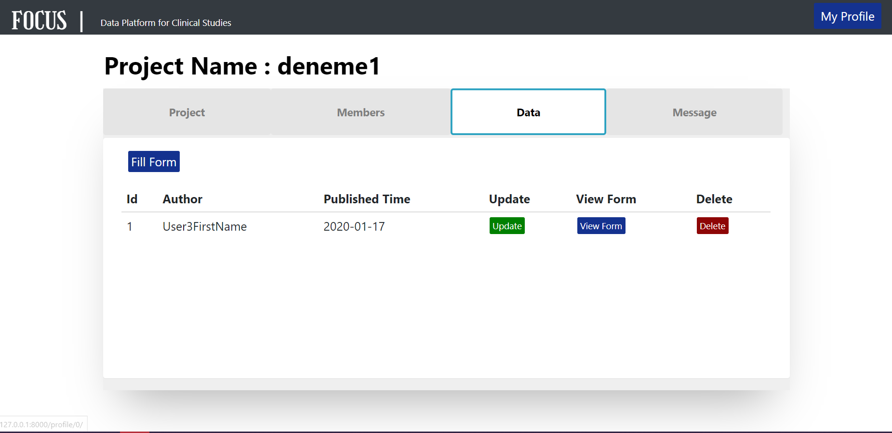
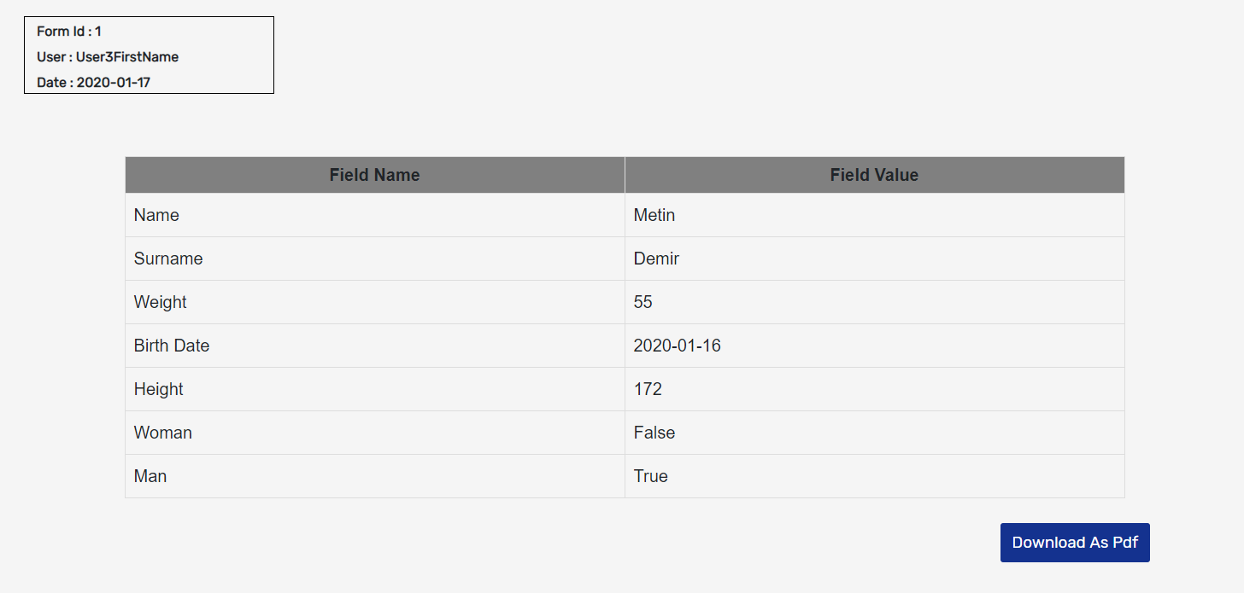
About Project
In this tab, users fill out predefined forms.
Users can view filled forms, edit or delete them.
Forms can be downloaded in pdf format as well.

Slide 18
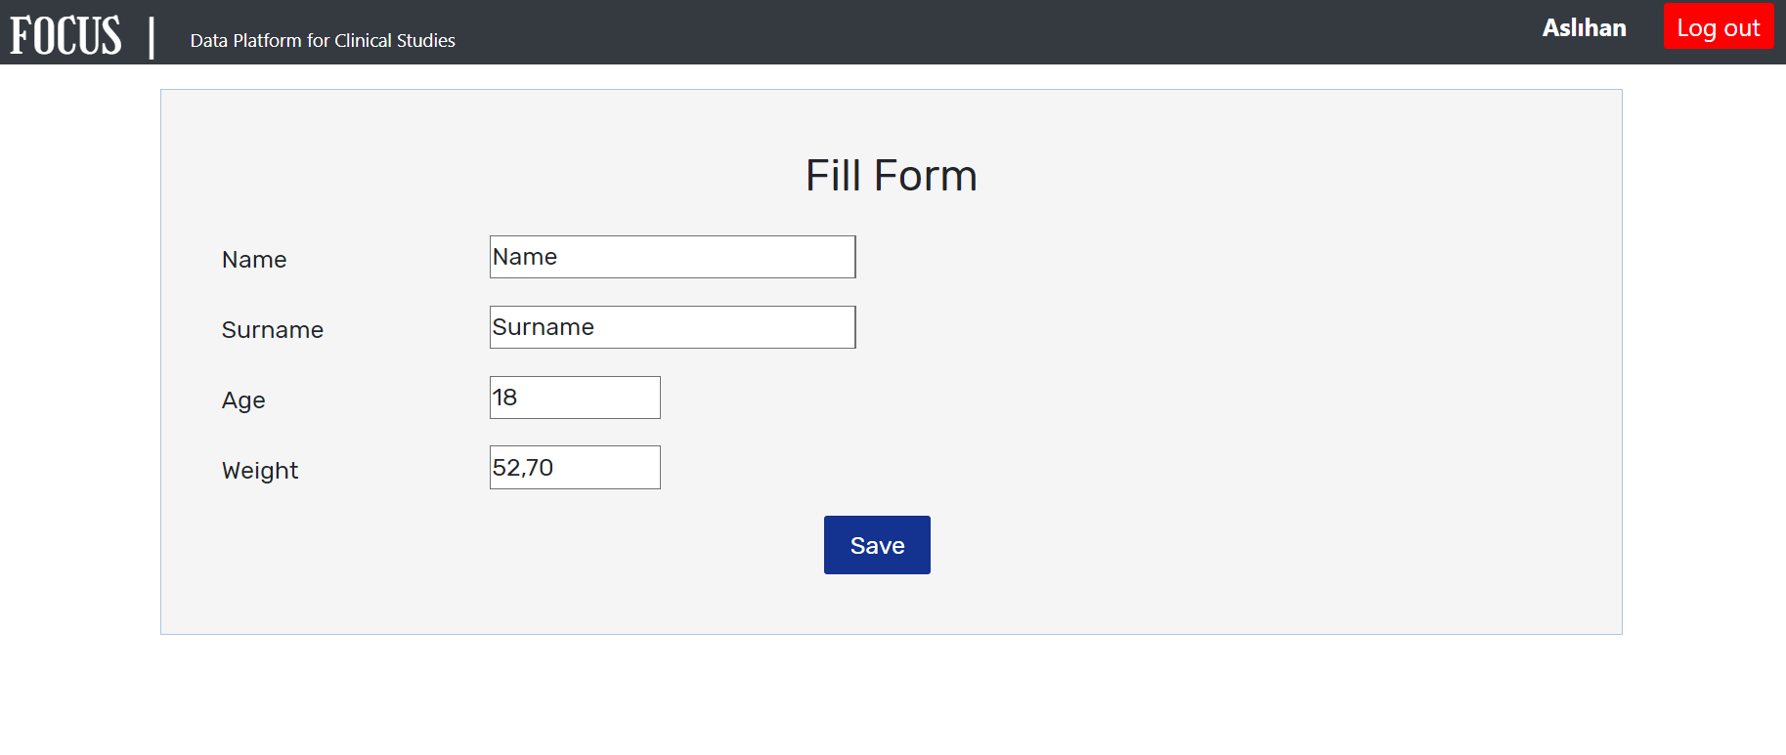
About Project
On this page, the user can fill in the form that was created previously.

Slide 19
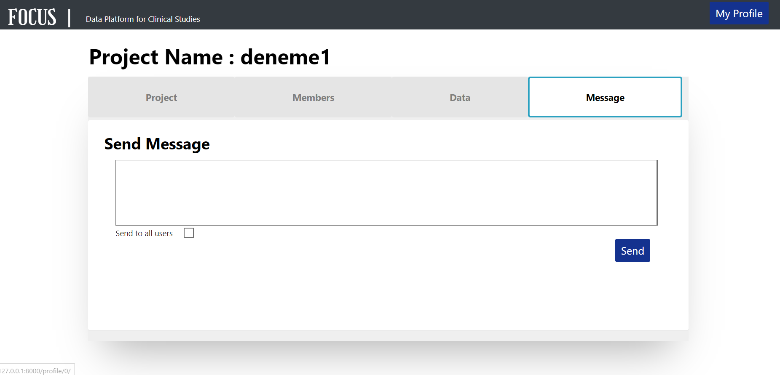
About Project
In this tab, users can send messages to other project members.
If "send to all users" option is selected the message is sent to all members of the project or only to the manager and owner when not selected.

Slide 20
Future Works
The data we’ll get from databases will be training data for our machine learning models.
We’ll train models with this training data.
When the training is done, all data about the patient are going to be test inputs for our machine learning models.

Slide 21
Future Works
With this proposed model, we want to help to doctors to decide which disease may patient has.
Therefore, we’ll make process run faster than it was and we aim to provide great convenience to medical staff.

Slide 22
Future Works
Second convenience we want to do is converting our databases to graphical information to make some analysis.
We’ll send our graphical information to health institutions like WHO, LOSEV etc. to analyze and produce new solutions on health area.

Slide 23
THANK YOU FOR LISTENING…

