Slide 1
MARBLE GAME
Metin DEMİR
21526902

Slide 2
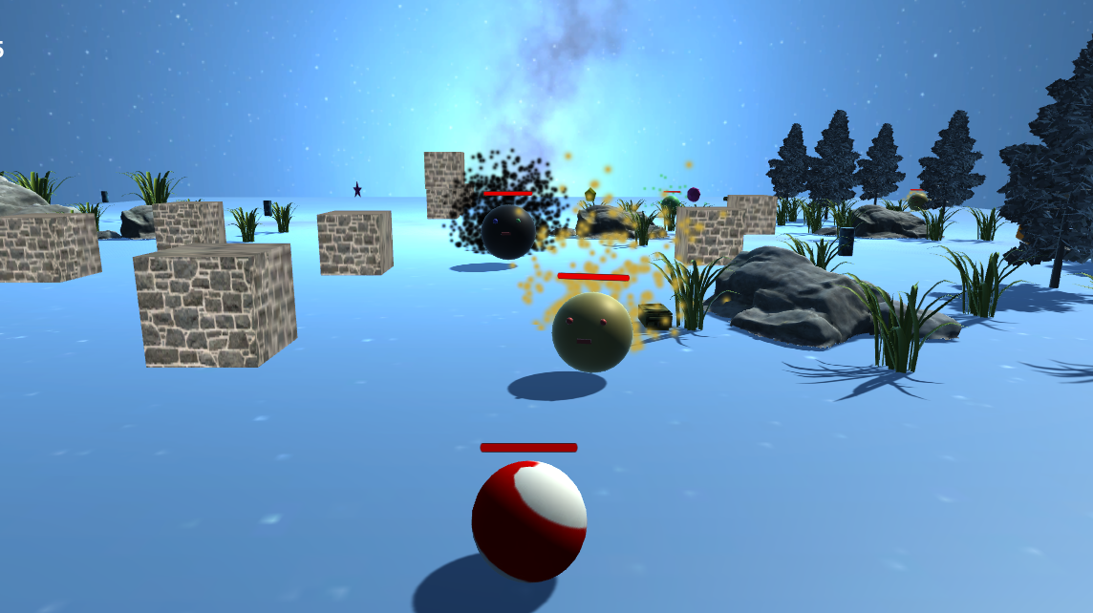
Game Description
We have to gather diamonds in scene.
When we try to gather diamonds . The enemy try to kill us.
İf we get enough diamonds we can pass next level.

Slide 3
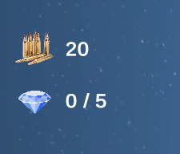
Game Description(Bullet and Diamonds)
Top Right side have bullet icon and diamond.
Bullet icon text show us, how many bullet we have
Diamond icon show us how many diamond we get and how many we need for next level.

Slide 4
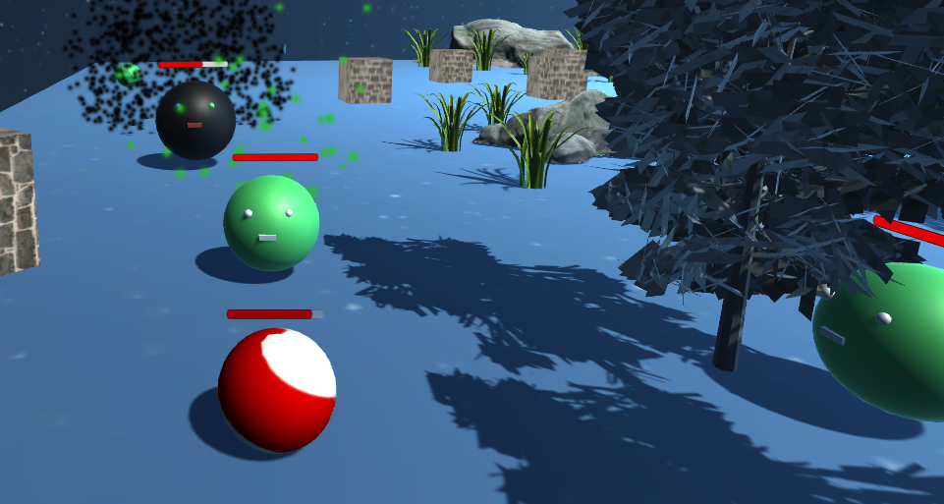
Game Description(Enemy)
We have 3 enemy type.
Each one have different speed , damage and live.
When enemy touch us, we lost live.

Slide 5
Player Control
WASD moving player
F fire bullet
Moving mouse right and left turn the player.
Escape key show us options in the game

Slide 6
Thank for Listening
Metin DEMİR

