Slide 1
CyberScope.
IoT device integrity attestation
Presented by
Zafran Firdaus
Daniel Mawston
Noah Adams
Aiden Monico
Mahyar Sabzevari
Mahdi Sharafeddine
Notes:
We're the CyberScope team. We're investigating how changes to an IoT device affect trust in its sensor data. Our approach is to compare an integrity map of the device's current state with an approved baseline.

Slide 2
Problem statement.
CyberScope
A working device.
Untrustworthy data.
56
%
cannot see below
the IT/OT boundary.
IoT devices are difficult to secure.
88
%
Compromise can have a large blast radius
and far-reaching effects.
struggle with detection
and response.
Industrial control
Findings from Dragos’s OT assessments and exercises;
not a survey of all ICS owners.
Smart homes
Source: Dragos · 2026 OT Cybersecurity Year in Review ↗
Changed device
Autonomous systems
CyberScope asks: has this device moved away from its trusted state?
Problem / Method / Demo
Notes:
Section 1: The problem and its impact
In a smart home, an industrial environment or an autonomous system, decisions depend on data coming from IoT devices.
Those devices are difficult to secure. The I2Map research describes how an attacker could change a device's hardware, software, network configuration or other settings without stopping it from operating.
We can no longer assume its data is trustworthy just because it still appears to work normally. The effects can reach the systems that depend on that device too.
Section 2: The evidence and CyberScope's purpose
In its OT assessments and exercises, Dragos reported that 56 percent lacked visibility below the boundary between IT and operational technology. It also found that 88 percent struggled with detection and response. These figures are findings from those engagements, not a survey of all industrial control system owners.
CyberScope checks whether a device has moved away from its known trusted state.
We use the I2Map approach to collect selected device parameters and compare the current state with an approved baseline. This lets us identify changes before relying on the device's data.

Slide 3
Design & methodology.
CyberScope
Collect → hash → compare → decide
Approve known-good state
Administrator
Approve / restore
Send I2Map to blockchain
Host 1 · Client
Physical Raspberry Pi
Host 2 · Verifier
Host 3 · Blockchain
Device parameters
I2Map
Hash-storage contract
CyberScope
Verifier service
Private Ethereum · Solidity
Hardware
SHA-256
attestation
Compare runtime with baseline
Software
I2Map generator
agent
Network / config
Compare I2Maps
Baseline
Environment
Submit I2Map
Base I2Map
—
Parameters → digest
Sensor data
Match
Mismatch
Accept sensor data
Sensor-data consumer
Reject & raise alert
Monitored state unchanged
IoT / autonomous system
Changed state detected
Alert administrator / restore approved state
Current activity
Scenario 1 Onboard & accept
Collect device parameters
Generate SHA-256 I2Map
Register trusted baseline
Send runtime I2Map to chain
Receive hashes & compare
Accept sensor data
Scenario 2 Reject & restore
Notes:
Collect, hash, compare, decide
Our test device is a physical Raspberry Pi running the CyberScope client. The design uses three separate hosts for the client, the verifier and the blockchain. We use Python on the Pi to collect selected hardware, software, network and configuration parameters. The environmental parameters we can monitor depend on the measurements available.
We then hash the collected values with SHA-256 to produce an integrity map, or I2Map. Hashing produces a digest; it doesn't encrypt the values.
Scenario 1: Onboard and accept
First, the administrator approves a device configuration known to be legitimate. The Raspberry Pi collects its parameters and generates the Base I2Map, our trusted reference. It sends that baseline to Host 3, where a Solidity smart contract stores it on a private Ethereum-compatible blockchain.
Once the device is operating, the Pi collects its parameters again and generates a runtime I2Map using SHA-256. It sends that map to the blockchain on Host 3. The blockchain then passes the runtime I2Map and the approved baseline to the verifier on Host 2, where the two digests are compared.
If the runtime digest matches the baseline, the monitored state hasn't changed. In this proposed flow, the verifier releases the sensor data to the consumer. The check only covers the parameters we monitor, so a match doesn't guarantee that every sensor reading is accurate.
Scenario 2: Reject and restore
Here, connecting an unauthorised USB device changes a monitored parameter. The Pi generates a new I2Map and sends it to the blockchain. The blockchain passes it to the verifier alongside the baseline. The verifier detects the mismatch, rejects the sensor data and alerts the administrator.
The administrator then restores the approved configuration. The Pi generates another runtime I2Map, sends it to the blockchain, and the blockchain passes it to the verifier for another comparison. Once the digest matches, the verifier can accept data again. Throughout this scenario, the original baseline on the chain stays the same.
Implementation, validation and demo handover
What you're seeing is the architecture we're working towards. The repository contains Python integrity checks and a contract that stores and retrieves hashes. We still need to bring those components together for the full flow from the Raspberry Pi to the blockchain and then to the verifier.
To test the integrated system, we'll deliberately change software, network settings and configuration, and connect an unauthorised USB device. To measure false positives, we'll repeat checks without changing the device. We'll also record execution time, transaction commit time and memory usage.
We'll now show the prototype's current behaviour in the live demo.

Slide 4
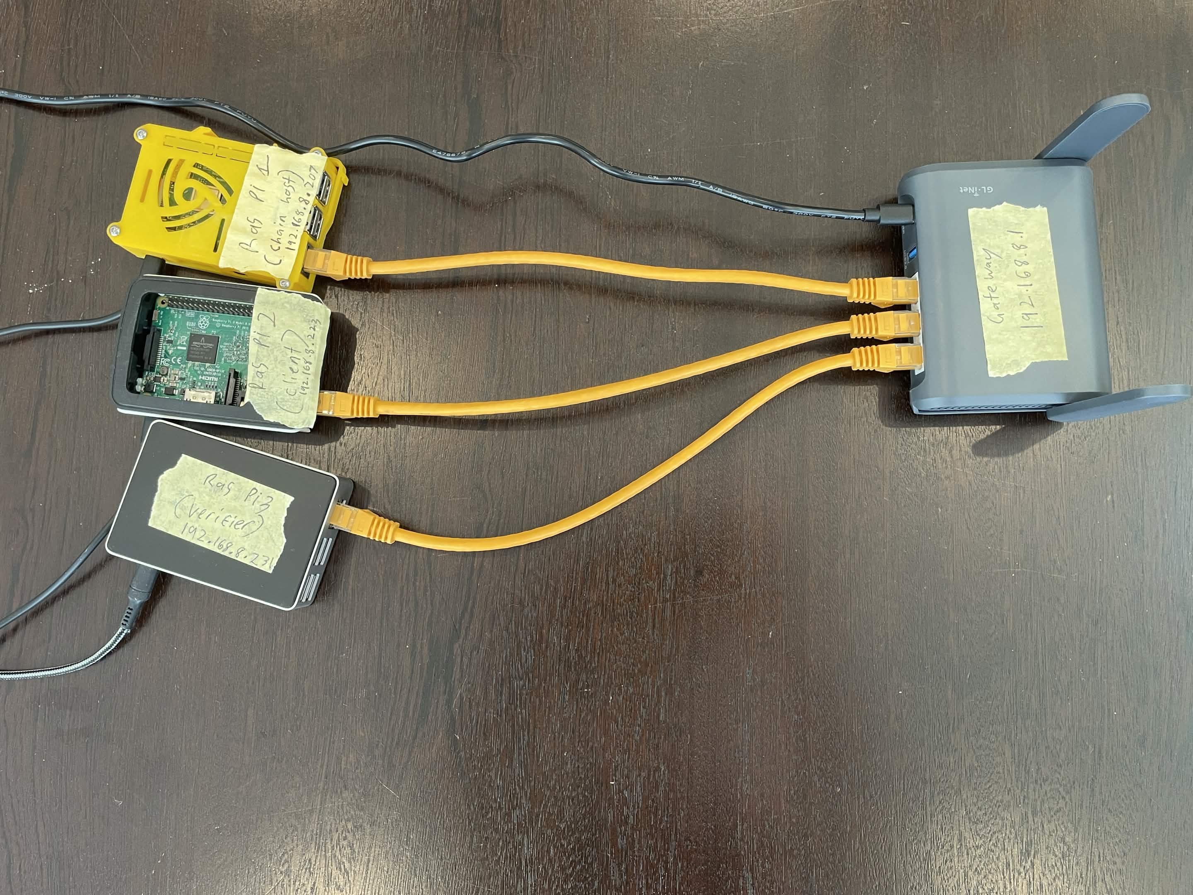
Demo layout.
CyberScope
Physical demo setup
Demo · 1 / 7

Slide 5
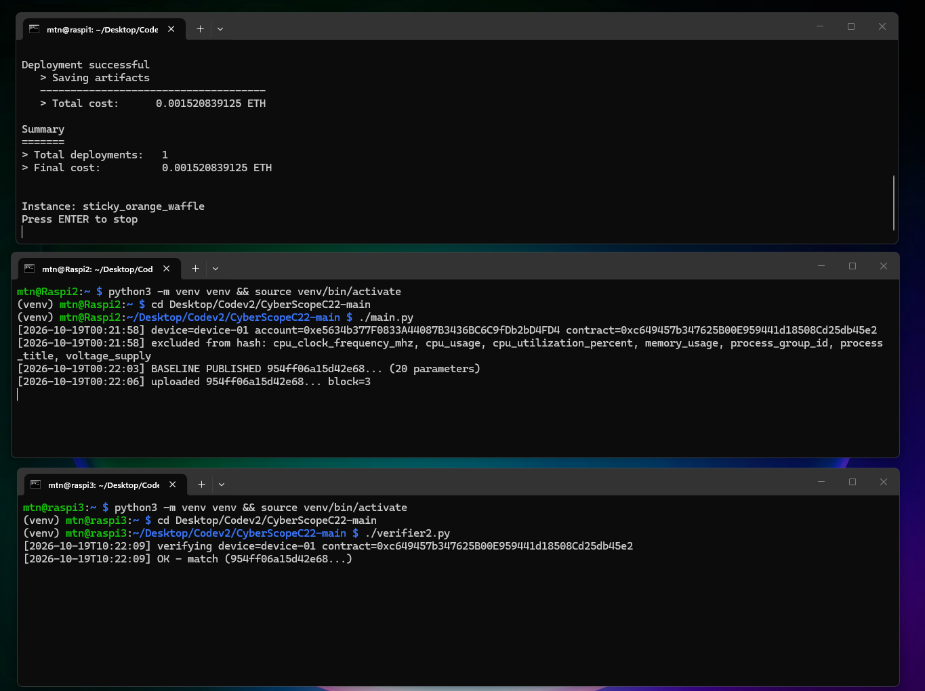
All clients online and active.
CyberScope
All clients online and active
Demo · 2 / 7

Slide 6
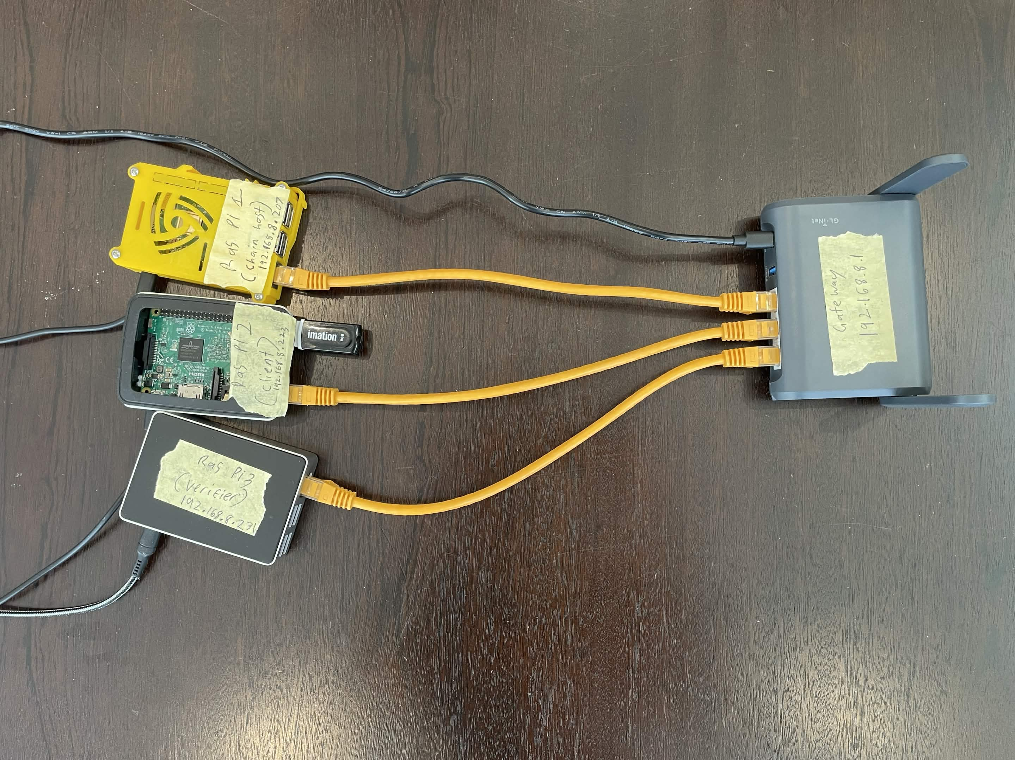
Demo layout with USB.
CyberScope
USB connected to a client
Demo · 3 / 7

Slide 7
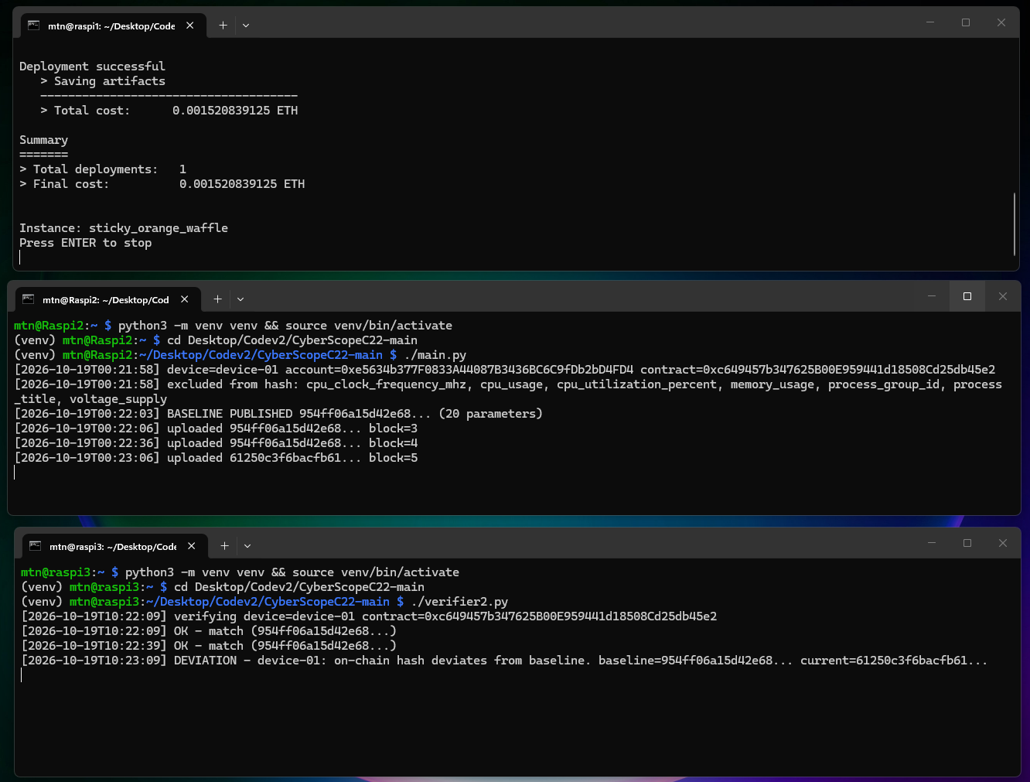
Clients active: deviation detected.
CyberScope
Clients active; deviation detected
Demo · 4 / 7

Slide 8
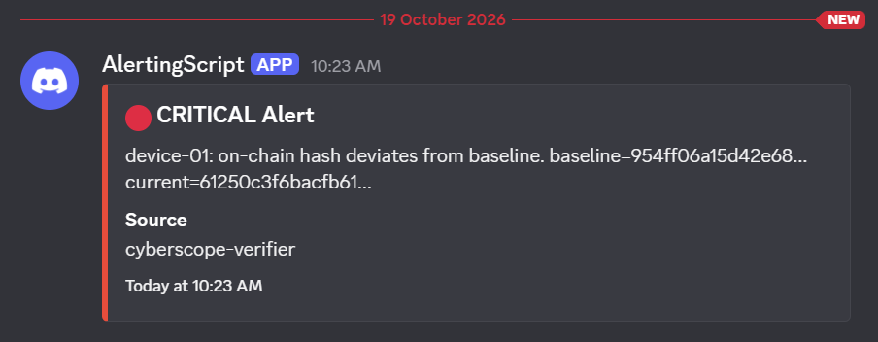
Discord alert.
CyberScope
Discord integrity alert
Demo · 5 / 7

Slide 9
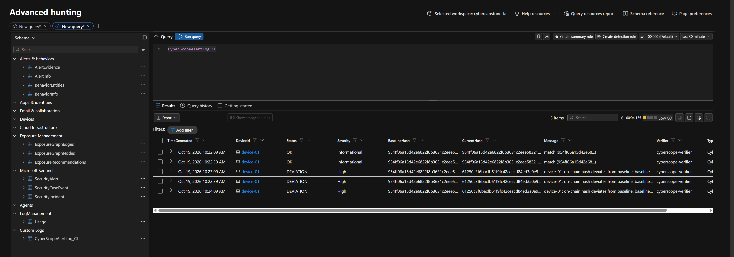
Advanced hunting query.
CyberScope
Advanced hunting query on the custom log table
Demo · 6 / 7

Slide 10
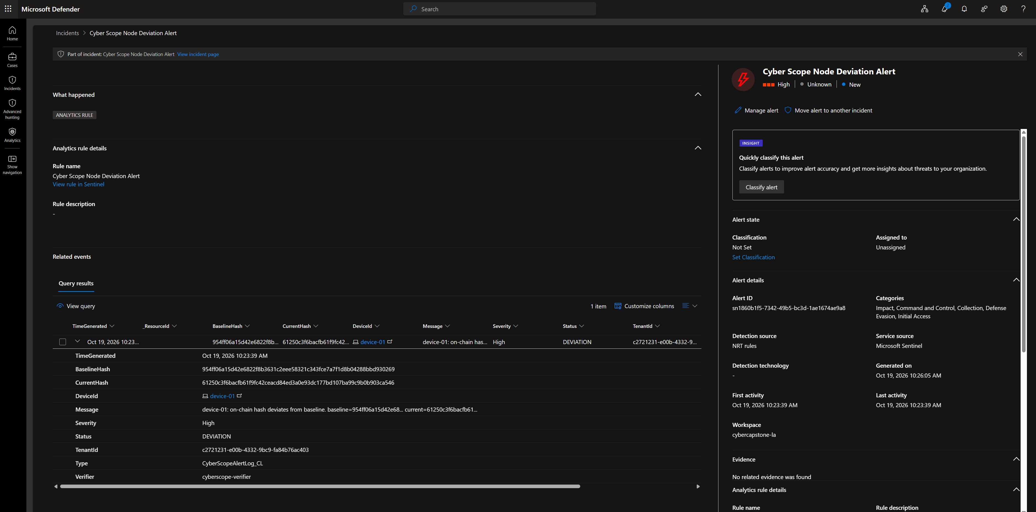
Defender alert open.
CyberScope
Defender alert details
Demo · 7 / 7

