Slide 1
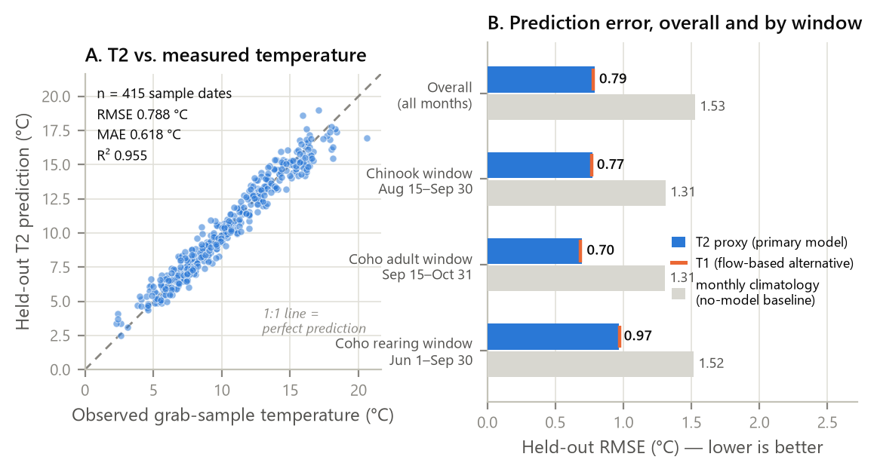
Figure 1
Figure 1. Leave-one-year-out validation of the primary T2 water-temperature reconstruction. T2 excludes streamflow so flow can later be tested independently against modeled temperature. The monthly-climatology bars provide a no-model baseline.

Slide 2
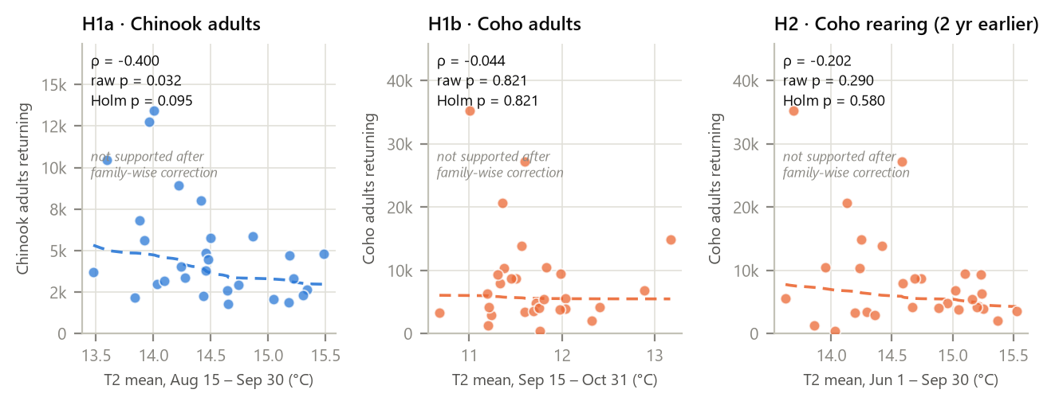
Figure 2
Figure 2. Prespecified salmon-temperature associations. Chinook adult migration (left) showed a moderate negative association, while adult Coho migration (center) and Coho juvenile/rearing exposure two years earlier (right) were weaker. Dashed lines are descriptive fits; confirmatory inference used Spearman correlation and permutation tests.

Slide 3
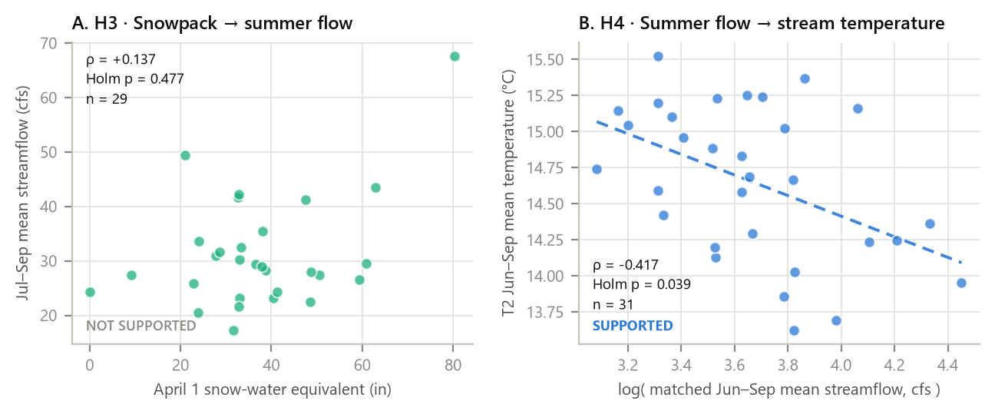
Figure 3
Figure 3. Physical-mechanism tests. April 1 Stampede Pass snow-water equivalent was not clearly associated with July–September Issaquah Creek flow (left). Higher matched June–September flow was associated with cooler modeled creek temperature (right).

Slide 4
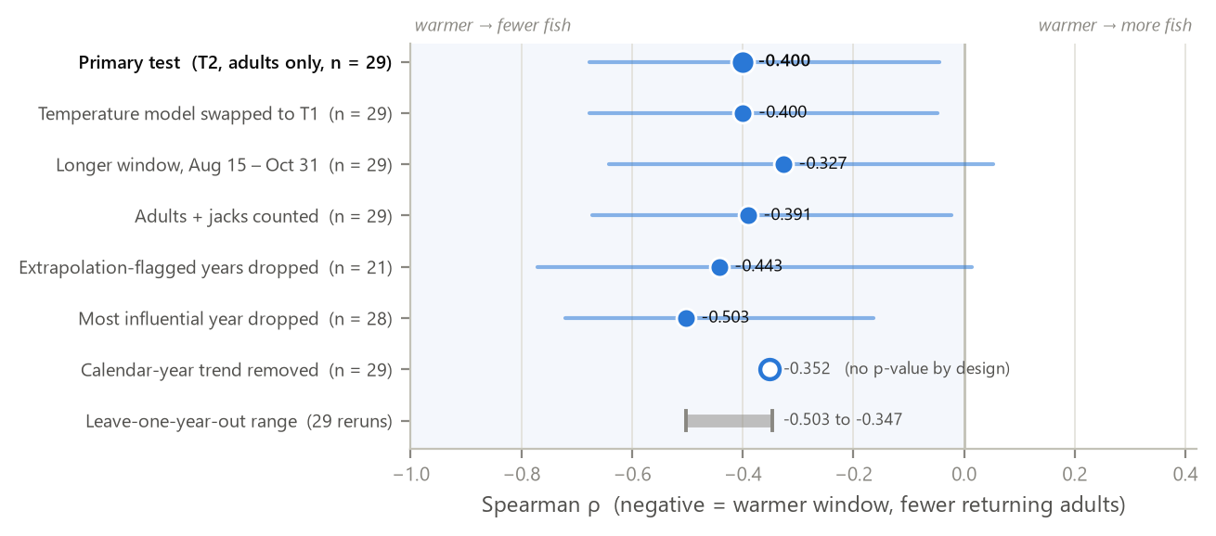
Figure 4
Figure 4. Prespecified robustness checks for the Chinook A1 association. The relationship remained negative across alternative temperature models, windows, outcomes, exclusion rules, and every leave-one-year-out rerun.

