Slide 1
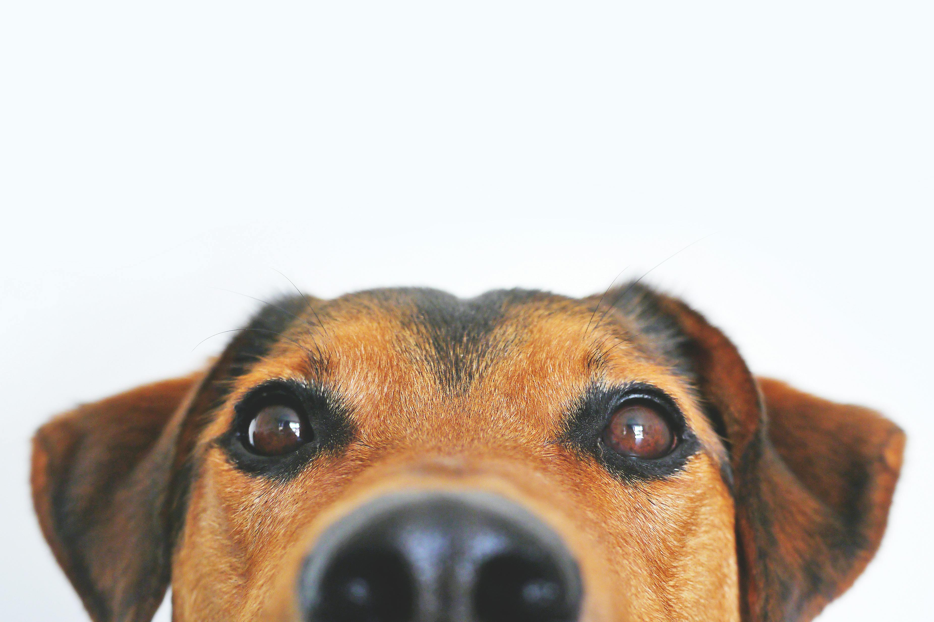
PetFace Deep Learning Exploration
Species classification & attribute prediction with ResNet
Notes:
Hi everyone, I’m Bruce DeSimas and in my part of the presentation I’ll walk through the neural‑network side of our PetFace project — what we did with the dataset, how we built the models, and what we learned from the results.
Very briefly, PetFace is a large‑scale pet image dataset where each pet can have multiple images and metadata like species, breed, color, and gender. Our goal was to use neural networks — specifically convolutional networks — to automatically predict both the species and those attributes directly from the images.
The structure of my section is: first a quick look at the dataset and its quirks, then the two‑stage modelling pipeline, the training strategy we used to fight imbalance, and finally the accuracy results and what they mean.

Slide 2
Dataset & Project Overview
Scale & Scope
• 257,484 unique pets
• 1,012,933 images (≈3.93 per record)
• 13 species represented
Dominant Species
Cats: 63.7% (164k records)
Dogs: 27.8% (71k records)
Rabbit: 2.5%
Parakeet: 1.8%
Others: <1%
Project Goal
Develop neural networks to classify species and predict breed, color and gender attributes from images. Explain why the chosen models suit the dataset, what inferences were made and propose future directions.
Notes:
To set the stage, here’s what the dataset actually looks like. PetFace contains about 257,000 unique pets and just over 1,012,000 images, so on average there are roughly 4 images per pet. There are 13 species in total — cats, dogs, rabbits, various small mammals, and a couple of bird species.
The distribution is extremely skewed: around 64% of records are cats and 28% are dogs, with rabbits at roughly 2.5% and parakeets at 1.8%. Everything else is well under 1% each. So right away we know any model we train has to be very careful not to just learn “cat vs dog” and ignore the rare species.
From a computer‑vision perspective, the images are very convenient: they are all 224×224 RGB PNGs with a uniform aspect ratio and similar file sizes. That means we can feed them directly into a standard ResNet architecture without complicated resizing logic or special handling per species.
The overarching project goal for our group is: build neural networks that can correctly classify the species and then predict breed, primary and secondary color, and gender wherever those labels are available. And importantly, we need to be able to justify why our chosen architecture makes sense for this dataset and what we can conclude from the results.

Slide 3
Composition & Missingness
Heavy imbalance
Cats and dogs dominate; minor species contribute <3% combined.
Missing metadata
Breed unknown ≈17%, Color2 missing in over half of cases; gender mostly known but absent for birds.
Species‑specific gaps: dogs & chimps have unknown colours; birds lack gender; small mammals lack breed info.
Notes:
This slide shows two of the big data issues we had to design around: class imbalance and missing metadata.
On the imbalance side, you can see that cats and dogs dominate the dataset, while species like ferret, chinchilla, or javasparrow are tiny. If we trained a naïve classifier, it could get a very high overall accuracy simply by almost always predicting cat or dog, and it would barely learn anything about the rare species.
The second issue is missingness in the attribute labels. Globally, about 17% of breeds are marked as Unknown, about 30% of Color1, and over half of Color2 are Unknown. Gender is better overall, only about 6% Unknown, but that hides some extreme cases by species.
For example, for dogs and chimps the color fields are basically unusable — Color1 and Color2 are 100% Unknown. For the bird species, parakeets and javasparrows, the gender label is almost always missing, in the 94–98% Unknown range. And for many small mammals, breed is often completely unknown or reduced to just one generic breed category.
The key takeaway for the modelling side is that we can’t just treat every attribute the same across species. Some attribute–species combinations are informative, and some are essentially noise, so we’ll reflect that in both our preprocessing and in the architecture choices later.

Slide 4
Challenges & Preprocessing
Class Imbalance
Cats/dogs ≫ others; minority species at risk of being ignored.
Mitigate via oversampling minority classes and weighting losses.
Missing Metadata
High unknown rates in Breed, Color and Gender for specific species.
Exclude unusable fields (e.g., colours for dogs), collapse sparse categories and treat Unknown as an explicit category.
ID & Leakage
Image record_id differs from annotation Name; multiple images per pet can leak across splits.
Standardise IDs (zero‑pad), stratify splits by record and species to prevent identity leakage.
Additional Steps
• Use canonical ID map and record‑level splitting
• Stratify by species/breed for balanced sets
• Apply light augmentations: flips, small rotations, colour jitter
Notes:
Given that data profile, we had three main preprocessing challenges.
First, class imbalance: cats and dogs massively out‑number the other species. If we just shuffled everything and trained normally, the model would see cats and dogs almost all the time and might almost never see, say, hedgehogs or ferrets. To mitigate that we combine oversampling for minority classes and class‑specific weighting in the loss, which I’ll describe more precisely on the training slide.
Second, missing metadata: some attribute labels are so sparse that they’re effectively unusable. For example, we decided that colour for dogs and chimps doesn’t make sense to model because it’s 100% Unknown; instead, we focus on attributes that are actually populated for that species. For attributes with partial coverage, we do two things: we collapse extremely rare categories into an “Other” bucket and we treat “Unknown” as its own explicit class rather than silently dropping those records.
Third, ID mismatch and potential leakage: images are stored with a numeric record_id, while the annotations use a zero‑padded string Name field. The counts match exactly, but if we split per image instead of per record, the same pet can appear in both train and test, which would massively inflate accuracy. So we standardised IDs, created a canonical mapping, and always split by record, not by individual images. That way, all images of a given pet live in the same split and we avoid identity leakage.
We also made some smaller but important preprocessing choices: stratifying splits by species and sometimes by breed, and applying light augmentations like flips and small rotations to increase robustness without changing the problem we’re actually trying to solve.

Slide 5
Two‑Stage Modelling Pipeline
Stage 2
Species‑specific ResNet‑18
Multi‑head: Breed, Colour, Gender
Stage 1
ResNet‑18 species classifier
Inference flow:
1. Stage 1 predicts one of 13 species.
2. Based on the species, select the corresponding specialist model.
3. The specialist outputs breed, primary and secondary colours and gender.
Notes:
Stage 1 is a single ResNet‑18 trained from scratch to predict one of 13 species for each image. You can think of this as a deep, non‑linear generalization of the perceptron: instead of a single layer of weighted inputs, we stack many convolutional layers, each with non‑linear activations, to learn increasingly abstract visual features that distinguish, say, a chinchilla from a hamster.
Stage 2 is a collection of species‑specific specialist models, again based on ResNet‑18, but with multiple output heads. For each species we define which attributes actually make sense — for cats, for example, we train heads for gender, breed, Color1, and Color2; for dogs, we train gender and breed; for some small mammals we only train color heads if color is annotated
At inference time the flow is: Stage 1 takes an image and predicts the species; based on that prediction, we select the corresponding specialist in Stage 2; the specialist then outputs breed, primary and secondary colors, and gender where those labels exist. There’s also a thin wrapper that maps the raw logits to human‑readable labels using the vocabularies we saved during training. That’s what allows us to evaluate the entire 1‑million‑image tree in a single pass.
This separation keeps Stage 1 focused on a clean 13‑way classification, while Stage 2 can be tailored to the quirks of each species’ annotations.

Slide 6
Training Strategy & Augmentations
Split & Sampling
• 80/10/10 split per record to avoid identity leakage
• WeightedRandomSampler over‑samples minority species (cap ×3)
• Adaptive sampling updates weights from confusion matrix after each epoch
Weighted Sampling (PyTorch)
Augmentations
• Base: random flip, colour jitter, small affine distortions, random erasing
• Tail classes: stronger jitter, optional RandAugment, higher erasing probability• All images normalised; inputs are 224×224 RGB PNG
Notes:
On this slide I’m focusing on how we actually train Stage 1 and, conceptually, how that idea carries over to Stage 2.
We start with an 80/10/10 split per record into train, validation and test. Because we split at the record (pet) level and not per image, every pet only appears in one split, which avoids the network memorising a specific animal and then seeing another photo of the same pet in the test set.
To address species imbalance we use a WeightedRandomSampler in PyTorch. We compute class weights based on how frequent each species is: classes with fewer samples get larger weights, capped at a factor of 3× so they’re oversampled but not to the point of exploding variance. Then, after every epoch, we recompute a confusion matrix on the validation set, estimate per‑class recall, and increase the sampling weight for classes that the model is struggling with. That gives us a kind of adaptive curriculum where rare or difficult species are shown more often.
For data augmentation, we use two regimes. Head classes (like cats and dogs) see a “base” transform: random horizontal flips, modest colour jitter, small affine transforms, and random erasing. Minority classes get a stronger “tail” transform — optionally with RandAugment, stronger jitter, and a higher probability of random erasing — to encourage the network to generalise from fewer examples. All images are treated as 224×224 RGB tensors, consistent with the dataset’s native format.
We train with AdamW, standard cross‑entropy loss, mixed precision for efficiency, and early stopping based on validation accuracy so we don’t overfit to the head classes.

Slide 7
Stage 1 Results: Species Classification
Overall Accuracy
99.82%
Min–max: 97–100%
Notes:
With that training setup, Stage 1 ends up performing extremely well. On the full 1,012,933‑image evaluation, the overall species accuracy is about 99.82% — that means only around 0.18% of images are misclassified at the species level.
Looking at the per‑species breakdown, cats are at 99.96%, dogs at 99.88%, and even the rare species — things like chinchillas, degus, and javasparrows — are all around 97–99%. There isn’t a single species below roughly 97% accuracy, which is impressive given how imbalanced the dataset is and how few examples some classes have.
This is where the dynamic sampling really pays off. Without rebalancing, the network would mostly ignore the minority species, but by focusing extra sampling weight on low‑recall classes and on classes with fewer examples, we achieve both high overall accuracy and strong coverage across all 13 species.
Practically, this means Stage 1 is essentially “solved” for the current dataset. There’s very little to gain from making the species network deeper or more complex unless the dataset or requirements change dramatically.

Slide 8
Stage 2 Results: Attribute Prediction
 | Global Accuracy | Best Species | Worst Species | Observation
Breed | 84.9% | Hamster 97.4% | Chimp 55.6% | Rich labels for cats/dogs; small mammals have unknown breeds
Colour1 | 83.1% | Hedgehog 91.7% | Degus 62.7% | Primary colour strong except for species with missing data
Colour2 | 77.2% | Chinchilla 95.6% | Degus 67.9% | Secondary colour often unknown or absent
Gender | 65.3% | Javasparrow 84.2% | Degus 50.4% | Gender is the hardest due to limited labels and subtle cues
Cat/Dog Snapshot
Cats: Breed 88.4%, Colour1 83.9%, Colour2 77.0%, Gender 67.3%
Dogs: Breed 76.8%, Gender 61.0%
Gender is the bottleneck
High missingness and subtle visual cues limit performance.
Notes:
Stage 2 is more challenging because we’re predicting breed, colours, and gender, and those labels are both noisy and missing in many places. To make the results interpretable, we report accuracy conditional on two things: Stage 1 must have predicted the correct species, and the attribute label must actually be known — we don’t count Unknowns.
At a global level across all species, we see that breed accuracy is about 84.9%, Color1 is around 83.1%, Color2 about 77.2%, and gender is around 65.3%. There’s also a “Color” head for some species that reaches roughly 88.7%. So breed and primary color are in the mid‑80s, secondary color is a bit weaker, and gender is clearly the hardest task.
If we zoom in on the dominant species, cats have 88.4% breed accuracy, 83.9% for Color1, 77.0% for Color2, and 67.3% for gender. Dogs have 76.8% breed and 61.0% gender accuracy. These are pretty usable numbers for many applications, especially for breed and main color, but you should think of gender as “right about two‑thirds of the time.”
We also see interesting per‑species extremes. For example, hamster breed classification reaches over 97%, whereas chimp breed accuracy is closer to 56%. For color, hedgehogs have very high Color1 accuracy, while degus are much lower. For gender, javasparrow hits about 84%, but degus gender is only around 50% — basically coin‑flip level. A lot of this variation correlates with how clean and complete the labels are for that species–attribute combination.
So the message from this slide is: the specialists do a very good job on breed and color when the labels are reliable, but gender in particular remains noisy and difficult.

Slide 9
Interpretation & Future Work
Key Interpretations
• Species classification is essentially solved (≈99.8% accurate).
• Breed & colour predictions are strong but not perfect; performance correlates with label completeness.
• Gender is the limiting factor—labels are scarce and visual differences subtle.
• Careful data hygiene (ID standardisation, stratified splits) and tailored sampling are critical.
Future Directions
• Integrate species and attribute tasks into a single multi‑task network.
• Leverage pretrained backbones (e.g., ResNet50, ViT) for richer representations.
• Employ record‑level aggregation: aggregate predictions across multiple images of the same pet.
• Explore semi‑supervised or self‑supervised methods to learn from unlabelled images and infer gender more robustly.
• Augment minority classes through synthetic data or style transfer.
Notes:
Putting the results together, we can make a few high‑level observations.
First, species classification is basically solved at ≈99.8% accuracy. There’s no obvious bottleneck there right now; the combination of ResNet‑18 plus adaptive sampling is enough to saturate performance on this dataset.
Second, the attribute specialists show that breed and colour are very learnable signals: mid‑80s accuracy is strong given the diversity of breeds and the fact that the same breed can appear in many different poses and lighting conditions. Secondary colour, Color2, is a bit weaker — partly because it’s often missing and partly because “second colour” is inherently ambiguous.
Third, gender is the main bottleneck. It’s not just a modelling problem; the data is working against us. For birds almost all gender labels are Unknown, and for some small mammals breed and colour are also heavily Unknown. Even for cats and dogs, the visual cues for gender are subtle; often you need context that isn’t in the cropped face image. So a gender model is trying to infer something that’s both weakly visible and inconsistently labelled.
In terms of future work, there are several directions: we could replace the two‑stage design with a single multi‑task network that predicts species and attributes jointly; we could swap in deeper or pretrained backbones like ResNet‑50 or vision transformers to see if richer features help; we could aggregate predictions across all images of a pet instead of treating images independently; and we could explore semi‑supervised or self‑supervised learning to make better use of the huge number of images without reliable attribute labels.
Another avenue is targeted data collection: for example, adding more balanced and clearly annotated gender examples for under‑performing species, or cleaning up the most ambiguous breed labels, which would almost certainly lift attribute performance.

Slide 10
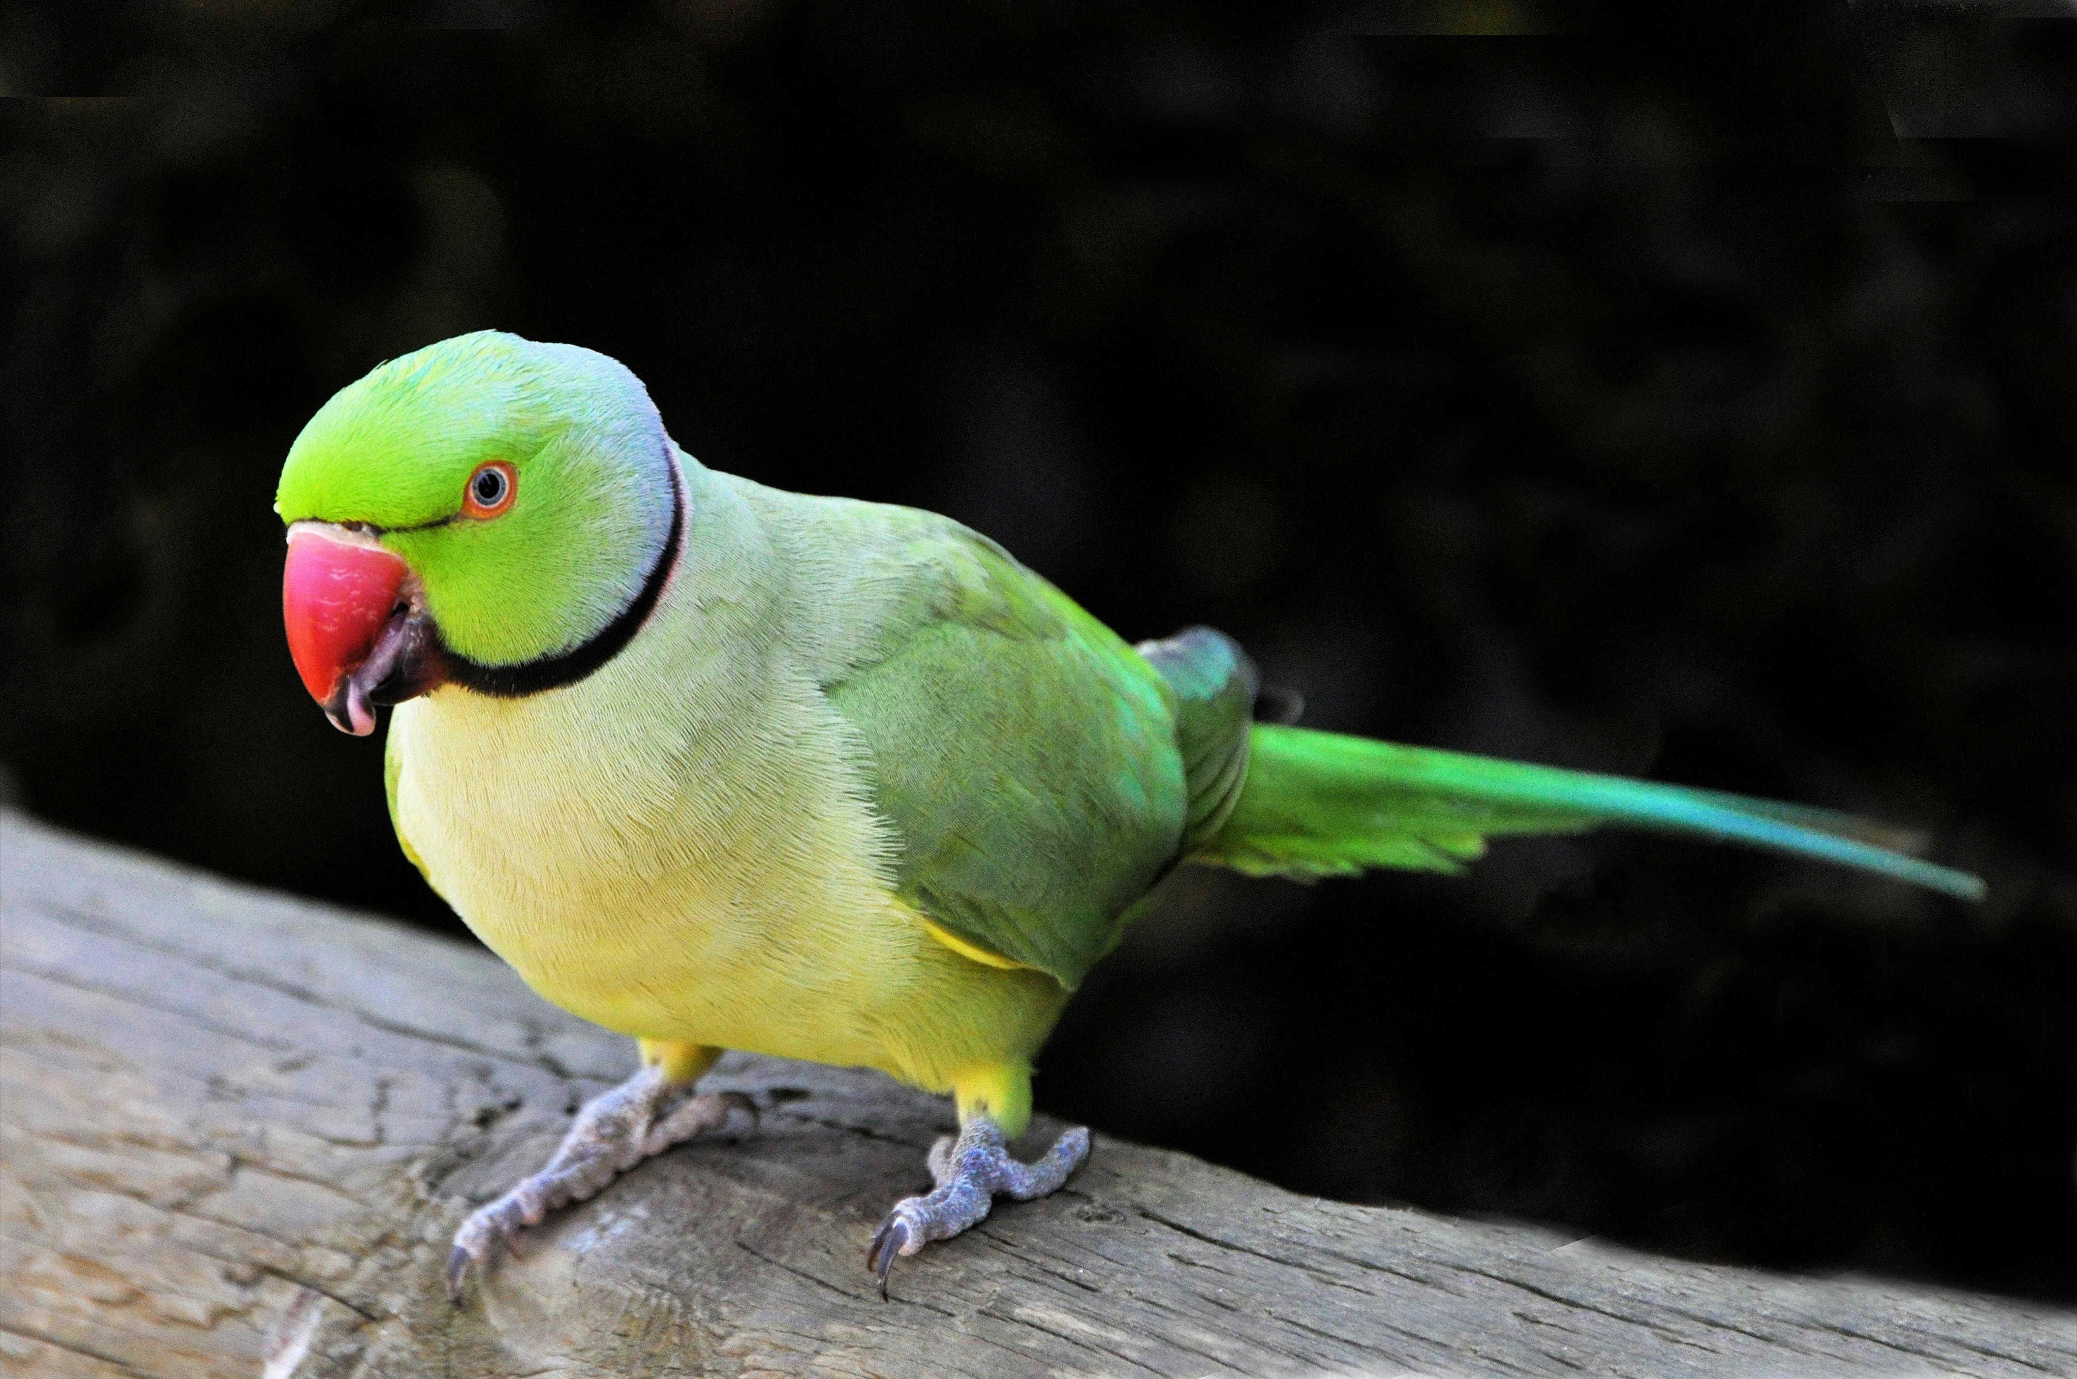
Conclusion & Takeaways
Key Takeaways
• Robust data hygiene and stratified sampling are foundational to success.
• A two‑stage ResNet pipeline solves species classification and delivers strong attribute predictions.
• Gender remains challenging; targeted data collection and modelling could narrow this gap.
• The PetFace dataset is fertile ground for experimentation: there’s still room to push boundaries.
Notes:
To wrap up my section, I’ll summarize the main points.
From a data perspective, good hygiene was essential: standardising IDs, preventing identity leakage by splitting on records, and handling missing labels explicitly rather than ignoring them. Those steps sound boring, but they directly enabled the strong performance we saw later.
From a modelling perspective, a relatively simple but well‑designed two‑stage ResNet pipeline — plus thoughtful sampling and augmentation — is enough to solve species classification and achieve strong attribute prediction on a million‑image dataset. We didn’t need exotic architectures; we needed to respect the structure and quirks of the data.
Finally, the PetFace dataset still has a lot of headroom. Gender prediction and some of the smaller species remain challenging, which makes this a great testbed for future ideas like multi‑task learning, better label curation, and more advanced backbones. So the big takeaway is: with careful data handling and the right neural‑network design, we can get very strong results already — and there’s still plenty of interesting work left to do.
Thanks for listening — I’ll hand it over to the next person in our group.

