Slide 1
JIT Stream designer
GUI Design

Slide 2
UI/UX Concept
Try and Undo
No show dialog box many times
You will see log board what you & application did.
Tablet device support (Tap + Swipe operation)
Not so small control (easy to tap)
Desktop pc support (Mouse + keyboard operation)
Multilingual (Main = English, Support Japanese)
UWP

Slide 3
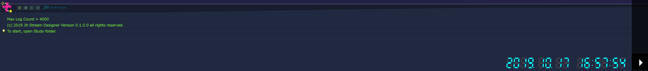
TOP screen
Hamburger menu
Tool bar icon
Log filter e:Err, w:Warning, i:Information, d:Debug trace
Application log board
Clock control button
Simulation Clock

Slide 4
Jit stream class
MakePartsSet
Yellow bar describes JIT Stream Class design mode
“JIT Stream class” is a modeling template to design your process.
However, This designer make instance automatically.
For you can try and error work-flow design.
This kind of first instance named “Main object”
You can instantiate sub object from the main object.
Jit Stream Classes
PartsLoadZone
Class tip
Class ID
PartsArrangeZone
Underline means ClassID
ClassID can use A-Z,a-z,0-9,_
(Cannot start with digit)
WaitingZone
Tap
Hamburger
menu
InternalDelivery
MakePartsSet
Current class for try-and-error design
LineProcess
AbnormalLine

Slide 5
PROPERTIES CASE
JIT object property editor
Screen
View
ScrollView
Screen
StackPanel (H)
Level1
StackPanel (V)
Level2
StackPanel (V)
To focus screen
Ex. JitProcess
Ex. CoSpan
・・・

