Slide 1


DDSAnalytics Talent Mangement Solutions
VENKAT Kasarla
Michael Toolin
Jaime Villanueva

Slide 2
Introduction
We have been provided information describing the existing employees at DDSAnalytics. This data provides a wide breadth of information. The current project’s goal is to ascertain the three primary reasons for attrition at the company. During this analysis the company is also interested in any trends regarding specific jobs that are uncovered
We are only examining past data and no predictive analysis is provided.

Slide 3
Executive Summary
The top three indicators for people leave the company
Total compensation
Job satisfaction
Career move

Slide 4
Data Set
The data provided contained information on 1470 individuals in the company. Each individual’s record contained 35 separate pieces of information.
Aside from company specific data such as payrate, the data contained details that ranged from personal information such as age and marital status to professional information such education level and number of years in the workforce.
Many of the variables are categorical. Our approach is to identify key variables and compare the percentage of people who left the company vs those who stayed at the company.

Slide 5
Exploratory Phase
Basic statistics of employees in the company
1470 employees with 35 variables describing each person
237 people have left the company, 1233 people remaining
Average age of employee is just under 37 years old
Employees have spent just over 7 years on average at the company and have spent almost 4.25 years in their current role.

Slide 6
Cleaning and munging
Mapping of the various categorical values according to Data definition
The data was filtered based on different Categorical variables against Attrition
Some variables that act as categorical variables had too many categories to do an effective comparison. In these cases various groups were created for data exploration. One example is Age, where the quantiles for Age were calculated and groups based on Age were created. These are discussed later on.

Slide 7
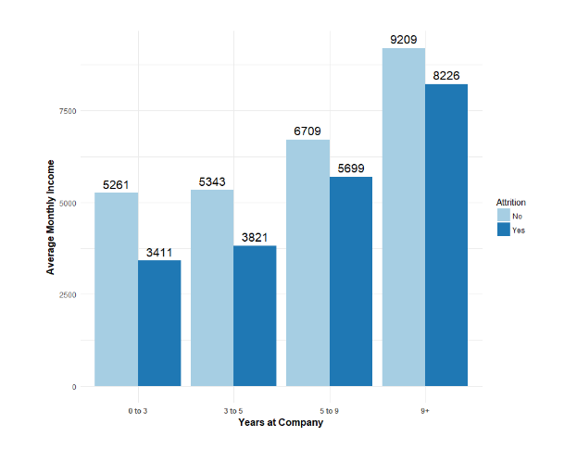
Attrition based on Monthly Income
Grouped by quantiles for number of years at company

Slide 8
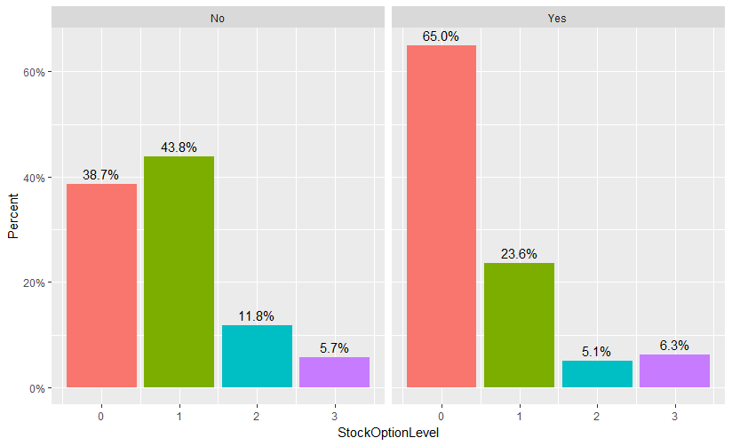
Stock Option Level vs Attrition
Employees who were at a stock option level of zero tended to leave the company

Slide 9
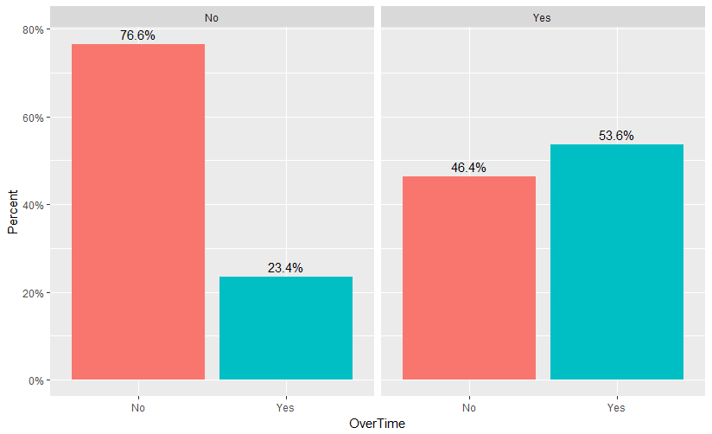
Overtime vs Attrition
Employees who worked more overtime left the company at a higher rate

Slide 10
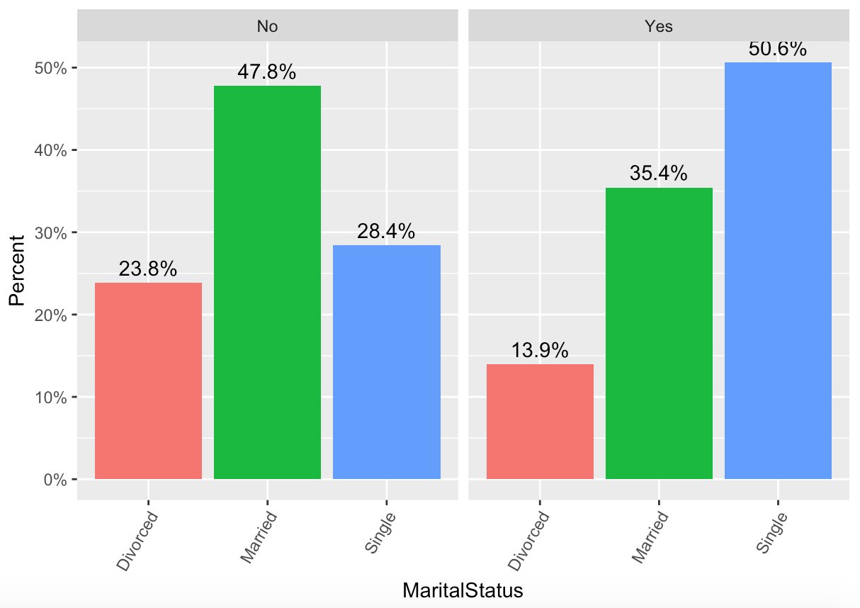
Marital Status vs Attrition
Single employees tended to leave the company

Slide 11
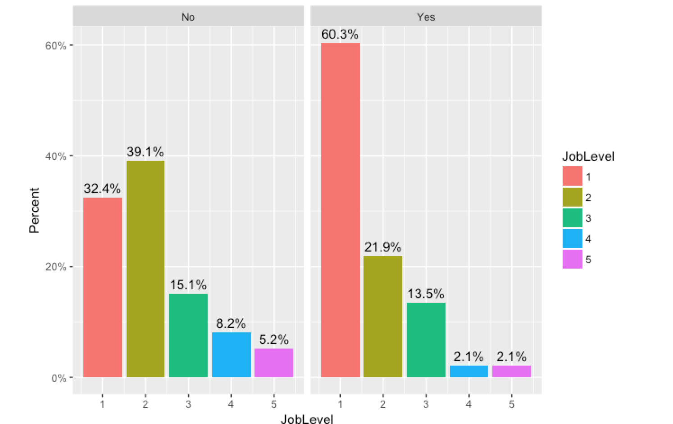
Job Level vs Attrition
Employees at the lowest Job Level leave the company at a higher rate

Slide 12
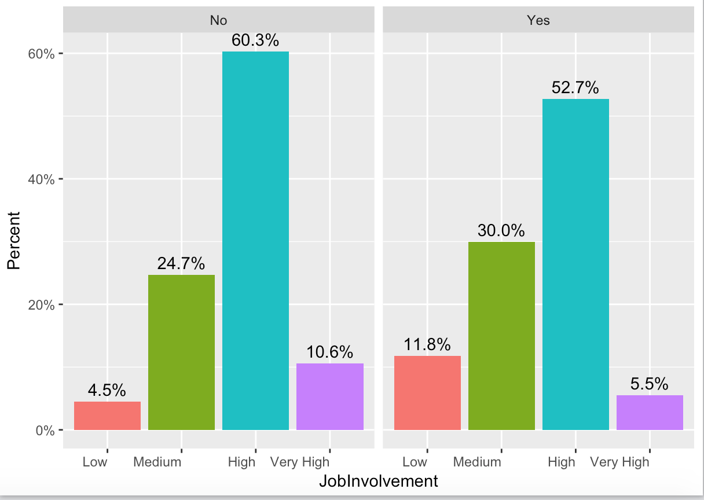
Job Involvement vs Attrition
More employees who rated their job involvement as a 1 or 2 left the company than stayed with the company.
The opposite is true for employees who rated their job involvement as a 3 or 4.

Slide 13
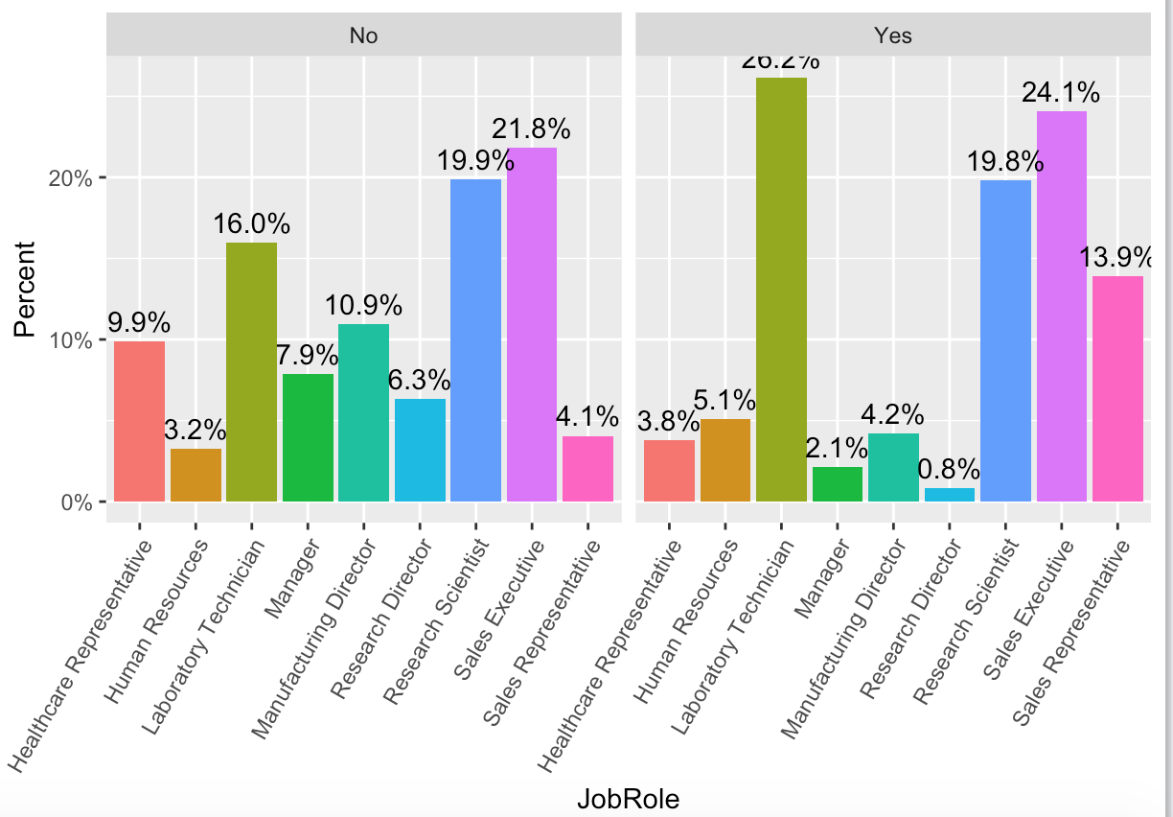
Job Role vs Attrition
Sales Representative , Laboratory Technician roles tend to leave

Slide 14
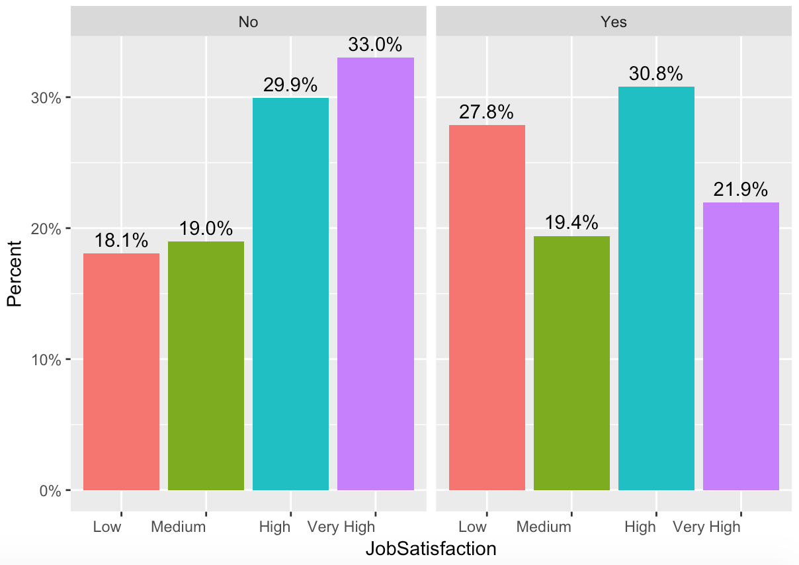
Job Satisfaction vs Attrition
Less Satisfied employees tend to leave

Slide 15
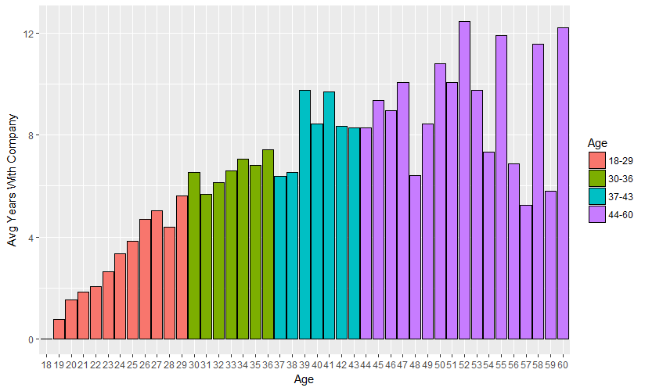
Age groups within the company
We have more middle age workers, yet older workers have been at the company longer, as expected.

Slide 16
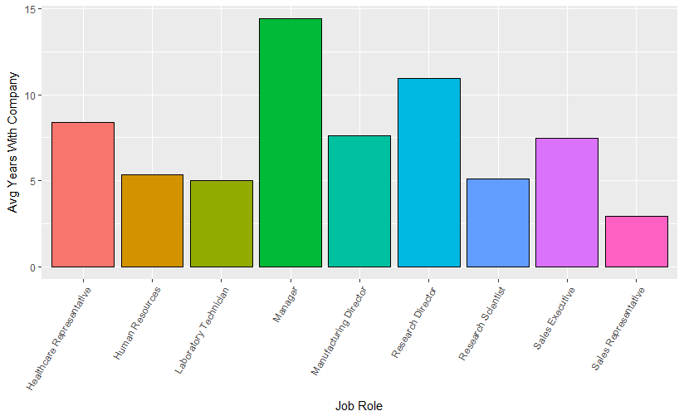
Which job roles stay?
Management has the longest tenure, our Sales Team the least

Slide 17
Conclusion
There are a variety of reasons why people leave the company.
Total Compensation package drives attrition
Stock Options – give people ownership
Monthly Income – Need to be competitive in the industry. A competitive analysis requires more data
We have a much higher turnover rate in Sales than anywhere else in the company
A feeling of ownership and job satisfaction is a contributing factor
A better model is required to predict if a person with certain characteristics is at risk of leaving the company.

