Slide 1
Umano
Foca
2
2
3
1
0
Scimpanzé
Balena

Slide 2
Umano
Foca
1
2
1
3
1
0
Scimpanzé
Balena

Slide 3
f
?
p
?
b

Slide 4
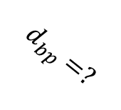
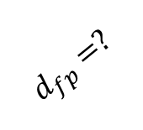
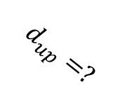
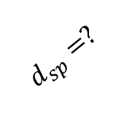
u
f
$$d_{up}=?$$
$$d_{fp}=?$$
p
$$d_{sp}=?$$
$$d_{bp}=?$$
s
b

Slide 5
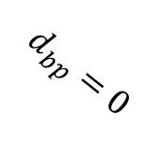
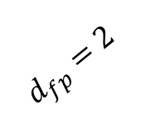
u
f
$$d_{up}=?$$
$$d_{fp}=2$$
p
$$d_{sp}=?$$
$$d_{bp}=0$$
s
b

Slide 6
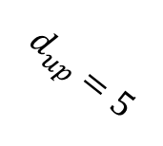
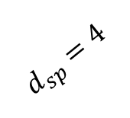
u
f
$$d_{up}=5$$
$$d_{fp}=2$$
p
$$d_{sp}=4$$
$$d_{bp}=0$$
s
b

Slide 7

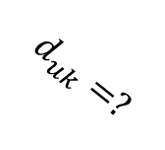
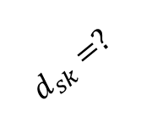
u
f
$$d_{uk}=?$$
$$d_{fp}=2$$
k
$$d_{kp}=?$$
p
$$d_{sk}=?$$
$$d_{bp}=0$$
s
b

Slide 8
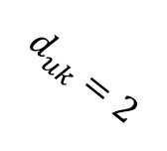
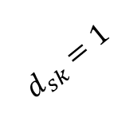
u
f
$$d_{uk}=2$$
$$d_{fp}=2$$
k
$$d_{kp}=?$$
p
$$d_{sk}=1$$
$$d_{bp}=0$$
s
b

Slide 9

u
f
$$d_{uk}=2$$
$$d_{fp}=2$$
k
$$d_{kp}=3$$
p
$$d_{sk}=1$$
$$d_{bp}=0$$
s
b

Slide 10
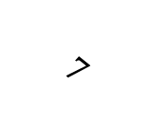
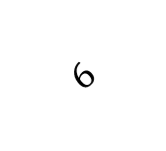

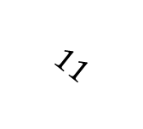
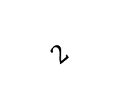
f
u
$$11$$
$$6$$
p
$$4$$
k
$$2$$
$$7$$
b
s

Slide 11


f
$$21$$
u
$$T(D^{{tagliata}_{s}})$$

Slide 12
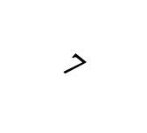
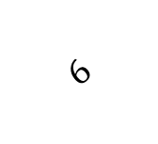

u
$$6$$
f
$$15$$
k
$$7$$
s

Slide 13
f
u
$$11$$
$$6$$
p
$$4$$
k
$$2$$
$$7$$
b
s

Slide 14

p
$$1,5$$
k

Slide 15
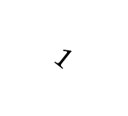
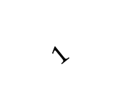
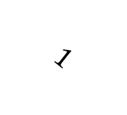
f
u
$$1$$
$$1$$
p
$$1,5$$
k
$$2$$
$$1$$
b
s

Slide 16












r
$$13$$
$$6$$
k
$$7$$
$$13$$
$$1$$
$$7$$
p
$$4$$
$$6$$
$$2$$
m
$$6$$
$$2$$
$$2$$
Orangotango
Gorilla
Scimpanzé
Bonobo
Umano

Slide 17
{u,s}
f
b
u
s

Slide 18


{u,s}
$$1$$
1
$$1$$
f
b
u
s

Slide 19




$$2$$
{f,b,u,s}
0,5
$$1$$
$$1,5$$
{f,b}
{u,s}
$$1$$
1,5
$$1,5$$
1
$$1$$
f
b
u
s

