Slide 1
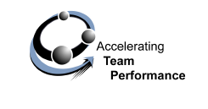
ACCELERATING TEAM PERFORMANCE:
TEAM AND STAKEHOLDER SURVEY
Sample Report
(EXCERPT only)

Slide 2
Overview
This report provides you with the results from the Accelerating Performance Team Survey that you and your team recently completed, and a companion survey that was completed by your team’s key stakeholders.
The Team and Stakeholder surveys are based on results from a multi-method, multi-year team research study which revealed that high team performance requires four key ingredients:
  A partnership and clear accountability among the team's leader, the team’s members and management
  A balance between what needs to get done (the task) and how team members need to work together
  Twelve distinct team leader and team member behaviors or drivers
  Two senior management enablers that contribute to high team performance
This report reveals in detail how your team did against these key factors of high performance
In addition, you will also be able to see how you did (at a high level) against the six team fundamentals described on the team fundamentals slide in this report
Important note: this document does NOT contain the entire results report

Slide 3
How the Team Views Itself

Slide 4
Team Fundamentals
Are understood, embraced, aligned and updated regularly
⇨ what we do
GOALS &
OBJECTIVES
Are explicit for all team members and key stakeholders, and interdependencies are clear
⇨ who does what
ROLES &
RESPONSIBILITIES
PROCESSES &
PROCEDURES
Project planning, operational methods, and communication pathways are clear
⇨ how we execute
Are grounded in a genuine desire to understand and trust each other to enhance performance
⇨ how we work together
RELATIONSHIPS
Leader provides clear direction, solves problems proactively, manages stakeholders, coaches and builds the team
⇨ how our leader leads the team
LEADERSHIP
EXTERNAL
ENVIRONMENT
Team proactively aligns with stakeholders. Stakeholders provide direction, information and support to the team.
how we impact, or are effected by others

Slide 5
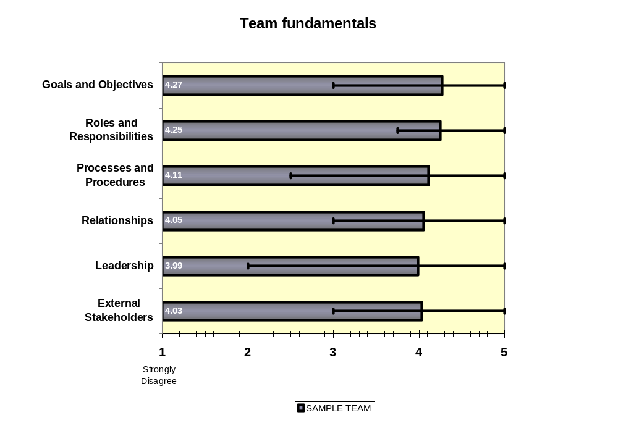

Slide 6

Factors that Influence
Team Performance
Management
Task Focus
Communicates
a clear direction
People Focus
Recognizes and values team contributions
Team Leader
Task Focus
Provides clear direction
Leads team to proactively solves problems
People Focus
Builds the team
Coaches team members
Manages stakeholder relationships
Team Members
Task Focus
Demonstrate an ongoing attention to goals and plans
Diligently document team’s work
Commit to improving team's
effectiveness
Clarify roles and responsibilities
People Focus
Seek to understand and
value each other
Meet challenges optimistically
and decisively
Proactively seek information and feedback from stakeholders
Outcomes are
Collaboration, Trust, Motivation, and
High Performance
Page <number>

Slide 7
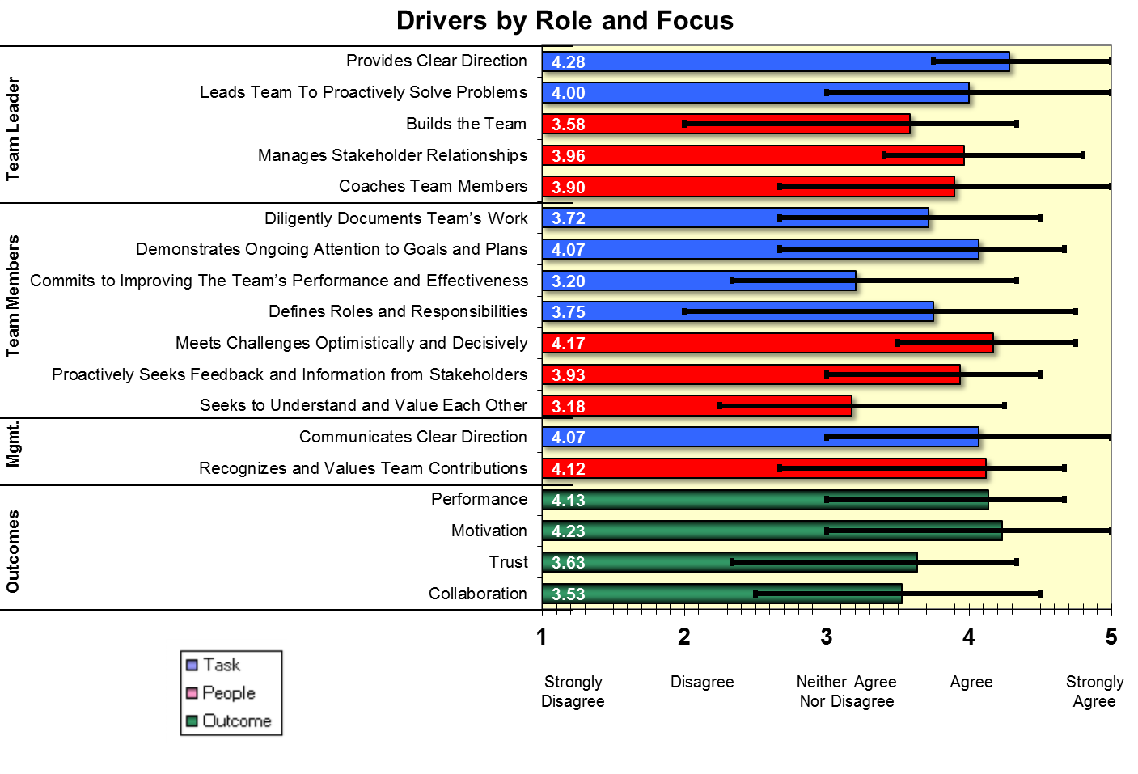

Slide 8
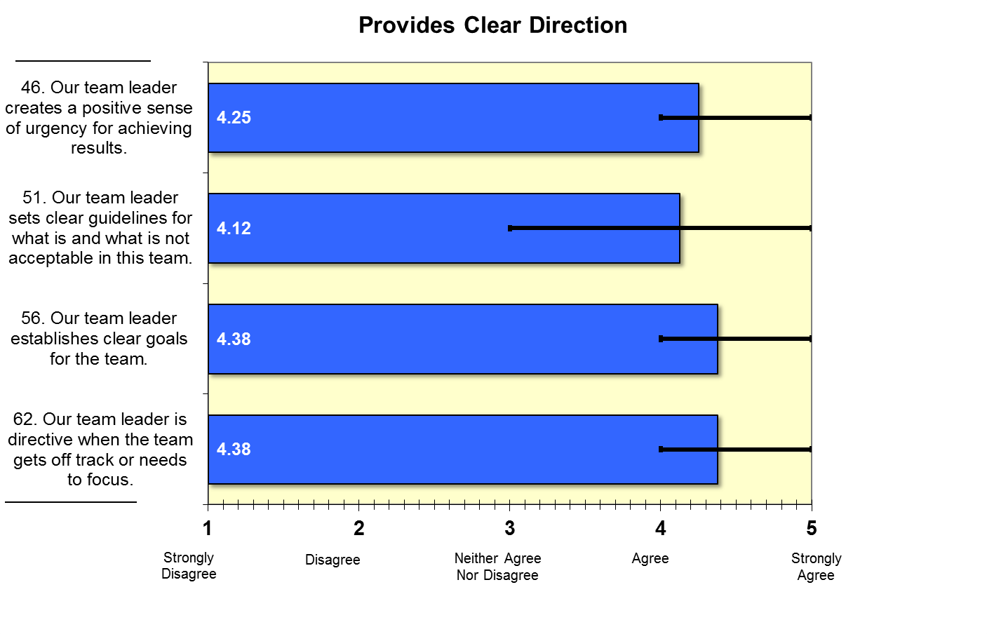
Team Leader:

Slide 9
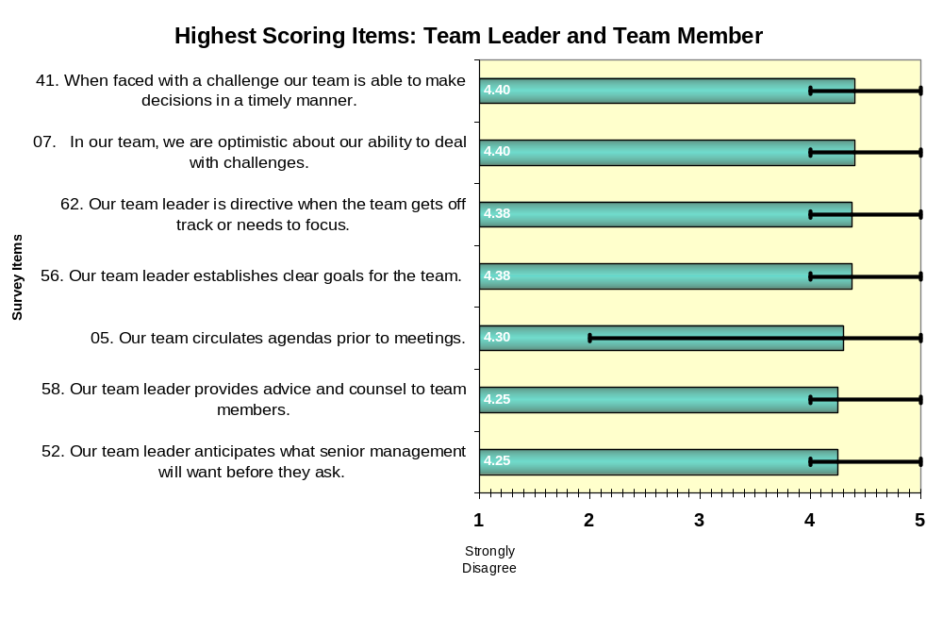

Slide 10
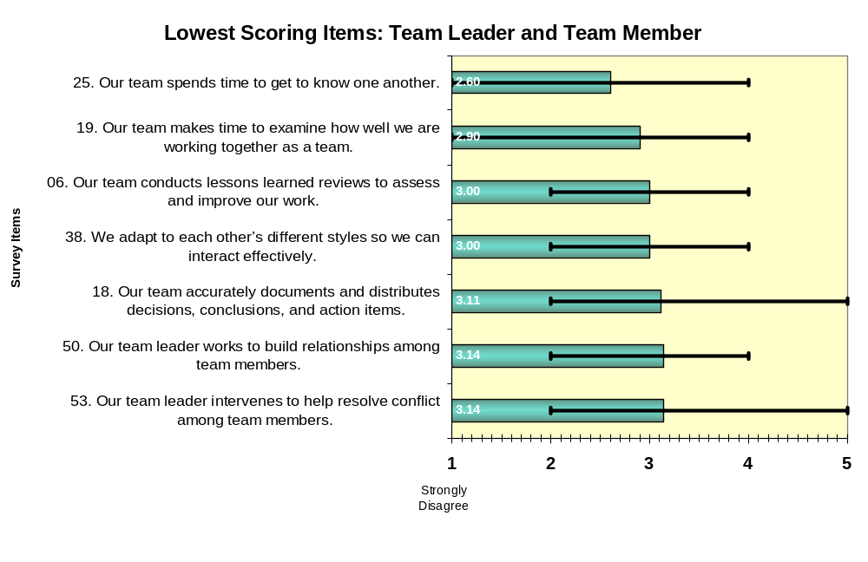

Slide 11
How Your Key Stakeholder View Your Performance as a team

Slide 12
