Slide 1

ACCELERATING TEAM PERFORMANCE:
TEAM AND STAKEHOLDER SURVEY
SAMPLE Team
© 2012 Team Performance Solutions™

Slide 2
Team Fundamentals
... are understood and shared by every team member and updated when necessary
⇨ what we do
GOALS &
OBJECTIVES
... of each team member are explicit and interdependencies are identified
⇨ who does what
ROLES &
RESPONSIBILITIES
PROCESSES &
PROCEDURES
... are agreed upon and followed for how the team will accomplish goals and objectives
⇨ how we execute
... are built on a genuine desire to develop an understanding of each other to enhance performance
⇨ how we work together
RELATIONSHIPS
LEADERSHIP
... in providing direction, solving problems, managing stakeholders and building the team
⇨ how our leader leads the team
EXTERNAL
ENVIRONMENT
… is proactively managed by the team to respond to needs and get needs met
⇨ how we align with and impact key stakeholders

Slide 3
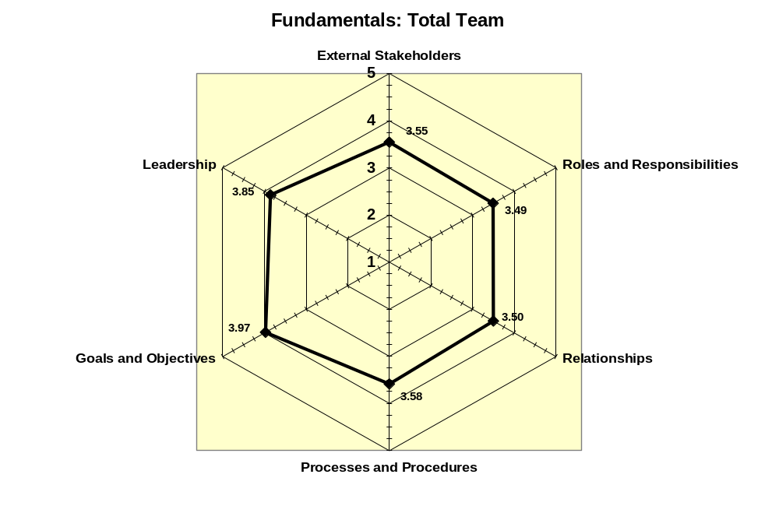
© 2012 Team Performance Solutions™

Slide 4
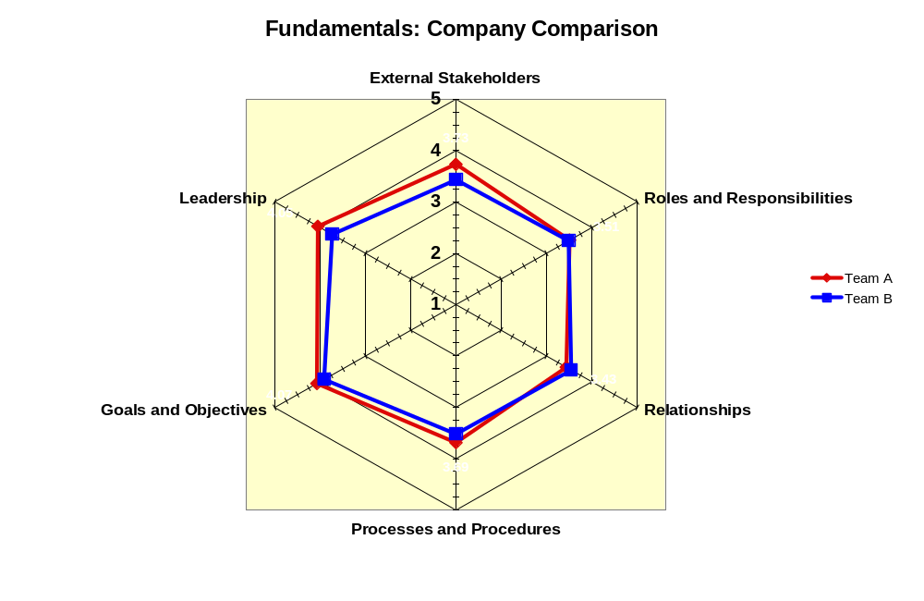
© 2012 Team Performance Solutions™

Slide 5

Another View: Beyond
Fundamentals
Management
Task Focus
Communicates
a Clear Direction
People Focus
Recognizes and Values Team Contributions
Team Leader
Task Focus
Provides Clear Direction
Leads team to Proactively Solves Problems
People Focus
Builds the Team
Coaches Team Members
Manages Stakeholder Relationships
Team Members
Task Focus
Ongoing Attention to Goals and Plans
Diligently Documents Teams Work
Commits To Improving Team's
Effectiveness
Defines Roles and Responsibilities
People Focus
Seek to Understand and
Value Each Other
Meets Challenges Optimistically
and Decisively
Proactively seek information and feedback from stakeholders
Outcomes are
Collaboration, Trust, Motivation, and
High Performance
© 2012 Team Performance Solutions™
© 2012 Team Performance Solutions™
Page <number>

Slide 6
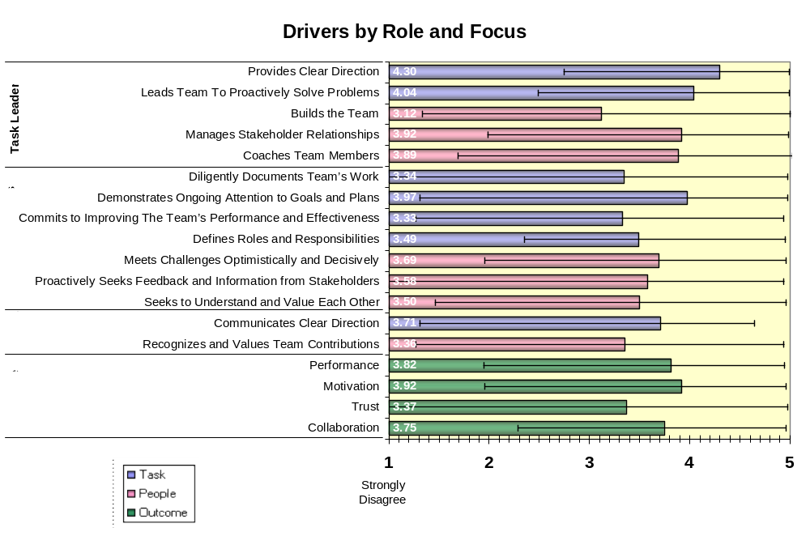
© 2012 Team Performance Solutions™

Slide 7
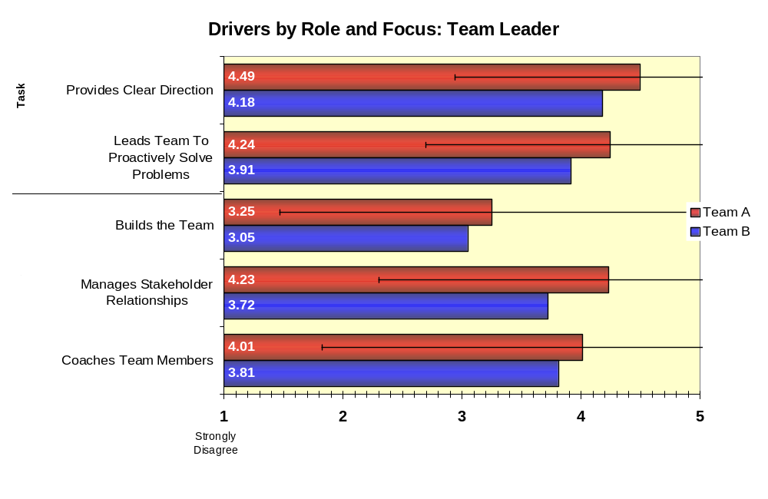
© 2012 Team Performance Solutions™

Slide 8
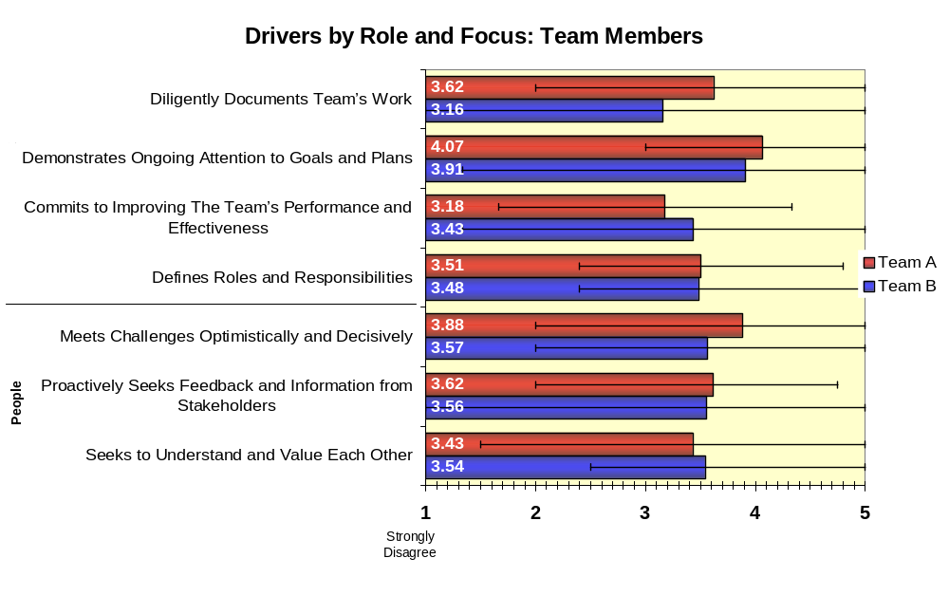
© 2012 Team Performance Solutions™

Slide 9
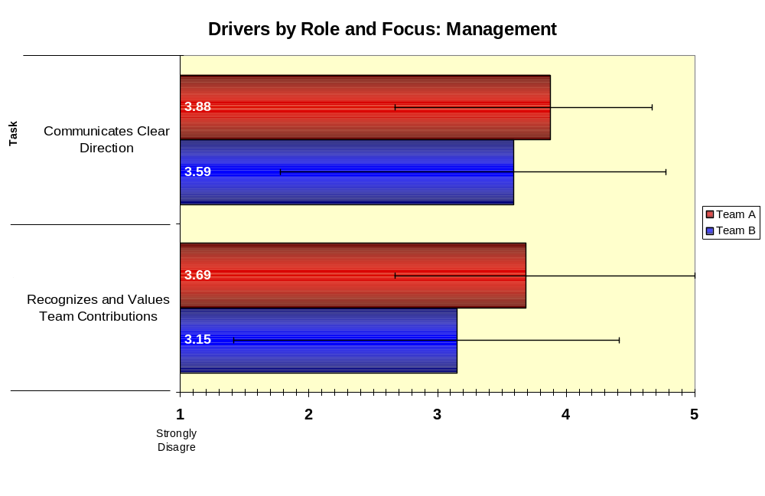
© 2012 Team Performance Solutions™

Slide 10
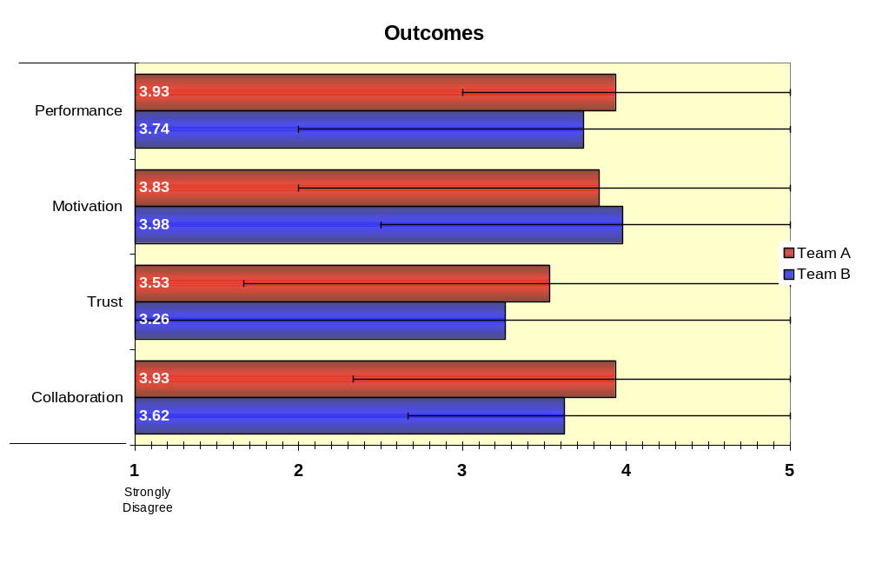
© 2012 Team Performance Solutions™

Slide 11
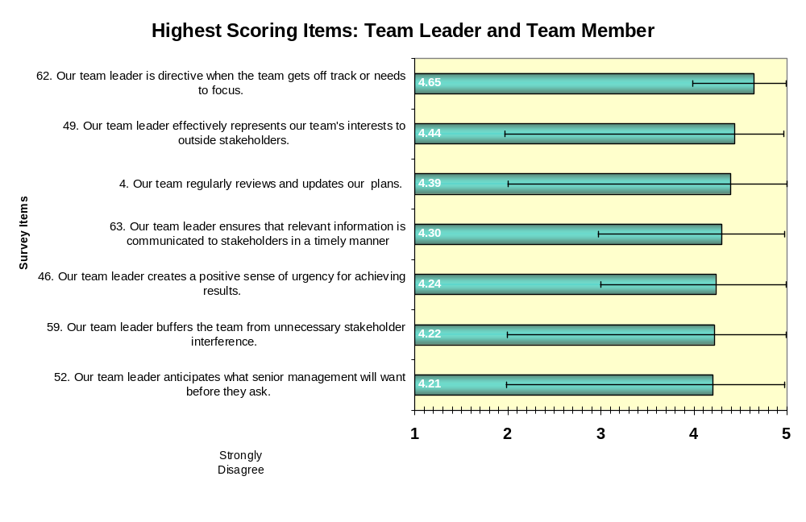
© 2012 Team Performance Solutions™

Slide 12
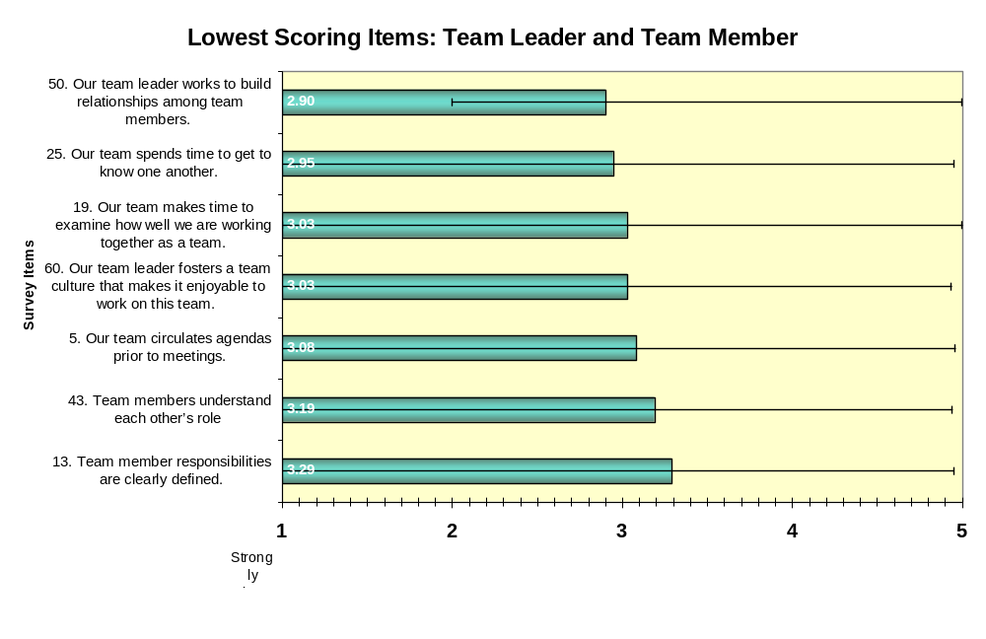
© 2012 Team Performance Solutions™

Slide 13
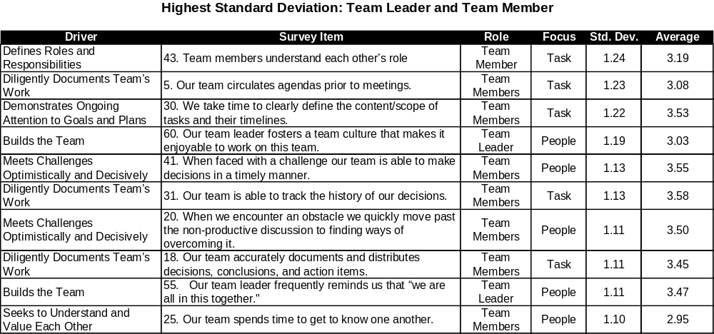
© 2012 Team Performance Solutions™

Slide 14
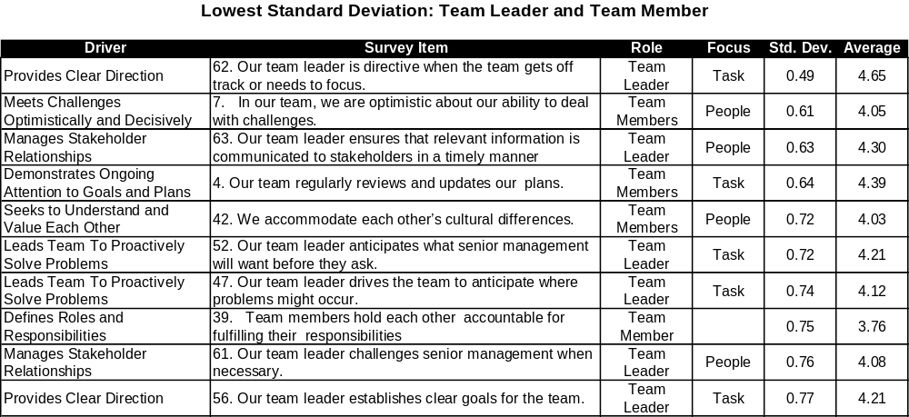
© 2012 Team Performance Solutions™

Slide 15
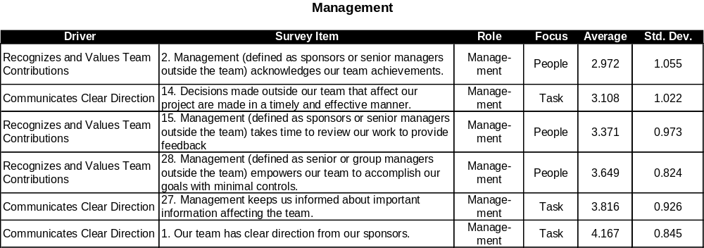
© 2012 Team Performance Solutions™

Slide 16
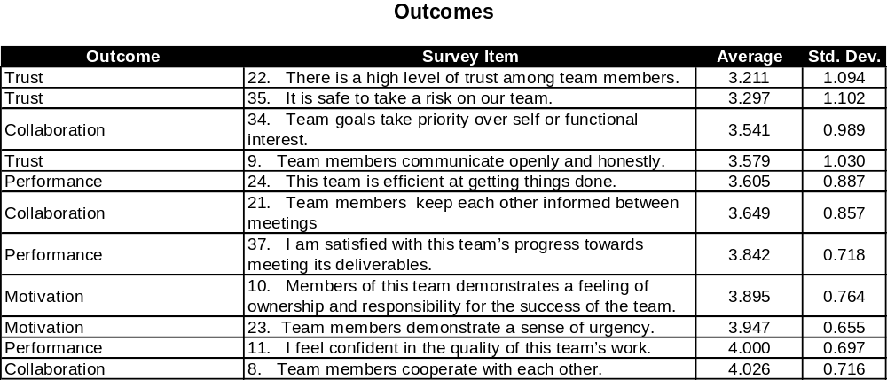
© 2012 Team Performance Solutions™

Slide 17
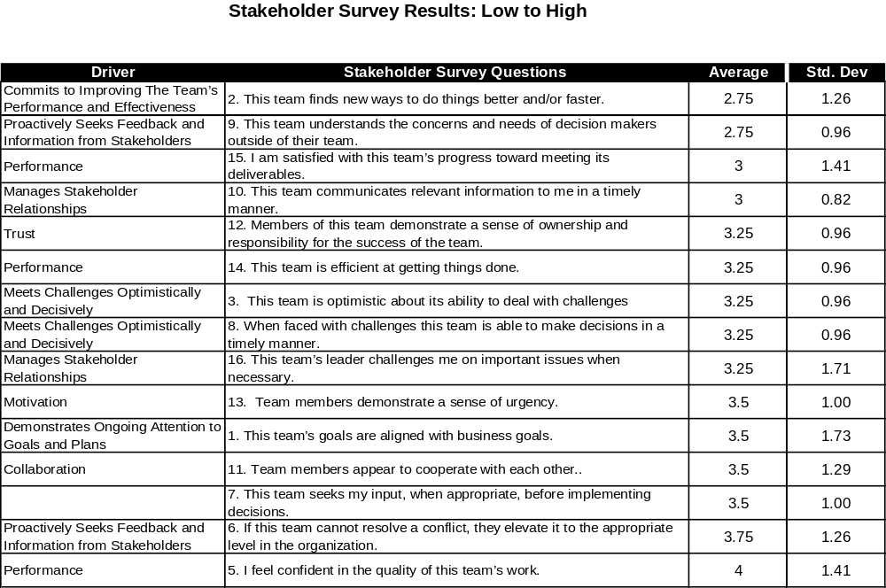
© 2012 Team Performance Solutions™

Slide 18
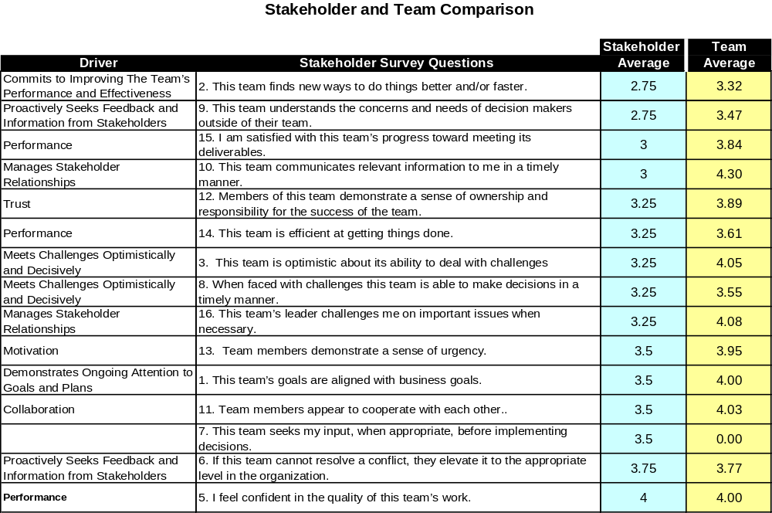
© 2012 Team Performance Solutions™

