Slide 1



TraceBench: An Open Data Set for Trace-Oriented Monitoring
Jingwen Zhou¹, Zhenbang Chen¹, Ji Wang¹, Zibin Zheng², and Michael R. Lyu^{1,2}
¹PDL, National University of Defense Technology, Changsha, China
²Shenzhen Research Institute, CUHK, Shenzhen, China
{jwzhou, zbchen}@nudt.edu.cn
18 December 2014
http://mtracer.github.io/TraceBench/
Notes:
This PPT needs the following fonts:
Calibri
Candara
Times New Roman
High Tower Text
Simplified Arabic Fixed
Hello, everyone. My presentation is about TraceBench – an open data set for trace-oriented monitoring

Slide 2
Motivation
Notes:
First is the motivation

Slide 3







Cloud System
The cloud system becomes more and more popular
…
…
Benefiting our daily life
Supporting different fields
Notes:
The cloud system becomes more and more popular,
benefiting our daily life, such as online surfing, online shopping, send or receive emails,
and supporting different fields, like transportation, scientific computation, and medical care.

Slide 4
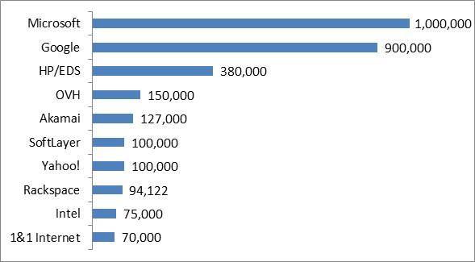





Cloud System
problems happen more and more often in cloud systems
The cloud system becomes more and more popular
…
…
Benefiting our daily life
Supporting different fields
2013.7
Increasing in scale
Increasing in complexity
In August 2013, meltdowns successively
happened in:
Company | Loss
Amazon | Lost 7 million dollars in 100 minutes.
Google | Lost 550,000 dollars in less than 5 minutes, and the global internet traffic dropped 40%.
…
Notes:
At the same time, the cloud systems become more and more large. For example, Microsoft contained 218,000 servers in 2008 and had about 1 million as announced in last year, which increased nearly 4 times in 5 years.
And the cloud systems also become more and more complex, like systems in Google concurrently applies the services of searching, email, advertisement, storage, and so on.
Therefore, problems happen more and more often in cloud systems.
For example, in August 2013, the systems of Apple, Google, Microsoft and Amazon were crashed successively for different reasons,
in which Amazon lost 7 million dollars in less than 100 minutes, while Google lost 550,000 dollars in 5 minutes and the global internet traffic dropped 40%.

Slide 5


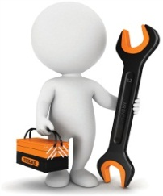
System Monitoring
System monitoring is an important method to improve the reliability of cloud systems at runtime.
In our category, system monitoring includes the activities of:
Supervising
Analyzing
Adjusting
such as the topics of tracing, failure detection, fault diagnosis, system recovery …
Notes:
So, we need to improve the reliability of cloud systems, in which system monitoring is an important method at runtime.
In our category, the monitoring contains the activities of supervising system running, analyzing the system behaviors based on the supervising results, and adjusting the system according to the analyzing results
Therefore, topics like tracing, failure detection, fault diagnosis and system recovery are all belong to the category of monitoring.

Slide 6
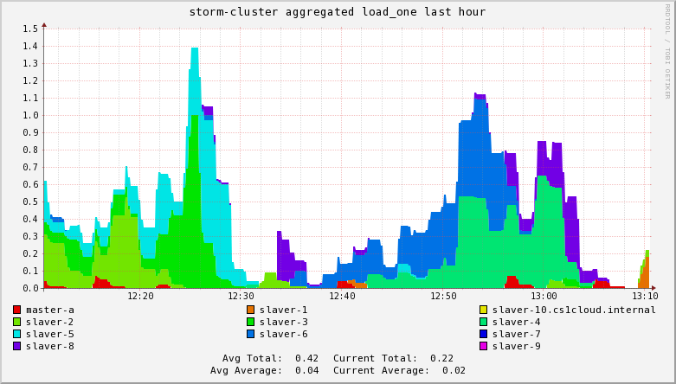
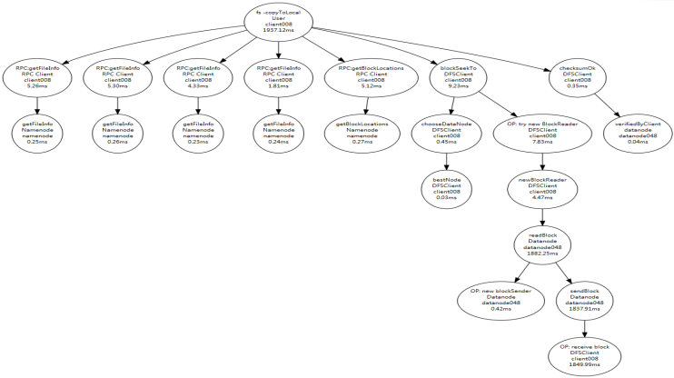
System Monitoring
Based on the recorded/used data, monitoring systems can be divided into:
Resource-oriented Monitoring
Trace-oriented Monitoring
later
Record/use the resource metrics, such as CPU and memory
Ganglia, Chukwa …
Record/use the paths of system execution, or called the traces
X-Trace, Dapper, Zipkin …
Generally speaking, the trace provides more valuable information than the resource metrics in revealing system behaviors.
Currently, more and more attentions are paid to the trace-oriented monitoring, which effectively improves the reliability of cloud systems.
Notes:
According to the recorded information, or say used data, the methods of monitoring can be basically divided into two types: resource-oriented monitoring and trace-oriented monitoring
The resource-oriented monitoring systems record the resource metrics of the whole system, such as CPU speed and available memory. Ganglia and Chukwa belongs to the resource-oriented monitoring systems.
In contrast, trace-oriented monitoring systems track the processes of handling user requests and record the context of each step, such as function call and execution time. X-Trace, Dapper and Zipkin are trace-oriented monitoring systems.
We will introduce the trace in details later.
Generally speaking, we consider the trace provides more valuable information than the resource metrics in revealing system behaviors.
Actually, more and more attentions are paid to trace-oriented monitoring, which effectively improves the reliability of cloud systems.

Slide 7




Motivation
The trace data is essential for the trace-oriented monitoring topics, e.g., evaluating the designed algorithms.
However, there are some difficulties in getting the data of trace:
1. Collecting traces by hand is a tedious and time-consuming process.
…
Choosing or
implementing
a tracing system
Instrumenting
and deploying
a target system
Designing and collecting traces
2. Manually synthesized traces are weak in authenticity and usability.
3. There is few data set of trace existing in academia
and industry.
4. Companies do not want to release their traces which
record the internal details of their systems.
Notes:
However, there still exists some difficulties in getting the data of traces, which is essential for the research, e.g., evaluating the designed algorithms.
First, collecting traces by hand is a tedious and time-consuming process
involving choosing or even implementing a collection system, instrumenting and deploying the target system, designing and establishing various scenarios, etc.
Moreover, these steps may need to be repeated if the collected traces are insufficient
Second, manually synthesized traces are often weak in authenticity, which reflects the usability.
Third, there is few data set of trace existing in academia and industry
Finally, for safety or other considerations, companies do not want to release their traces that record the internal details of their systems.
Actually, all the difficulties hinder the development of trace-oriented monitoring, which also motivate our work.

Slide 8



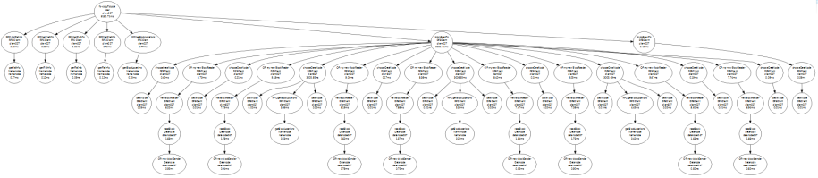
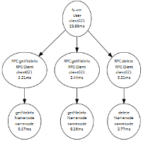


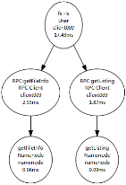
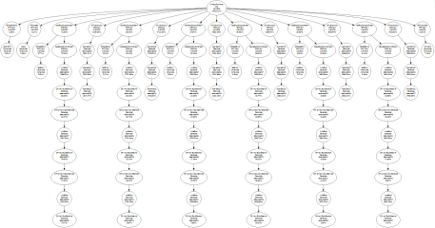
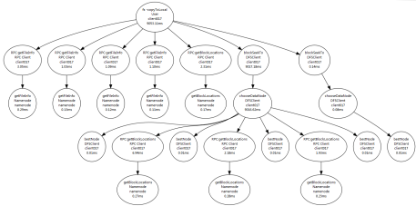
Motivation
Supervising
Analyzing
Adjusting
Trace-oriented monitoring topics
1. Data Format
2. Other Details
3. Applications
4. Discusses
TraceBench
Notes:
In this paper, we release a fine-grained user request centric open trace data set, called TraceBench,
for supporting the trace-oriented monitoring research topics in cloud computing
Following, we will introduce TraceBench from these 4 aspects: data in TraceBench, details of TraceBench, applications based on TraceBench and discusses of TraceBench.

Slide 9
Data Format
Notes:
First, let’s see the data format in TraceBench

Slide 10
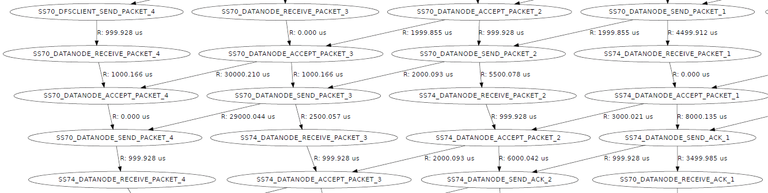
Trace
The trace records the process of system running,
and can be expressed as:
low
less
Linear event sequence
TraceBench stores the traces in the form of trace tree.
Trace tree
high
more
Request flow graph
complexity
information
Notes:
Trace records the process of system running
for example, this trace, in the form of linear event sequence, expresses the process of building a TCP connection between host A and B, using socket
The trace can also be expressed as the forms of trace tree, request flow graph, and so on.
The format of linear event sequence has the lowest complexity and contains the least information. In contrast, the request flow graph contains the most information but has the highest complexity.
To balance between recording abundant information and having a intelligible format, TraceBench adopts the format of trace tree

Slide 11
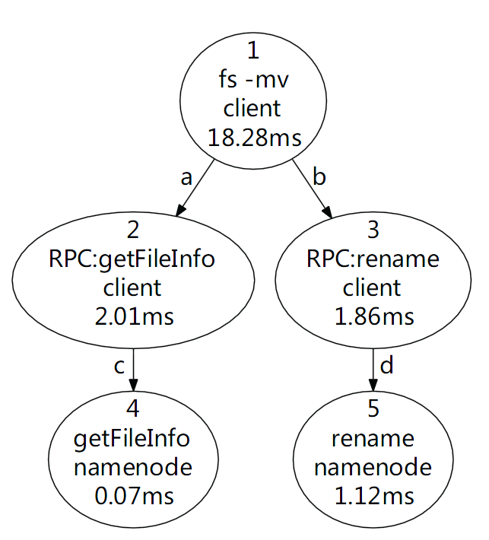
Trace Tree
Notes:
Here is a sample of trace tree, recording the process of handling a mv request in HDFS. The client first get the information of the target file from the namenode,
like whether the file exists, using the RPC: getFileInfo, and then rename the file with the RPC: rename.

Slide 12
Trace Tree
Trace = events + relationships
Event: function name and latency …
Relationship: local and remote function calls …
Trace => Trace Tree
Nodes correspond to events.
Edges correspond to relationships
Trace Tree => linear event sequence
events
relationships
1
id: 1
name: fs -mv
……
a
fatherId: 1
childId: 2
type: local call
……
2
id: 2
name: RPC:getFileInfo
……
……
……
DFS: 1 , 2, 4, 3, 5
Notes:
A trace in the form of trace tree contains the event set and the set of the relationships between the events.
The event records the context of each request step, where a request step usually means a function, the recorded information contains the function name, start time, end time, host address, return value, and so on.
And the relationship records the causality between two events. For example, relationship a represents that event 1 is the father event of event 2, and the relation between them is local function call.
Using the events and relationships, we can reconstruct the trace tree.
The nodes in the tree correspond to the events, like node 1 corresponds to event 1
Edges in the tree correspond to the relationships, like edge a corresponds to relationship a
Naturally, we can transfer a trace tree to a linear event sequence with different methods
For example, using the Depth First Search (DFS), the sample trace can be transferred to 1,2,4,3,5

Slide 13


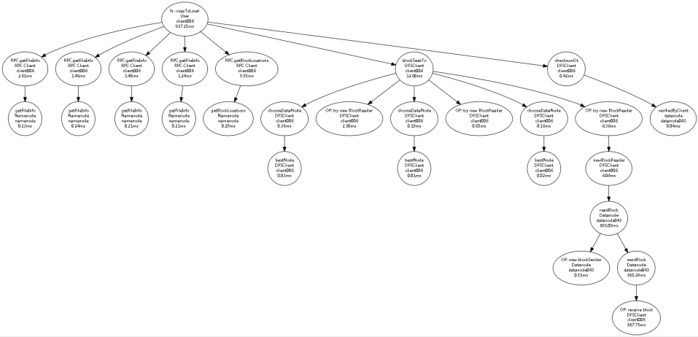
Samples
Normal
Meet a killDN fault (function fault)
Notes:
Following, we give some samples in TraceBench, to show the information contained by the trace tree
This sample illustrates a normal process of handling a read file request in HDFS. The client first queries the file information from the namenode, then downloads the file from related datanode, and last informs the result to the namenode.
When reading a data block, the client first chooses the best datanode from the datanode list informed by the namenode, and then get the block from the best datanode.

Slide 14
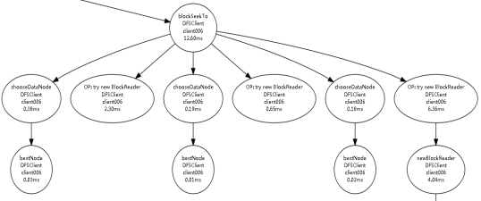

Samples
Normal
Meet a killDN fault (function fault)
Notes:
However, when meeting some faults, the topology of the trace tree would change. For example, when the best datanode encounters a killDN fault, a function fault which kills the HDFS processes on some datanodes, the operation of reading the data block will fail. Then, the client would tries other datanodes in the datanode list.

Slide 15
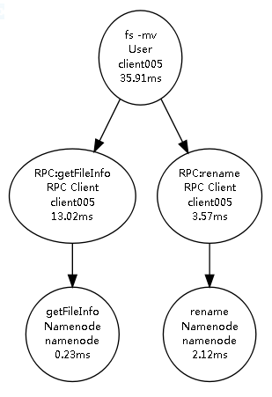
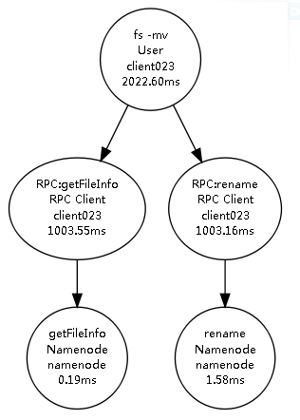
Samples
Meet a slowHDFS fault
(Performance fault)
Normal
Notes:
As another example, when encountering a fault of slowHDFS, which belongs to performance faults and slows the whole network of the HDFS cluster,
the latencies of some events in the trace tree would increase.

Slide 16
Other Details
Notes:
Following, we will talk about other details of TraceBench

Slide 17
Structure
Class
Type
Trace File
Normal
Workload
collected under different workload speeds
Collected when system
running normally
Datanode
collected with various cluster sizes
Each trace file corresponds to a certain scenario, considering different cluster size, request type,
workloads speed, injected faults, etc.
Process
affect the processes on HDFS nodes
Abnormal
Network
bring anarchies to the network in the cluster
Collected when a
permanent fault injected
Data
introduce errors in the data on datanodes
System
inject faults to OSs of the HDFS nodes
Combination
Single
faults are chosen from a single fault type
Collected when system
encountering temporal faults
All
faults are chosen from all the four types
Notes:
TraceBench consists of three classes: Normal , Abnormal and Combination. where the Normal class and the Abnormal class are collected during the HDFS running normally and abnormally, respectively, while the Combination class is collected by randomly injecting faults and later recovering the system
each class includes several types.
For example, the Abnormal class consists of four types according to the fault type. The Process faults affect the processes on HDFS nodes, while the Data faults introduce errors in the data on datanodes, and the faults in the Network type and the System type bring anarchies to the network in the cluster and the OSs of the HDFS nodes, respectively.
When collecting the traces in each type, we consider different aspects, like requests type and number of faulty nodes, etc., to simulate various scenarios. Thus, each type contains many trace files, each of which contains the traces collected in a scenario.

Slide 18
Statistics
The whole collection work lasted for more than half a year.
50 clients + (50+1) HDFS nodes + others > 100 hosts
inject 14 faults of 4 types
whole size of TraceBench ≈ 3.2 GB, including:
361 trace files
366,487 traces
14,724,959 events
6,273,497 relationships
trace length = [5, 420]
nodes per trace = [2, 44]
……
Notes:
The whole collection work lasted for more than half a year.
The data set is collected in a cluster consists of more than 100 hosts
During collection, 14 faults in 4 types are introduced
the whole size of TraceBench is about 3.2GB, including 366,487 traces, 14,724,959 events and 6,273,497 edges in 361 trace files
The number of contained events of a trace, or say trace length, in TraceBench spreads from 5 to 420, and the number of involved hosts in a trace spans from 2 to 44.

Slide 19
Collection Process
client001
client002
…
clientN
Clients
control
track
HDFS requests
monitor
monitor
controller
control
MTracer Server
monitor
Ganglia Server
control
control
inject faults
track
monitor
Datanode001
Datanode002
…
DatanodeM
Namenode
HDFS
CloudStack
Notes:
Our collection environment was deployed on CloudStack in a real cluster
We choose the HDFS system as the target system, with one namenode and 50 datanodes. The traces in TraceBench record the execution processes of the HDFS system
Clients, simulating real users, generate different requests to HDFS, where N=50
As a tracing system we developed, MTracer tracks the process of handling user requests in HDFS from clients.
The controller controls the collection process and injects faults
The Ganglia server monitors the whole environment to ensure no unexpected issues happen during collection

Slide 20
Collection Process
start MTracer
and HDFS
stop MTracer
and HDFS
Normal
start Clients
trace collection period
stop Clients
request handling period
inject
a fault
recover
the system
Abnormal
request handling period
inject
a fault
inject
a fault
inject
a fault
inject
a fault
inject
a fault
Combination
request handling period
Notes:
When collecting trace in the Normal class,
we first start the MTracer server and the HDFS system with a certain cluster size
then launch the workloads concurrently on some clients
After finishing the collection, workload terminates first
the HDFS system and the MTracer server stop after finishing all requests
during handling request,
the HDFS system is running normally all the time
While in collecting Abnomral class,
faults are injected before starting workload
and the system is recovered after finishing all requests
to makes sure all requests are handled during the HDFS is running abnormally
While in the Combination class,
faults are randomly injected after starting workload then the system ﻿is recovered after an interval, and the next fault is carried out in a same way, which simulates occasionally happened faults.

Slide 21
Applications
Notes:
To validate the usability and authenticity, we employed TraceBench in several applications

Slide 22
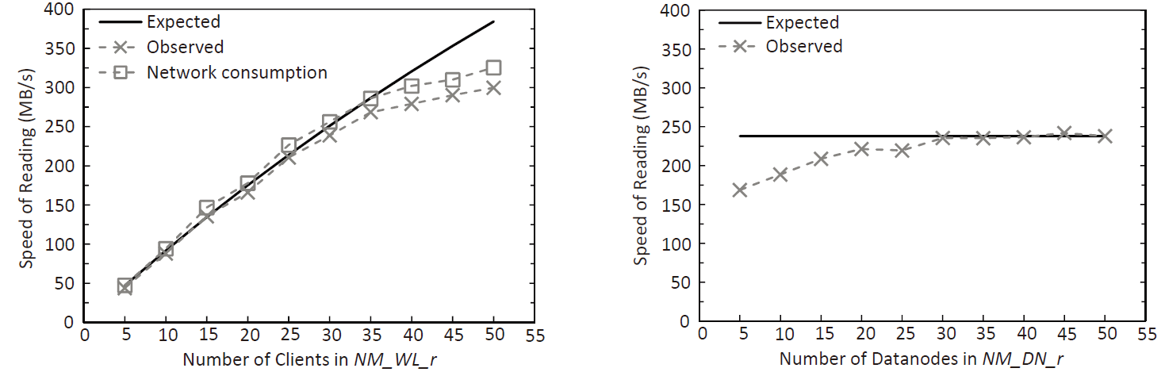
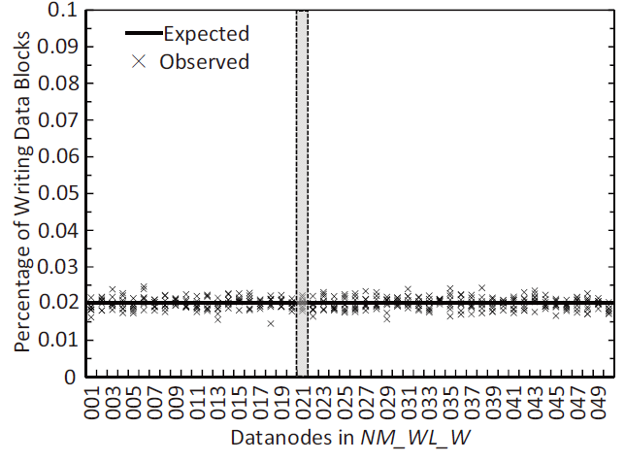
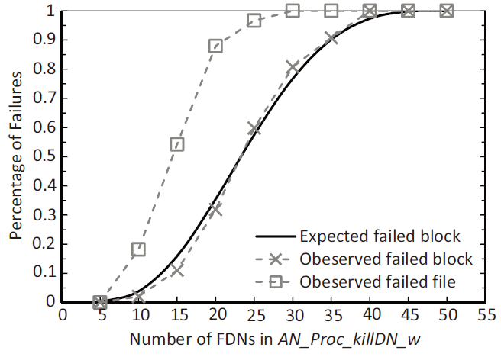
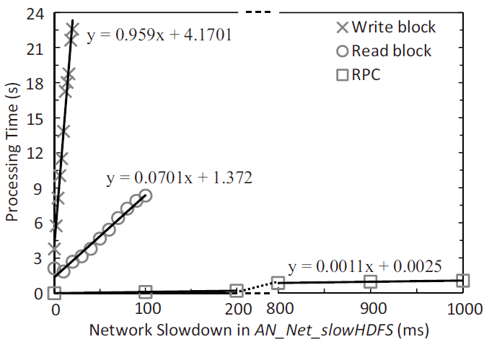
Data Analysis
Based on TraceBench, we analyzed the behaviors of HDFS on the aspects of request handling, workload balancing, fault influence, etc.
Notes:
Based on TraceBench, we analyzed the behaviors of HDFS on the aspects of request handling, workload balancing, fault influence, etc.

Slide 23
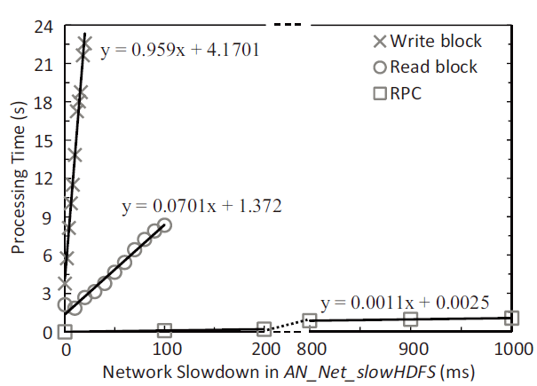
Data Analysis
Based on TraceBench, we analyzed the behaviors of HDFS on the aspects of request handling, workload balancing, fault influence, etc.
Analysis of the influence of a performance fault
Notes:
This is the analysis of the influence of a performance fault, slowHDFS, which slows the cluster network by milliseconds. The processing time of each operation increases as the network becomes slower. The slope of each curve reflects the sensitivity of the corresponding operation to this fault. Because requiring plenty
of network communications, writing a block is the most sensitive operation, whose slowdown is about 1,000 times of the network slowdown, i.e., one millisecond slowdown in network results in one second increase in writing a block. Since only a few network interactions are required, RPC is the least sensitive one, where one millisecond slowdown results in one millisecond increase.

Slide 24
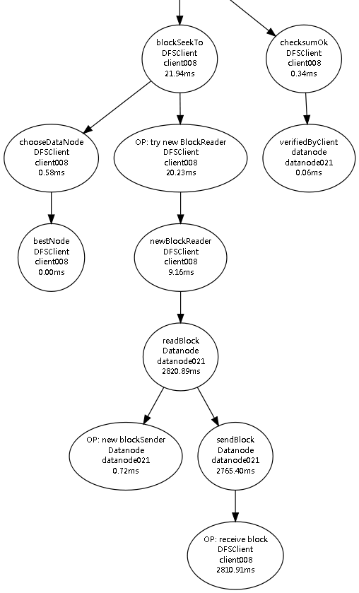
Detecting Failed Requests
The same kind of user requests usually result in the traces with similar topologies, which can be extracted as properties.
For example:
Reading a data block starts with invoking:
blockSeekTo (B)
if success, ends with:
checksumOK (K)
So, a successful file read request should satisfy the following LTL property:
Exist
Always
Next
Read at least one data block
The last data block reading
Successfully reading
If a trace of read request violates the property, we say a failure happens.
Notes:
The same kind of user requests usually result in the traces with similar topologies
For example, reading a data block
starts with invoking the function “blockSeekTo” (short for B),
and ends with calling “checksumOk” (K) if success
So, a successful file read request should satisfy the following property:
i.e., read at least one data block
and the last data block
should be read successfully
If a trace of read request violates the property, we say a failure happens.

Slide 25
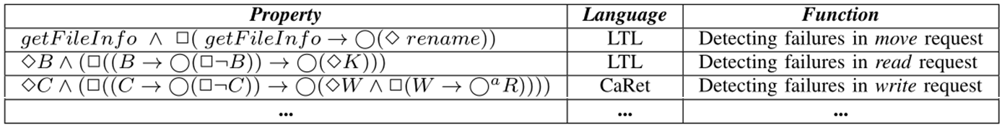
Detecting Failed Requests
Similarly, we extracted properties for other requests:
In the form of SQL queries, we check the traces with above properties in some TraceBench sets with faults injected in.
100% of failed traces are identified without FPs.
Besides detecting failures, we also extracted properties for detecting faults in requests, e.g., read request:
Notes:
Similarly, we extracted properties for other requests.
To validate these properties, we checked the traces in some TraceBench sets in the form of SQL queries to detect failures.
All of the failed requests are picked out correctly.
Besides the properties for detecting failures, we have also extracted tens of properties for diagnosing various faults, such as datanode invalid, data block missing, operation latency anomaly, etc. All of these properties can be in turn used to monitoring an HDFS system with different methods,

Slide 26
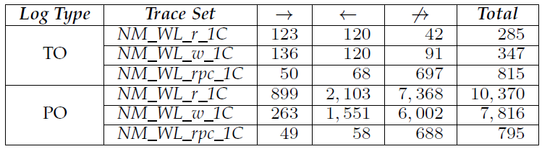
Mining Temporal Invariants
Synoptic*: a tool for mining temporal invariants from logs.
With Synoptic, we mined temporal invariants in TraceBench:
Always followed by
Never followed by
Totally ordered
From TraceBench
Always precedes of
partially ordered
*https://code.google.com/p/synoptic/
Notes:
The temporal invariant is an important respect of system features. Synoptic is a famous tool for mining temporal invariants from logs. With Synoptic, we mined temporal invariants in some TraceBench sets.
Here is the results.
We focus on three kinds of invariants: “Always followed by”, “Always precedes of” and “Never followed by”
TO represents for the totally ordered logs and the PO represents for the partially ordered logs

Slide 27
Mining Temporal Invariants
When dealing PO logs:
1. Too many invariants are generated.
2. Some false invariants arise.
3. many invariants contain the same information.
Reason: Synoptic treats the same kind of events generated from different hosts as different events.
Conclusion: When dealing PO logs, Synoptic seems to be more suitable for the systems with few hosts.
Notes:
We found that, when dealing with PO logs,
Synoptic generates too many invariants
in which some invariants are false
and some contain the same information
The reason is that Synoptic treats the same kind of events generated from different hosts as different events.
So, when dealing PO logs, Synoptic seems to be more suitable for the systems with few hosts.

Slide 28
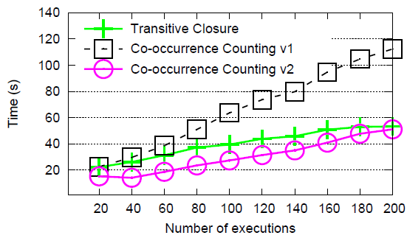
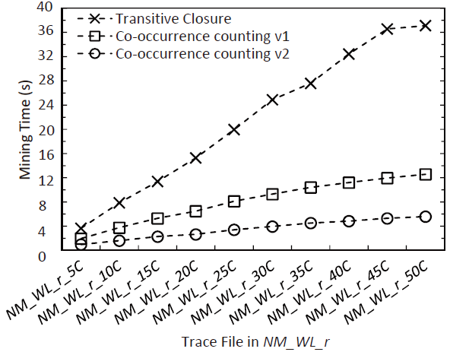
Mining Temporal Invariants
Synoptic on synthesized logs vs. on TraceBench
with synthesized logs [1]
with TraceBench
The experiment results based on TraceBench are more convincing.
[1] I. Beschastnikh, Y. Brun, M. D. Ernst, A. Krishnamurthy, and T. E. Anderson, “Mining temporal invariants from partially ordered logs,” ACM SIGOPS Operating Systems Review, 45(3), pp. 39–46, 2011.
Notes:
We also redid the experiments of Synoptic for comparing different mining algorithms, where the original experiments employed the synthesized logs and ours based on TraceBench.
The experiment results based on TraceBench are more convincing than the original one, which validates the authenticity of TraceBench.

Slide 29


Diagnosing Performance Anomalies
We implemented a PCA based performance anomalies diagnosing algorithm[2] and evaluated it with TraceBench.
(total anomalies),(found anomalies),(incorrectly found anomalies)
[2] A. Lakhina, M. Crovella, and C. Diot, “Diagnosing networkwide traffic anomalies,” in Proceedings of SIGCOMM 2004, pp. 219–230, 2004.
Notes:
We also implemented a principal component analysis (PCA) based performance anomalies diagnosing algorithm, which finds the traces with abnormal latencies and
locates the faulty events as root causes.
We evaluated the algorithm on TraceBench in two experiments.
that is, fix the trace length and change the trace amount
and fix the amount of trace and change the trace length
the diagnosing results are expressed as (total anomalies),(found anomalies),(incorrectly found anomalies)

Slide 30
Diagnosing Performance Anomalies
1. Find all anomalies in some cases
2. However sometimes only a small parts
3. Without false alarm in our experiments
4. Analysis time increases very fast with the trace length
5. but slowly when growing the trace amount
This algorithm is sensitive with the feature of data
This algorithm is pretty accurate
This algorithm is more feasible for short traces
Notes:
This algorithm finds all anomalies in some cases,
and however sometimes only a small parts
Actually, the results depend on the features of data, since only some outliers exceeding the related thresholds are reported as anomalies. So, when some very abnormal traces exist, some other less abnormal ones would be ignored.
in our experiments this algorithm reports no false alarms
which indicates the accuracy of this algorithm
On the other hand, the analysis time increases very fast when increasing the trace length,
but slowly when growing the trace amount,
which indicates that this algorithm is more sensitive to trace length than trace amount.

Slide 31
Discusses
Notes:
Finally, we discuss some aspects of TraceBench

Slide 32
Discusses
Traces are collected only on HDFS.
Traces from HDFS are representative, because:
HDFS is a widely used system,
and many mechanisms and procedures in HDFS are shared by others.
During collection, the HDFS cluster is small.
It is enough for exhibiting various features of HDFS, because:
traces are collected in different scenarios.
Many other faults exist rather than the injected faults.
Injected faults are representative, because:
containing different types,
involving both function and performance faults,
and selecting the most frequent faults.
Notes:
﻿We collected traces only on a HDFS system
However, the traces from HDFS are representative. Because HDFS is a widely used system in academia and industry, and many mechanisms and procedures in dealing user requests in HDFS are shared by other systems.
During collection, the HDFS system maximally contains 50 datanodes
It is enough for exhibiting various features of HDFS, because the traces are collected in different scenarios
Besides the faults we introduce, many others exist.
Nevertheless, the faults we selected are representative, because we consider different fault types involving both function and performance faults, and the chosen faults are the most frequent ones in real systems.

Slide 33
Thanks and Any Questions?
http://mtracer.github.io/TraceBench/
Notes:
TraceBench is freely available at the link on the left bottom corner.
Thanks and any Questions?

