Slide 1
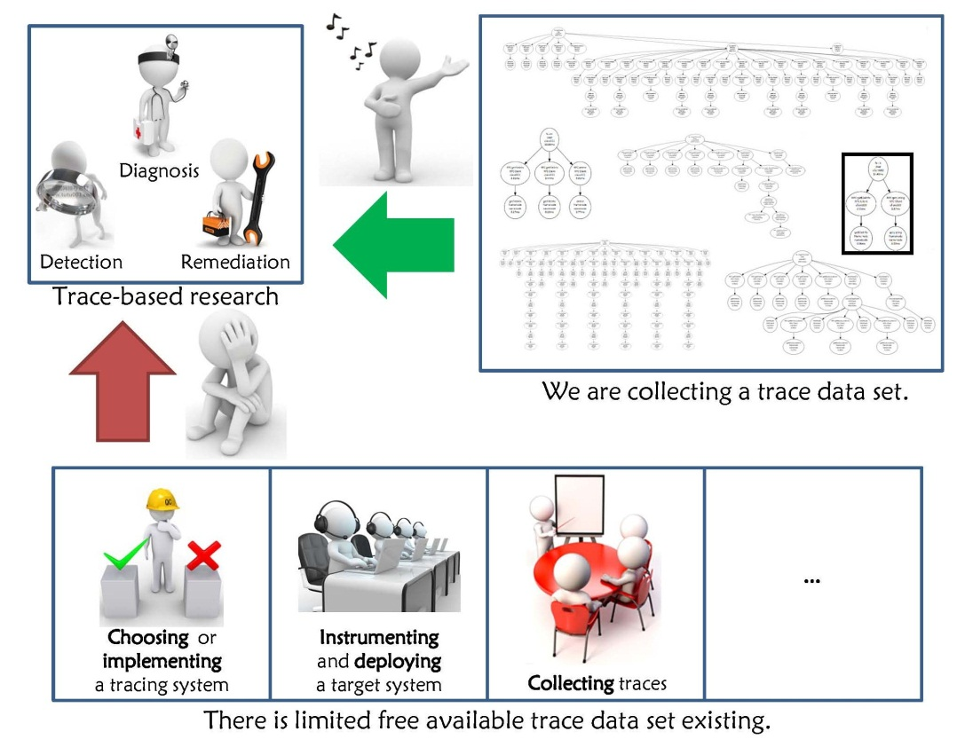
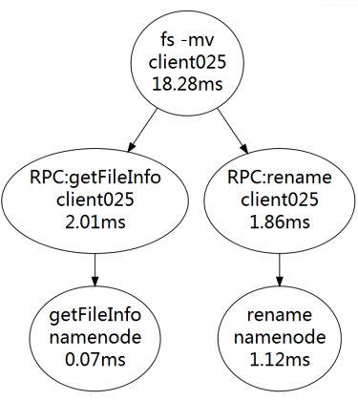
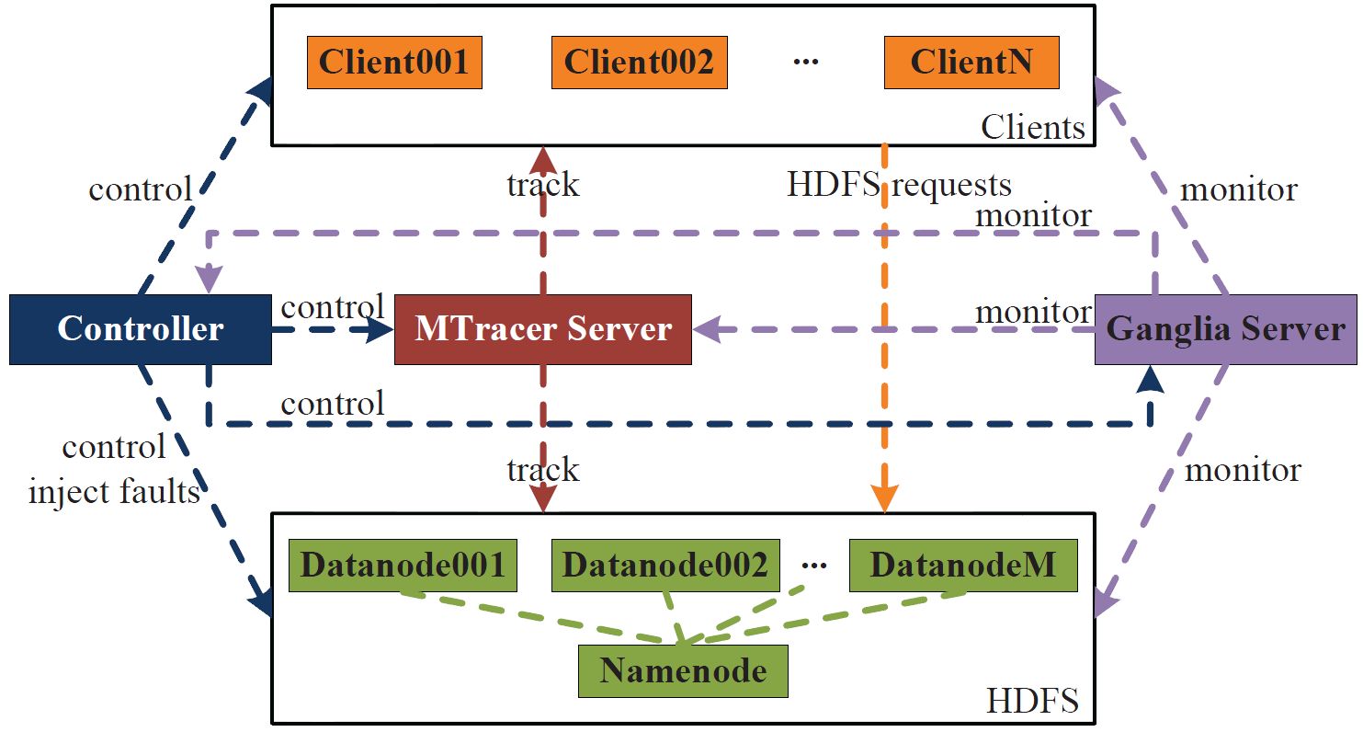


Jingwen Zhou, Zhenbang Chen, Ji Wang,
Zibin Zheng, and Michael R. Lyu
Towards An Open Data Set for Trace-Oriented Monitoring
1. Motivation
2. Data Set
3. Details of Collection
Class | Type
NM | WL
 | DN
AN | Proc
 | Net
 | Data
 | Sys
COM | Single
 | All
During collection, many aspects are considered, including cluster sizes, user requests, workload speeds, injected faults, etc., to
simulate different situations.
We believe that this data set will be helpful for the research of
trace-oriented monitoring.
For more information, please contact
Jingwen Zhou: jwzhou@nudt.edu.cn or Zhenbang Chen: zbchen@nudt.edu.cn

