Slide 1





Towards An Open Data Set for Trace-Oriented Monitoring
Jingwen Zhou¹, Zhenbang Chen¹, Ji Wang¹,
Zibin Zheng², and Michael R. Lyu^{1,2}
¹National University of Defense Technology, Changsha, China
²Chinese University of Hong Kong, Hong Kong, China
Email: {jwzhou, zbchen}@nudt.edu.cn
This work is supported by :
National 973 Program of China (No. 2011CB302603)
NSFC (No. 61161160565 and No. 61303064)
SRFDP (No. 20114307120015)

Slide 2







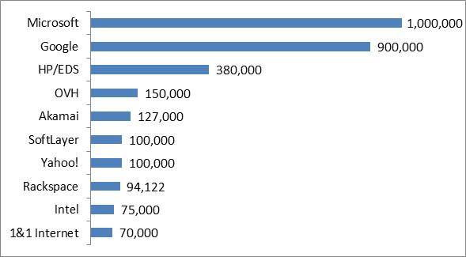

Motivation
…
…
Benefiting our daily life
Supporting different fields
The cloud system becomes more and more popular
2013.7
Increasing in scale
Increasing in complexity
Notes:
1. The cloud system becomes more and more popular
2. benefits our daily life, such as online surfing, online shopping, send or receive emails.
3. and supports different fields, like transportation, scientific computation, and medical care
4. At the same time, the cloud systems become more and more large. Microsoft has 218,000 servers in 2008 and announce 1 million last year, which increases nearly 4 times in 5 years.
5. and the cloud systems also become more and more complex, like systems in Google concurrently applies plenty of services, such as search, mail, advertisement, storage, etc.

Slide 3
Motivation
…
…
Benefiting our daily life
Supporting different fields
problems happen more and more often in cloud systems
The cloud system becomes more and more popular
2013.7
Increasing in scale
Increasing in complexity
Notes:
1. Therefore, problems happen more and more often in cloud systems.

Slide 4







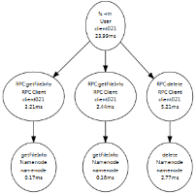
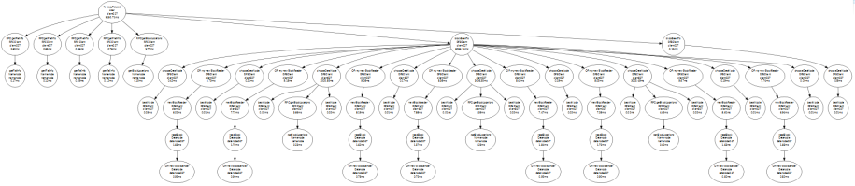
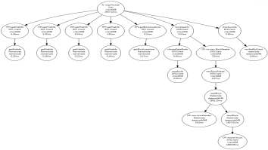
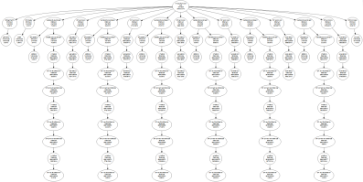
Motivation
In August 2013, meltdowns successively
happened in:
Company | Loss
Amazon | Lost 7 million dollars in 100 minutes.
Google | Lost 550,000 dollars in less than 5 minutes, and the global internet traffic dropped 40%.
…
problems happen more and more often in cloud systems
and bring enormous loss
Detection
Diagnosis
Remediation
Trace-oriented monitoring is one of the methods to improve system reliability at runtime.
Notes:
1. For example, in August 2013, the systems of Apple, Google, Microsoft and Amazon were crashed successively for different reasons.
2. These problems usually bring enormous loss, Amazon lost 7 million dollars in less than 100 minutes during the meltdown last year, while Google lost 550; 000 dollars in 5 minutes, and the global internet traffic dropped 40%.
3. Trace-oriented monitoring is one of the methods to improve system reliability at runtime.
4. With the data recorded by tracing systems, namely trace,
5. many activities can be carried out, such as fault detection, fault diagnosis, and even remediation.

Slide 5



Diagnosis
Detection
Remediation
Trace-based research
Detection
Diagnosis
Remediation
There is limited free available trace data set existing.
Notes:
1. However, there is no freely available trace data set existing in academia and industry.

Slide 6


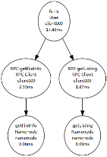
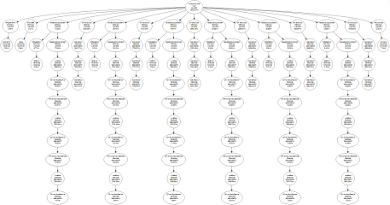
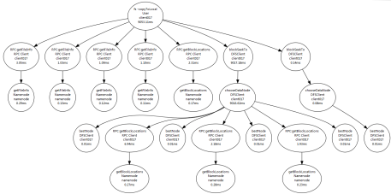




Diagnosis
Detection
Remediation
Trace-based research
We are collecting a trace data set.
…
Choosing or
implementing
a tracing system
Instrumenting
and deploying
a target system
Collecting traces
There is limited free available trace data set existing.
Notes:
1. As a result, before starting a certain trace-based research, plenty of work need to be done first, including choosing or even implementing a tracing system, instrumenting a target system, deploying the instrumented system, collecting different kinds of traces, and so on
2. which is a tedious and time-consuming process. Actually, the lack of trace data hinders the development of trace-based research.
3. So, we are collecting a trace data set,
4. With the data set, many trace-based research can be simply carried on, saving many heavy jobs.

Slide 7

Diagnosis
Detection
Remediation
Trace-based research
Each element in our data set is a trace.
The trace records the execution path of a user request.
Trace = events + relationships
Event: function name and latency …
Relationship: local and remote function calls …
Trace → Trace Tree
Nodes and edges correspond to events and relationships, respectively.
Sample: A trace tree about a read file request in HDFS.
We are collecting a trace data set.
…
Choosing or
implementing
a tracing system
Instrumenting
and deploying
a target system
Collecting traces
There is limited free available trace data set existing.
Notes:
Each element in our data set is a trace,
which records the execution path of a user request.
A trace consists of the events and the relationships,
where each event records the context of a request step, such as function name and latency,
and a relationship records the casual relation between two events, like local and remote function calls.
According to the events and the relationships, a trace can be constructed to a trace tree,
in which the nodes correspond to the events and the edges correspond to the relationships
This figure illustrates the process of handling a read file request in HDFS. The client first queries the file information from the namenode, then downloads the file from related datanode, and last informs the result to the namenode.

Slide 8
Structure of Data Set
Class
Type
Trace File
Normal
Workload
collected under different workload speeds
considering different requests, etc.
collected when HDFS running normally
Datanode
collected with various cluster sizes
Process
affect the processes on HDFS nodes
considering different requests, number of faulty nodes, etc.
Abnormal
Network
bring anarchies to the network in the cluster
collected when a fault injected
Data
introduce errors in the data on datanodes
System
inject faults to OSs of the HDFS nodes
Combination
Single
faults are chosen from a single fault type
repeat many times
collected when faults are randomly injected and later eliminated
All
faults are chosen from all the four types
Notes:
1. In our plan, this data set consists of three classes: Normal , Abnormal and Combination. where the Normal class and the Abnormal class are collected during the HDFS running normally and abnormally, respectively, while the Combination class is collected by randomly injecting faults and later recovering the system
2. each class includes several types.
3. The Normal class contains two types. Trace in the Workload type are collected under different workload speeds, while the Datanode type mainly considers various cluster sizes decided by the number of the datanodes in the HDFS system.
4. The Abnormal class consists of four types according to the fault type. The Process faults affect the processes on HDFS nodes, while the Data faults introduce errors in the data on datanodes, and the faults in the Network type and the System type bring anarchies to the network in the cluster and the OSs of the HDFS nodes, respectively.
5. ﻿According to whether faults are picked from a single fault type or all the four types, the Combination class can be divided into the Single type and the All type.
6. When collecting the traces of each type, we consider different aspects, like requests type and number of faulty nodes, etc., to simulate various scenarios. Thus, each type contains many trace files, each of which contains the traces collected in a scenario.

Slide 9
Details in Collection
client001
client002
…
clientN
Clients
control
track
HDFS requests
monitor
monitor
controller
control
MTracer Server
monitor
Ganglia Server
control
control
inject faults
track
monitor
Datanode001
Datanode002
…
DatanodeM
Namenode
HDFS
CloudStack
Notes:
1. We deploy the environment on CloudStack in a real cluster
2. We choose the HDFS system as the target system, with one namenode and many datanodes. (M=50)
3. Clients, simulating real users, generate different requests to HDFS. (N=50)
4. Use the MTracer, we developed, to tracks the process of handling requests and collects the traces.
5. The controller controls the collection process and injects faults.
6. The Ganglia server monitors all nodes and the whole process

Slide 10
Details in Collection
start MTracer
and HDFS
stop MTracer
and HDFS
Normal
start Clients
trace collection period
stop Clients
request handling period
inject
a fault
recover
the system
Abnormal
request handling period
inject
a fault
inject
a fault
inject
a fault
inject
a fault
inject
a fault
Combination
request handling period
Notes:
1. When collecting trace in the Normal class,
2. we first start the MTracer server and the HDFS system with a certain cluster size
3. then launch bash scripts concurrently on some clients to generate workload
4. After finishing the collection, workload terminates first
5. and the HDFS system and the MTracer server stop after finishing all requests
6. during handling request,
7. the HDFS system is running normally all the time
8. While in collecting Abnomral class,
9. faults are injected before starting workload
10. and the system is recovered after finishing all requests
11. to makes sure all requests are handled during the HDFS is running abnormally
12. While in the Combination class
13. faults are randomly injected after starting workload then the system ﻿is recovered after an interval, and the next fault is carried out in a same way, which simulates occasionally happened faults.

Slide 11
Threads to Invalidity
Traces are collected only on HDFS.
Traces from HDFS are representative, because:
HDFS is a widely used system,
and many mechanisms and procedures in HDFS are shared by others.
During collection, the maximal DN number is 50.
It is enough for exhibiting various features of HDFS, because:
traces are collected in different scenarios.
Many other faults exist rather than the injected faults.
Injected faults are representative, because:
containing different types,
involving both function and performance faults,
and selecting the most frequent faults.
Notes:
﻿We collect traces only on a HDFS system
However, the traces from HDFS are representative
because HDFS is a widely used system in academia and industry, and many mechanisms and procedures in dealing user requests in HDFS are shared by other systems.
During collection, the HDFS system maximumly contains 50 datanodes
It is enough for exhibiting various features of HDFS, because
the traces are collected in different scenarios
Besides the faults we introduce, manyothers exist.
Nevertheless, the faults we selected are representative, because
we consider different fault types
both function and performance faults
and choose the most faults in real systems.

Slide 12
Thanks for your attention!
Jingwen Zhou, Zhenbang Chen, Ji Wang,
Zibin Zheng, and Michael R. Lyu
Email: {jwzhou, zbchen}@nudt.edu.cn
This work is supported by :
National 973 Program of China (No. 2011CB302603)
NSFC (No. 61161160565 and No. 61303064)
SRFDP (No. 20114307120015)
Notes:
thanks for your attention. and any questions?

