Slide 1


Workshop Statistical Analysis and Data Visualization Using RStudio
Max Trauernicht, PhD candidate
Bioinformatics
Netherlands Cancer Institute
University of Twente

Slide 2
Outline of the workshop today
Introduction to the workshop (ppt) [~10 minutes]
Introduction to GitHub workshop page [~15 minutes]
Setting up RStudio [~15 minutes]
Introduction to RStudio & tidyverse [~30 minutes]
Hands-on work in RStudio [~2 hours]

Slide 3
Learning objectives
By the end of this session, you will be able to:
Navigate RStudio and understand its key components.
Use tidyverse for efficient data manipulation.
Create professional ggplot2 visualizations.
Perform basic statistical analyses.
Document and present your results using RMarkdown.

Slide 4
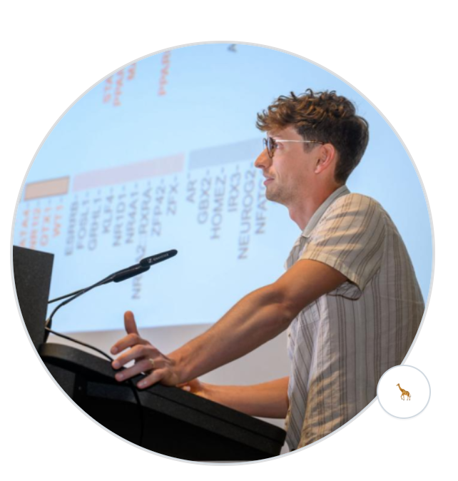
My background
PhD candidate in genomics & bioinformatics
Specialized in developing custom computational pipelines for analyzing large-scale genomics datasets using R and Python

Slide 5
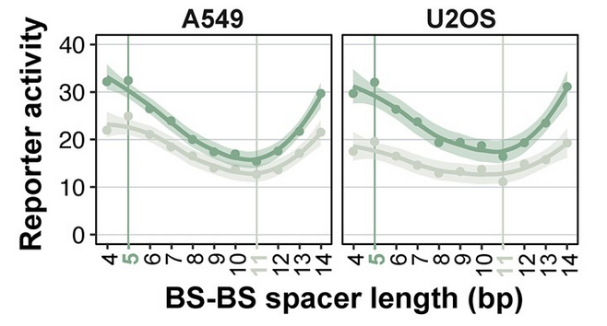
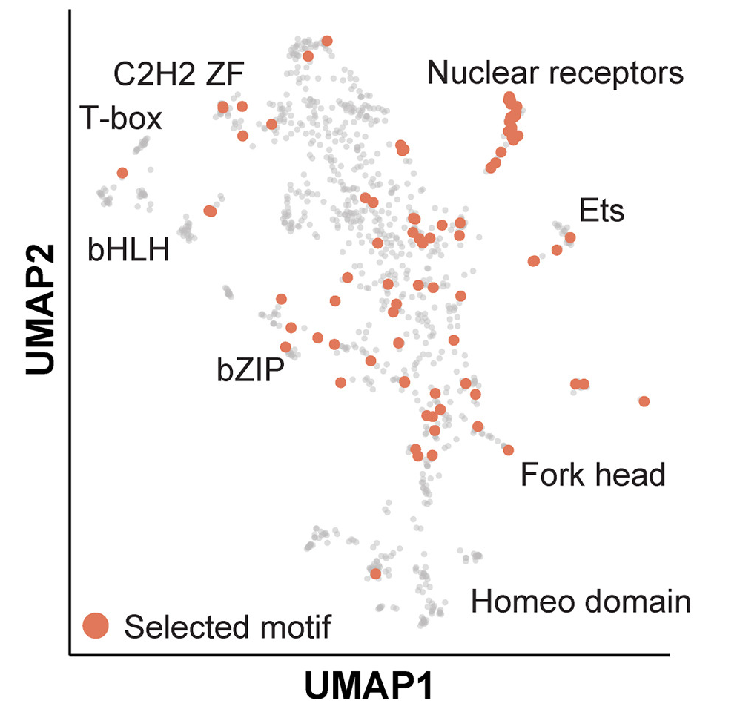
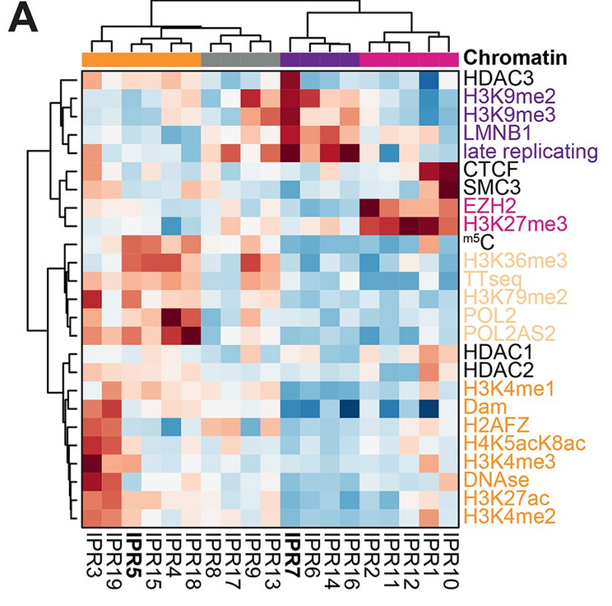
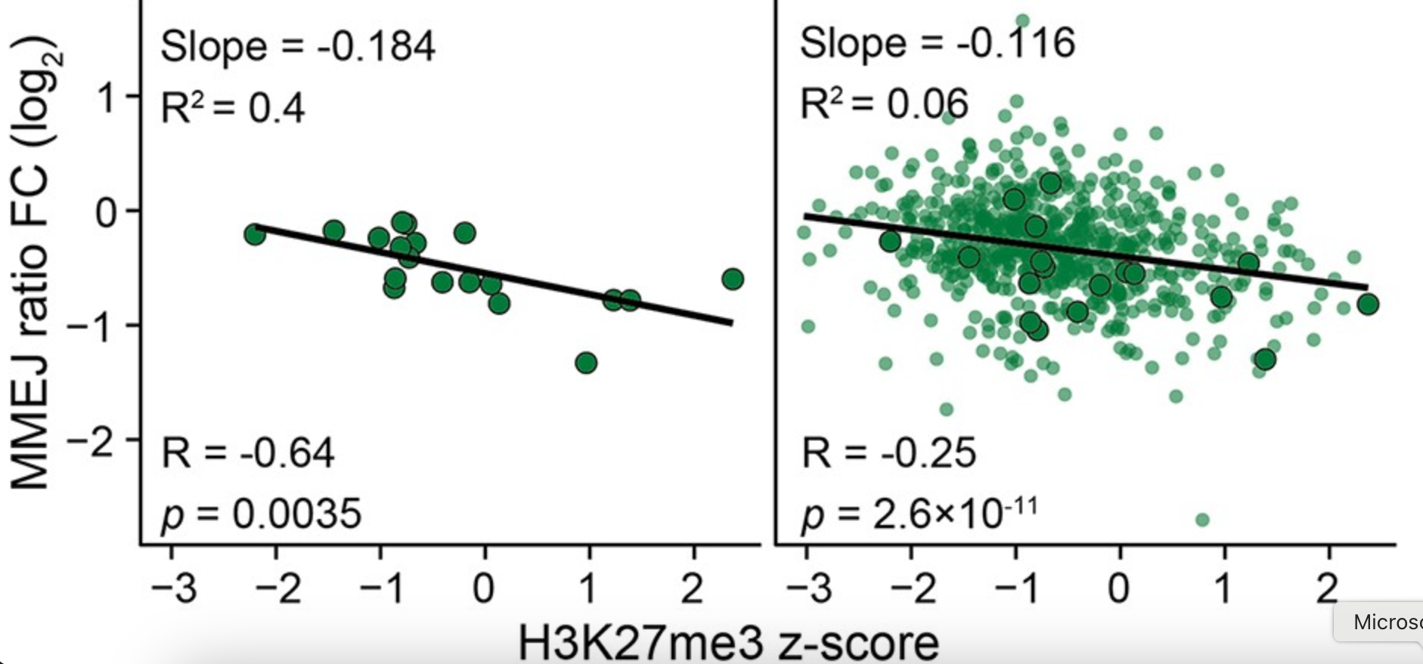
Examples of what we are doing with R
Advanced data visualization
Data modelling & statistical testing

Slide 6
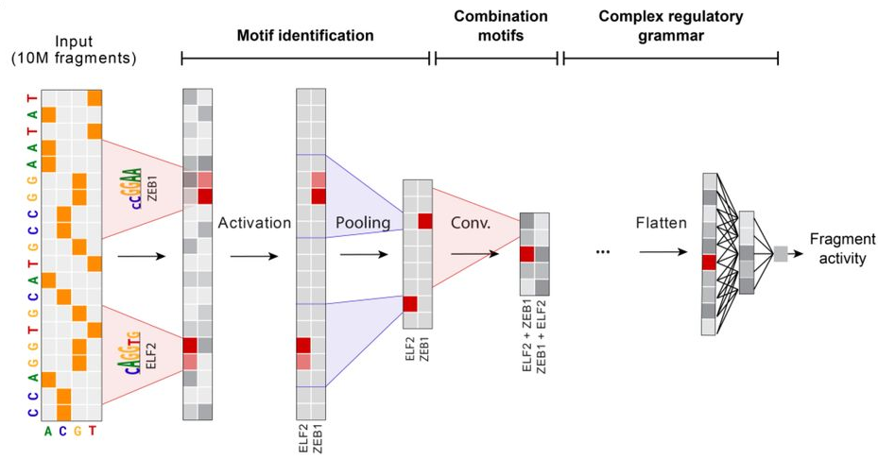
Examples of what we are doing with R
Deep learning (mainly python)
Data modelling & statistical testing

Slide 7
Why R and Rstudio?
Designed for statistical computing
Highly customizable data visualization
Easy data manipulation
User-friendly interface
Open-source

Slide 8
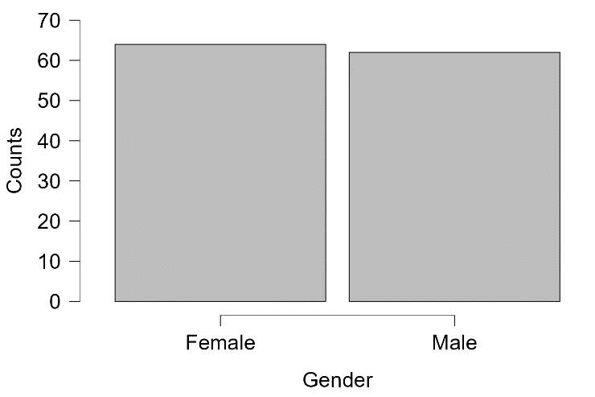
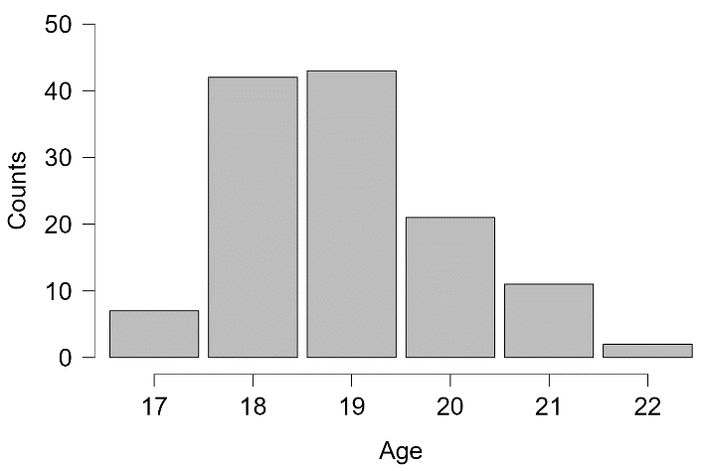
Dataset for the exercises today
Cybersecurity questionnaire:
Students were asked about the importance of cybersecurity before and after a cybersecurity workshop -> two datasets available (for before and after)
Gender distribution
Age distribution

Slide 9
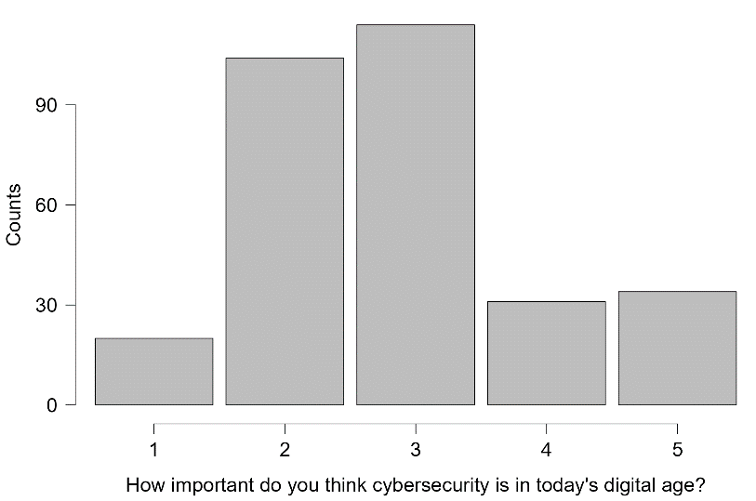
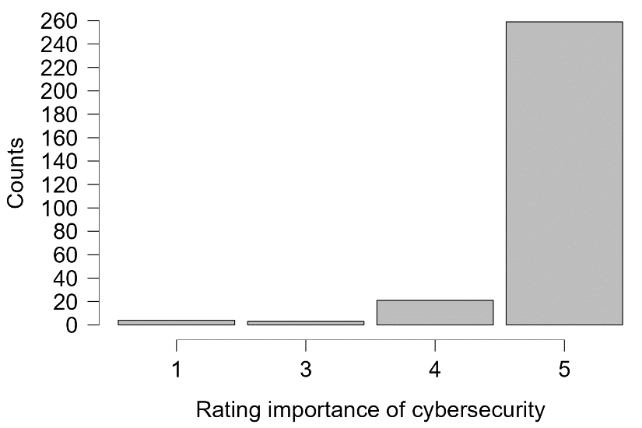
Dataset for the exercises today
Before workshop
After workshop
1 = very bad, 5 = very good

Slide 10
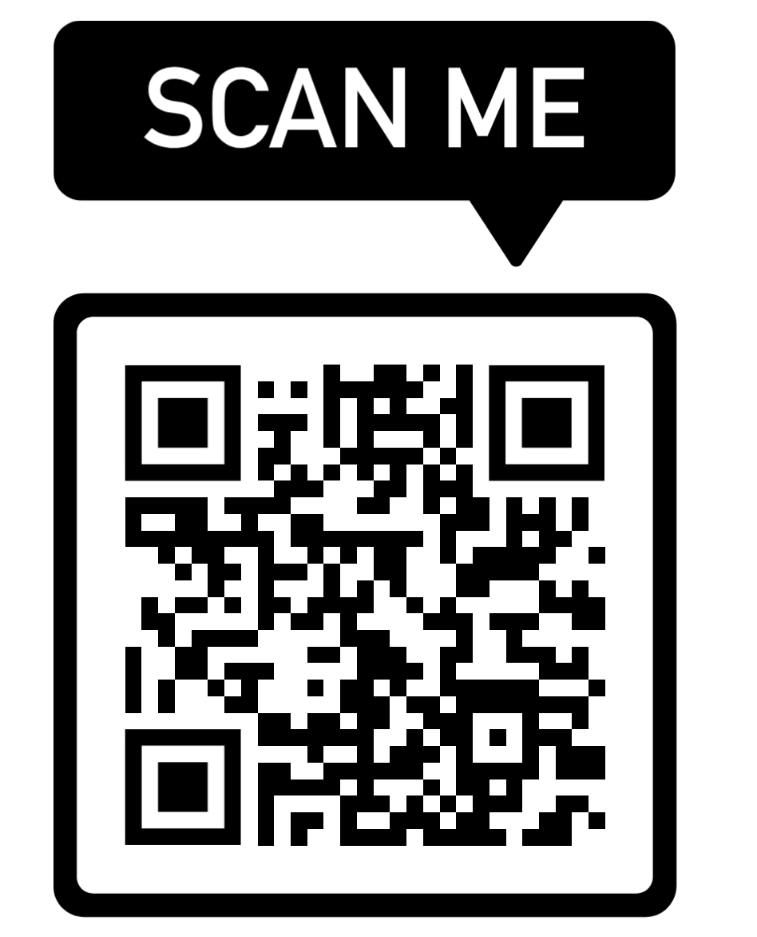
GitHub workshop page
All information & exercises on:
https://github.com/mtrauernicht/RStudio_workshop

