Slide 1
note chromatic pitch indices
(dim = 88)
quarter note
sixteenth note steps
(dim =
16 * measures)
eighteenth note chords

Slide 2
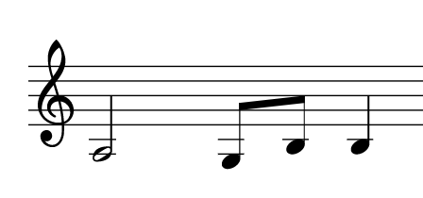
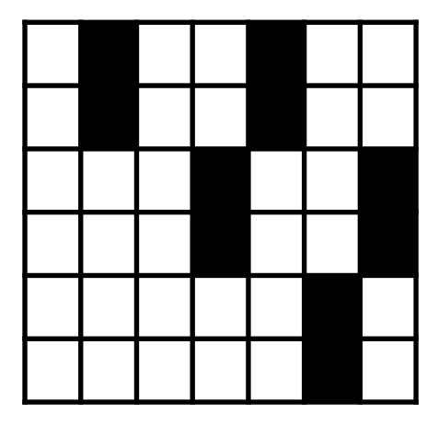

training
testing

