Slide 1
GRaSS: The Next Generation Subsetter/Regridder Science Category
_____________________________________
Jay Su, Code 610.2
Margaret Trimpin, Towson University
Notes:
Good afternoon everyone, my name is Margaret Trimpin, and I am here to present my Fall 2021 research, on developing GRASS: the next generation subsetter and regridder.

Slide 2
Introduction
Goal: To develop a
Subsetter and Regridder superior to the current tool in use, LEARS (Level 3/4 Regridder and Subsetter). Uses CDO as a backend.
Abilities:
Spatial Subset
Temporal Subset
Vertical Subset
Variable Subset
Regrid based on a variety of different interpolations and resolutions.
Notes:
The goal of this research project has been to develop a subsetter and regridder superior to the
current tool in use, LEARS (Level 3/4 Subsetter and Regridder). Though working, LEARS has limited functionality and is far from optimized; both factors that prompted this research.
So, a little background on LEARS: The NASA Goddard Earth Sciences Data and Information Services Center (GES DISC) Level 3/4 Regridder and Subsetter (LEARS) has been the primary subset and regrid tool used for Earth Satellite Data for years. It is one of the most popular HTTP services at the center in terms of number of files and volume of data moved. This tool provides the ability to subset spatially, temporally, vertically and by variable, and regrid based on a variety of different interpolations and resolutions. These processes are executed using CDO as a backend.
Though working, the LEARS tool is still limited in some functionality and is far from optimized. Thus, this project aims to see if we can develop a new, more optimal subsetter and regridder.

Slide 3
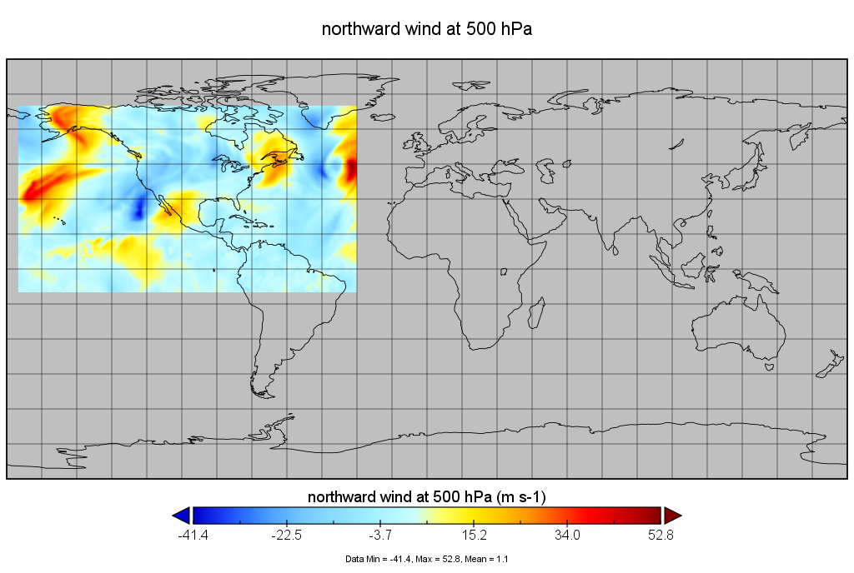
Brief Background on Subsetting
Subsetting is the process of retrieving just the parts of large files which are of interest for a specific purpose.
Notes:
So, we know that the LEARS tool can subset and regrid data, but what does that MEAN?
**Subsetting** is the process of retrieving just the parts of large files which are of interest for a specific purpose. The main purpose of subsetting is to save bandwidth on the network and storage space on the client computer.
There are many reasons to subset data, including
* restrict or divide the time range
select cross sections of data
exclude particular observations
Spatial subsetting is the easiest one to visualize , so here you can see an example of spatial subsetting from the coordinates -175, -30 longitude, -10, 70 latitude. Subsetting the data thusly increases the ease of observation for that area of interest, by excluding any irrelevant surrounding data.

Slide 4
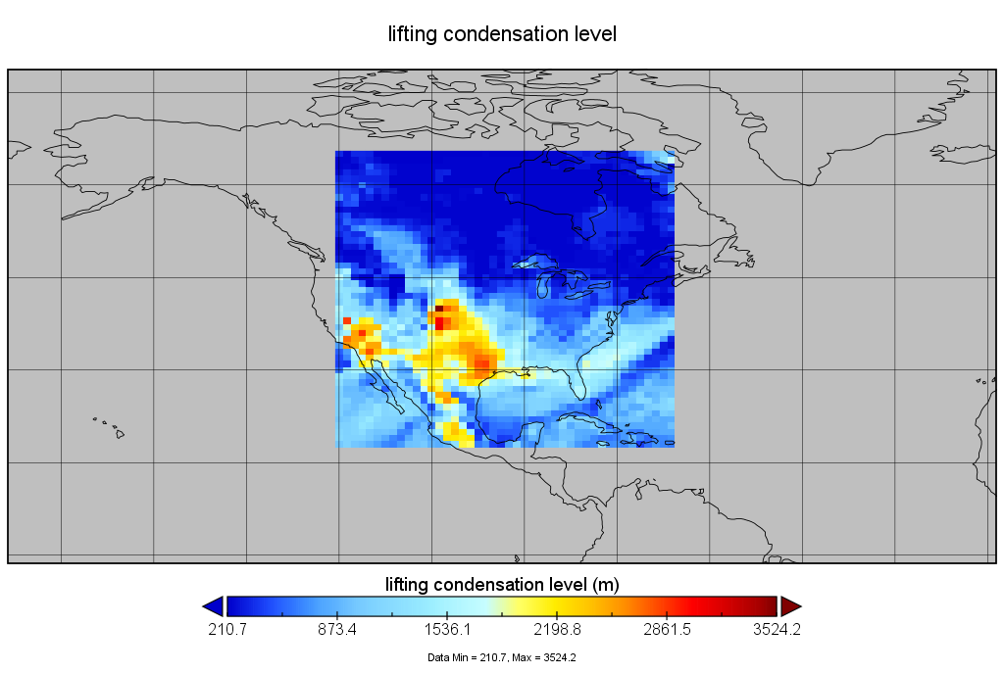
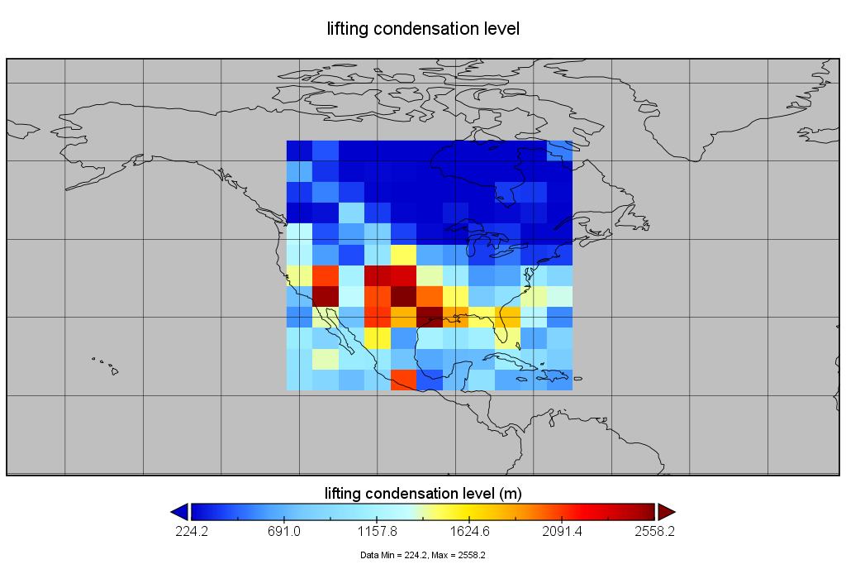
Input Grid
Brief Background on Regridding
Output Grid
Notes:
Regridding, on the other hand, is the process of interpolating from one grid resolution to a different grid resolution.
This can be done in many different ways, depending on a chosen interpolation method and grid resolution.
Interpolations refer to the method of regridding, which has to do with how points in the source grid contribute to points in the destination grid.
Resolution refers to the destination grid size or degree.
This shows an example of bilinear regridding. On the left is the original grid, showing North America. Its grid resolution is 1.0∘×1.5∘., meaning that the lat/lon data values occur at every 1x1.5 degree gridpoint.
On the right shows the same grid after regridding. The resolution for the output grid was defined as 5∘×5∘. Since the resolution of the output grid is larger than that of the input grid, it means that there will be fewer data values on the output grid than on the input grid. Now, datapoints occur at every 5 degree gridpoint.
Note that the input grid appears a lot more detailed than the output grid. Again, this is because the output grid was upsampled to a larger resolution, and thus plots data values less frequently.

Slide 5
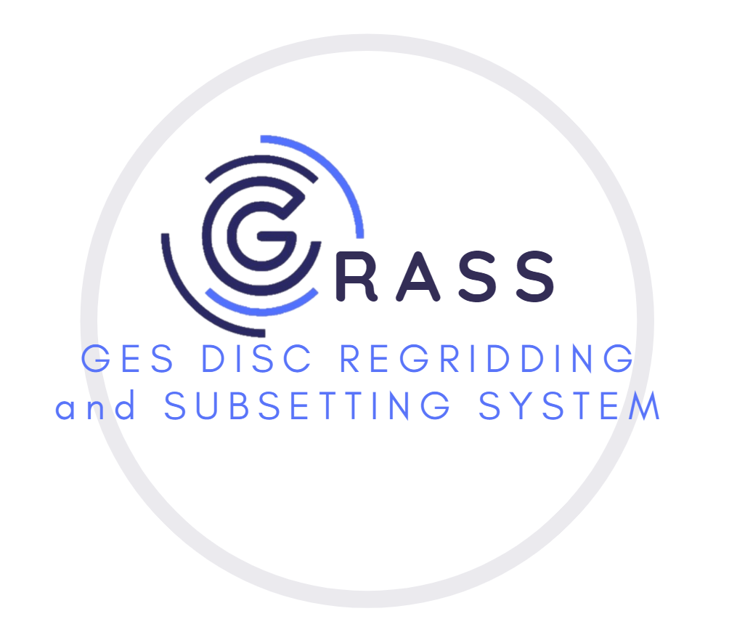
Methods & Approach
New Tool for Implementation: GRaSS (The GESDISC Regridding and Subsetting System).
GRaSS was developed using the Xarray and xESMF python packages, and using data from the GES DISC website for testing purposes.
Notes:
So, on to our tool. The tool that has been developed over the course of this project has been named GRASS (the GESDISC Regridding and Subsetting System).
GRaSS was developed using the Xarray and xESMF python packages, and using data from the GES DISC website for testing purposes.
The aim of this research has been to prove that GRASS produces identical output to LEARS on all subsetting and regridding processes. Once it does, we wish to prove that GRASS is superior; Whether it be in terms of functionality, efficiency, or customizability.

Slide 6
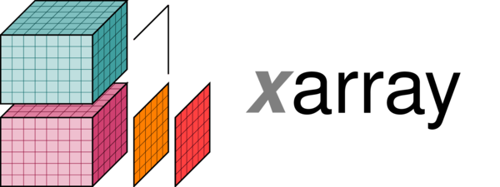
Methods & Approach – Why Xarray/xESMF?
Superior:
Functionality
Customizability
Versatility
Speed/efficiency
Additionally:
Compatible with xESMF regridding tool
Ability to process data other than MERRA
Notes:
As mentioned, the primary package used for GRASS’s development is xarray. ‘’Xarray is a python package for working with labeled multi-dimensional arrays, and includes functions for advanced analytics and visualization.
When compared to other data processing and subsetting tools, xarray displayed far more functionality and customizability, and is currently one of the fastest and most efficient tools available
Additionally, xarray datasets are comparable with xESMF, a fast, easy regridding package that uses ESMF as backend, with bilinear, conservative, nearest neighbor and patch interpolations supported. Xarray and xESMF are both also able to process a variety of different data sets and formats, meaning GRASS will not be limited to only processing MERRA Earth Data.
These are the two primary tools that will be used by GRASS to process datasets, analyze metadata, and perform subsetting and regridding operations.

Slide 7
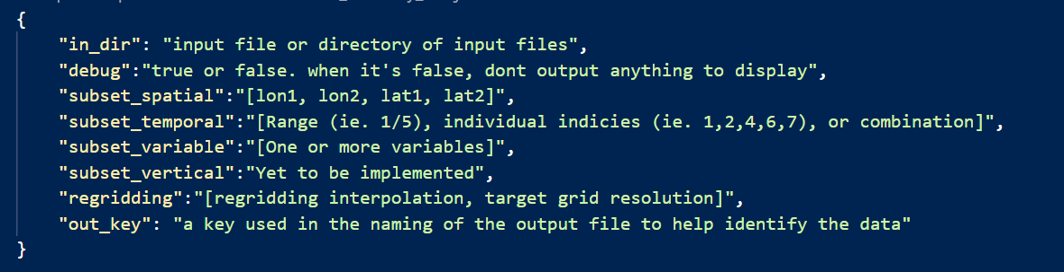
Methods & Approach- Input Format
Notes:
GRASS takes input in the form of a json file passed as a sole parameter. Said json file contains the following information:
As shown in the json input file above, the "in_dir" is where the user should supply the path to the netcdf file(s) for processing. If the "in_dir" field is a directory path rather than a file path, the script runs the following processes on each .nc4 file in the directory. Otherwise, it simply performs the operation on the one input file. Xarray also includes support for OPeNDAP data, which lets us access datasets over HTTP. Thus, the "in_dir" field can also be a link to a remote dataset, which the code can open and process accordingly.
Next, the "debug" field can be set to True or False, based on whether the user would like the program to output diagnostic updates to the compiler.
For the five fields reserved for subsetting and regridding, the program checks the values for each key. If a given key is not empty, a method is called to perform the subsetting or regridding operation that corresponds to the key title and value(s).
GRaSS checks for each key in the following order:
Variable subsetting, regridding, spatial subsetting, temporal subsetting, vertical subsetting (not yet implemented).
Each process is then executed on the dataset one by one. The new dataset output by GRASS after processing becomes the working dataset to be passed on to the next process.

Slide 8
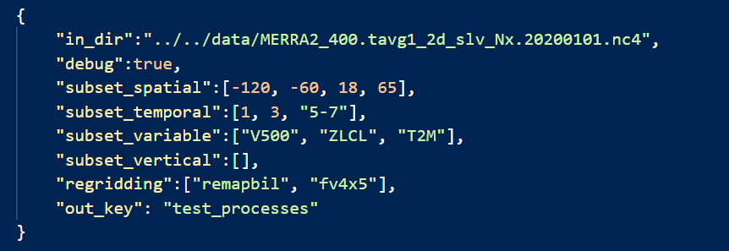
Methods & Approach- Input Format
Notes:
Here is an example input json file. As you can see, we have the input directory, which is the path to the netCDF file for analysis. Next we have debug=true, meaning we wish to see diagnostic reports.
As you can see, we wish to perform spatial, variable, and temporal subsetting on this dataset, as well as regridding. The spatial subset field tells us that the output file will show data only between the coordinates of -120 to -60 degrees longitude and 18 to 65 degrees latitude. The numbers indicated in the temporal subset field tells us that the output dataset will only contain data for 1, 3, and 5-7 hours after midnight on the daily dataset. The subset variable field shows the variables we wish to include in the output dataset, and finally, the regridding field shows us two keys- one corresponding to the interpolation method, and one corresponding to the resolution. Both of these keys are interpreted in GRASS. For example, “remapbil” translates to bilinear interpolation, and fv4x5 translates to a 4x5 degree global resolution.
Once all of the operations are complete, a new nc4 file is outputted to an arbitrary temporary directory, with a name identifiable by the output key.

Slide 9
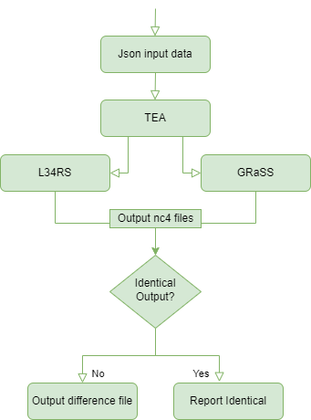
Results
TEA (the Tool Equivalence Analyzer): Compares outputs GRaSS and LEARS, generated by the same input file of subsetting and regridding parameters.
Notes:
In order to evaluate the accuracy and performance of the new tool, an additional script was created to compare the output files of GRASS against those of LEARS. This comparison script is called TEA, the Tool Equivalence Analyzer.
TEA's purpose is to compare files subsetted and regridded by GRASS to those subsetted and regridded by LEARS, using the same input values. The files will be compared using the [NCO] tool nccmp.
TEA reads the input json file and searches for existing output files from each tool for that file. If the files do not exist, then TEA runs each tool on the input file, where an output netcdf file is generated. TEA then runs the nccmp operation on the generated output files in the command line. If the output files already exist, TEA simply compares the existing files.
If the files are identical, the program reports as such. If differences in the comparison files are detected, they are outputted to a text file in a temp directory, with a name corresponding to the names of the two tools and json file under evaluation.

Slide 10
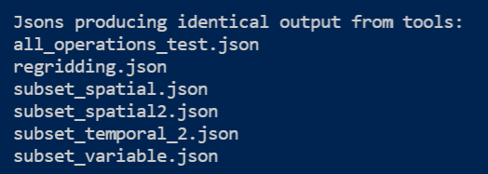
Results
According to TEA, GRaSS was observed to produce identical output files to those of LEARS.
Notes:
Upon comparison of the completed GRASS tool with the currently implemented LEARS tool, GRASS was observed to produce identical output files to those of LEARS. All functions were tested by TEA, with many different input varieties for each process. Here we have screenshots of example TEA output, and note as well that TEA is able to process many json test files at once

Slide 11
Functionality Evaluation against LEARS
Things that set GRASS apart from LEARS:
Remote file processing functionality
Ability to take a json files as input
Ability to process multiple json files as an input and process all of them accordingly
Notes:
As a whole, GRASS provides more functionality than the existing LEARS tool. Thanks to its xarray sctructure, it provides a variety of advanced operations and more customizability than otherwise available with CDO (The library used by LEARS). Aspects that set GRASS apart from LEARS include:

Slide 12
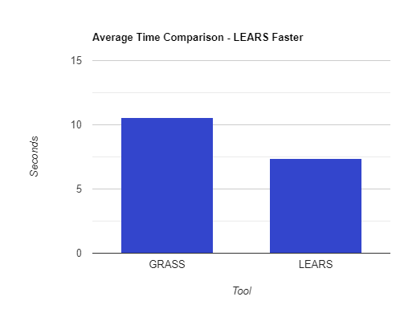
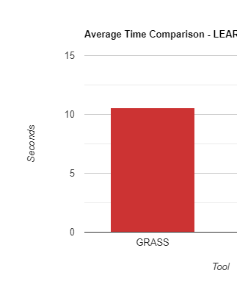
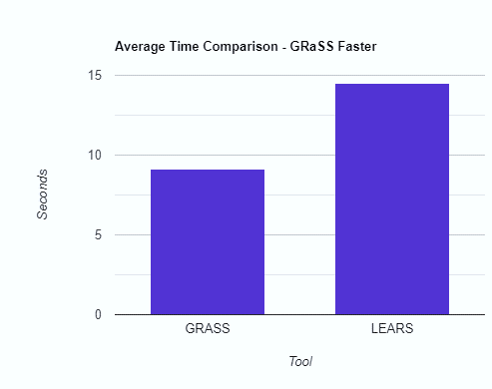
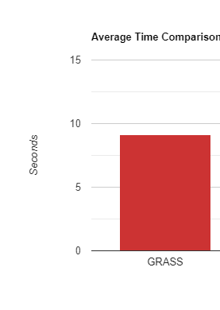
Efficiency Evaluation against LEARS
Processes Where LEARS is Faster
Processes Where GRaSS is Faster
Notes:
In addition to increased functionality, the time and memory resource allocation for each tool was analyzed. A script was developed to run each tool 25 times, and take the average amount of time and memory used for execution. These values were then compared, and the following conclusions were drawn:
In the case of spatial, multi-variable, and certain types of temporal subsetting, GRASS is faster than LEARS, with an average of 5.628 seconds saved per execution.
Here we see bar graphs for the processes in which LEARS is faster, compared to those in which GRaSS is faster. As you can see, though GRASS is slower than LEARS in some cases, the average amount of time saved in processes in which LEARS is faster is only 3.266 seconds per execution. This is less than the 5.628 seconds saved by GRASS per process on average, and thus, GRASS on average saves more time than LEARS.

Slide 13
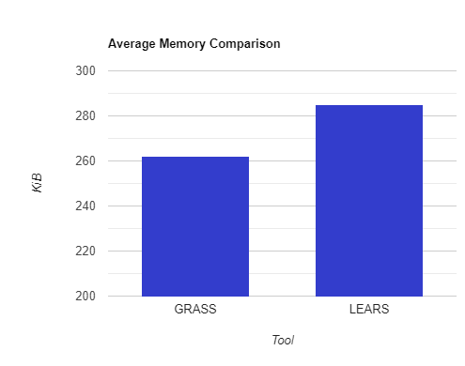
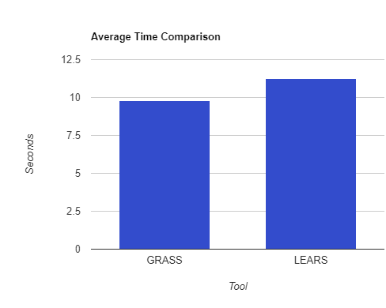
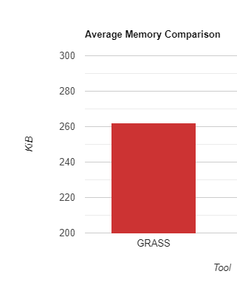
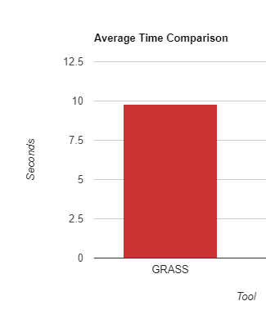
Efficiency Evaluation against LEARS (cont.)
Notes:
As mentioned, GRASS saves more time on average than LEARS, with GRASS performing faster in specific processes.
However, for all operations, GRASS requires less memory than LEARS, with an average of 25.33 KiB of memory saved per execution.
Additionally, in regards to the conda environment dependencies required for the successful execution of each tool, the minimized LERARS is larger than that of GRASS, making GRASS more memory efficient in more ways than one.

Slide 14
Conclusion
Notes:
Though not completely ready for deployment at the moment, GRASS has proven to be a reliable subsetting and regridding tool. GRASS not only provides more extensive functionality and customizability due to its Xarray and xESMF backend- It also proves more efficient in memory and, in some cases, time resource allocation.
All in all, GRASS has proven itself to be more than capable to one day be a reliable and optimal resource for the GES DISC.

Slide 15
References and Acknowledgements
L34RS: Level 3 and 4 Regridder and Subsetter for Earth Satellite Data. (2018, December). NASA/ADS. Retrieved November 29, 2021, from https://ui.adsabs.harvard.edu/abs/2018AGUFMIN43A..20S/abstract
NASA. (2010). GES DISC. GES DISC. https://disc.gsfc.nasa.gov/datasets/
xarray: N-D labeled arrays and datasets in Python. (2014). Http://Xarray.Pydata.Org/. http://xarray.pydata.org/en/stable/
xESMF: Universal Regridder for Geospatial Data — xESMF 0.3.0 documentation. (2017). Xesmf.Readthedocs.Io. https://xesmf.readthedocs.io/en/latest/
Notes:
Here are all of the datasets used in my research, as well as documentation for all of the tools and packages that I used over the course of my research. Also I would like to give special thanks to my mentor Jay Su for all of his help over the course of my internship. Thank you also to the GES DISC for all of the information and assistance that they provided me and continue to provide to NASA and the general public, in an attempt to increase humanity’s understanding of our world.

Slide 16

For more information, please visit our web site:
www.nasa.gov/goddard
Notes:
Thank you for your time, are there any questions?

Slide 17
Future Works
Global regridding not reliable- xESMF does not yet support regridding at the poles
Vertical subsetting has not yet been implemented
GRASS is to be put into a Docker container
Notes:
Though working, GRASS is not fully ready for implementation. GRASS still has limitations on global regridding- xESMF does not yet support regridding at the poles
Additionally, vertical subsetting has not yet been implemented, and once complete, we will be putting GRASS into a Docker container for agency use.

Slide 18
Challenges Faced
Temporal Subsetting: Conversion from datetime64 to integer
Spatial Subsetting across anti-meridian
Notes:
There were aspects that caused challenges in the process of designing this tool. For example, in xarray datasets, temporal information is of type datetime64. On the other hand, some of the datasets for analysis display time in integer form, to represent hours since a certain time. In the development of GRASS, an extra step had to be taken to make these two datatypes compatible.
Another issue is that xarray cannot translate slicing data spatially across the anti-meridian. Thus, GRASS has to take an extra step to divide a subset on both sides of the meridian and concatenate them, producing the expected result.

