Slide 1

Economic Development: Technology Progress and Next Steps
THREE WORKSTREAMS
01
First Nations Business Directory portal migration
PRIMARY FOCUS
02
Grants & Funding Tracker
Mihir Trivedi
IT Specialist, Chiefs of Ontario
03
Secure business verification with Makwa7

Slide 2

WORKSTREAM 1 · FNBD MIGRATION
FNBD portal migration
COO now owns and operates the survey, data files and Power BI report.
The migration is complete. Business and staff survey submissions now reach COO’s SimpleSurvey account. The report uses COO’s OneDrive files; adding recent responses to it remains manual.
COMPLETE · TRANSFERRED FROM IFSD TO COO
REMAINING
SURVEY
DATA
REPORT
MAPS
WEBSITE
SimpleSurvey projects transferred
Data sources moved to COO OneDrive
Published through COO’s Power BI account
Azure Maps enabled and tested
Replacement follows final review
WordPress access is ready
Existing survey links kept active
Power BI connections validated
Economic Development · Technology progress and next steps
02

Slide 3
WORKSTREAM 1 · FNBD MIGRATION
Current survey data
As of October 13, 2026
735
+
490
=
1,225
Business-submitted responses
Staff / approved-user responses
Submitted responses collected
66 incomplete responses excluded
WHERE THE 1,225 RESPONSES ARE NOW
1,182
43
In the current Power BI dataset
Awaiting processing
Already included in the 1,225
RESPONSE COUNTS, NOT UNIQUE BUSINESSES
The unique-business count requires duplicate review
Economic Development · Technology progress and next steps
03

Slide 4
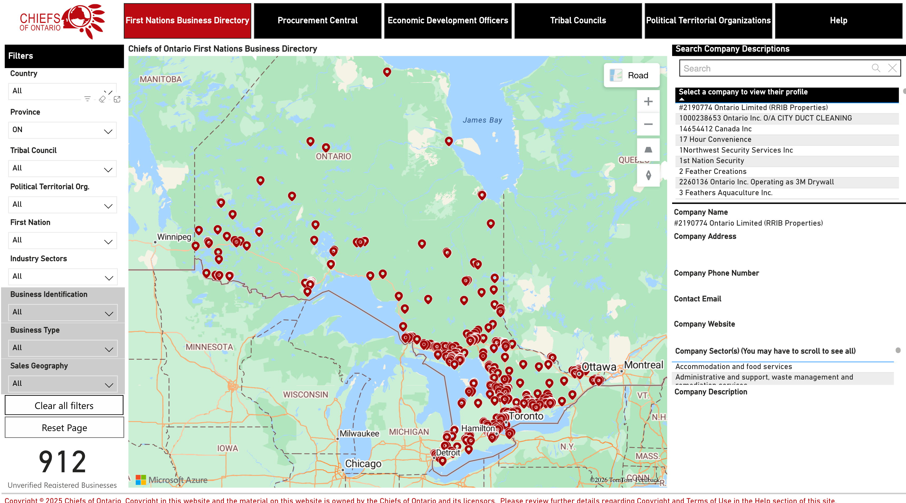
WORKSTREAM 1 · FNBD MIGRATION
COO report preview
FILTERED VIEW
Current COO report, filtered to Ontario: 912 submitted records . Counts change with filters; duplicate review is pending.
OVERALL DATASET
1,225 collected; 1,182 in Power BI (slide 3)
View COO Power BI report
Economic Development · Technology progress and next steps
04

Slide 5
WORKSTREAM 1 · FNBD MIGRATION
Recent submissions and next steps
CURRENT POSITION
New survey submissions reach COO’s SimpleSurvey account.
Adding recent responses to the report is still a manual step.
NEXT STEP · MANUAL, LED BY MIHIR
PLANNED
1
2
3
4
5
THEN
Process recent responses
Check duplicates
Map locations
Greg reviews the update
Refresh the report
Automate this recurring process
Economic Development · Technology progress and next steps
05

Slide 6
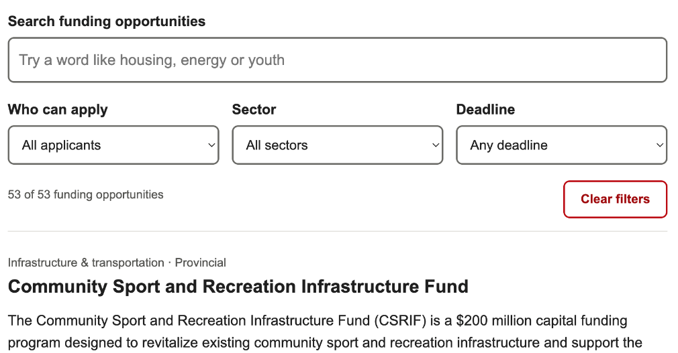
WORKSTREAM 2 · GRANTS
Grants & Funding Tracker
Making funding opportunities easier to find
Built
Search grants, filter opportunities, view eligibility, deadlines and application links
Demonstrated
Working prototype on a standalone WordPress page
Collaborated
Communications requested font, wording and source-edition updates
Next
Complete updates and internal review; agree hosting and maintenance
Value to COO: grant information is easier to browse, with less need to search through a spreadsheet.
Not yet publicly launched
Economic Development · Technology progress and next steps
06

Slide 7
WORKSTREAM 3 · MAKWA7
Secure business verification with Makwa7
A secure process for collecting documents and verifying First Nations businesses
BUSINESS
PRIVATE · SUPPORTING DOCUMENTS IN M-FILES
RESULT
1
2
3
4
5
Business registration
Document submission
Secure storage in M-Files
Business verification
Verification result
Verification Officer reviews the application
Business ID and verification status recorded once approved
Completes SimpleSurvey; receives a unique business ID
Makwa7 upload portal: ID, email and supporting documents
Makwa7 data centre on First Nation land in Kamloops
Sent to downstream storage for directory and reporting use
If information is missing: the business is asked to upload additional documents
To be confirmed
Power BI supports the public business directory. M-Files manages the private documents and verification process behind it.
Economic Development · Technology progress and next steps
07

Slide 8
WORKSTREAM 3 · MAKWA7
Makwa7: current status and next steps
CURRENT STATUS
NEXT STEPS
Makwa7 configured the document upload and M-Files verification workflow
Access
M-Files training; test access for Sonnet and Mihir
Infrastructure
Confirm VM scope, cost and responsibilities; secure the COO workstation
Makwa7 introduced the workflow and began onboarding COO staff
COO purchased a dedicated verification workstation
Testing
End-to-end test with sample businesses, including additional-document requests
COO is reviewing the VM option for a controlled connection to Makwa7’s environment
Integration
Confirm how verification status reaches COO OneDrive and Power BI
Operations
Document procedure, access management and support
MY ROLE
OPEN POINT · TO BE CONFIRMED
Coordinate the COO technical setup, test the complete data flow and document the process for ongoing operation.
Makwa7 mentioned Google Drive and OneDrive as outputs. COO’s final destination and its Power BI connection still need confirmation.
Economic Development · Technology progress and next steps
08

Slide 9
SUMMARY
Immediate priorities and discussion
FNBD
Makwa7
Grants tracker
Process recent responses, check duplicates and map locations, then refresh the report after Greg’s review. Website replacement follows final review.
Complete training and test access, confirm VM arrangements, test the verification workflow and confirm the reporting integration.
Finish Communications updates, complete internal review and agree on hosting and maintenance.
Next phase: automate the recurring process.
Discussion and guidance on next steps
09

