Slide 1
Applied Data Science Capstone - Car accident severity
Peer-graded Assignment

Slide 2
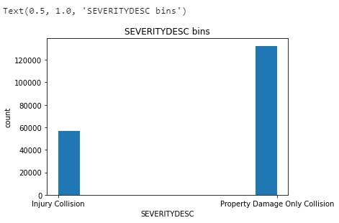

Slide 3
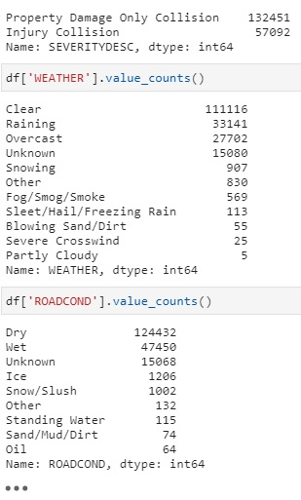

Slide 4
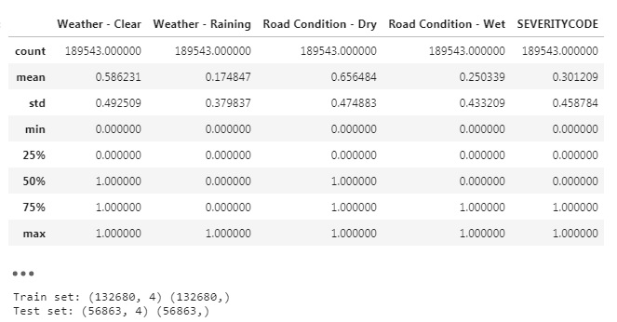

Slide 5
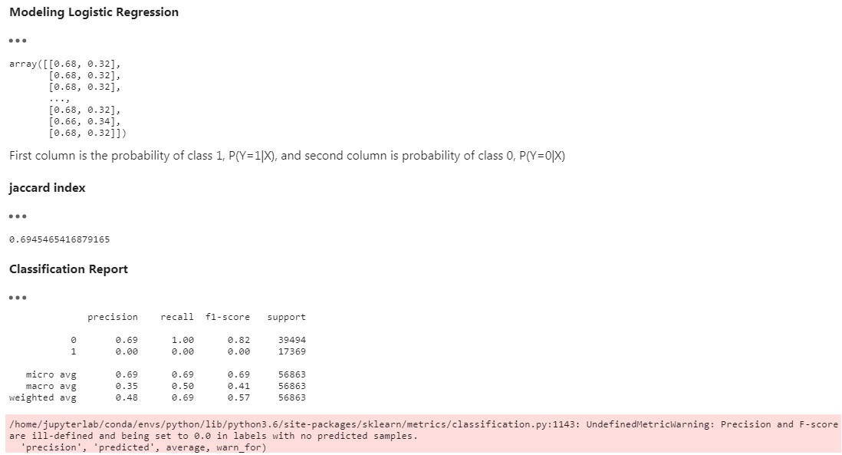

Slide 6
