Slide 1
Concurrent and distributed systems
Photo saver
Lorenzo Biagini
Martina Troscia

Slide 2
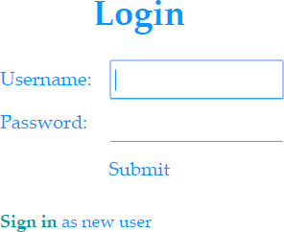
Services offered
Customer registration/authentication
Photos upload
Photos removal
Photos thumbnails
Photos download
Secure data exchange

Slide 3
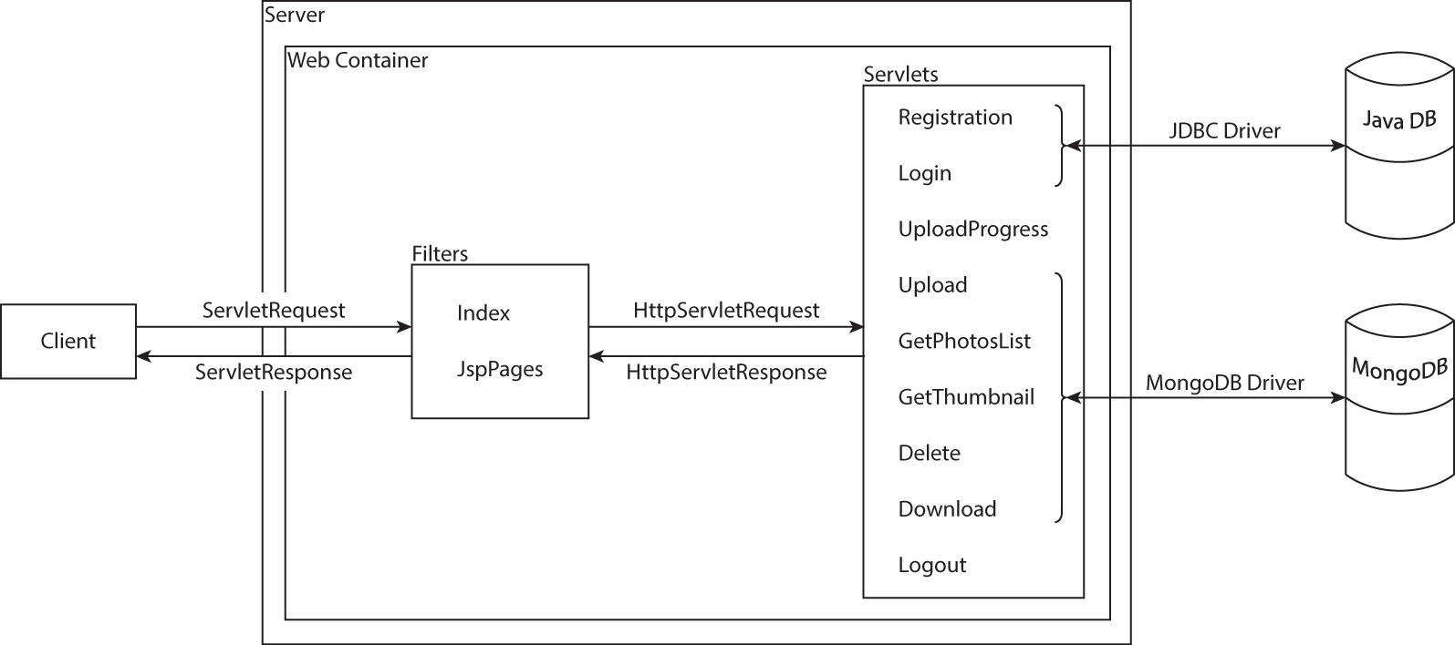
Architecture
Each service relies on a specific Servlet

Slide 4
Concurrency
Accesses to the databases are handled by the respective databases’ drivers
The Mongo class is thread-safe and the database remains consistent even with more than one instance of the class
Derby databases handle concurrency on their own

Slide 5

Filters
Two filters control the access to the pages
The Index filter forwards the client to the login page or to the userHome, depending on the client session
The JspPages filter forwards the unauthenticated clients to the login page when they try to access private JSP pages

Slide 6
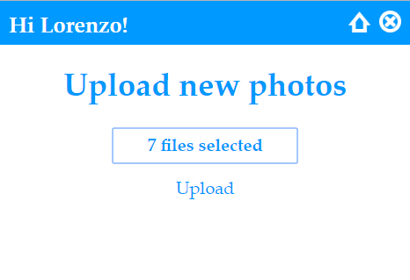
Servlet Upload
Saves the uploaded files on hard disk, if their dimension is bigger than 4 MB
Checks for duplicates and correct format of the photo
Gets the metadata:
MIME type
Date
Image dimensions
File name
Creates a thumbnail
Saves the image in the MongoDB
Returns to the client the list of the failed uploads

Slide 7

Servlet UploadProgress
Performance issue: the function to assess the upload progress may be called after every received packet, depending on the servlet engine and other factors: such function must update the progress state only after a specified amount of received bytes

Slide 8
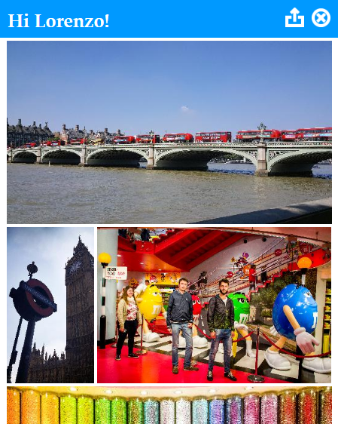
Servlet GetThumbnail
Creating a thumbnail is memory hungry
The thumbnail is created only once during the upload process and it is stored only in the MongoDB chunks collection (not in the files collection) in order to not make it appear in the files list when the client asks for it
When a photo is deleted, also its thumbnail is removed

Slide 9
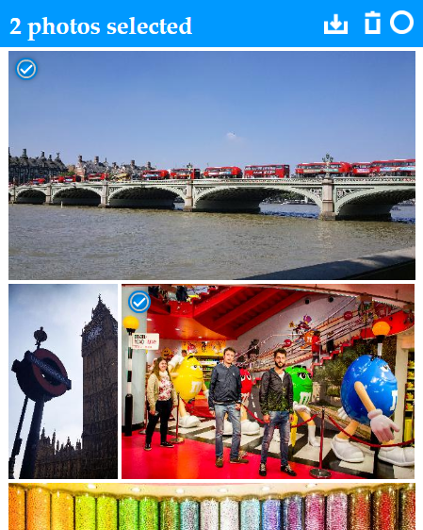
Servlet Download
Creates a zip archive
All the requested photos are packed into a single archive to be downloaded

Slide 10
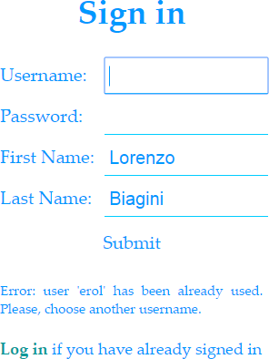
JSP Pages
JSP Pages are used to personalize the user experience
The embedded Java code permits to show users’ information (like their name) in the user home
Some information passed during the authentication phase is kept in the page so the client has not to insert it again

Slide 11
SSL
Information exchange between client and server uses the SSL protocol
The certificate is self-signed and it is meant only for demonstration purposes

