Slide 1
Optimize your crowdfunding success
Meredith Trotter

Slide 2
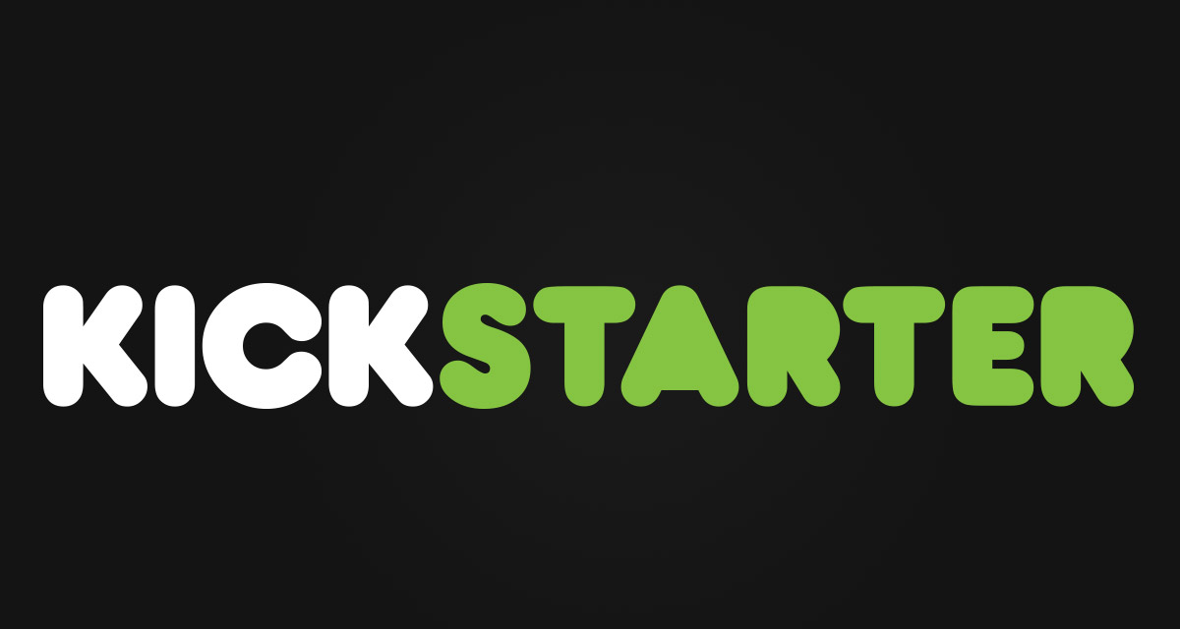

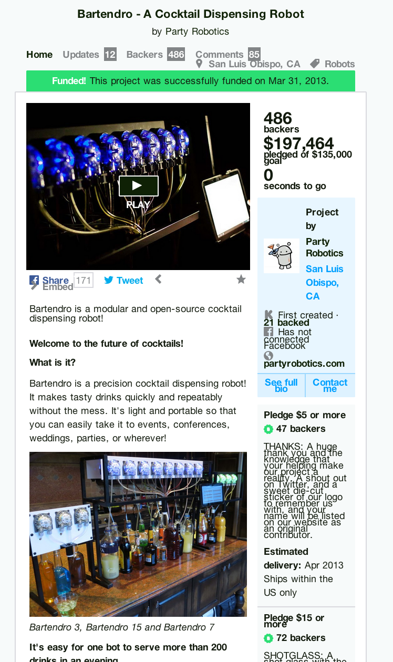
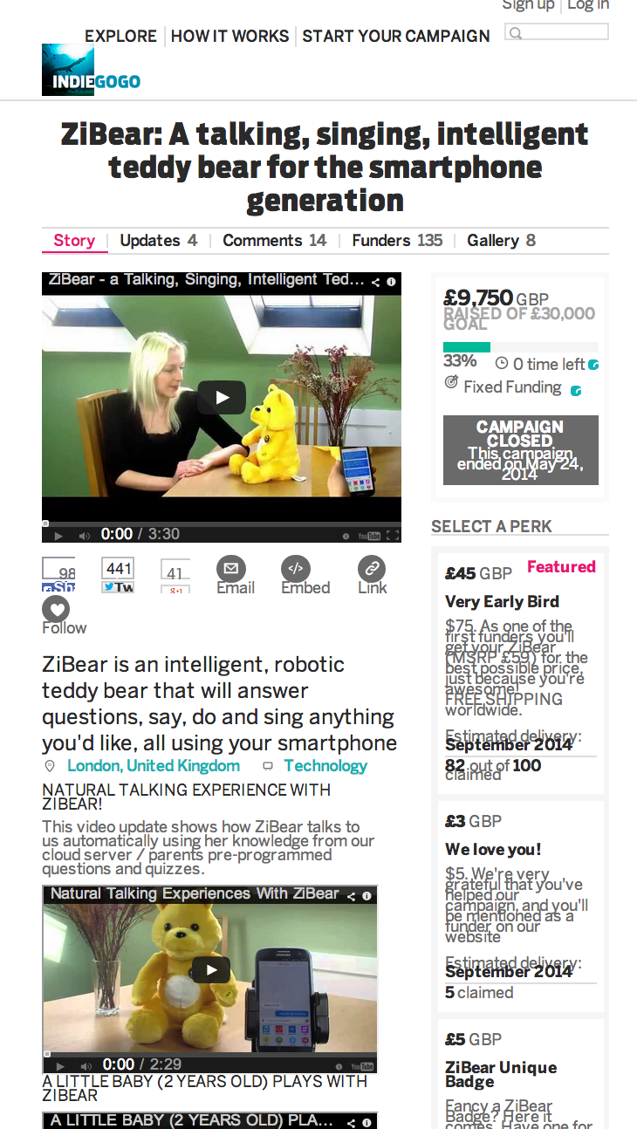

Slide 3
The Challenge
Can I predict the success of a crowdfunding campaign using
only information you would have
BEFORE
you commit to a platform?

Slide 4




How it works
Scraped data:
25 000+ Kickstarter campaigns
25 000+ Indiegogo campaigns
Stored Useful Features:
Funding goal, Story
Category, Duration
Videos, Pictures
Links, Perks
Models for success: Random Forest Classifier and Regressor

Slide 5
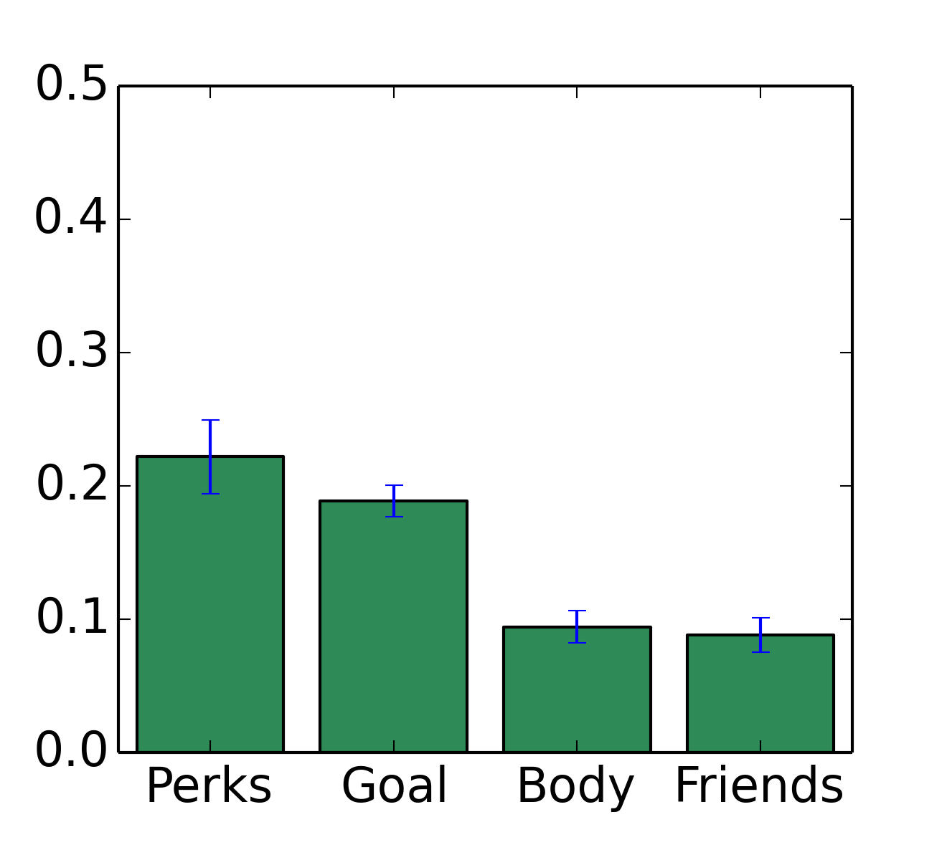
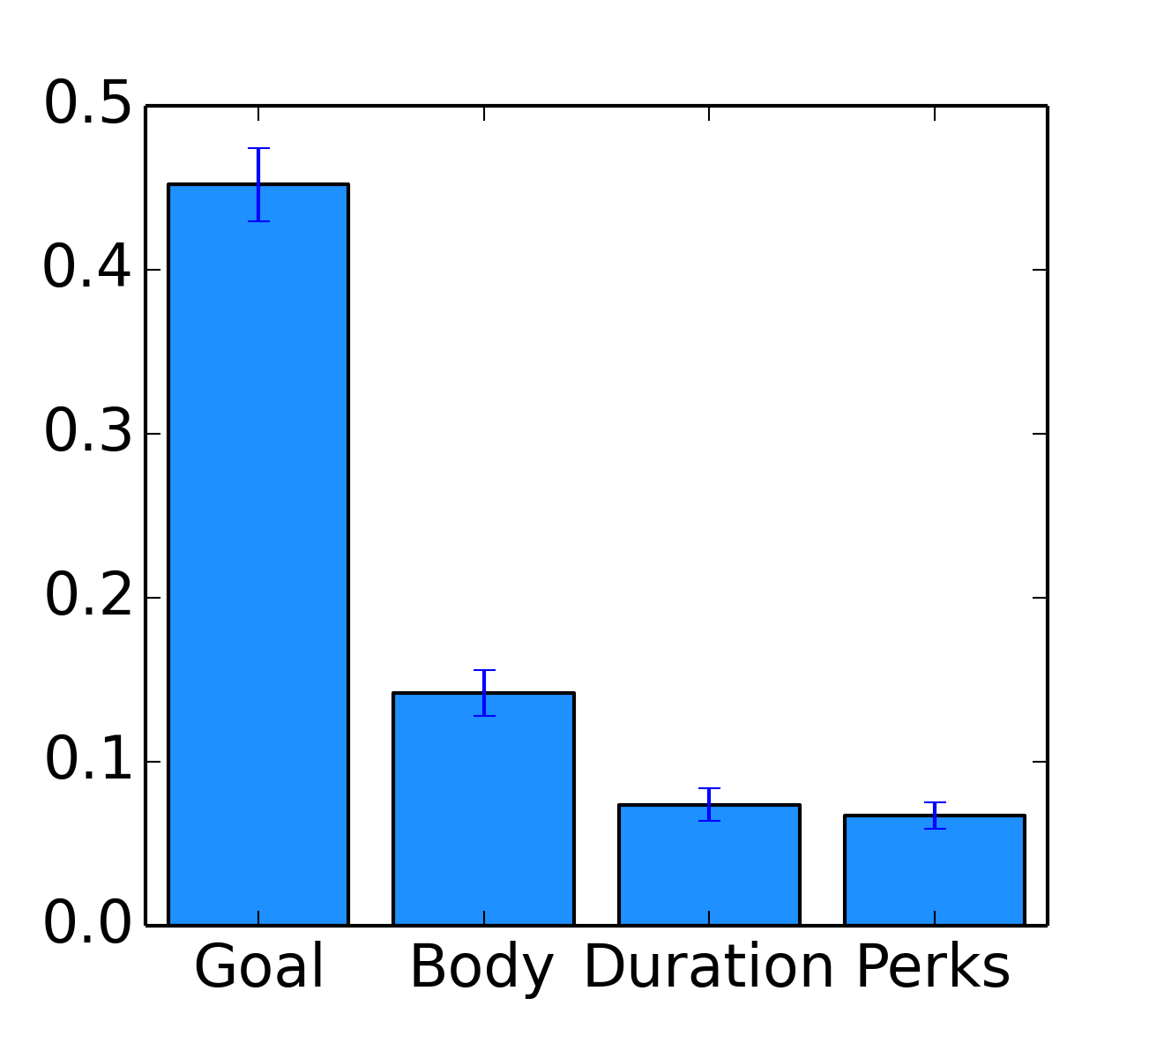
Important Features
Kickstarter
Indiegogo
Feature Importance
Accuracy: 0.83, Precision: 0.78
Accuracy: 0.82, Precision: 0.89

Slide 6
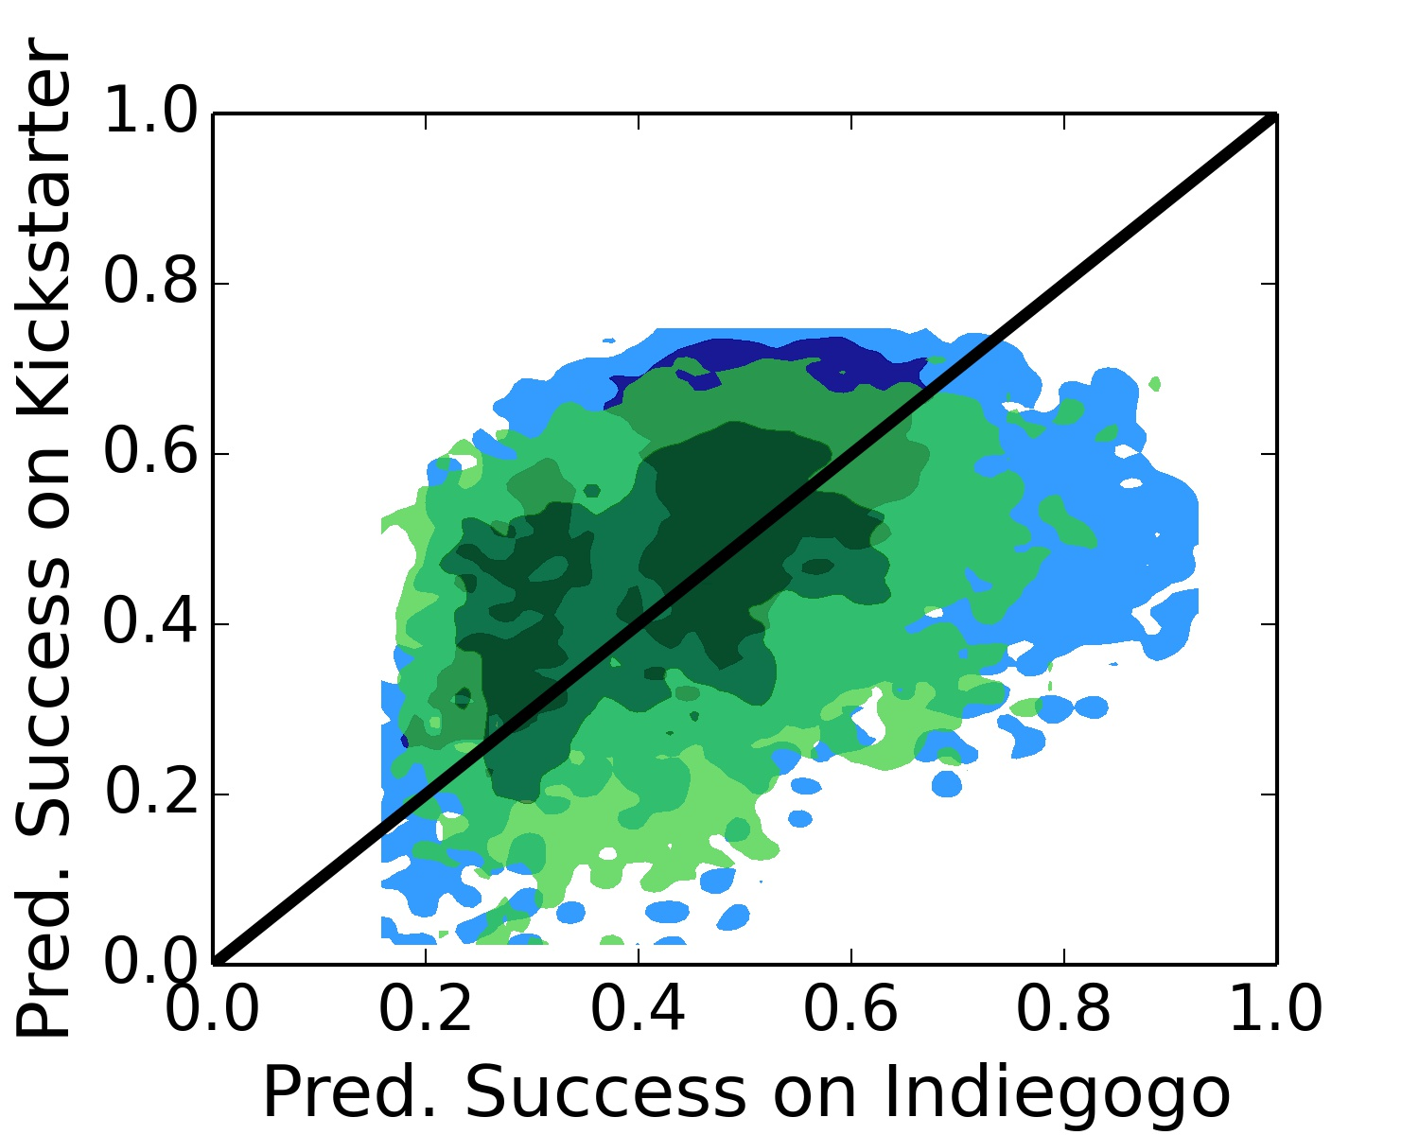
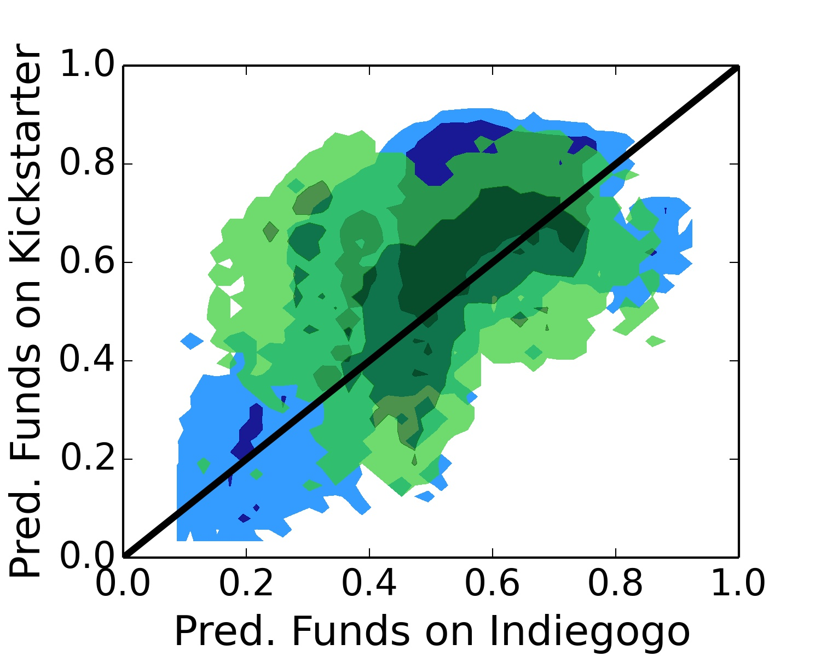
Are users behaving optimally?
Kickstarters
Indiegogoers
Kickstarters
Indiegogoers
57% of Kickstarters, 78% of Indiegogos
predicted to do better on Kickstarter
66% of Kickstarters, 70% of Indiegogos
predicted to make more $ on Kickstarter

Slide 7
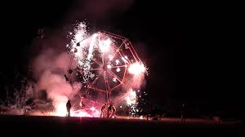
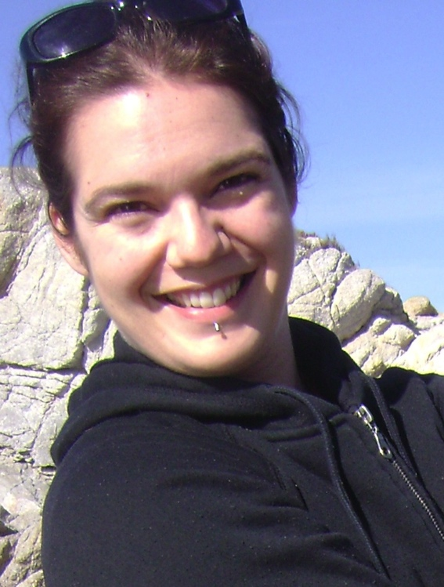
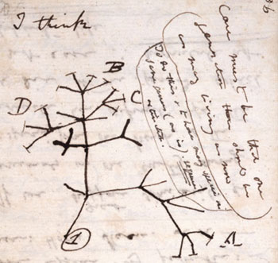
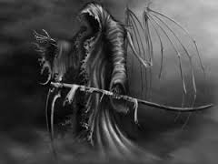
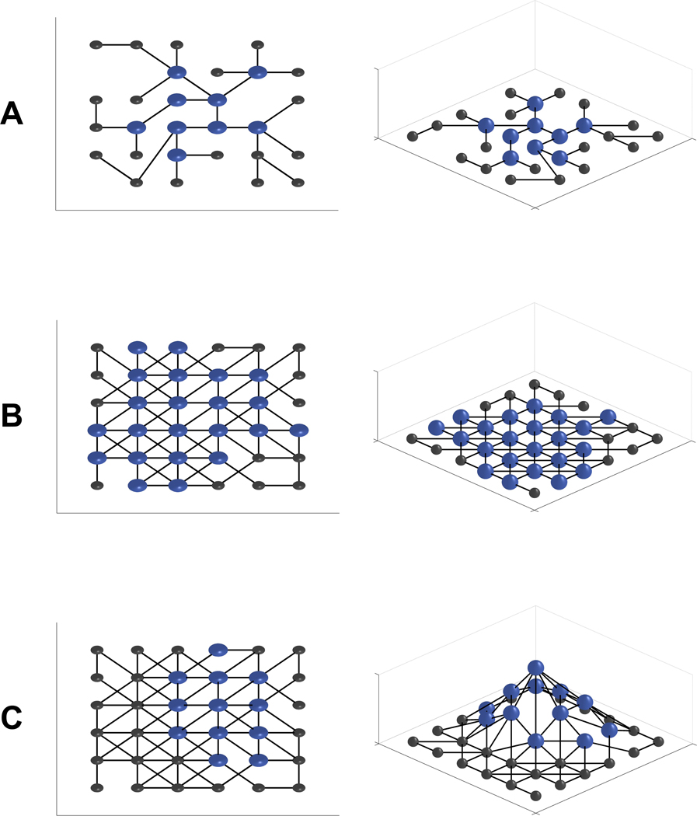
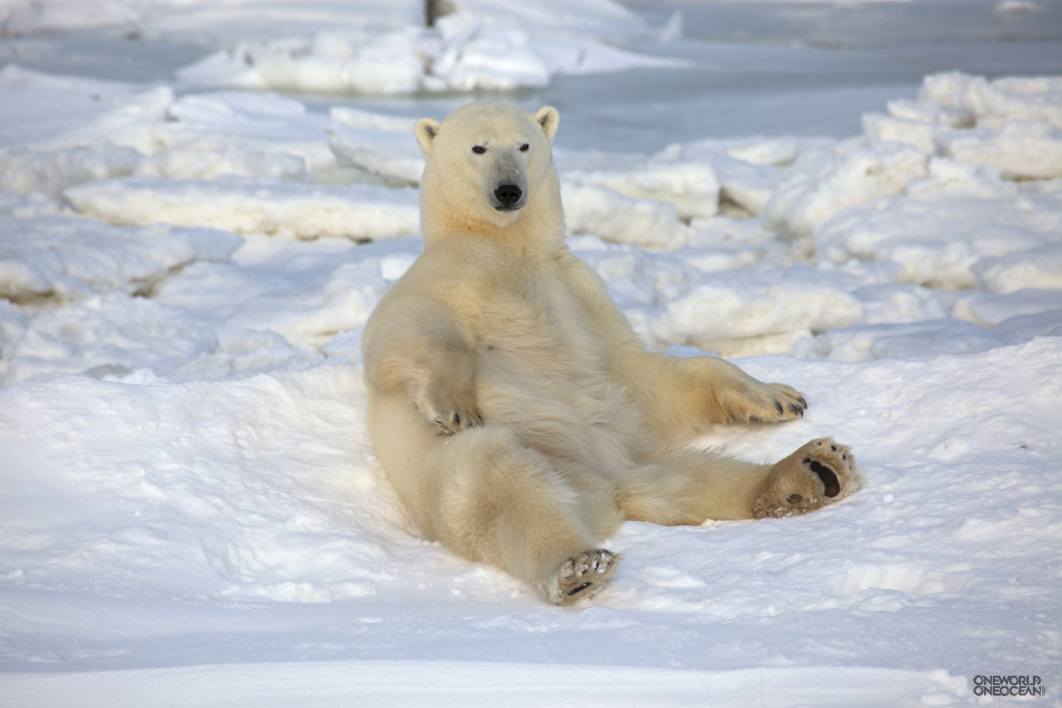



Meredith Trotter

