Slide 1
Optimize your crowdfunding success
Meredith Trotter

Slide 2
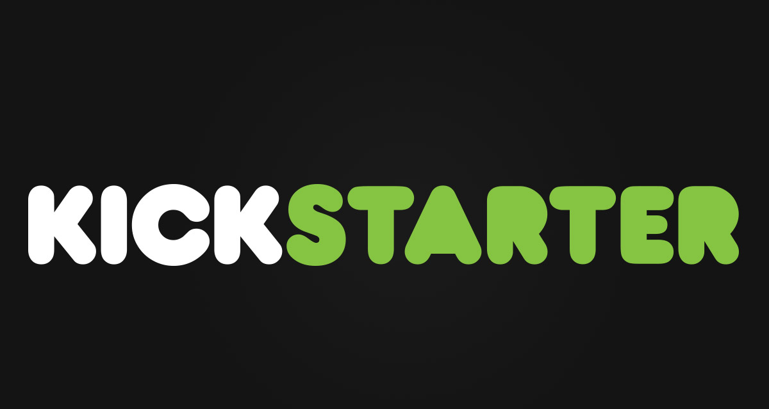

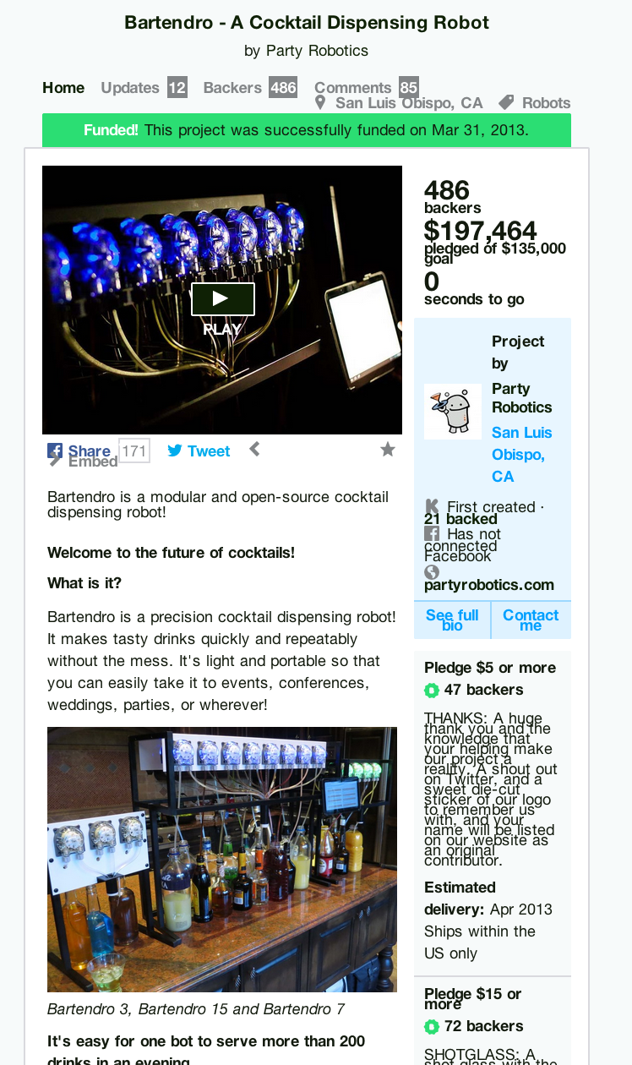
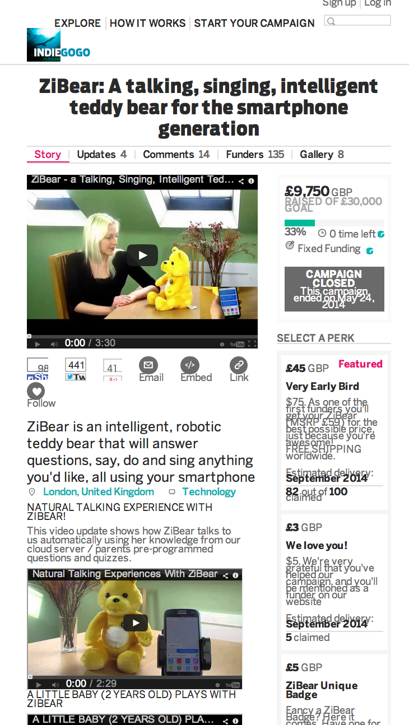

Slide 3
The Challenge
Can I predict the success of a crowdfunding campaign using only information you would have BEFORE you commit to a platform?

Slide 4
The Data
25 000+ Kickstarter campaigns
25 000+ Indiegogo campaigns
Features:
Funding goal
Category
Videos, Pictures
Links
Perks

Slide 5
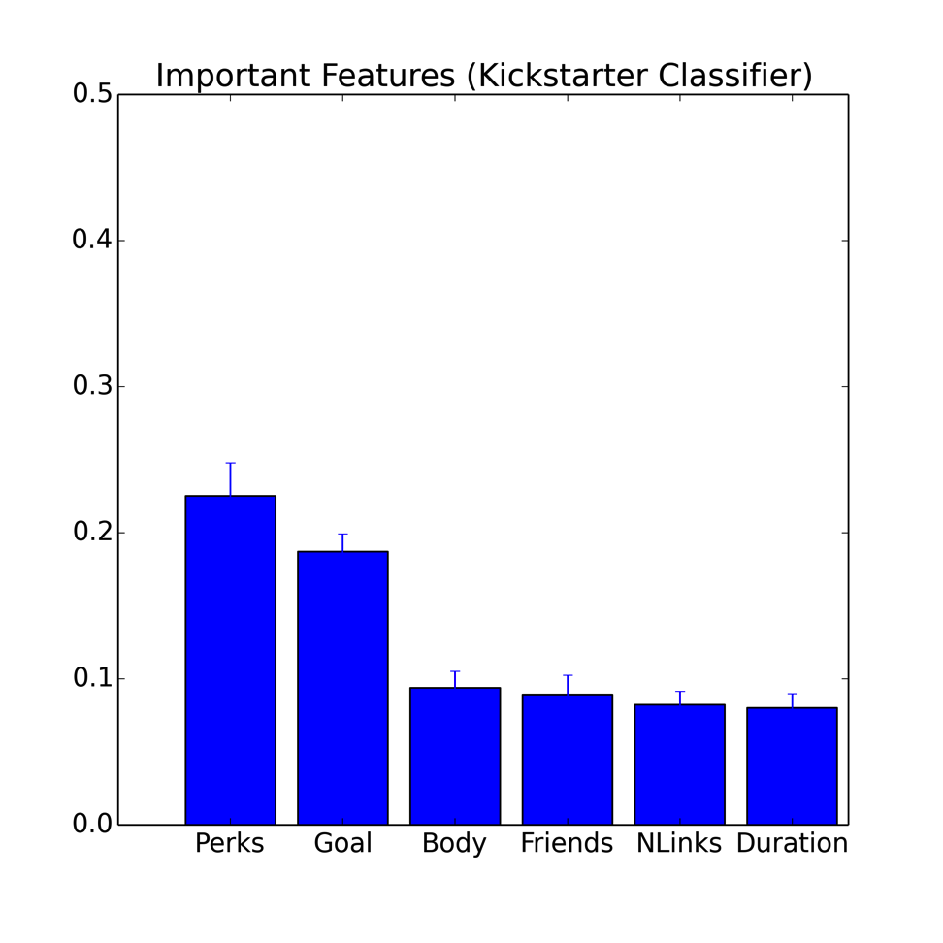
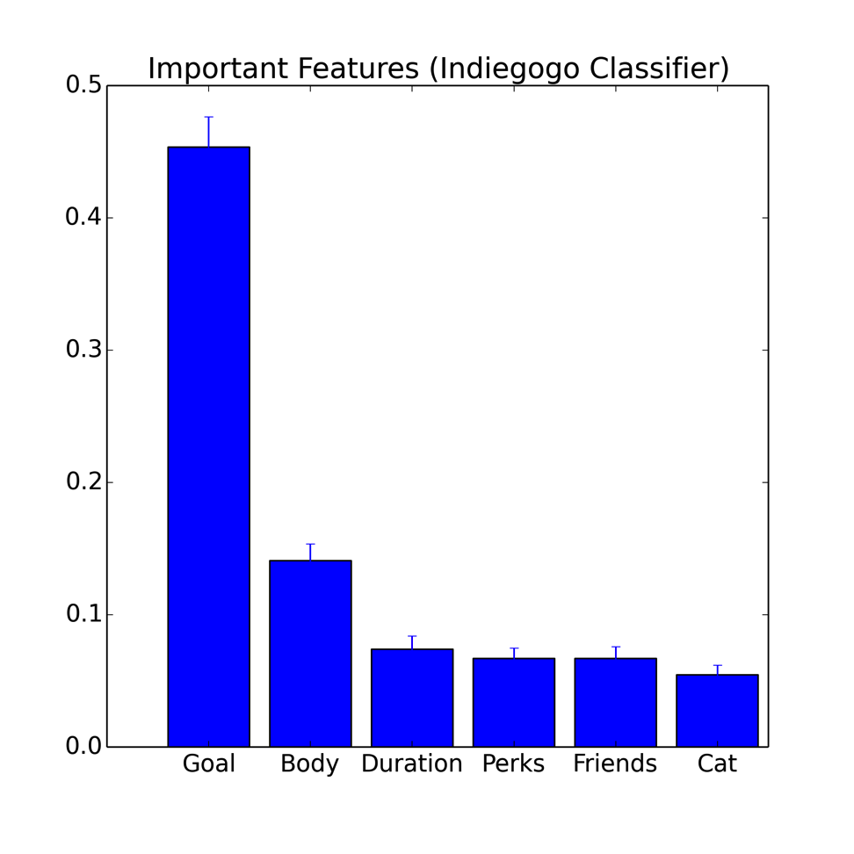
Findings
Kickstarter
Important features:
Indiegogo
Important features:

Slide 6
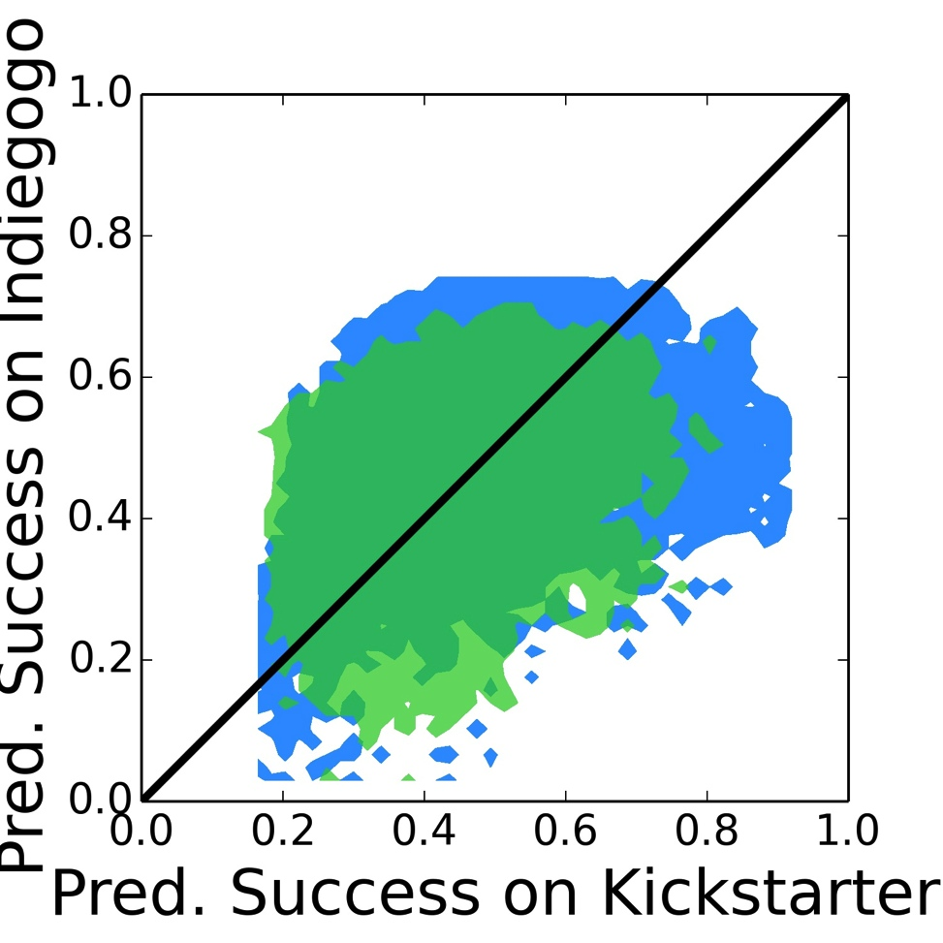
Should they have kicked or should they gogone?
Green = Kickstarter
Blue = Indiegogo

Slide 7
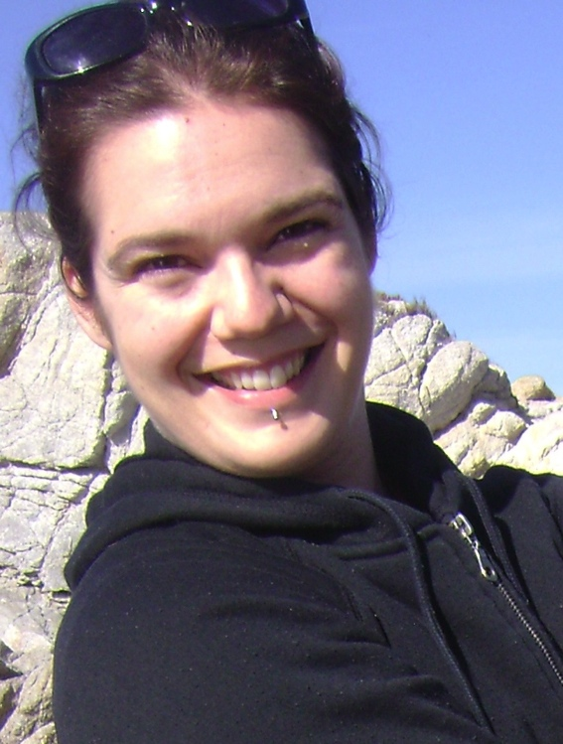
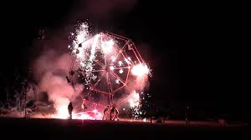
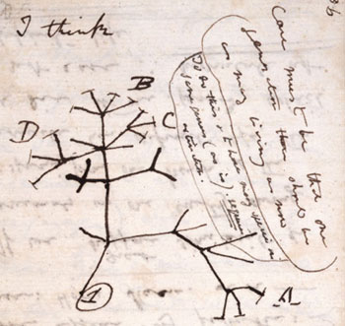
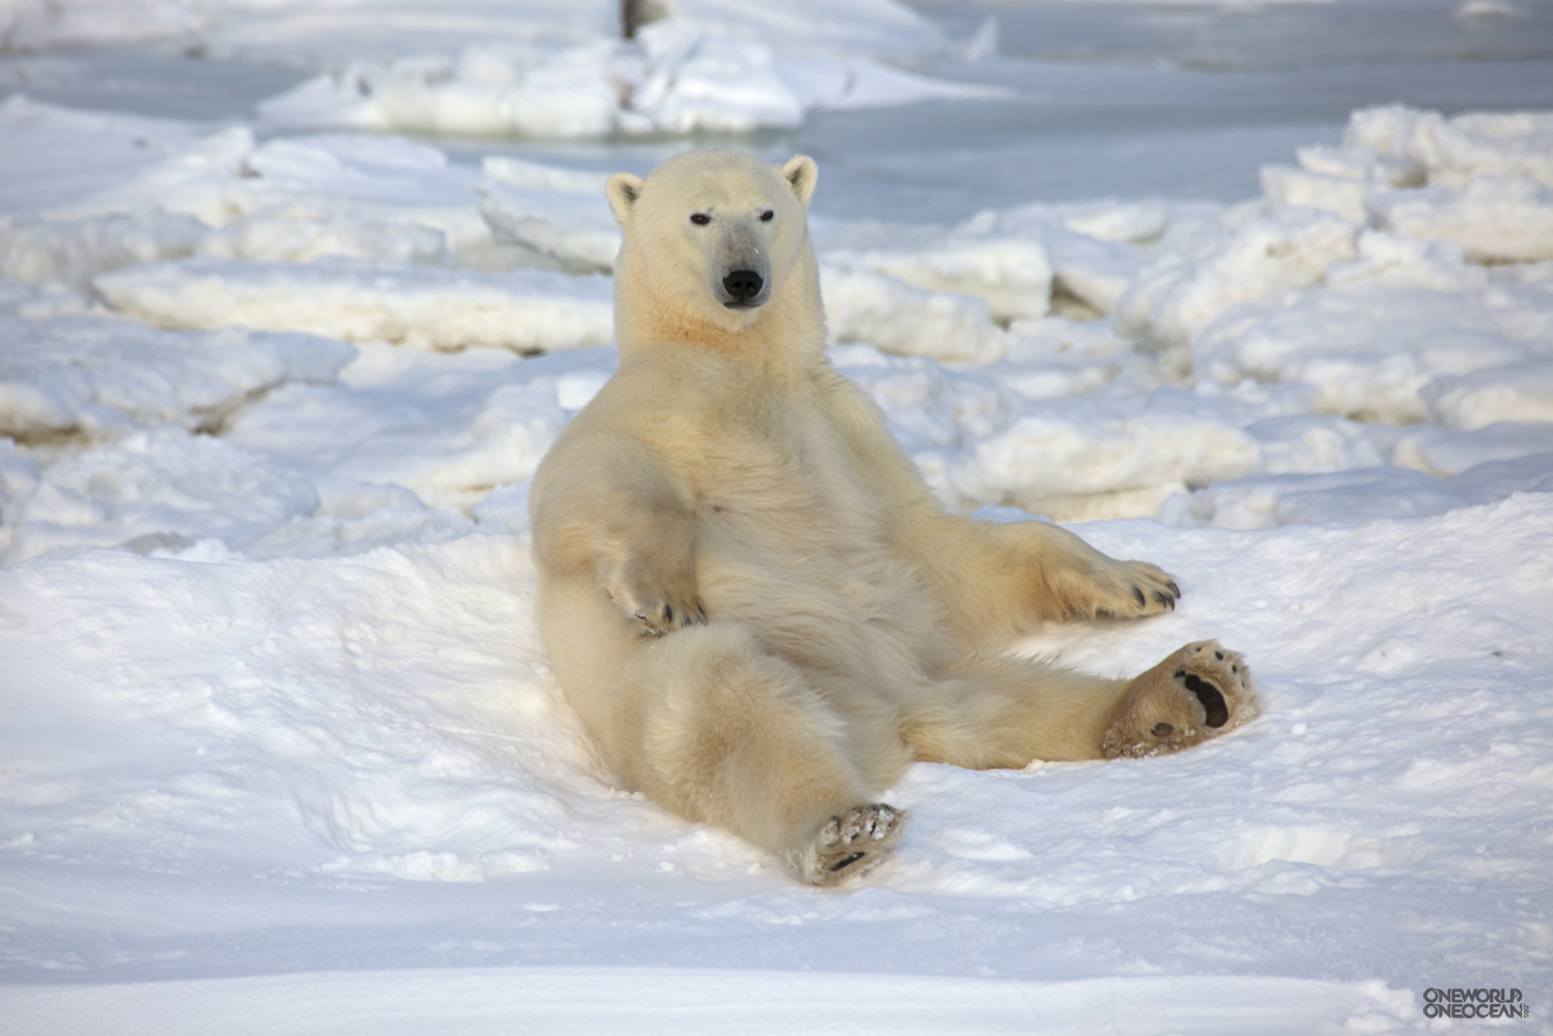
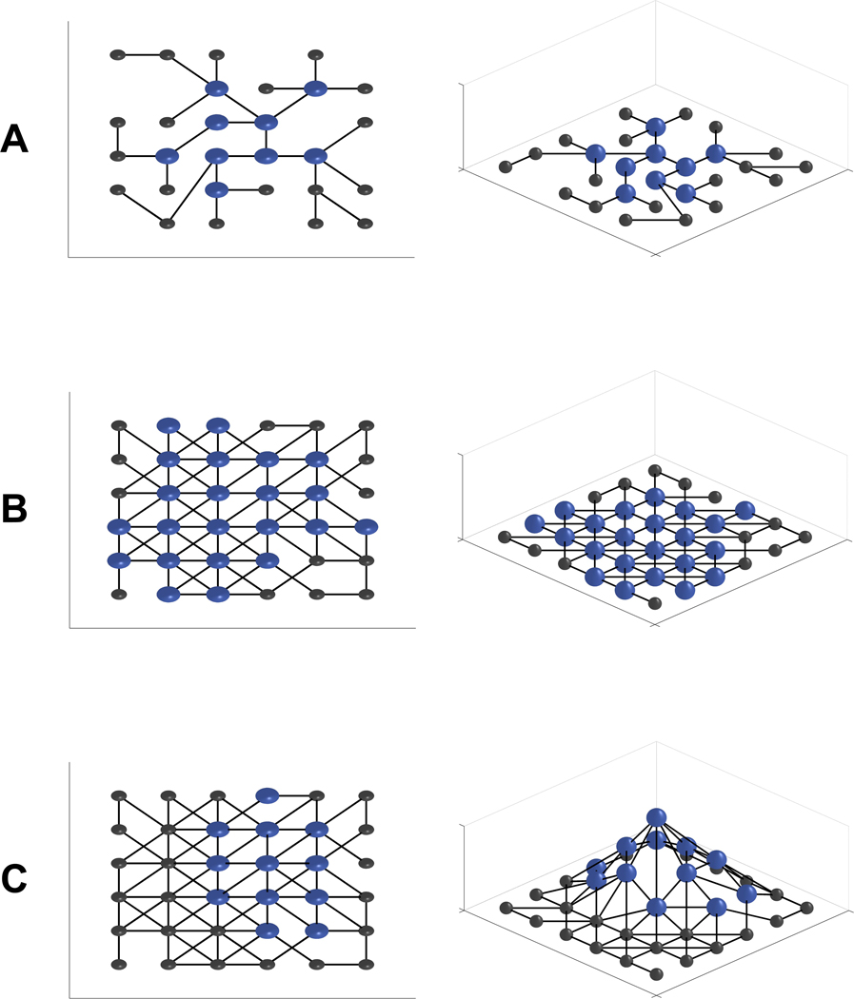
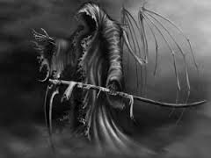



Meredith Trotter

