Slide 1

My Bubble Buster
By: Student Name

Slide 2
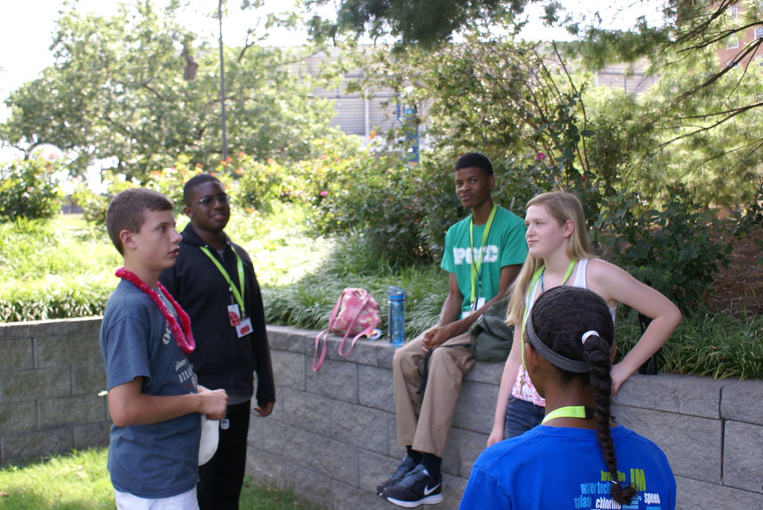
University of Maryland
Replace this image with your own photo or screenshot. Then delete this text.
Python
July 24th – July 29th

Slide 3


Write Title for Page
Explain something you’ve learned here.
Explain something you’ve learned here.
Explain something you’ve learned here.
Explain something you’ve learned here.
Explain something you’ve learned here.
Replace this image with your own screenshot. Then delete this text.
To replace image: Right click and choose “Change Picture”.

Slide 4
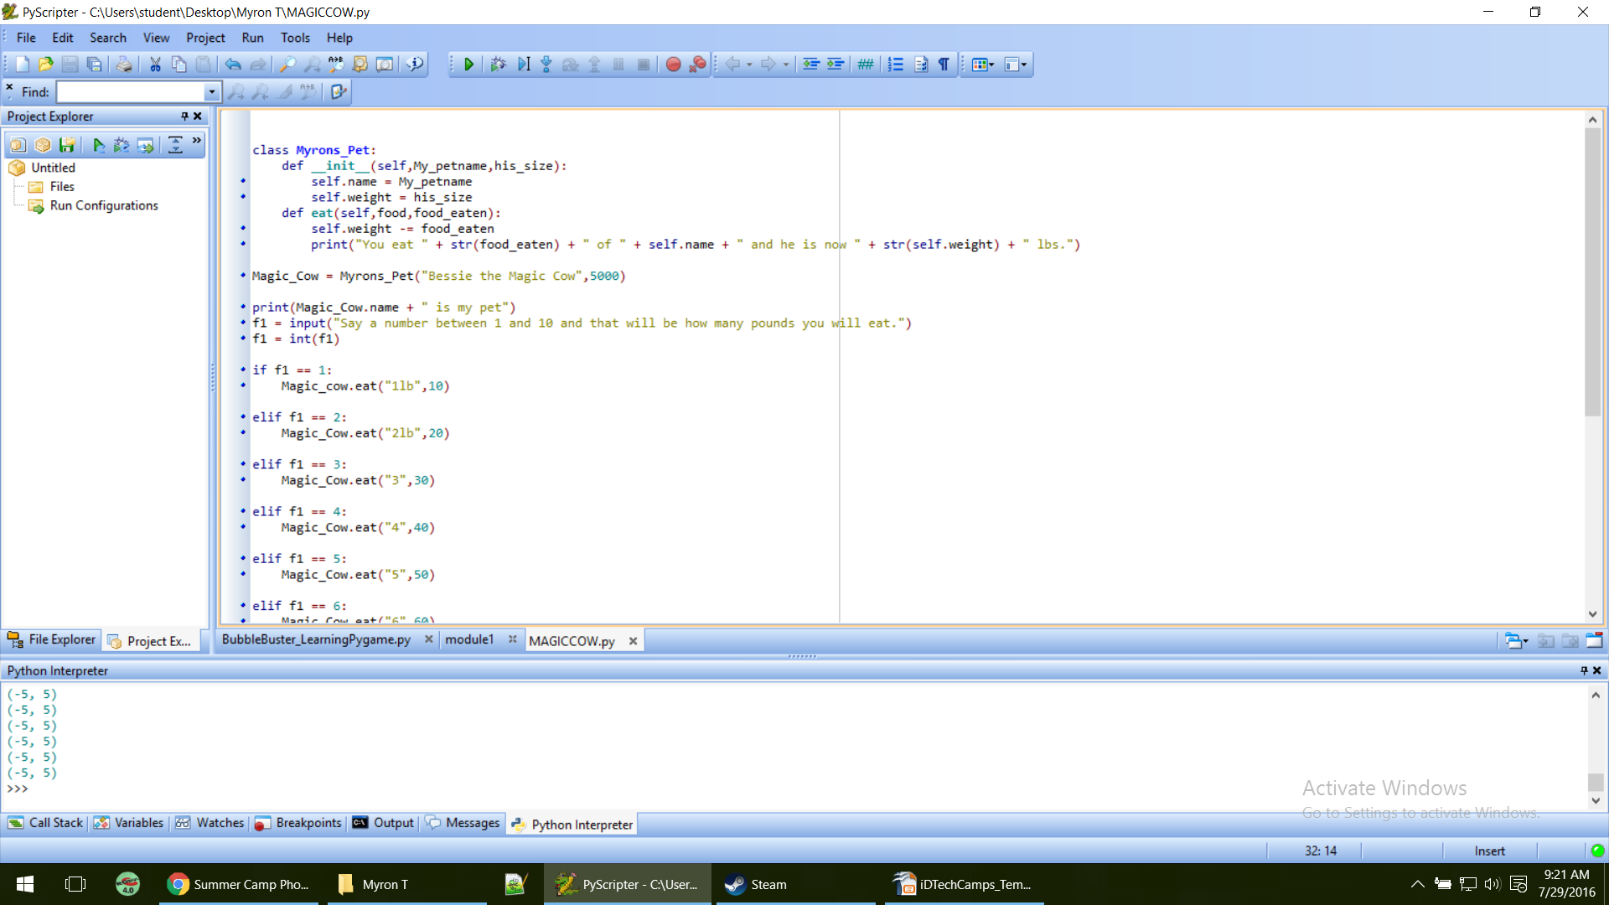
Using classes and if statement
Here I learned how to use classes and I used if statements from prior modules.
Replace this image with your own screenshot. Then delete this text.
To replace image: Right click and choose “Change Picture”.

Slide 5
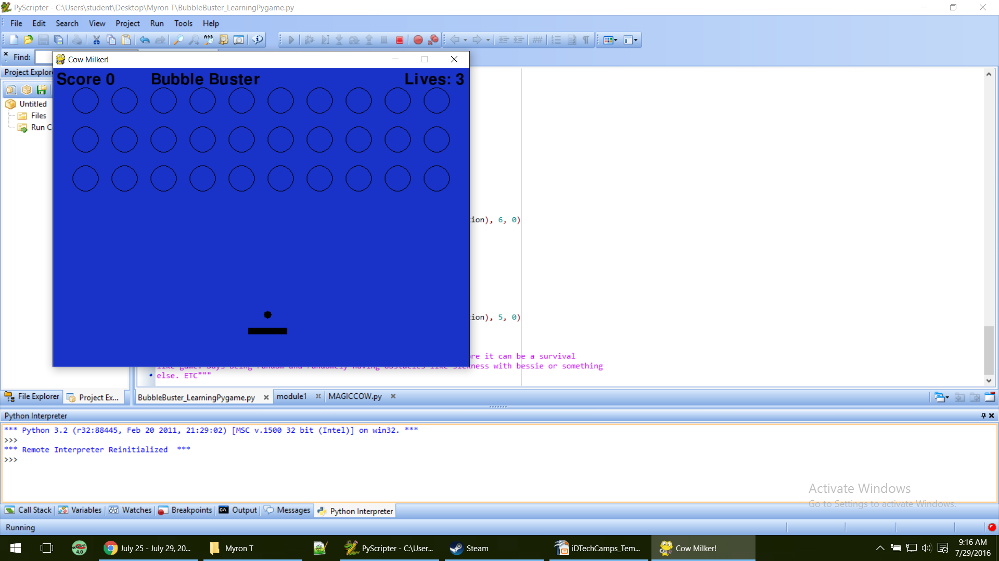
Almost Finished
I had learned how to make the balls hit-able on my final project.
I learned how to add text to pygame.
Replace this image with your own screenshot. Then delete this text.
To replace image: Right click and choose “Change Picture”.

Slide 6
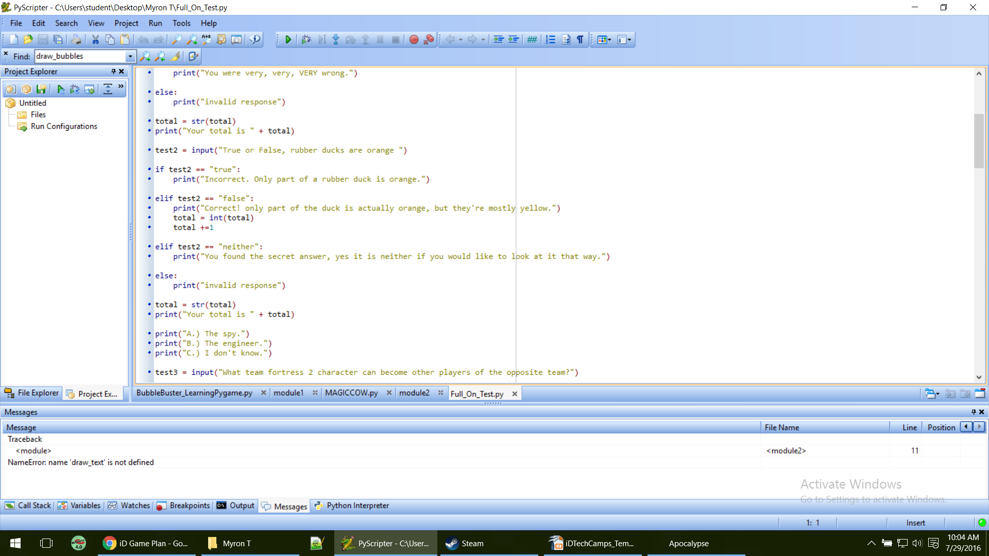
If Statements
I learned how to make if statements.
Replace this image with your own screenshot. Then delete this text.
To replace image: Right click and choose “Change Picture”.

Slide 7
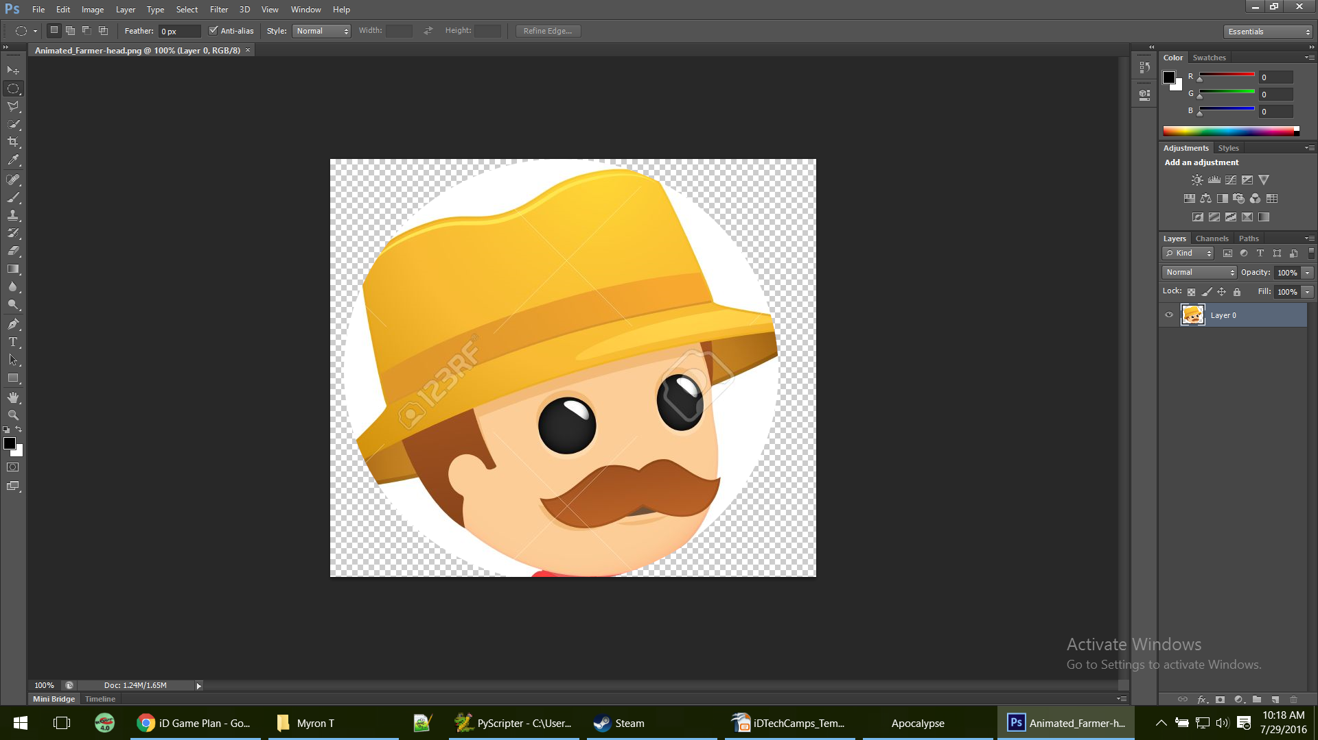
Sprites
I worked on setting up sprites to add to my game when I get home
Replace this image with your own screenshot. Then delete this text.
To replace image: Right click and choose “Change Picture”.

Slide 8
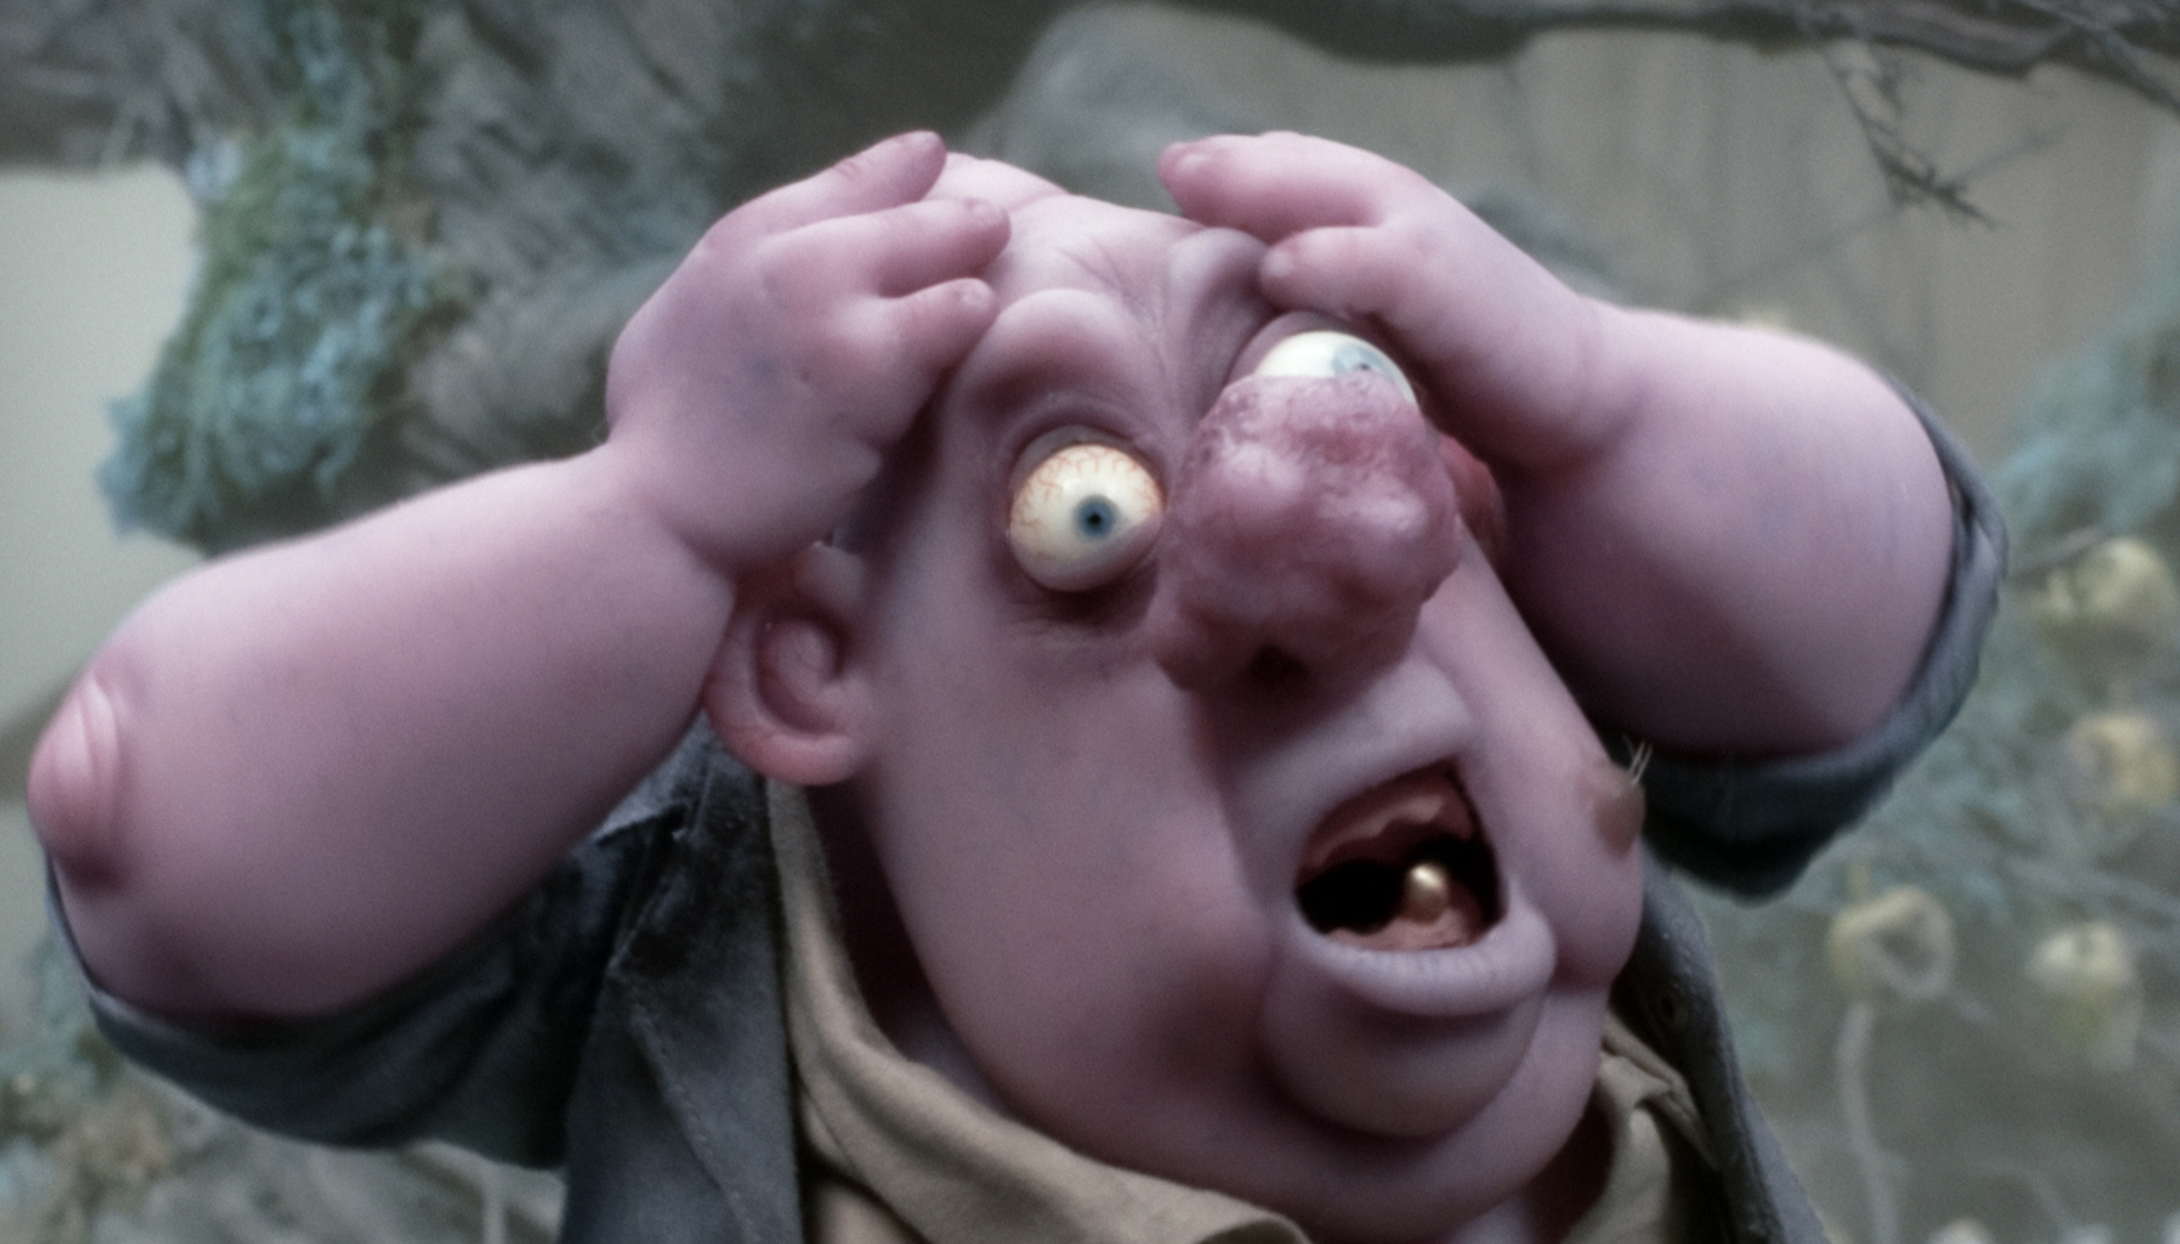
Favorite Camp Memory

