Slide 1
Handsup
Красивая фотка)

Slide 2

Много голосов!
Как посчитать?
WRITE SOMETHING HERE
ABOUT
OUR COMPANY
Что сложно человеку, то просто машине

Slide 3
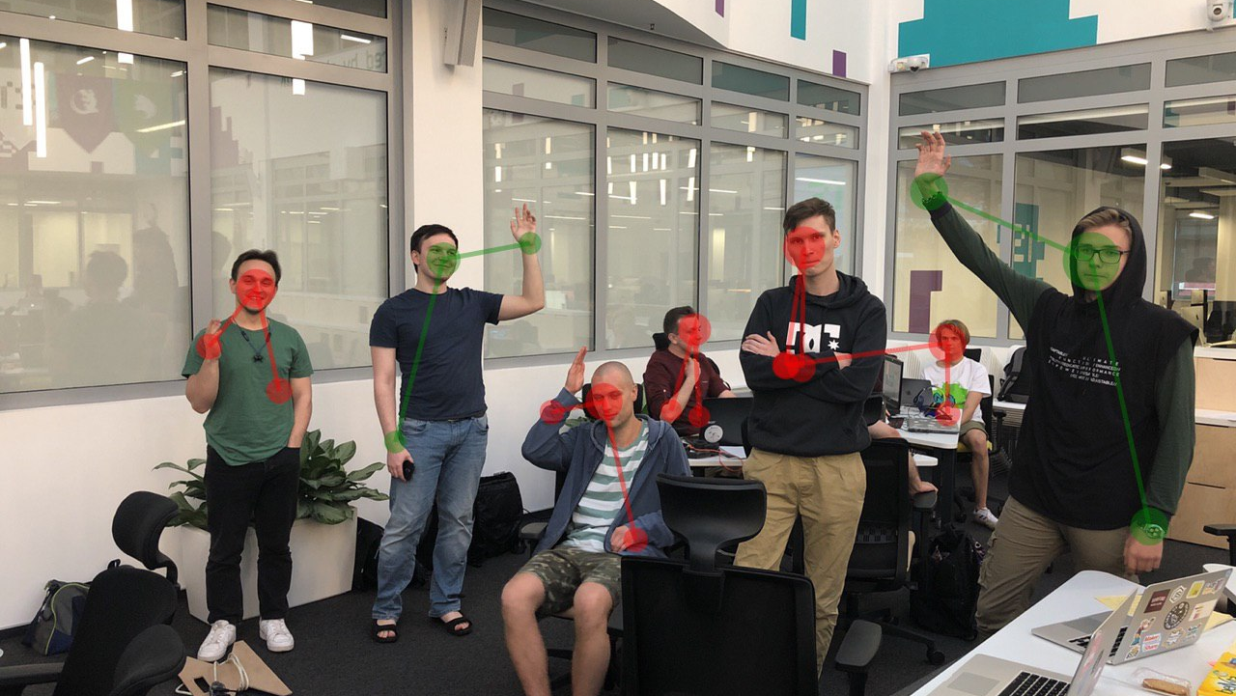
Handsup
Много голосов!
Как посчитать?
WRITE SOMETHING HERE
ABOUT
OUR COMPANY
Что сложно человеку, то просто машине

Slide 4
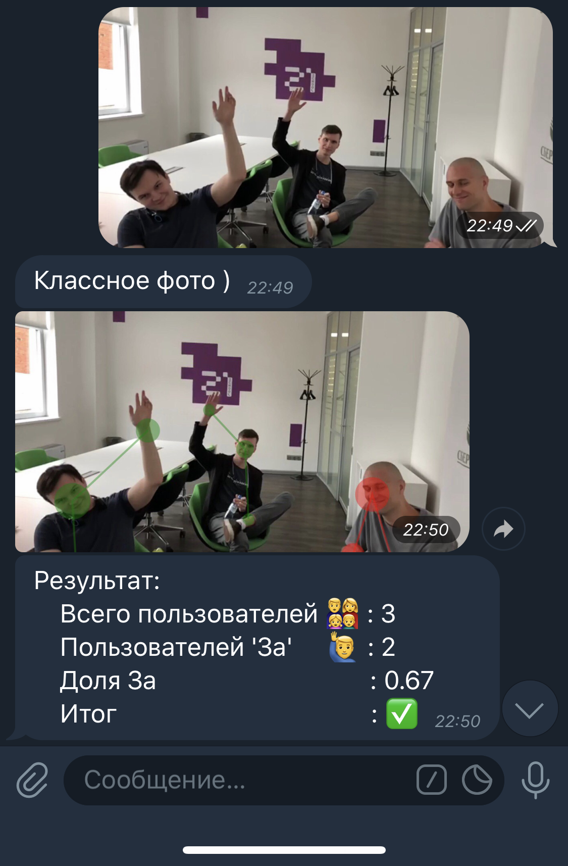
Telegram bot
handsup
Доступный и простой инструмент подсчета
Постоянный доступ к истории голосований
Easy to share

Slide 5
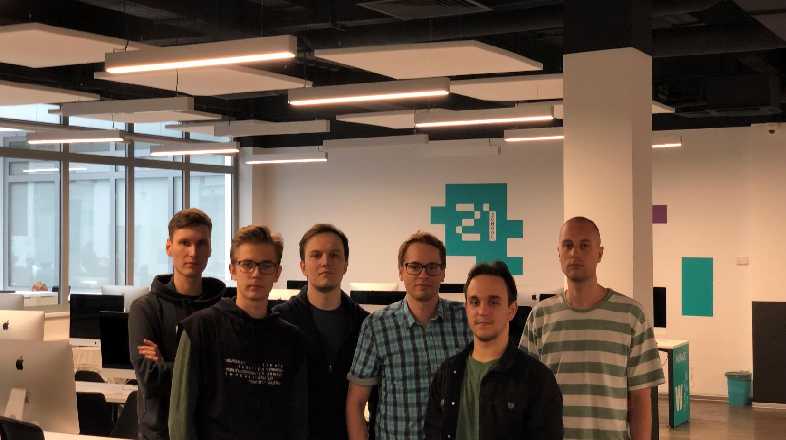
Write here
Something about
НАША КОМАНДА – LAZY HOT DOGS
Entrepreneurial activities differ substantially depending on the type of organization and creativity. Entrepreneurial activities differ substantially depending on the type of organization and creativity. Entrepreneurial activities differ substantially.

Slide 6
Write here
Something about
WRITE SOMETHING HERE
Entrepreneurial activities differ substantially depending on the type of organization and creativity. Entrepreneurial activities differ substantially depending on the type of organization and creativity. Entrepreneurial activities differ substantially.. Entrepreneurial activities differ substantially depending on the type of organization and creativity.
Entrepreneurial activities differ substantially depending on the type of organization and creativity. Entrepreneurial activities differ substantially depending on the type of organization and creativity. Entrepreneurial activities differ substantially.. Entrepreneurial activities differ substantially depending on the type of organization and creativity.

Slide 7
Write here
Something about
WRITE SOMETHING HERE
Entrepreneurial activities differ substantially depending on the type of organization and creativity. Entrepreneurial activities differ substantially depending on the type of organization and creativity. Entrepreneurial activities differ substantially.. Entrepreneurial activities differ substantially depending on the type of organization and creativity.
Entrepreneurial activities differ substantially depending on the type of organization and creativity. Entrepreneurial activities differ substantially depending on the type of organization and creativity. Entrepreneurial activities differ substantially.. Entrepreneurial activities differ substantially depending on the type of organization and creativity.

Slide 8
OUR LATEST
WORKS
WRITE SOMETHING HERE
PROJECT NAME
PROJECT TITLE
WRITE HERE
Entrepreneurial activities differ substantially depending on the type of
Entrepreneurial activities differ substantially depending on the type of
Entrepreneurial activities differ substantially depending on the type of

