Slide 1

Hanoi University of Science and Technology
School of Information and Communication Technology
Project Report
Movies Streaming System Database
Group 8
Course: Database Lab – IT3290E
Supervisor: Dr. Vu Tuyet Trinh

Slide 2
PROJECT DISTRIBUTION
GROUP 8
 | Name | Task
1 | Pham Quang Anh 20220071
2 | Ngo Minh Trung 20226004
3 | Nguyen Long Vu 20226006

Slide 3
TABLE OF CONTENT
01
05
PROJECT DESCRIPTION
TRIGGERS
02
06
REQUIREMENTS
VIEWS
03
07
DATABASE
DESIGN
FUNCTIONS
04
08
TABLES
INDEX

Slide 4
01
PROJECT DESCRIPTION
The movie streaming service database system is designed to manage user subscriptions, payments, and content.
Each account is uniquely identified by an id, some attributes of user account including password hash, account status (active/inactive), their name (first name and last name) and their nationality. An account can subscribe to a pre-determined subscription pack. The available subscription packs differs by level of access (1, 2, 3 – Default level is 1) and duration ( 6 months and 12 months). When they pay for the pack, a record of that subscription is added. Each level can access a certain number of contents. When a user is created, the user will automatically subscribe to a level 1 pack with unlimited duration.
Each content (includes movies and series) contains at least 1 episode. We consider movies as a series that have only one episode. Each content can belong to many different genres and involves different actors or actresses. Each content also has a list of available subtitles (language) which correspond to some countries.
Each time an user watches an episode, the timestamp and the last checkpoint of the episodes will be recorded. We also consider if the user has finished their movies or not. Users can also mark some contents as their favorite and rate each content by giving a point from 1 to 5.

Slide 5
02. REQUIREMENTS

Slide 6
03
DATABASE DESIGN
Entities
Country: Information about countries where the service operates.
Users: Details about the accounts registered on the platform.
Content: Details of all available content, including movies and series.
View_history (Weak Entity): Tracks the viewing activity of users for specific episodes.
Episode (Weak Entity): Represents individual episodes of series or standalone episodes for movies.
Language: Details of languages available on the platform.
Casts: Information about actors and actresses involved in the content.
Genre: Categories of content available on the platform, such as drama, comedy, or thriller.
Subscription_pack: Details of subscription plans offered by the service: Free, Standard (6/12 months), Premium (6/12 months).

Slide 7
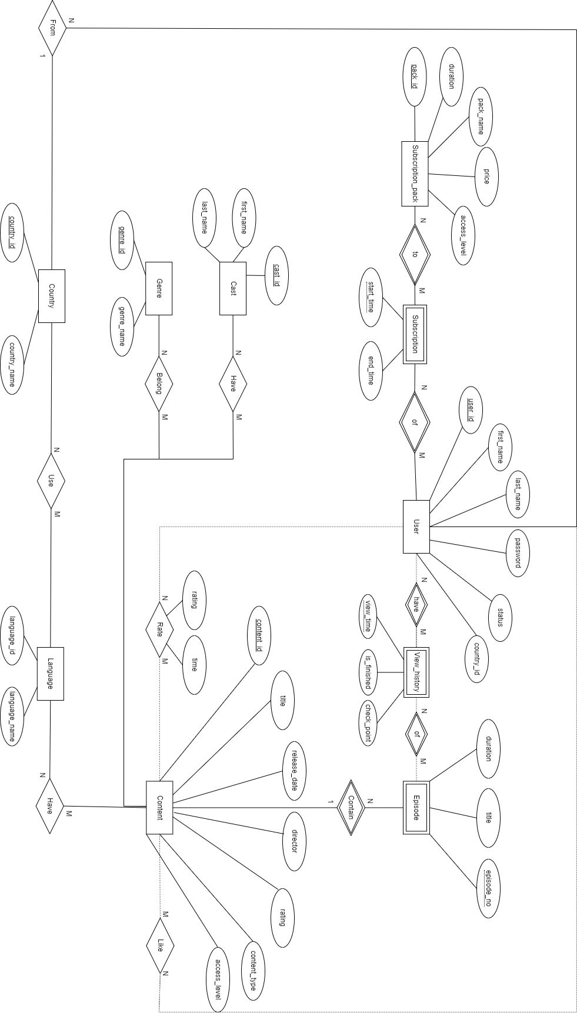
ERD

Slide 8
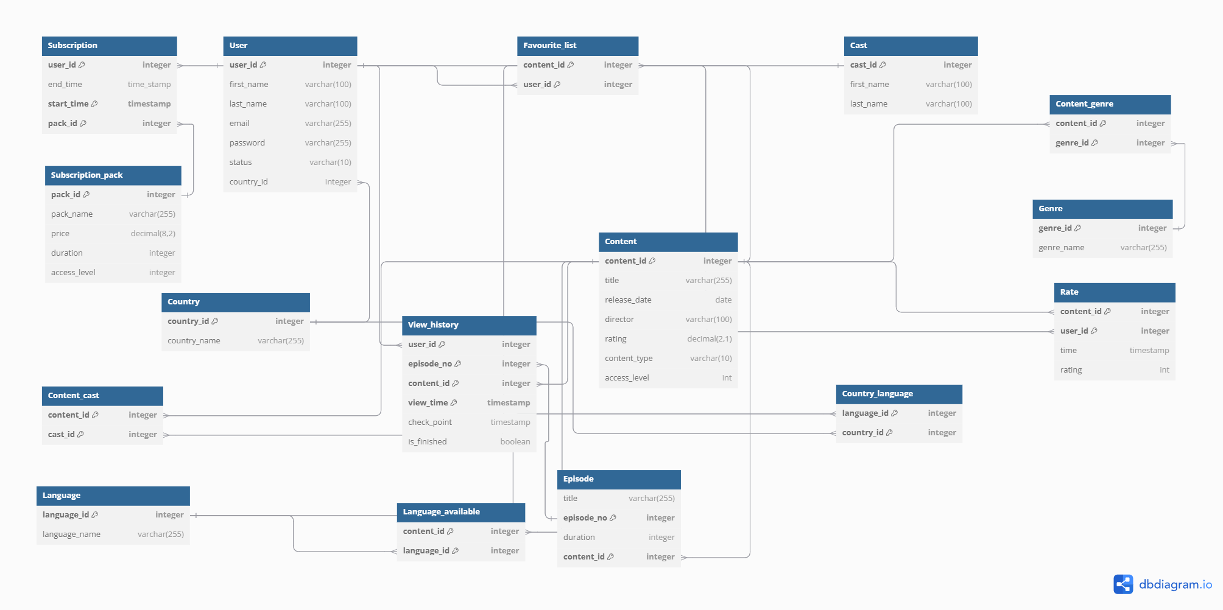
Relational schema

Slide 9
04. TABLES
Country
Represents the countries where the platform is available.
country_id: Unique identifier for each country (Primary Key).
country_name: Name of the country (e.g., 'USA', 'India').
Users
Stores user information and their registration details.
user_id: Unique identifier for each user (Primary Key).
first_name: User's first name.
last_name: User's last name.
email: Unique email address for the user
password: User’s account password
status: Current status of the user (active, deleted, suspended).
country_id: Country associated with the user (Foreign Key referencing Country.country_id).

Slide 10
Content
Represents movies and series available on the platform.
content_id: Unique identifier for each content (Primary Key).
title: Title of the movie or series.
release_date: Release date of the content.
director: Name of the director.
rating: Viewer rating for the content (1.0 to 5.0).
content_type: Type of content ('movie' or 'series').
access_level: Minimum access level required to view the content (1 to 3).
Episode
Details episodes for series content.
content_id: Identifier for the series (Primary Key, Foreign Key referencing Content.content_id).
episode_no: Episode number within the series (Primary Key in combination with content_id).
title: Title of the episode.
duration: Duration of the episode.

Slide 11
Genre
Defines the different genres for content classification.
genre_id: Unique identifier for each genre (Primary Key).
genre_name: Name of the genre (e.g., 'Action', 'Comedy').
Casts
Stores information about actors or actresses in content.
cast_id: Unique identifier for each cast member (Primary Key).
first_name: First name of the cast member.
last_name: Last name of the cast member.
Rate
Records user ratings for content.
content_id: Identifier of the content (Foreign Key referencing Content.content_id).
user_id: Identifier of the user (Foreign Key referencing Users.user_id).
time: Timestamp when the rating was given.
rating: User's rating for the content (1 to 5).

Slide 12
Subscription_pack
Details the subscription plans offered by the platform.
pack_id: Unique identifier for each subscription plan (Primary Key).
pack_name: Name of the subscription plan.
price: Cost of the subscription plan.
duration: Duration of the subscription ('6', '12', or 'infinity').
access_level: Access level provided by the subscription plan (1 to 3).
Subscription
Tracks users' subscriptions.
user_id: Identifier of the user (Foreign Key referencing Users.user_id).
pack_id: Identifier of the subscription plan (Foreign Key referencing Subscription_pack.pack_id).
start_time: Start date of the subscription (Primary Key in combination with user_id and pack_id).
end_time: End date of the subscription, defaults to 'infinity'.

Slide 13
Content_genre
Maps content items to their respective genres.
content_id: Identifier of a content (Foreign Key referencing Content.content_id).
genre_id: Identifier of the genre (Foreign Key referencing Genre.genre_id).
Content_cast
Links content items to their cast members.
content_id: Identifier of the content (Foreign Key referencing Content.content_id).
cast_id: Identifier of a cast member (Foreign Key referencing Casts.cast_id).
Favourite list
Tracks users' favorite content.
content_id: Identifier of a content (Foreign Key referencing Content.content_id).
user_id: Identifier of the user (Foreign Key referencing Users.user_id).

Slide 14
Language
Represents the available languages.
language_id: Unique identifier for each language (Primary Key).
language_name: Name of the language (e.g., 'English', 'Spanish').
Language_available
Tracks languages in which content is available.
content_id: Identifier of the content (Foreign Key referencing Content.content_id).
language_id: Identifier of the language (Foreign Key referencing Language.language_id).
Country_language
Maps countries to their officially supported languages.
country_id: Identifier of the country (Foreign Key referencing Country.country_id).
language_id: Identifier of the language (Foreign Key referencing Language.language_id).

Slide 15
View_history
Tracks users' viewing activities on the platform.
user_id: Identifier of the user (Foreign Key referencing Users.user_id).
content_id: Identifier of the content (Foreign Key referencing Episode.content_id).
episode_no: Episode number (Foreign Key referencing Episode.episode_no).
view_time: Timestamp of when the viewing occurred (Primary Key).
check_point: The timestamp in the video where the user paused or stopped.
PK(user_id, content_id, episode_id, view_time)

Slide 16
05. TRIGGER

Slide 17
06. VIEWS

Slide 18
07. FUNCTION

Slide 19
08. INDEX

