Slide 1
PRE-LAUNCH CAMPAIGN TESTING
SPIEGEL
Simulate a social media for customer reactions
A simulated audience of buyer personas reacts to your creative in a simulated social feed — so you see the sentiment, the objections and the virality before a single real customer does.
Prepared by NTH · Project pitch · 5 minutes

Slide 2

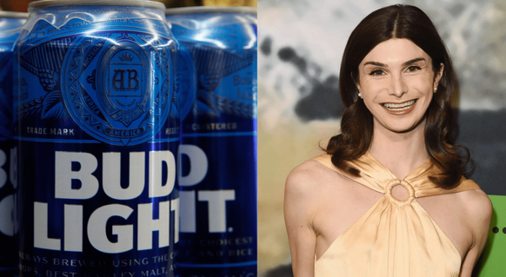

THE PROBLEM
Big budgets don't buy immunity to backlash.
Two campaigns. Same story: real money, zero testing on a real audience.
→
Gap, 2010
Bud Light, 2023
$100M
$1B+
Customers hated the new look — reverted in 6 days.
Core drinkers hated one influencer deal — lost its #1 US spot.
Neither was caught before launch — because there was no way to see the reaction coming.
Sources: The Branding Journal, Reuters (2010); AP, CNBC (2023)
2

Slide 3





THE SHIFT
Stop testing campaigns on real customers.
WITHOUT SPIEGEL
WITH SPIEGEL
Plan & produce
Plan & produce
Launch to the real world
Test with a simulated audience
Real audience reacts
Launch with confidence
First real test — money already spent.
Real audience reacts like you predicted.
The only step that changes: when the real reaction happens.
3

Slide 4




HOW IT WORKS
Five steps from brief to verdict.
Graph building
Your brief and creative are extracted into a knowledge graph — Graphiti over Neo4j.
Audience setup
Entities become buyer personas: demographics, needs, brand attitude, media habits.
Simulation
The creative is seeded into simulated Twitter and Reddit; agents react over N rounds.
Measurement
Every action is logged and counted into marketing metrics — nothing is eyeballed.
Report
A report agent reads the metrics and the graph, and writes the verdict — chat with it or interview agents.
4

Slide 5





THE OUTPUT
What you get — grounded in your data, not guesswork.
THE METRICS
WHY TRUST IT
Reach & reach rate
Self-hosted knowledge graph
Runs in your own deployment. No data leaves it.
Engagement rate
Counted, not estimated
Sentiment split
KPIs come straight from the action log.
Virality ratio
A real simulation engine
Share of voice
Built on OASIS (CAMEL-AI) — not one model’s opinion.
Round-by-round curve
Available in the full report — and as JSON from the API.
5

Slide 6


THE OPPORTUNITY
A trillion-dollar market that still launches on guesswork.
$1T+
Global ad spend crosses $1 trillion for the first time in 2026 — and pre-testing is still slow, expensive, or skipped.
An active, paying market
A real gap to fill
More than marketing
Brands already budget for pre-testing. Kantar, System1 and VidMob charge $200 to $10,000+ a month for surveys and panels.
Those tools ask people what they think. Spiegel simulates what they’d actually do — post, share, object — grounded in your own brief.
Any question of majority opinion runs on the same engine — election polls, policy surveys, market research — not just marketing.
Sources: eMarketer & dentsu (2026 global ad spend); public pricing pages, industry roundups (2026)
6

Slide 7
LIVE DEMO
See it live
▶ localhost:3000

Slide 8
SPIEGEL
Thank you for listening.

