Slide 1

Week 3: Logical Tests and Nested Functions

Slide 2
Logical Tests
A logical test or logical expression is an expression which returns either TRUE or FALSE (or error)
Full list of logical operators:
Logical operator (in Excel) | Operator name
= | Equal To
> | Greater Than
< | Less Than
>= | Greater Than or Equal To
<= | Less Than or Equal To
<> | Not Equal To
Source

Slide 3
Logical Functions
Excel also has logical functions to build more complex logical tests
Common logical functions:
Function | Description
AND | Returns TRUE if all arguments are TRUE
OR | Returns TRUE if any argument is TRUE
NOT | Reverses the logic of its argument
XOR | Returns a logical exclusive OR of all arguments
Full list

Slide 4
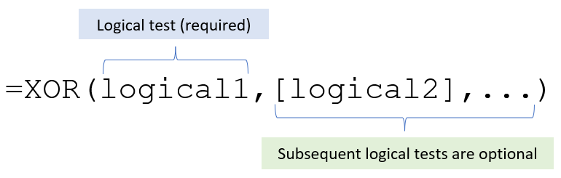
XOR: Exclusive OR
If | XOR Returns
0 conditions are met | FALSE
1 condition is met | TRUE
More than 1 condition is met | FALSE
Reference

Slide 5
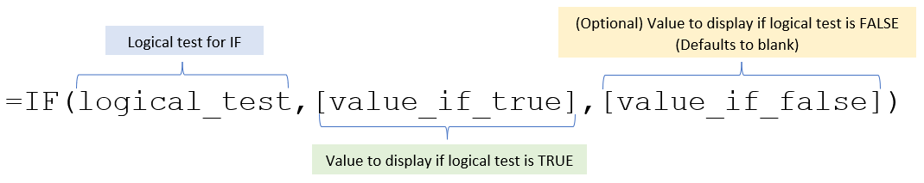
IF Statements
The IF function allows you to return (display) values based on whether the specified condition has been met
More examples

Slide 6
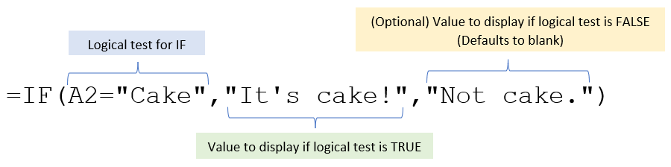
IF Statements
The IF function allows you to return (display) values based on whether the specified condition has been met
More examples

Slide 7
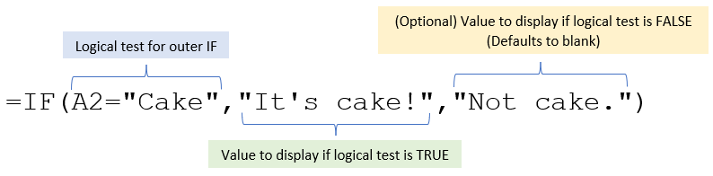
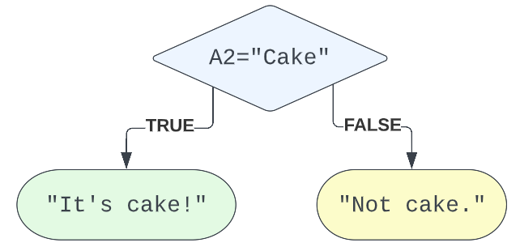
IF Statements

Slide 8
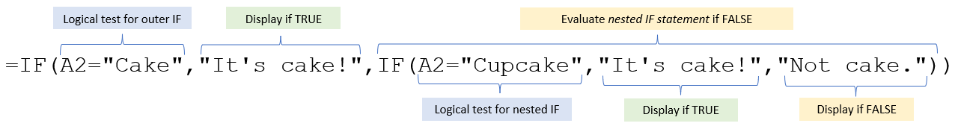
Nested Functions
You can use a function as an argument of another function.
Reference

Slide 9
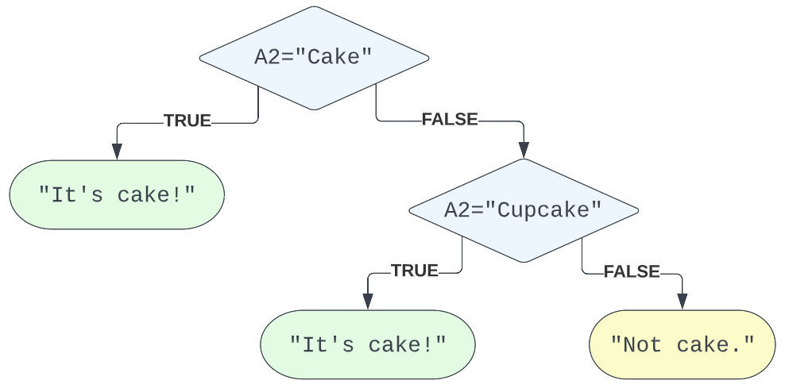
Nested Functions

Slide 10
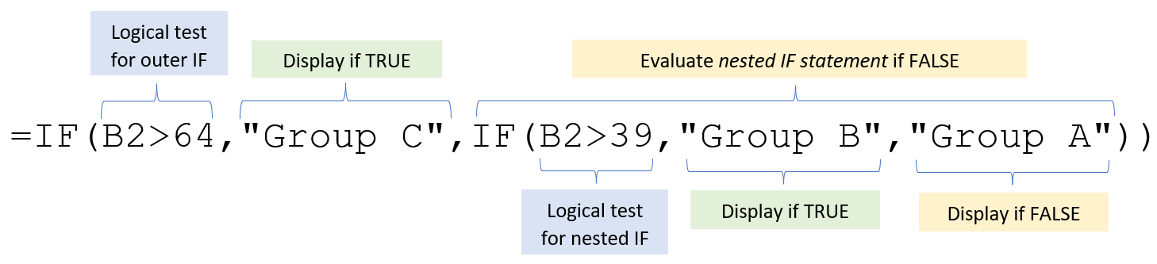
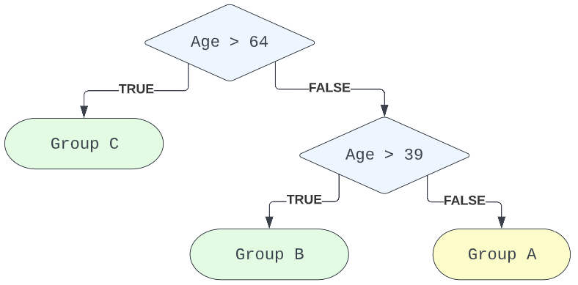
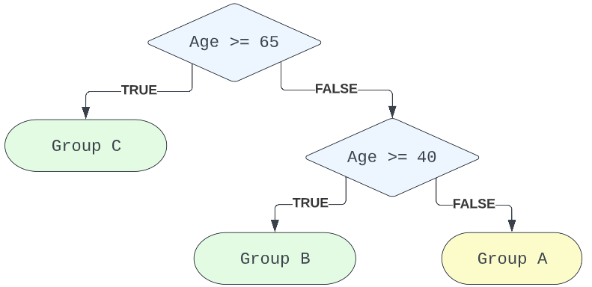
Nested Functions
These are the same:

