Slide 1

Week 2: Introduction to Formulas and Functions

Slide 2
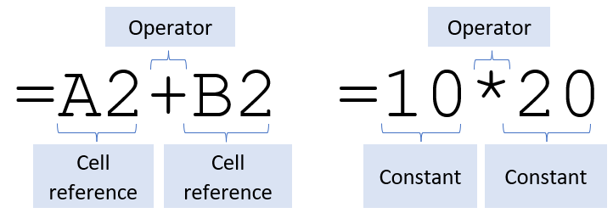
Terminology
A formula is an expression which calculates the value of a cell
Functions are pre-defined formulas available in Excel
Over 400 available. Explore under Formulas tab.

Slide 3
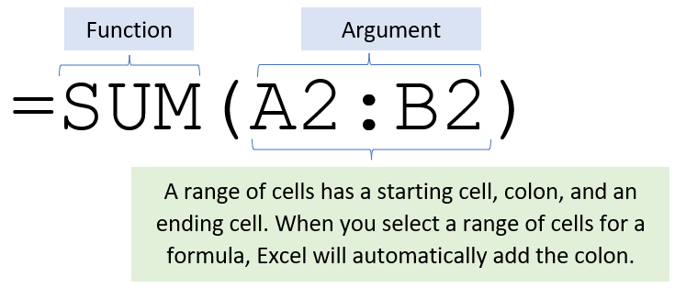
Using Formulas
Start with = (equals sign), click or type cell references. Enter to confirm or Esc to cancel.
Insert functions from Formulas tab or type into Formula bar.

Slide 4
Auto Fill Formulas
Default copy/paste (Ctrl + C / Ctrl + V) will copy formula, formatting, conditional formatting
You can quickly copy formulas into adjacent cells by dragging the fill handle
Double-click fill handle to copy down entire column
You can also press Ctrl + D to fill the formula down in a column, or Ctrl + R to fill the formula to the right in a row.

Slide 5
Auto Fill Data
Auto Fill can also be used to fill in data
Copy cell
Sequential
Auto-detect pattern
Auto Fill options
Use on number, text, or dates
You can also create custom lists to fill

Slide 6
Types of References
- Relative (default)
- Absolute
- Mixed
Another worksheet
Learn more at UCLC: Referencing data in Excel 365

Slide 7

“X-Ray Vision”
Use Ctrl + ` to see all formulas in worksheet
tilde
backtick

