Slide 1

Week 4: Conditional Functions and Data Validation

Slide 2
Conditional Functions
Conditional functions let you sum, average, or count a range based on a given condition, or criteria you specify.
SUMIF
AVERAGEIF
COUNTIF
Not covered here: Use IFS, SUMIFS, AVERAGEIFS, COUNTIFS for multiple conditions
Source

Slide 3
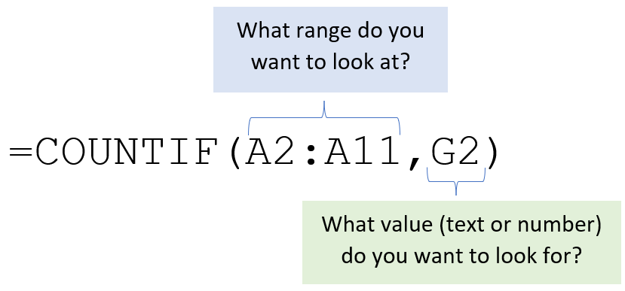
COUNTIF
Reference

Slide 4
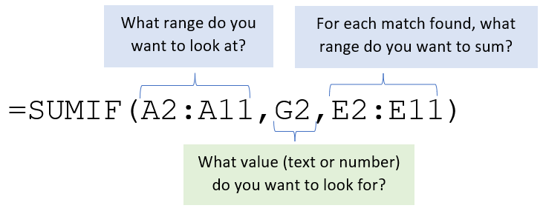
SUMIF
Reference

Slide 5
Data Validation
Data validation is used to restrict the type of data or values a user can enter into a cell
Short video demo
More info
In-depth guide

Slide 6
Create a dropdown list
Use data validation to create a dropdown list
Not covered here: Recommended to use Excel tables
Video walkthrough

Slide 7
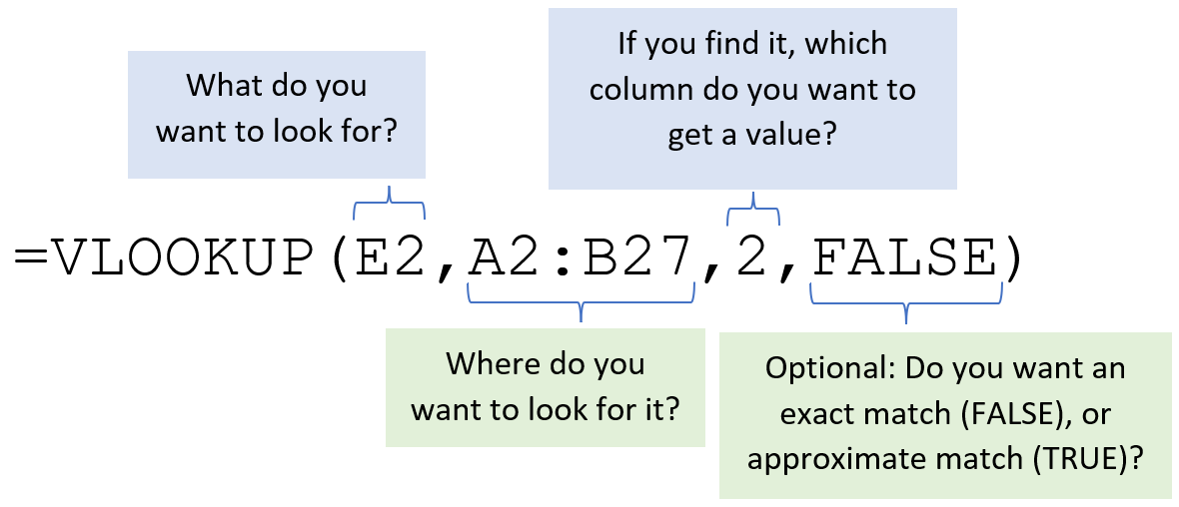
VLOOKUP
VLOOKUP lets you look a value in a column on the left, then returns information in another column to the right if it finds a match.
Video walkthrough

Slide 8
VLOOKUP
Argument | Description
lookup_value | The number or text you’re looking for.
table_array | A cell reference of table range. Note: Do NOT include headers if you are searching for text and approximate match.
col_index_num | The number of the column you want to return. This is based on the table you pass. For example, if your range is B2:D5, column 1 is B and column 2 is C.
range_lookup | Optional argument. If left out, defaults to TRUE. TRUE: Looks for approximate match. -For a numerical search, it will return the closest number smaller than the value you’re looking for, if it does not find an exact match. -First column in the table must be sorted from smallest to largest (or for text, alphabetical). FALSE: Looks for exact match. If no exact match is found, an #NA! error will be returned.
Table source | Reference card

Slide 9
Bonus: Import tables from the web
Video walkthrough
We’ll use data from:
https://excelnotes.com/states-abbreviations-in-us/

Slide 10
LOOKUP Family
VLOOKUP: Vertical Lookup
HLOOKUP: Horizontal Lookup
New!
XLOOKUP: Vertical and Horizontal Lookup (Not available in Excel 2019 or Google Sheets)

