Slide 1
The ‘Whats’ and ‘Whys’
We need the Internet and right now, the Internet needs us.
Somewhere down the lane, your smartphone will absolutely need to get an IPv6 address and connect to a website that has IPv6 too!
Reason- We have already made the most out of the scarce little IPv4 address space.
What has measurement got to do with it?- A lot of modern day devices incorporate IPv6 addresses, but servers, routers, ISPs are far from the arena. We need to know who made it so far!

Slide 2
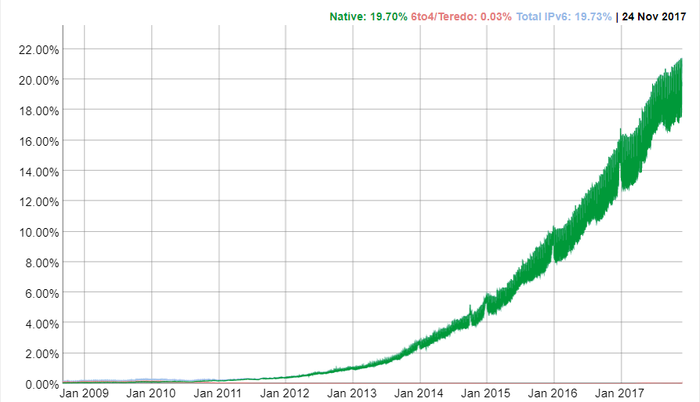
Why wouldn’t they Flip the Switch?
Remember the Hour Glass? The Internet is literally constrained around IPv4 and transitioning is hard in terms of time and cost.
World IPv6 Launch Day was observed on 6 June 2012 and today almost five years down the lane we have not even reached the 25 % deployment rate.
Percentage of users accessing Google over IPv6

Slide 3
Who has researched it all?
In 2016, John B. Southworth, explored the deployment of IPv6 in 1000 colleges and universities of the United States.
Jakub Czyz et. Al., measured IPv6 adoption rate and has discovered that while roughly 36 percent of new monthly (and 12 percent of cumulative) allocated prefixes are IPv6, we find just 0.63 percent of average traffic is carried over IPv6 (a two-order-of-magnitude difference)
Clearly the problem lies in the network itself and not the end hosts, which motivated our research to be focused on measuring the network directly.

Slide 4
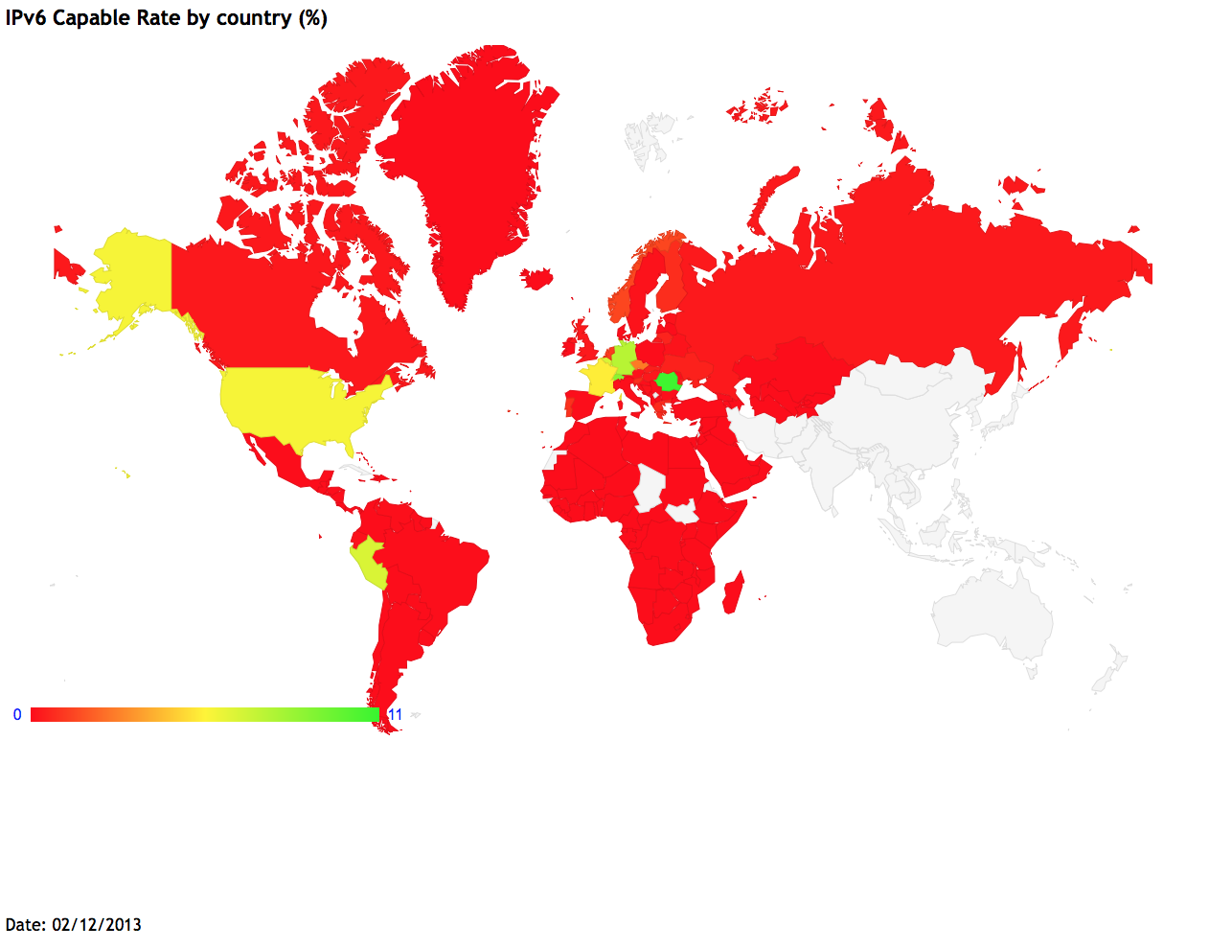
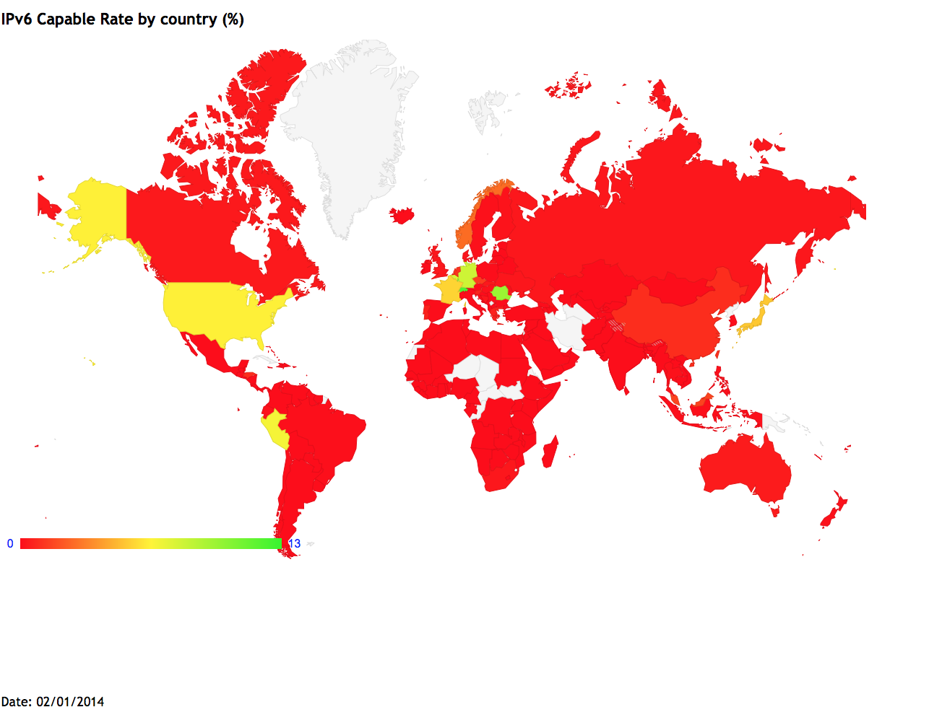
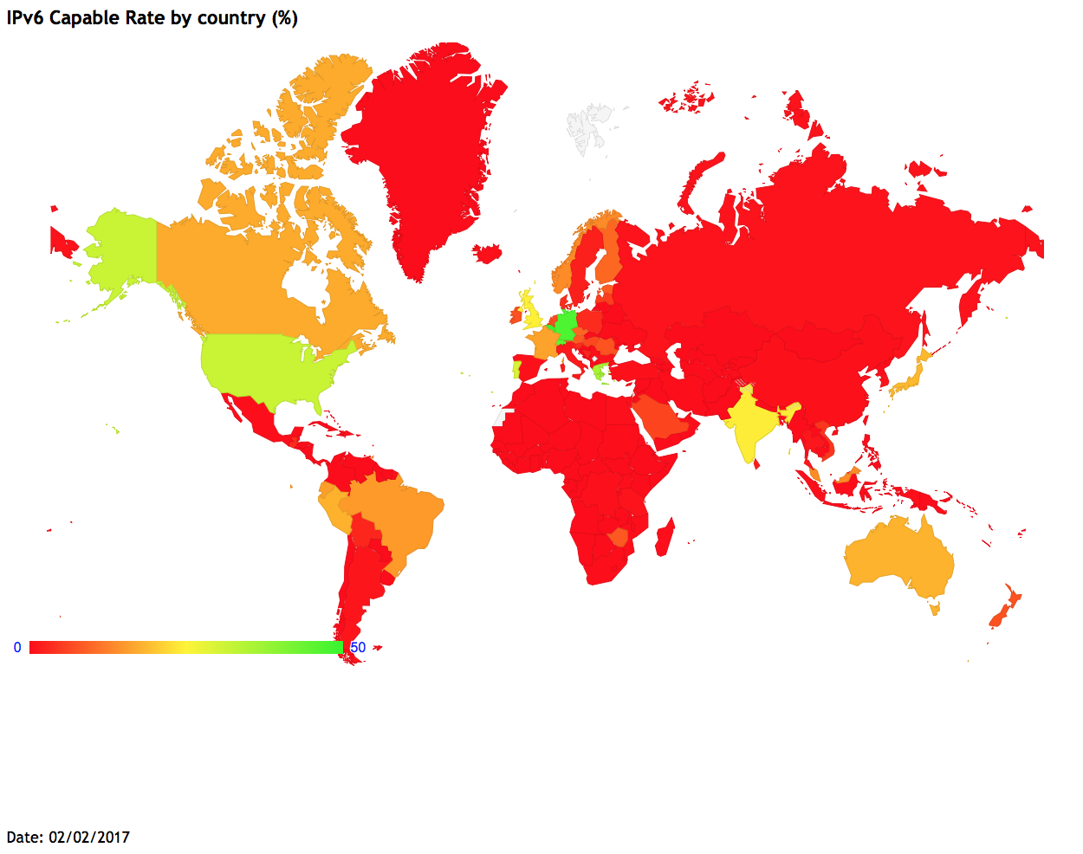
The Race so Far…

Slide 5
Which one is Better?
IPv6
Approximately 3.4×10³⁸addresses.
Restoration of end to end transparency.
Internet of Things needs IPv6!
Handling of large router tables is definitely going to cause some problems. Security issues will arise in IPv6 as acquiring a new address will be very easy. IPv4 wasn’t all bad!

Slide 6
What have we done?
We wanted to see the extend to which IPv6 has been deployed and its performance as compared to IPv4.
We performed traceroutes through RIPE Atlas probes spanning ten different countries as clients and fifteen different websites as servers.
We fed the traceroute files into our python parser to analyze them.
We took two measurement units to compare performance, round trip times (latency of responses) and number of hops.

Slide 7
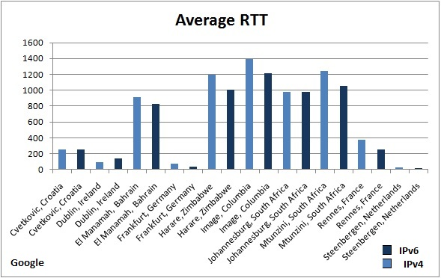
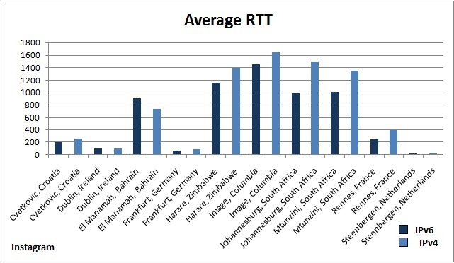
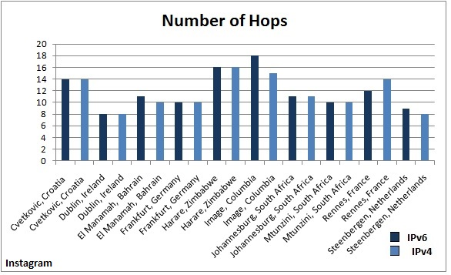
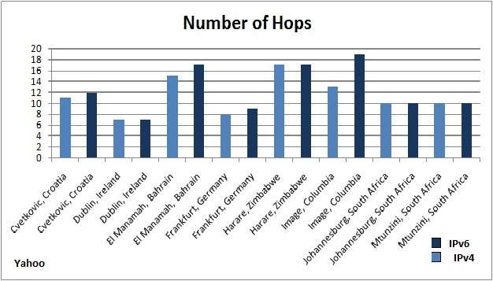
Results
Performance with reference to websites

Slide 8
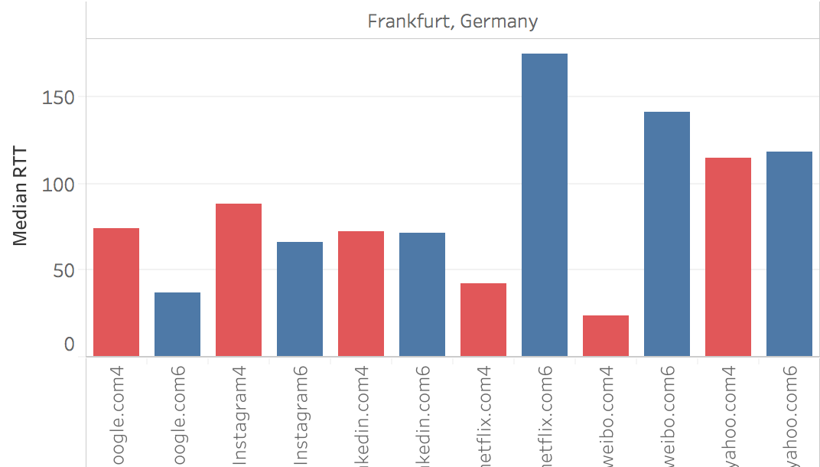
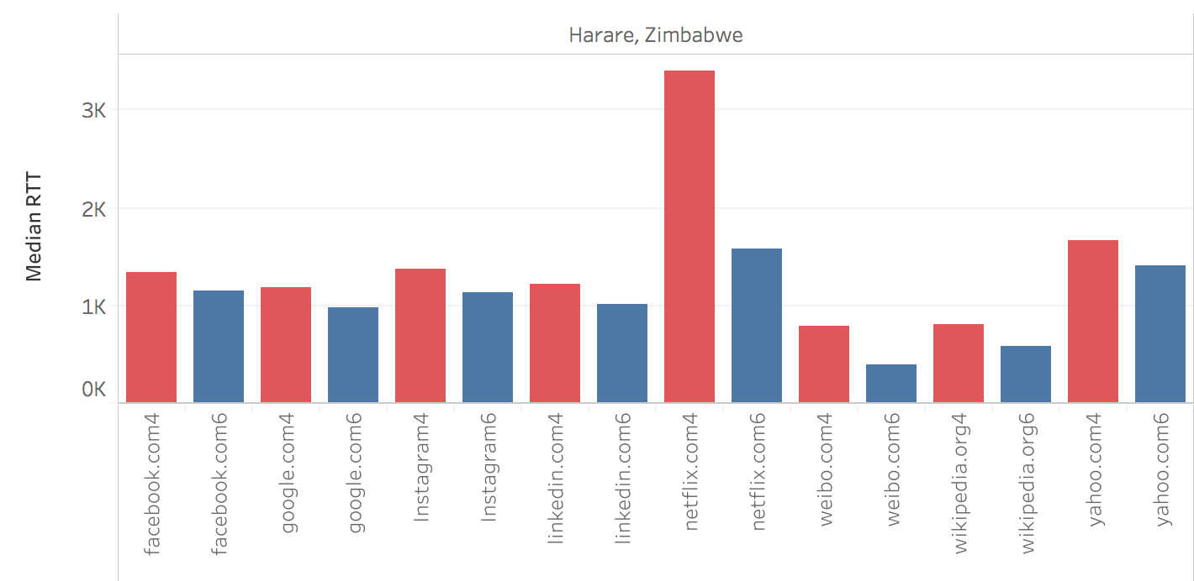
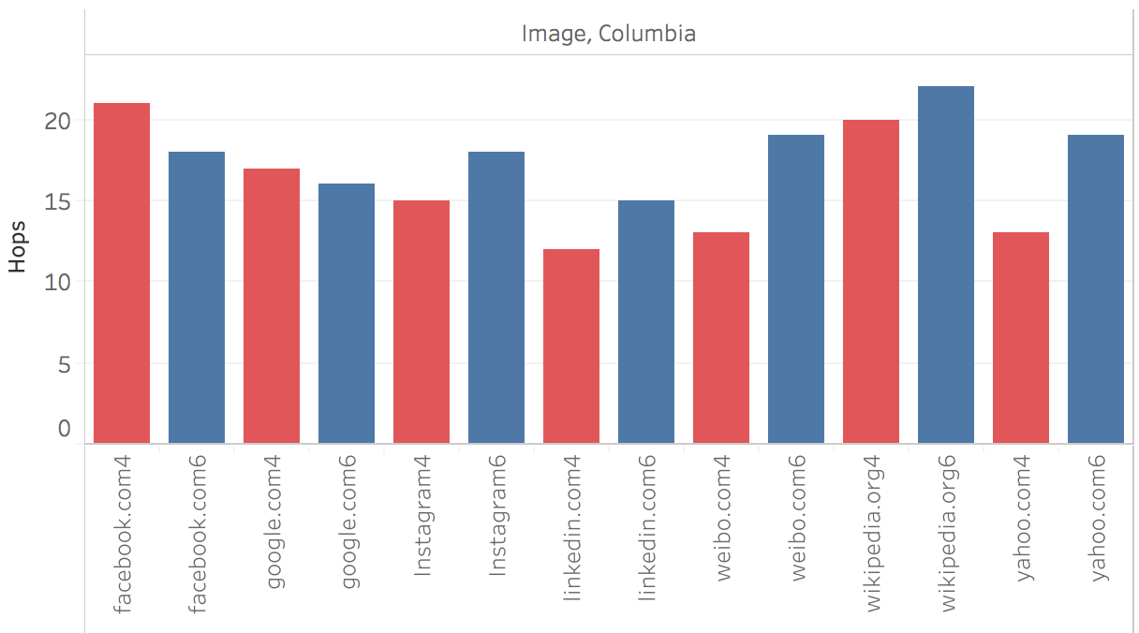
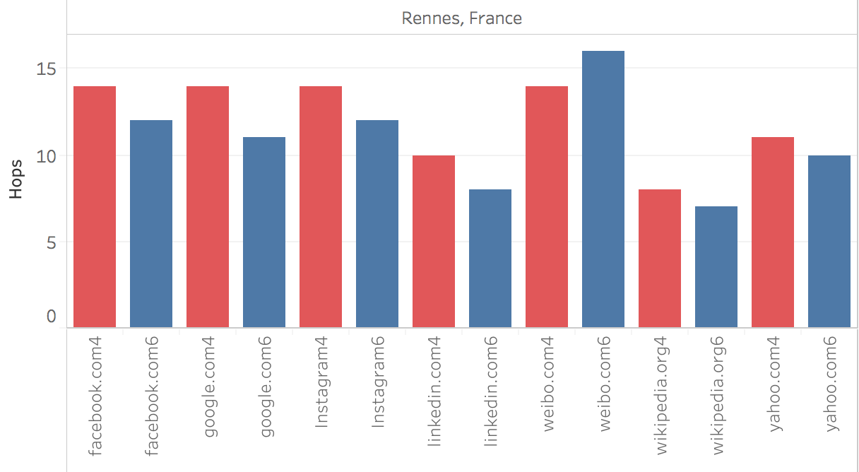
Performance with reference to countries

