Slide 1
WebDriver & Selenium
Matt Smith
February 7, 2014

Slide 2
History
Jason Huggins started Selenium in 2004
JavaScript library that would drive a web page
Had limitations due to different browser restrictions on JavaScript
Simon Stewart started WebDriver in 2006 at Google
Got tired of doing workarounds for the pitfalls with Selenium
He wanted native communication with the browser, thus bypassing JavaScript restrictions
The two projects merged in 2008
They both address shortcomings in each other

Slide 3
History
2013 Started submissions to the W3C for a WebDriver API standard
Attempting to offload the native communication work to the browser’s original authors following a standard API
Authors:
Simon Stewart – Google
Facebook
David Burns – Mozilla
Firefox already does this
Notice there is no console window launched when testing with Firefox

Slide 4
Broad Community Connections
Java
C#
Python
Ruby
Perl
PHP

Slide 5
Supported Operations
Page Navigation
User Input
Keyboard
Ctrl
Alt
Shift
Any key you can press on the keyboard, and even some you can’t
Mouse
Click
Double Click
Right Click
Scroll
Drag and Drop

Slide 6
Supported Operations
Manage multiple Windows (Tabs) and Frames
Popup Dialogs
Navigation History and Location
Cookies
Must be on the domain that the cookie will be valid for
Screenshots
Manage browsers on remote machines

Slide 7
Supported Browsers
HtmlUnit (Headless browser)
Fastest and most light weight driver.
Does not run JavaScript by default
Firefox
Targeted Versions
3.6
10
latest – 1
latest
Windows, Mac, Linux
Runs with no installed plugins by default
IE
Targeted Versions: 6, 7, 8, 9, 10, (Not 11 yet) on appropriate combinations of XP, Vista, and Windows 7
Be cautious of 32 vs. 64 bit machines
Some setup required…. read the docs
XPath selector does not work
CSS Selectors not support in 6 and 7, Sizzle is injected instead
CSS Selectors in 8 and 9 are native, but those browsers don’t fully support CSS3

Slide 8
Supported Browsers
Chrome
Maintained by Chromium
Like IE the driver is a process outside the browser
Since Chrome is a Webkit-based browser, the ChromeDriver may allow you to run Safari, but JavaScript may differ.
Opera – See the docs
iOS – See the docs
Android – See the docs
Phantom (Headless browser)

Slide 9
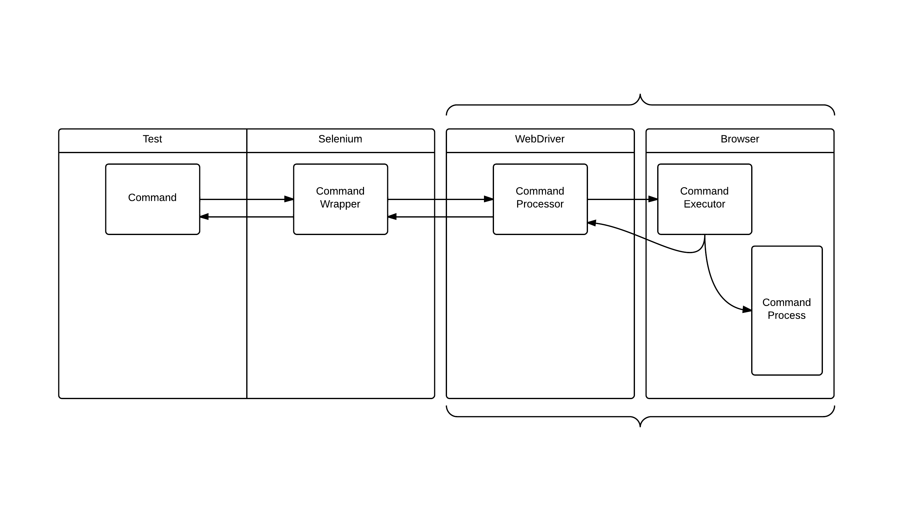
Basic Flow
Firefox runs both of these in the same process
Chrome and IE run in separate processes

Slide 10
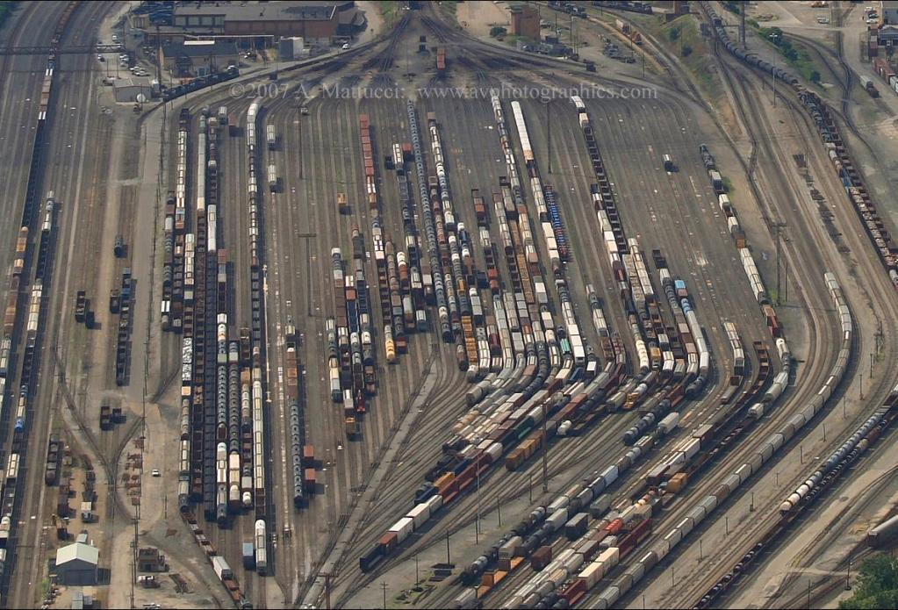
Element Location
WebDriver will retrieve any DOM element you want
The elements are marshaled from the browser

Slide 11
Basic Flow
Firefox runs both of these in the same process
Chrome and IE run in separate processes

Slide 12
Element Location
ID
Class Name
Tag Name
Name
Link Text
CSS Selector
Xpath (ick!)
JavaScript
In Serenity there is By.jQuery now! (As of last week)

Slide 13
Let’s analyze this
Driver.FindElements(By.CssSelector(".class-name"))
.Select(x => x.FindElement(By.TagName("input")))
.ToArray()
.Select(x => x.GetAttribute("name"))
.ToList()
O(1)
O(1 + n)
O(1 + n + n)
O(2n +1)
How much does this really cost us?

Slide 14
Basic Flow
Firefox runs both of these in the same process
Chrome and IE run in separate processes

Slide 15
Let’s refactor
Driver.FindElements(By.CssSelector(".class-name"))
.Select(x => x.FindElement(By.TagName("input")))
.ToArray()
.Select(x => x.GetAttribute("name"))
.ToList()
O(2n + 1)
Driver.FindElements(By.CssSelector(".class-name input"))
.Select(x => x.GetAttribute("name"))
.ToList()
O(n + 1)
Filter the elements you want before you marshal them; as much as you reasonably can

Slide 16
If you used JavaScript
Driver.ExecuteScript(“return $(‘.class-name input’)
.map(function() { return $(this).attr(‘name’) })
.get();”);
O(1)
However, this approach can be brittle depending on different browser JavaScript capabilities and restrictions

Slide 17
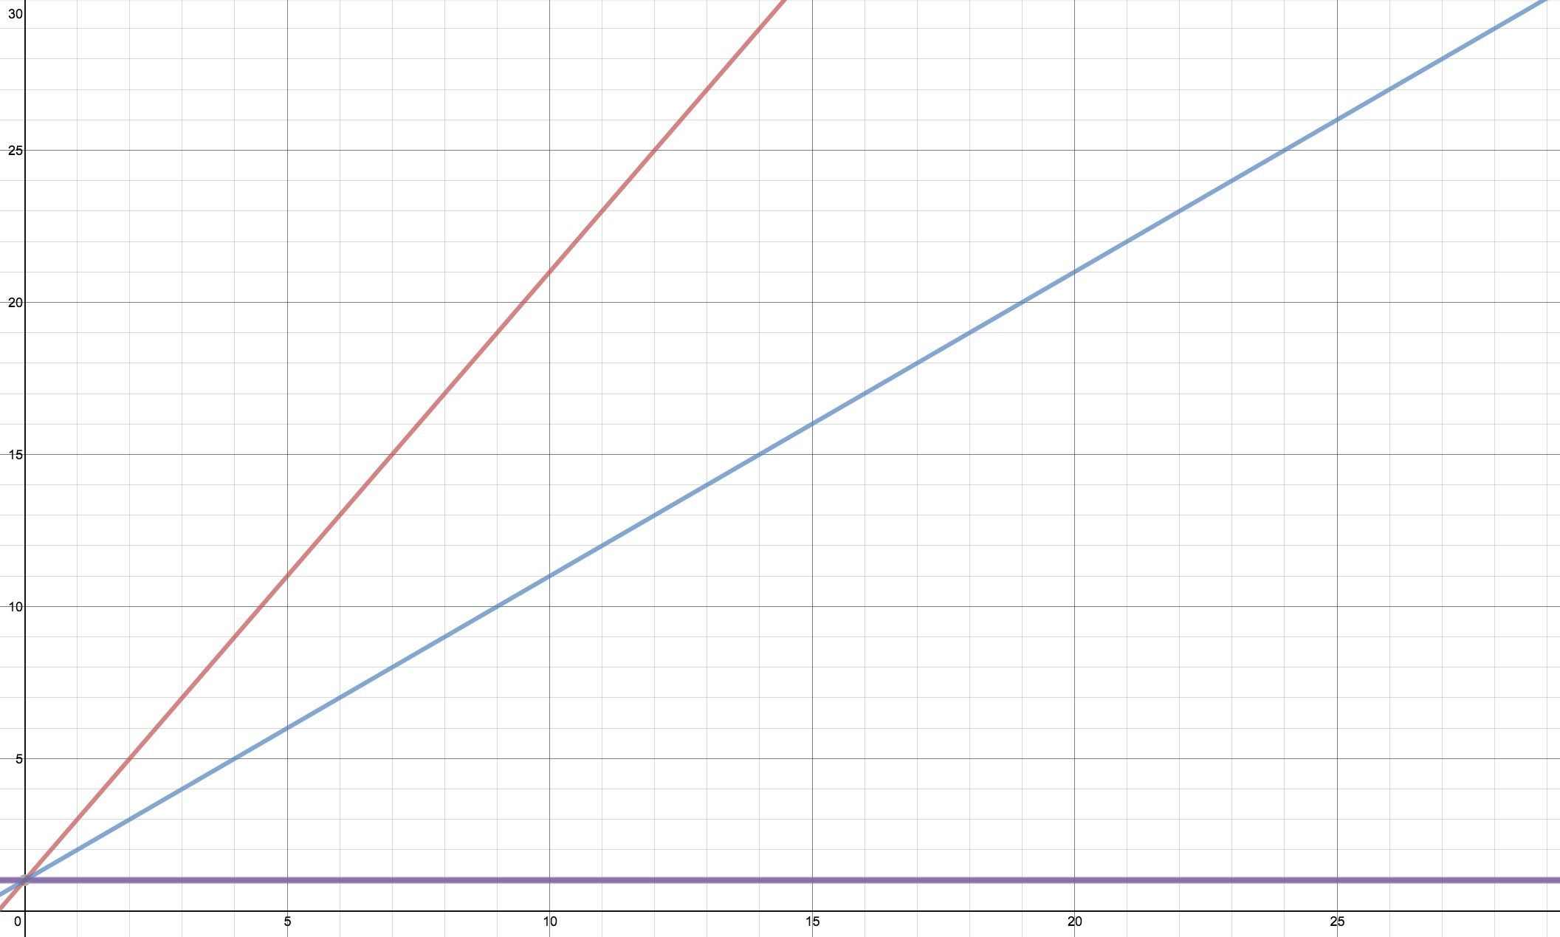
O(2n + 1)
O(n + 1)
Calls to WebDriver
O(1)
Elements

Slide 18
For 5 Elements
Chrome Firefox Phantom
O(2n + 1) 55 ms 176 ms 71.5 ms
O(n + 1) 30 ms 96 ms 39 ms
O(1) 6 ms 16 ms 6.5 ms
For an inactive browser with only 5 elements on the DOM
demo

Slide 19
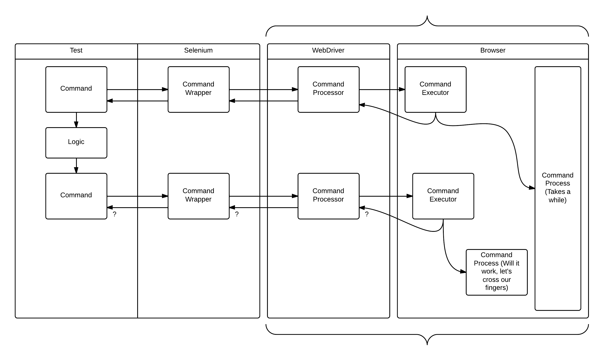
Where things can go wrong

Slide 20
WebDriver tries to help
Navigation – Page loading strategies
Conservative
The remote end must wait until all iframes in the current window are in a document.readyState equal to ‘complete’. There are no outstanding HTTP requests, other than those caused by XMLHttpRequests.
Normal (default)
Remote end must wait until the document.readyState of the frame currently being handled equals ‘complete’, or there are not more outstanding network requests other than XMLHttpRequests.
Eager
Remote end must wait until the document.readyState of the frame currently being handled equals ‘interactive’ or ‘complete’, or there are no more outstanding network requests other than XMLHttpRequests.
None
The remote end does not do any checks to see if the page load is currently active.

Slide 21
WebDriver tries to help
Mouse Click
Will attempt to scroll the element into view if it is not within the viewport.
Does not always work, you’ll have to scroll it yourself.
Keyboard
Will set focus on the element you send text to
Will not leave focus; other then the result of the interaction itself, ie. Tab

Slide 22
WebDriver tries to help
Exceptions
NoSuchElementException – The element wasn’t there when you asked for it; does not mean its not “there”
InvalidElementStateException, StaleElementReferenceException – The element was there now it’s not; or it wasn’t when you tried to work with it.
ElementNotVisibleException – It’s there, but was not visible when you tried to work with it.
Plus more…

Slide 23
Where things can go wrong

Slide 24
Waits
If the polling interval is too high, the browser will not have time to do its work.
Be cautious of WebDriver exceptions
NoSuchElementException
InvalidElementStateException
Avoid waits on things that are not specific.
Ajax requests complete, how can you be sure it was the Ajax request you care about?

Slide 25

Questions?

